Slide 1
14 months of
Earned Media with the
Oregon Conservation Partnership

Slide 2
The approach:
There is public benefit to SWCD work
Partnerships with landowners are key to creating change
Diverse focuses across the state are all pieces to the larger puzzle

Slide 3
Effective storytelling
Human-centered, relatable stories:
Focus on real world impact - benefits and results
Tie your work to timely issues or challenges
Find new and unique angles to present your old work
Talk about goals by highlighting work that’s in process
Highlight collaborative efforts but focus on your unique contributions
Site visits for reporters change the game

Slide 4
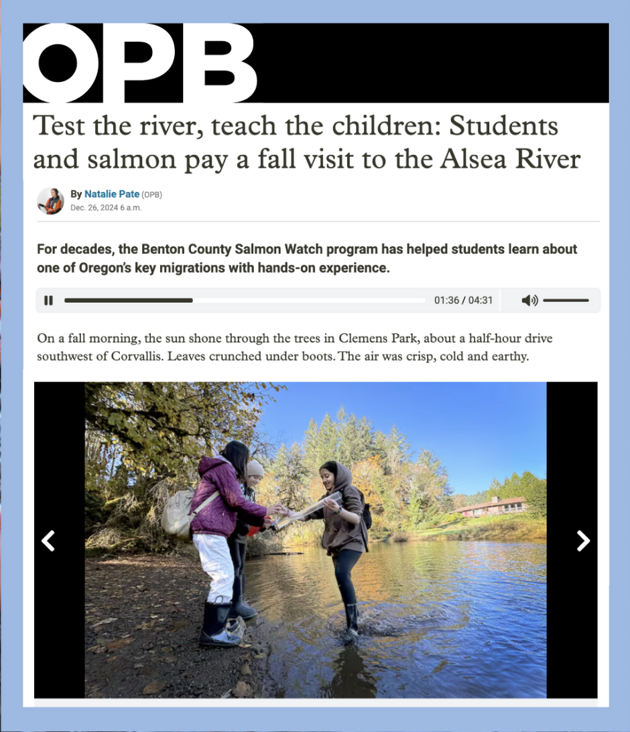
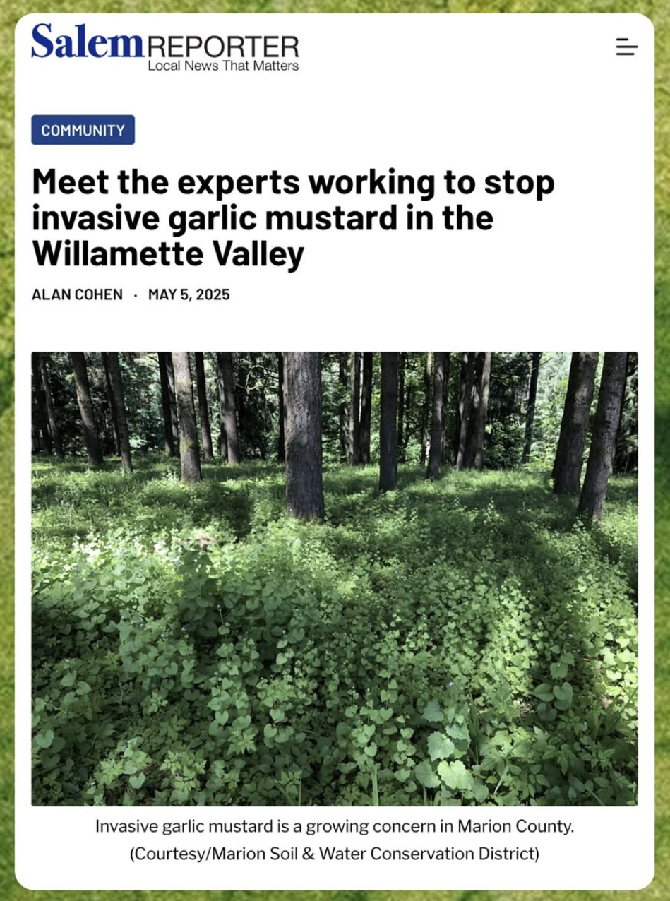

Slide 5
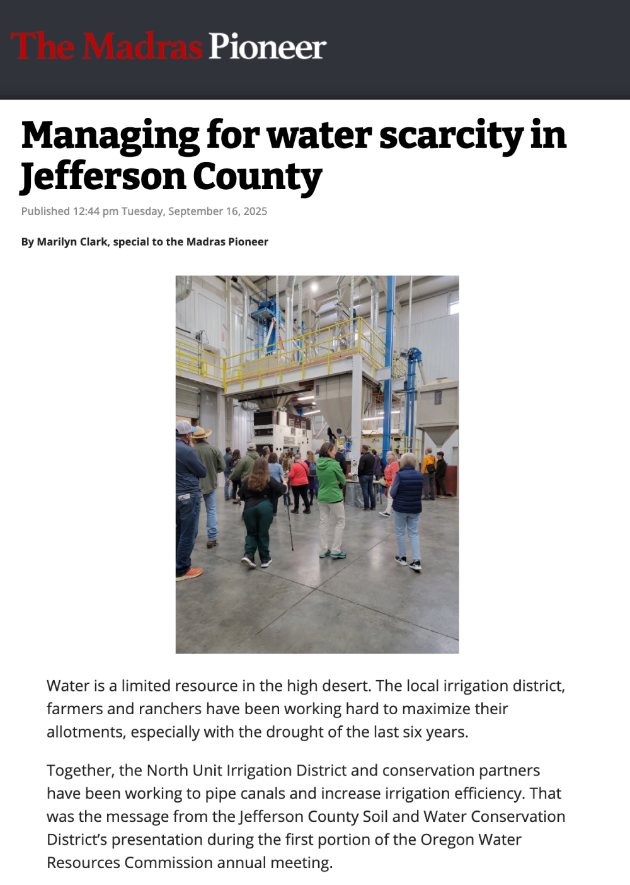
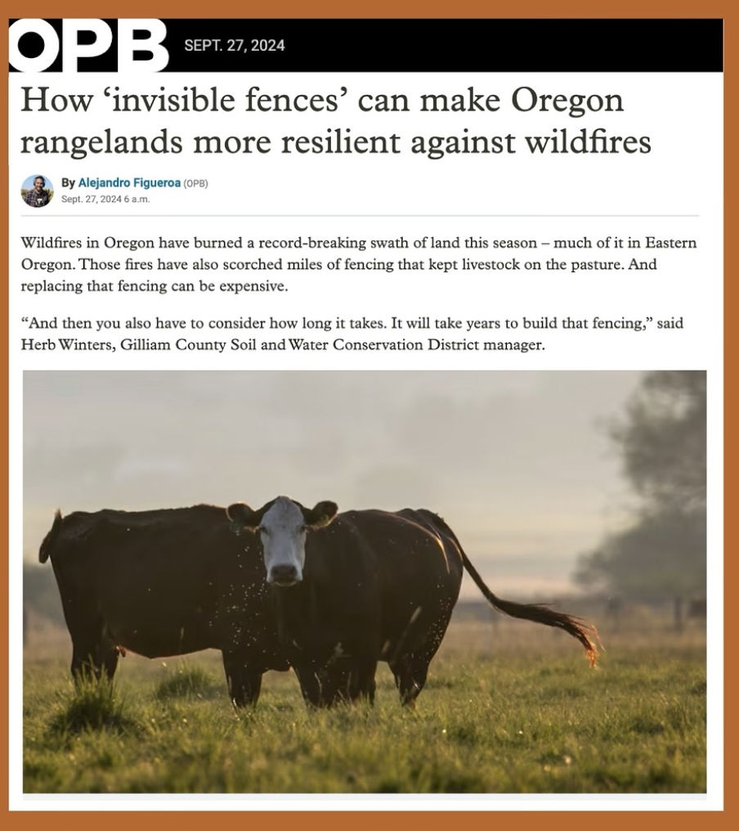

Slide 6
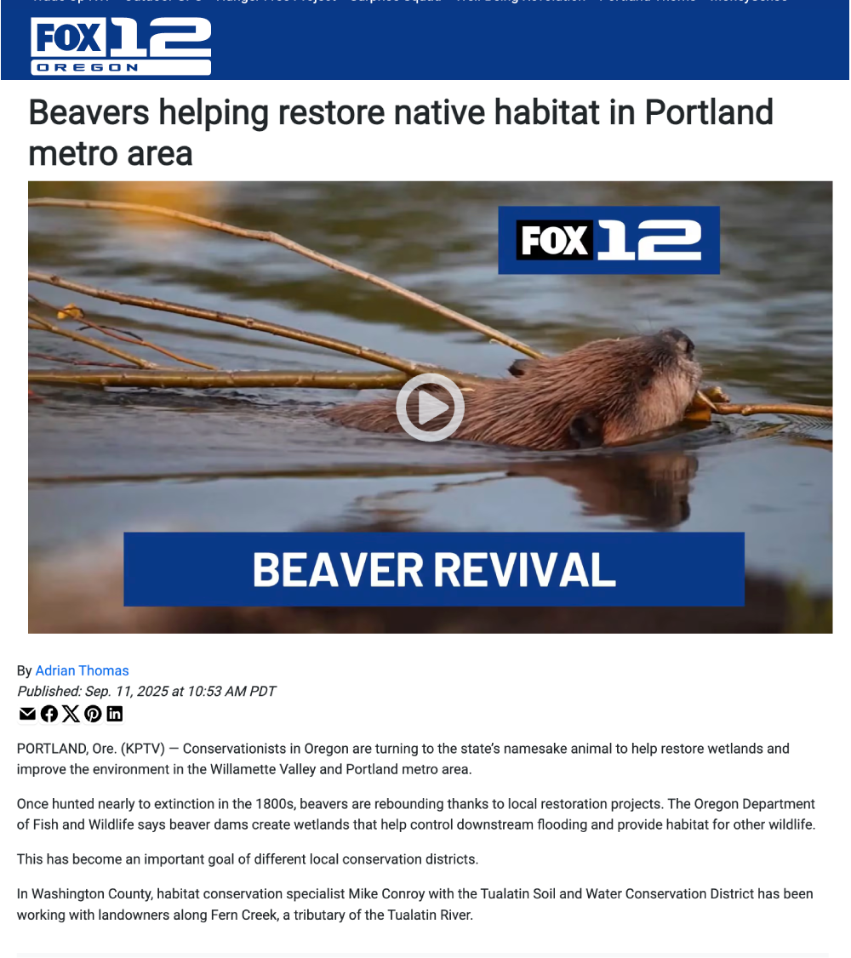
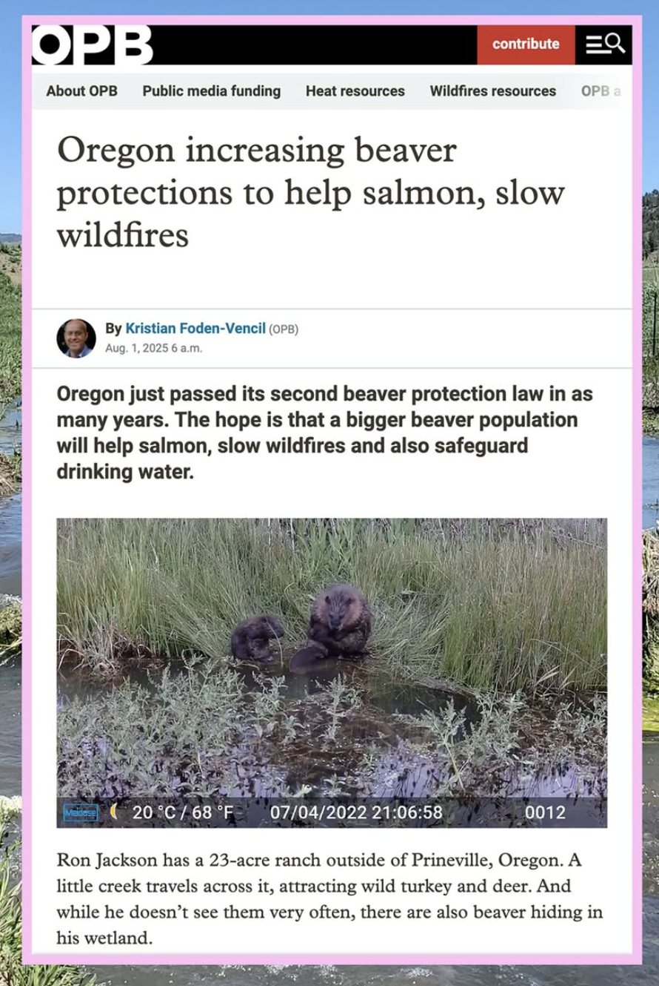

Slide 7
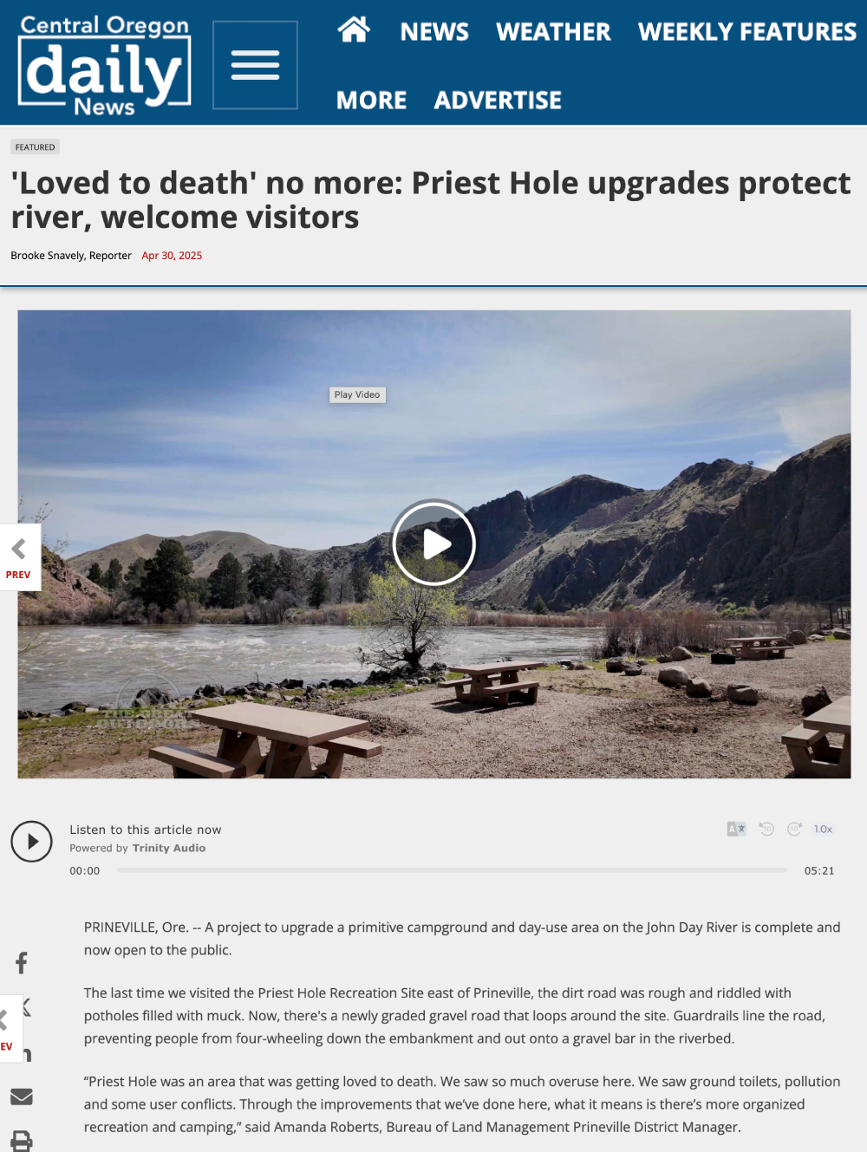
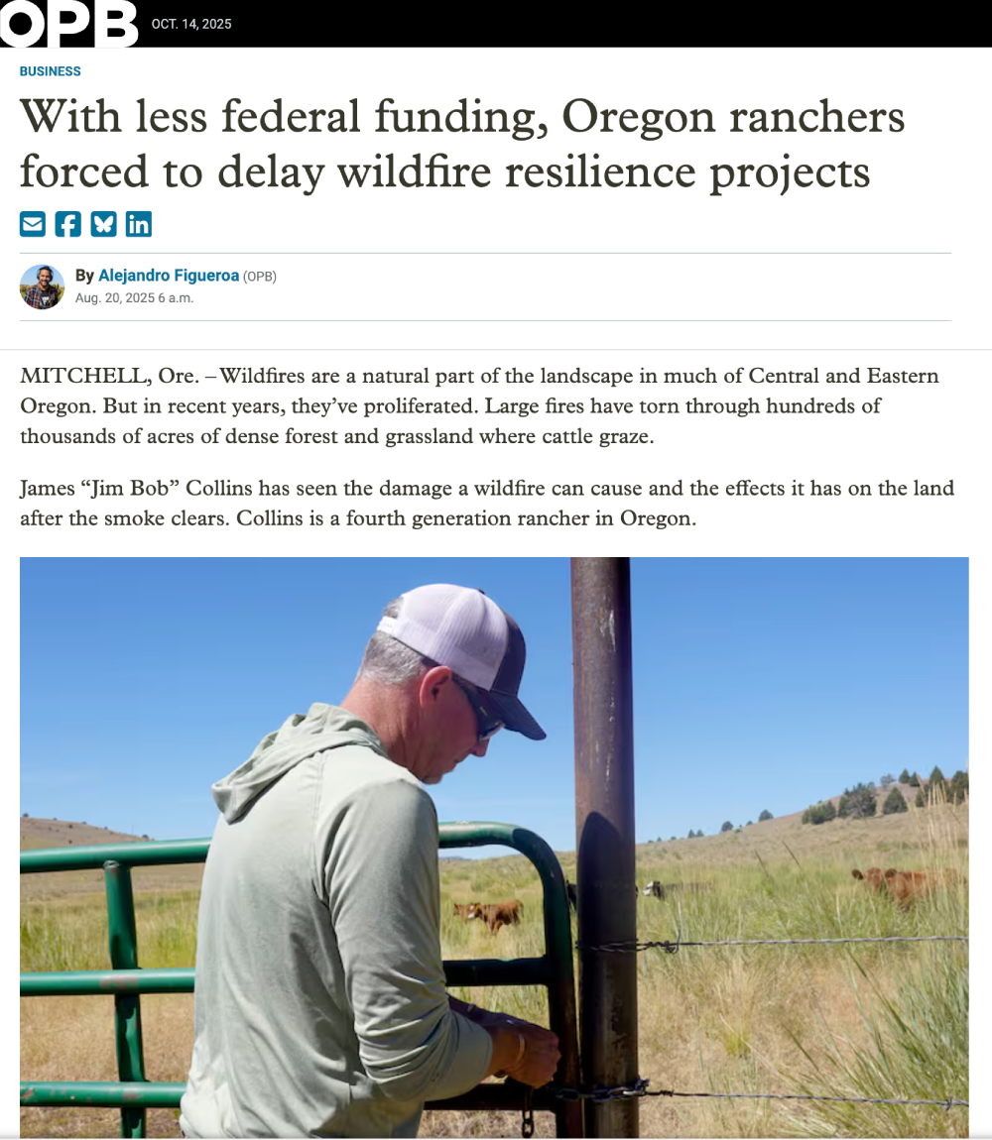

Slide 8
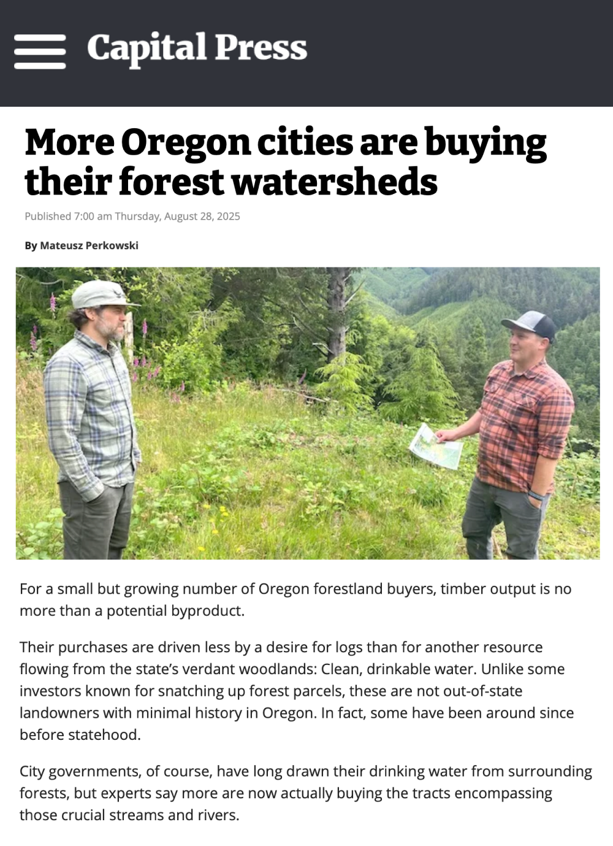
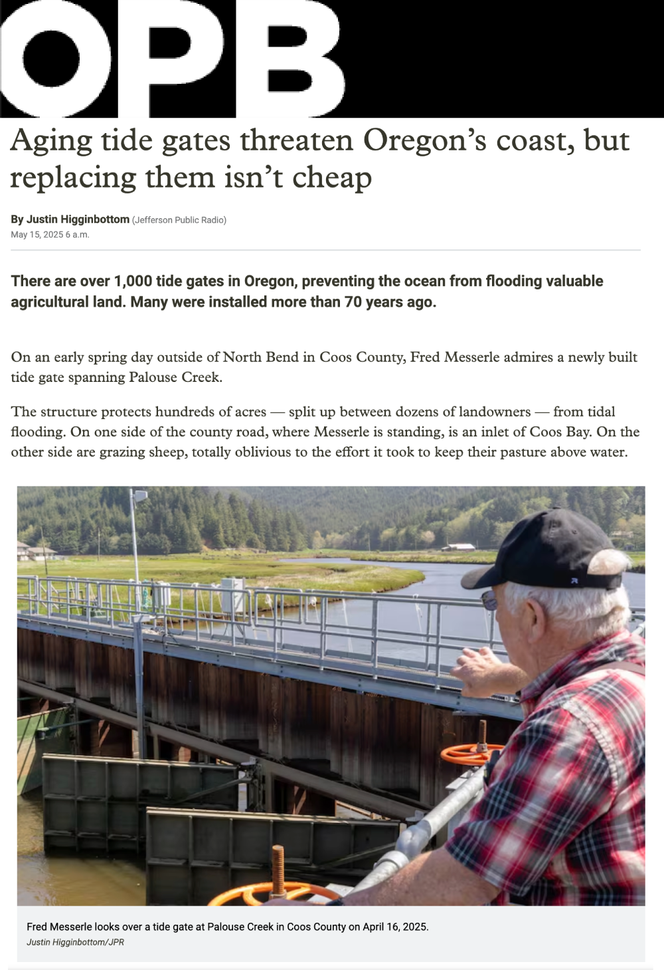

Slide 9
When to share stories
Don’t wait for my email requests!
Whenever you have a “this is awesome moment” shoot me an email
When the public benefit is noteworthy
When an event affects your work
When a news event is even tangentially related to your work
Seasonal moments
Back to school, summer and water, Fall and fire, Spring and farming
When multiple districts are working on similar issues from different angles

Slide 10
ORCP’s/OACD’s PR services
It’s free to you! Email me a paragraph about a newsworthy project
Monthly stories: Either one comprehensive story or smaller projects as part of a series
Process: Initial interview, pitch writing, approval, media connection
Email: eric@weareforestgreen.com

