Slide 1
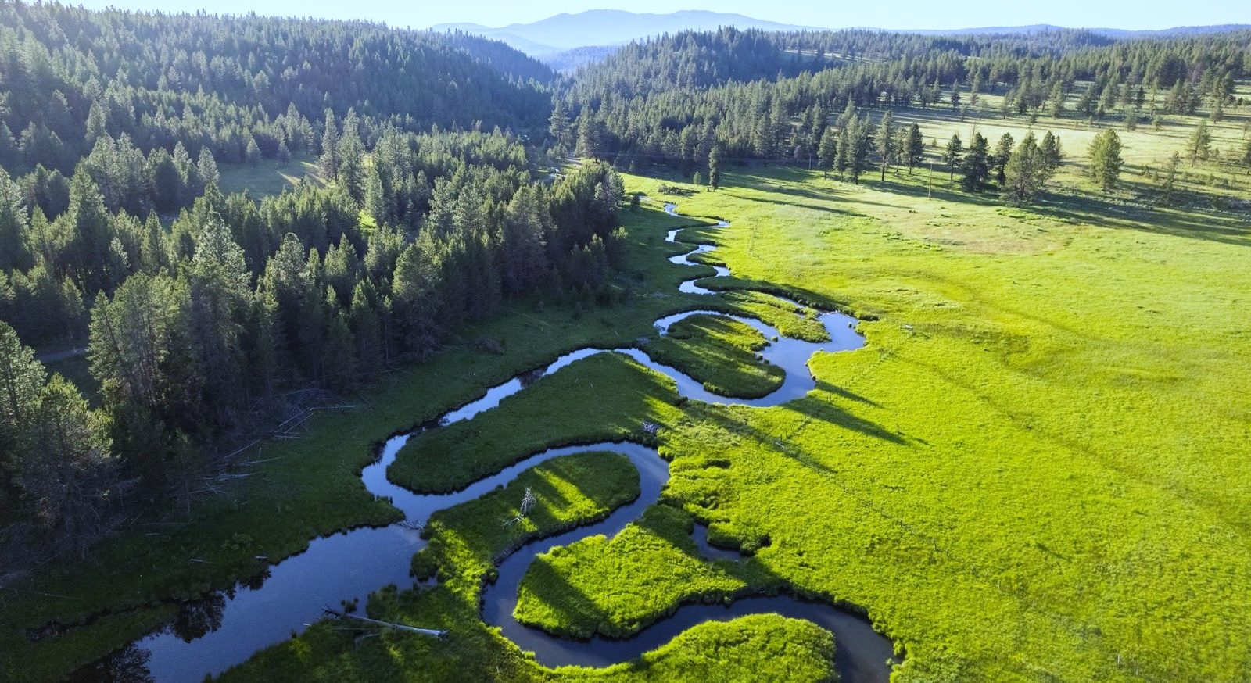


OWEB Grants
Phipps Meadow, John Day Basin Partnership Focused Investment Partnership
Notes:
OWEB is a small state agency that administers grants for watershed restoration, fish and wildlife habitat, and clean water. These slides provide more information about who we are and how we do our work.
A few key points:
- OWEB programs support enterprise level watershed health priorities such as flow restoration, clean water, and fish and wildlife habitat. We fund projects that take place from ridgetop to ridgetop on the landscape. The programs that we’ll cover today have connections with watershed health and that is why they are housed at OWEB.
- Our programs connect to climate resiliency and carbon sequestration in many ways.
- We are currently conducting engagement around some new funding related to carbon sequestration on natural and working lands and would like your feedback.

Slide 2
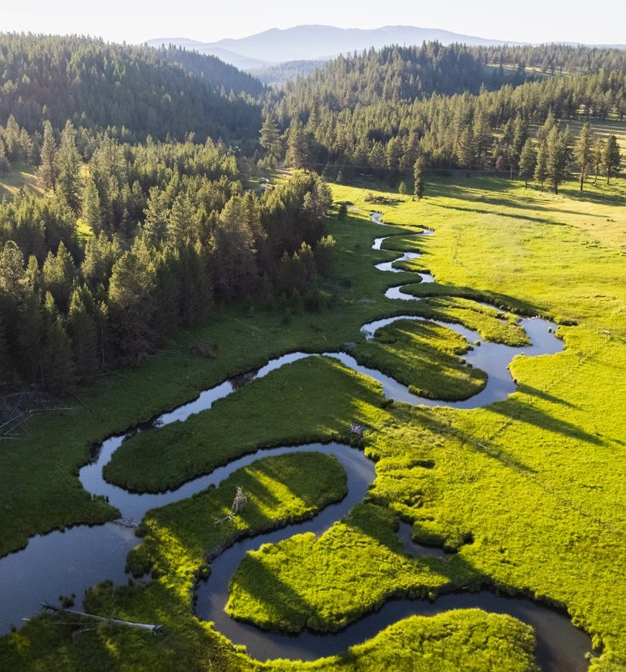
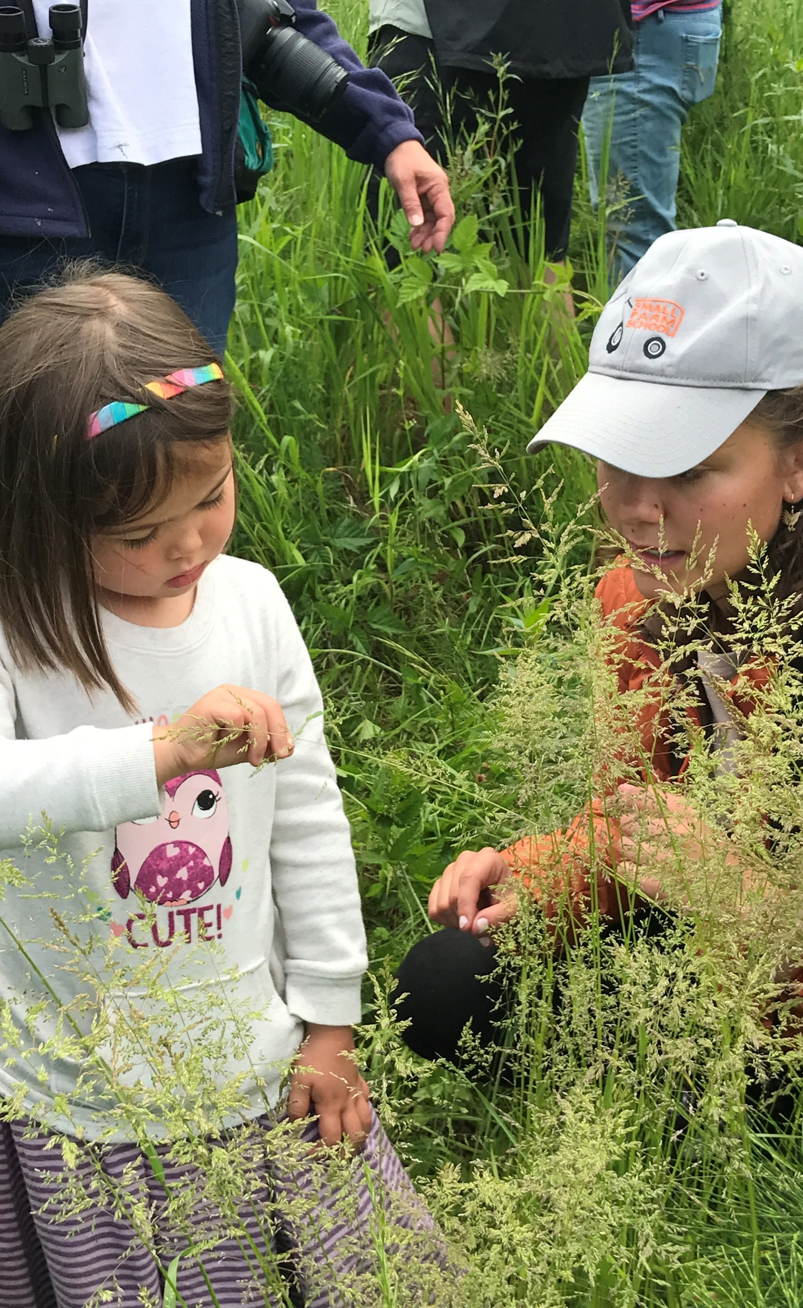
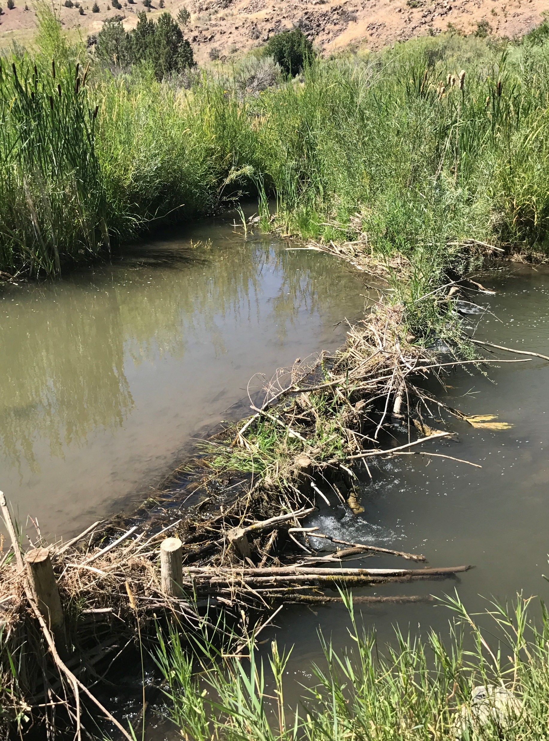
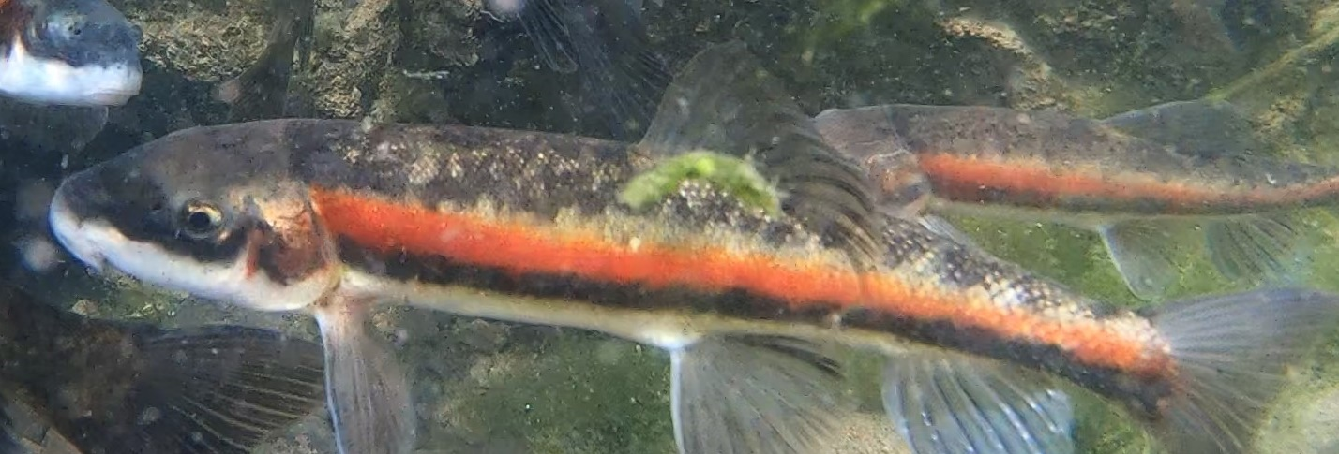
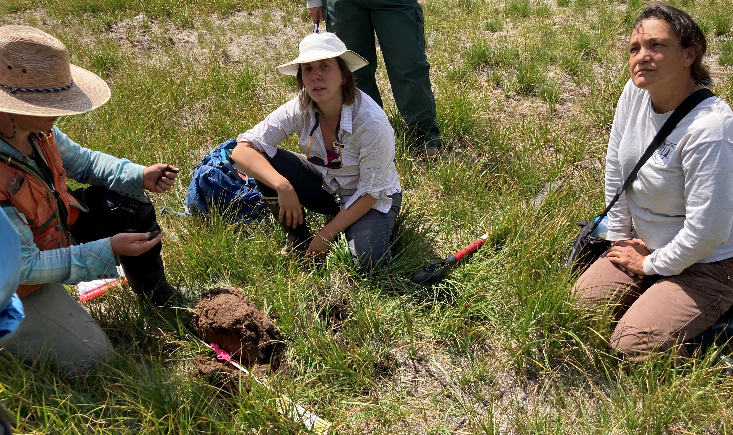
OWEB Mission
To protect and restore healthy watersheds and natural habitats that support thriving communities and strong economies.
Notes:
I won’t read this word for word, but would like to highlight the threefold mission of supporting watershed and habitat health; supporting communities, and supporting local economies. All of these are important parts of OWEB’s mission. There have been a couple of studies (several years ago) looking at the job creation associated with OWEB’s investments.
We achieve this mission by administering grants. Our grants support state and local priorities. So for example we support needs and priorities identified in ODFW’s wildlife conservation strategy and in DEQ’s clean water plans. Local partners identify strategic needs in their communities that support these priorities and develop projects to address them.
One other thing that I wanted to note is that we are one of many agencies that offers grants for conservation work. We try to stay aware of programs that have been allocated to other agencies too, because we all work for the state. If our program is not a good fit there may be another program that is a good fit. Examples – ODFW conservation and recreation fund, ODFW PFA grant program.

Slide 3

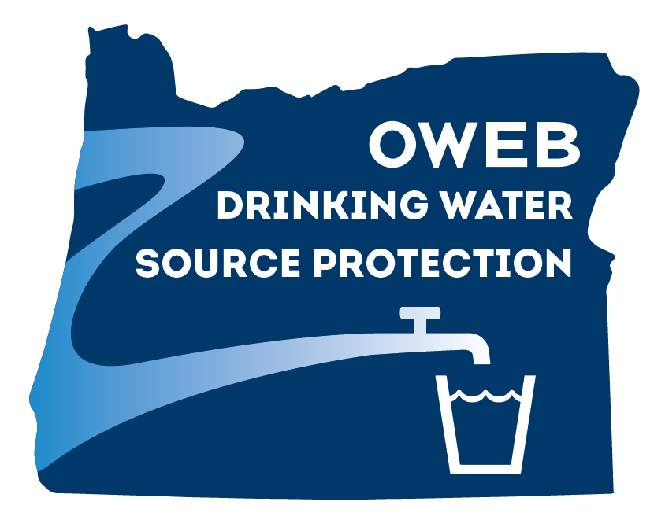

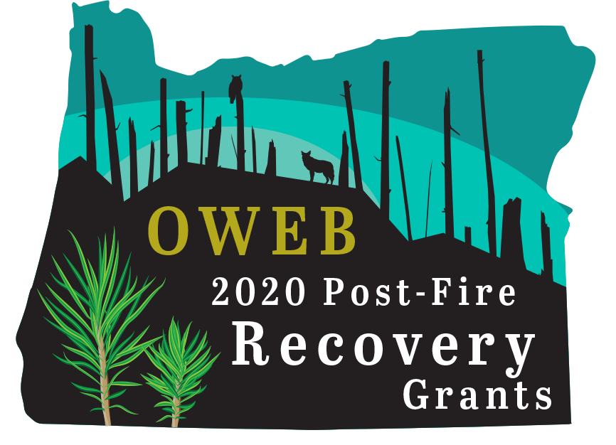
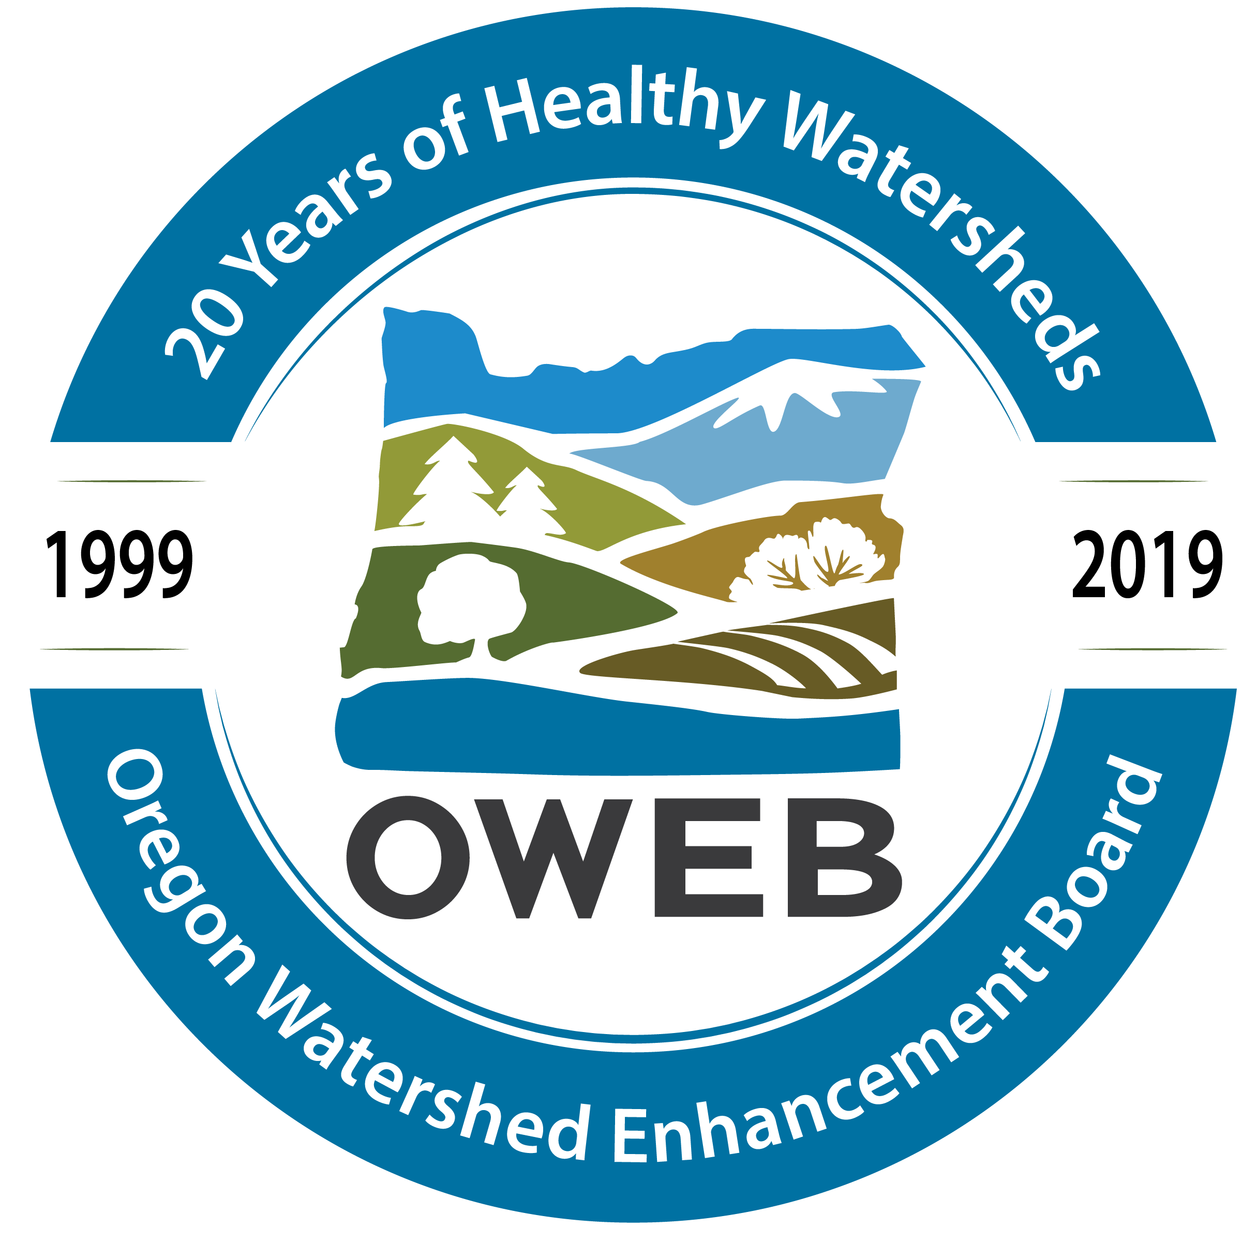





Historical Context
IDEA
Voluntary Restoration – Cooperative Conservation
GWEB
Modest Investment
M66
(1998)
Time-limited Funding
M76
(2010)
Permanent Funding
20 Years
(2019)
NEW PROGRAMS
OAHP
Drought
Wildfire
Drinking Water Source Protection
Natural and Working Lands
Environmental Restoration Council
Notes:
1986 – Oregon Watershed Improvement Coalition formed. Miracle at Bridge Creek documentary, narrated by veteran character actor, Jack Elam, who appeared mostly as a villain in numerous westerns.
OWEB first came into being in the late 1990s as an important part of the state’s plan to restore salmon and watersheds. Much of this was tied to impending ESA listings of several fish species. Salmon recovery is a critical part of OWEB’s programs; programs have also diversified over the years to support additional fish and wildlife priorities such as sage grouse recovery.
One thing I would like to note is that about 2/3 of OWEB’s funding historically came from lottery dollars allocated to us from M76. The other 1/3 historically was federal pacific coast salmon recovery funds. There are some constitutional limitations on the M76 dollars that affect what types of projects we are able to fund. One example is education projects – it puts limitations around outreach and education projects. Another example is on land acquisitions. OWEB can provide grants for land acquisitions; must provide fish and wildlife habitat.
Recently, OWEB has received a variety of new programs that we took on to respond to requests from customers, partners, the Governor’s office, and the legislature. These include post-wildfire recovery grants after the 2020 and 2021 fires, drought resiliency grants, the Oregon Ag Heritage Program, and new investments in water acquisitions. The most recent programs are the Environmental Restoration Council, a land acquisition grant program for source water protection and OWEB was also assigned a fiscal agent role for a new natural climate solutions fund. In addition to acting as fiscal agent for the initial $10M invested into the fund, OWEB will collaborate with several other state agencies and the Oregon Climate Action Commission to figure out how to invest those funds.

Slide 4






Connecting Project Outcomes to Constitutional Requirements
Article XV (4b) Constitution & ORS 541.956: Moneys shall be used only to...
Acquire from willing owners
interests in land or water
that will protect or restore
fish & wildlife habitat
Carry out projects to protect or restore fish & wildlife habitat
Carry out projects to protect
or restore natural watershed
functions to improve water
quality or stream flows
      Technical Assistance
      Engagement/Outreach
      Monitoring
Activities Necessary for Projects

Slide 5






Consistent Grantmaking Process
Solicitation
Application
TECHNICAL Review & Recommend
Award
Grant Agreement
Reporting

Slide 6
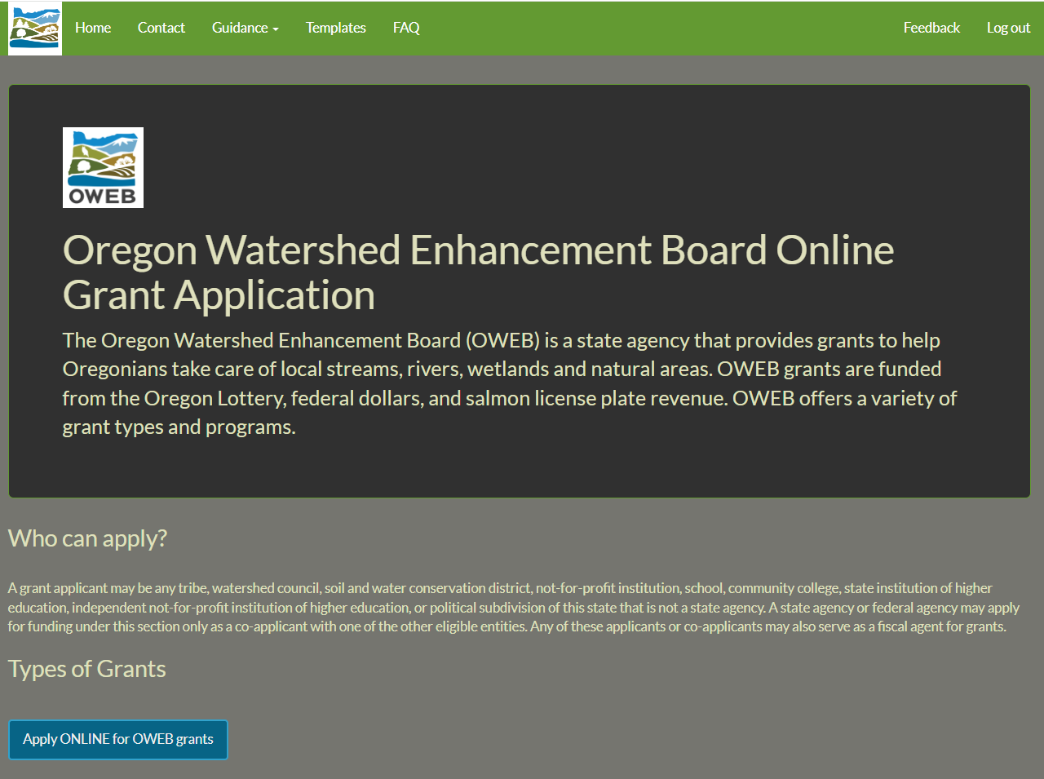
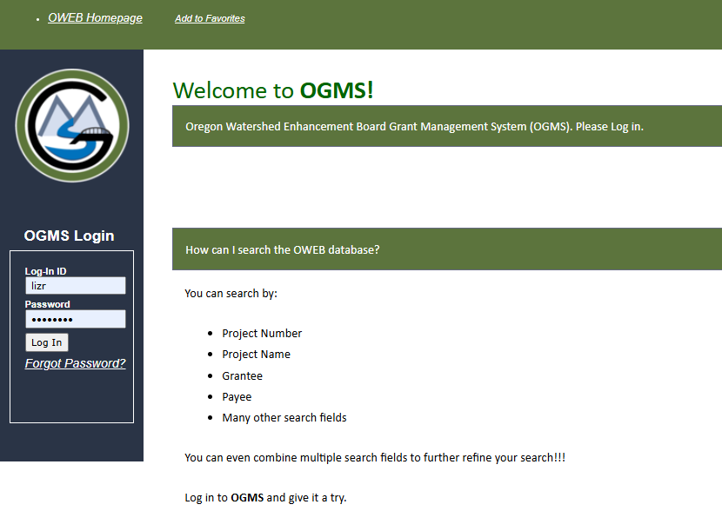
Online Application Connected to Database

Slide 7
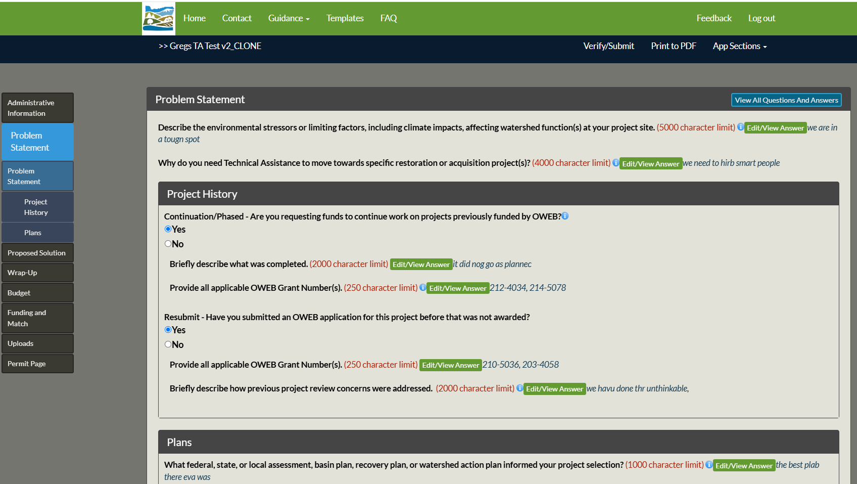
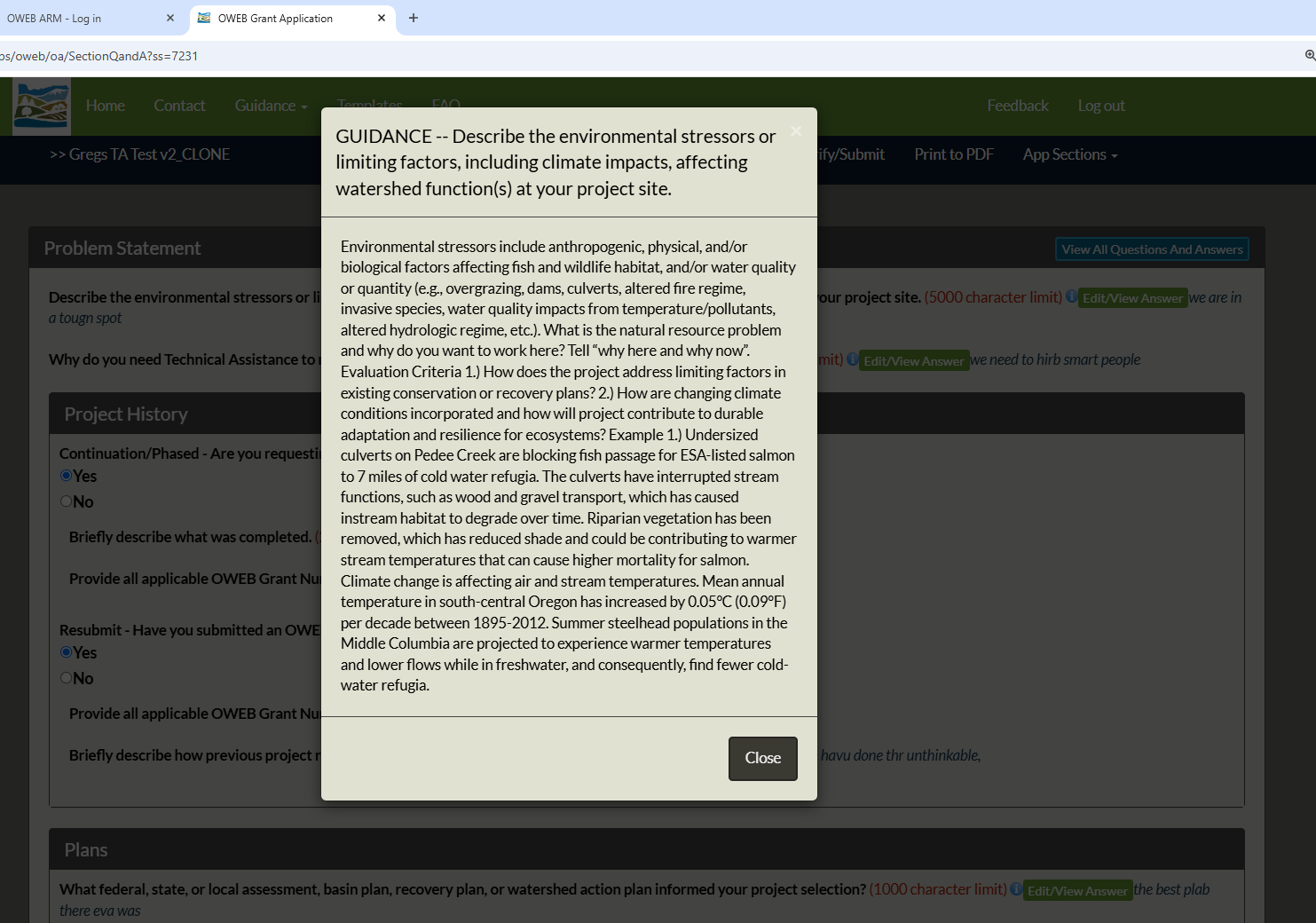
Application Guidance – iButtons + Templates
Notes:
Templates + iButtons

Slide 8
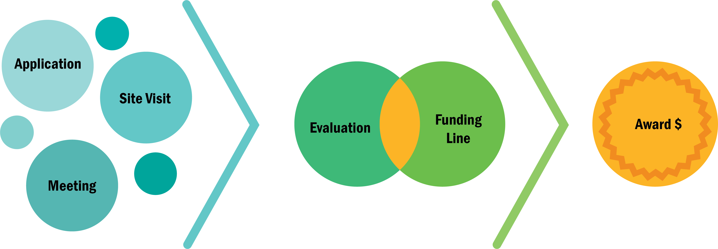
Decision Pathway to Fund Projects
REVIEW TEAM
RECOMMENDATION TO STAFF
STAFF RECOMMENDATION
TO THE OWEB BOARD
BOARD
DECISION
Notes:
Talking Points
Why we meet/need review teams…to give out money…and put it in the right places on the ground…
Board has the power to “fund projects,” review team and staff are providing a recommendation to the Board.

Slide 9




Meeting Protocols
Trust
Consideration
Agree to Disagree
Conflict of Interest
Avoid
Advocacy
  What is said at the team meeting stays at the team meeting
  Everyone’s input is important
  If disagreement occurs, we will take a vote and move on
  Tie vote = DNF
  Know the policy and declare as necessary
  Conflict
  vs bias
  Waiting room
  Stick to technical review
Notes:
Talking Points
Trust- Process relies on anonymous review so that we can get honest feedback so it is important that what is said in the room stays in the room. We do not attribute comments to individuals and the evaluation product summarizes the collective input from group.
Consideration- Strength of review team is diversity of expertise, make sure we take advantage of that and ensure everyone has opportunity to share feedback.
Agree to Disagree- This is not a consensus process. The purpose of the conversation is to provide learning space for reviewers to better understand projects so that you have the information to make a recommendation.
COI- Reminder of the policy. New policy provides some definition and separation of COI versus bias. Since we are so connected and networked within the watershed restoration community as partners, technical advisors, etc., we hope this is helpful for building transparency within our conversation here and understanding what elevates to COI and leaving the room.
Conflict- You or family will financially benefit from the award, you are staff of the applicant organization, or you wrote the application….Let us know…Move to the waiting room…
Bias- Some examples of potential bias is your agency is providing match, you participated on the design team, or you are a board member of the applicant organization. These could introduce bias but are not considered COI that requires you to leave the room. We encourage you to note potential bias to provide that transparency to our conversation today. You can also let us know if you prefer to leave the room.
Avoid Advocacy- for or against a project and stick with technical comments.

Slide 10
RESTORATION
Does the application have clearly stated objectives & describe how those objectives will be met?
How will the project implement a clearly defined method appropriate for addressing the problem?
Evaluation Criteria
OAR 695-010-0060
How does the project address limiting factors or watershed issues by treating the causes rather than the symptoms of disturbance?
Is the project ready to be implemented?
All projects must meet the following:
Will the project provide public benefit by supporting improved water quality, habitat, &/or ecosystem functions?
Does the project demonstrate sound watershed management principles?
Are project methods adapted to the project location?
Will professionally accepted restoration approaches be followed?
Does the application provide an overall budget that reflects expected & quantified watershed health benefit?
Proposal
Clarity
How were alternatives to address the identified problem identified & evaluated?
How are watershed benefits quantified in the application?
How does the budget reflect necessary costs & demonstrate reasonable rates for direct costs & match?
Cost
Effectiveness
Technical
Soundness
How are changing climate conditions incorporated & how will project contribute to durable adaptation & resilience for ecosystems?
SWEET SPOT: Likelihood
for success
How does the applicant have capacity for successful long-term stewardship & maintenance of the project?
How has consideration of greenhouse gas emissions or long-term carbon sequestration or storage informed project?
What is the applicant’s track record in managing projects, completing projects as proposed & reporting?
Capacity
of Applicant
Watershed
Context
How were likely impacts to the site & adjacent properties during & after project implementation considered?
What specific action(s) will be implemented that are within an explicit geography prioritized in a watershed restoration plan?
How will appropriate partners be engaged in the project?
How did/will engagement with local communities disproportionately impacted by climate change inform the project?
How does the project address watershed function & ecosystem processes, including water quality & the life stages of fish & wildlife?
How does the project fit within the context of past & planned future restoration efforts in the watershed?
How will the project promote public awareness that may lead to opportunities for watershed restoration?

Slide 11
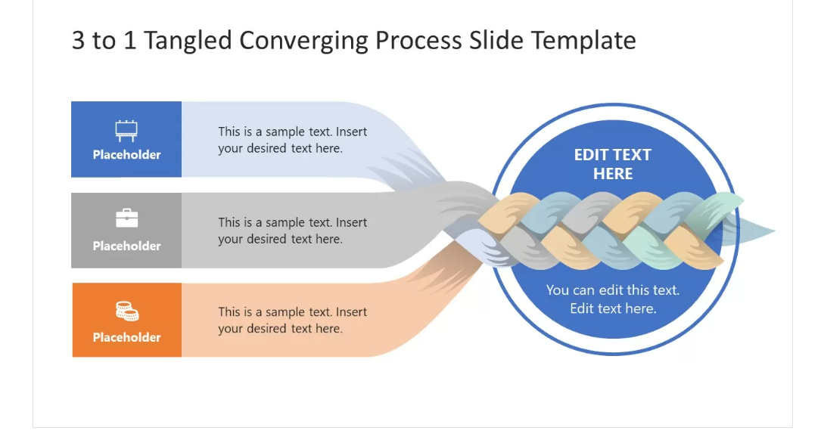

Knitting it all Together
GRANT
State Constitution, Statutes, Rules & Policies
Federal Requirements (when applicable)
Requirements of the Award
AGREEMENT
Grant Application as the Project Scope of Work

Slide 12
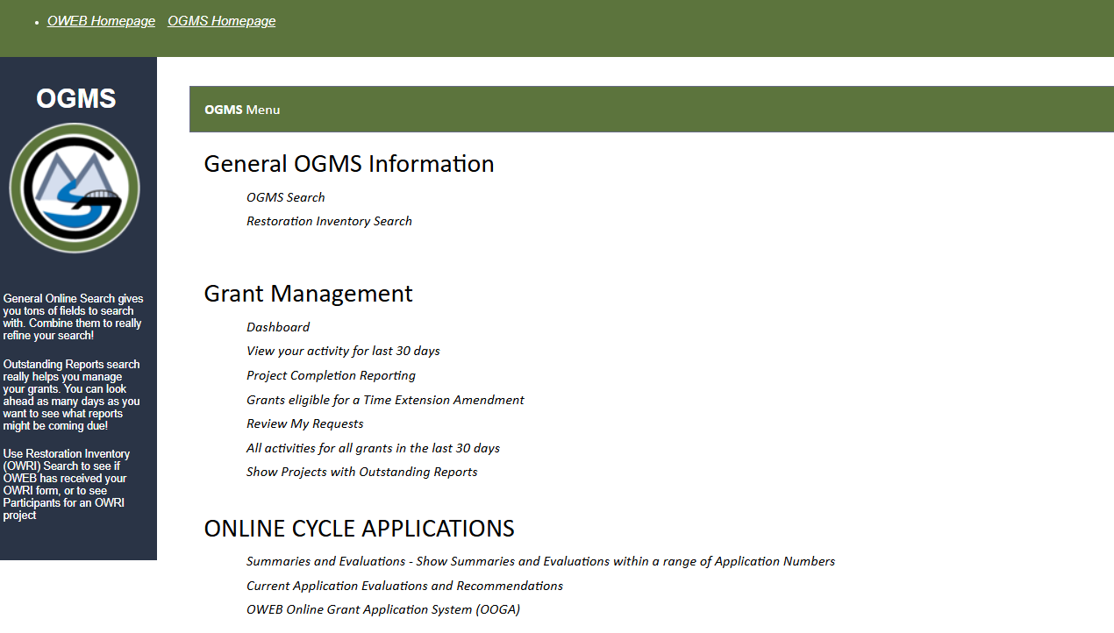
Grantee OGMS Menu

Slide 13
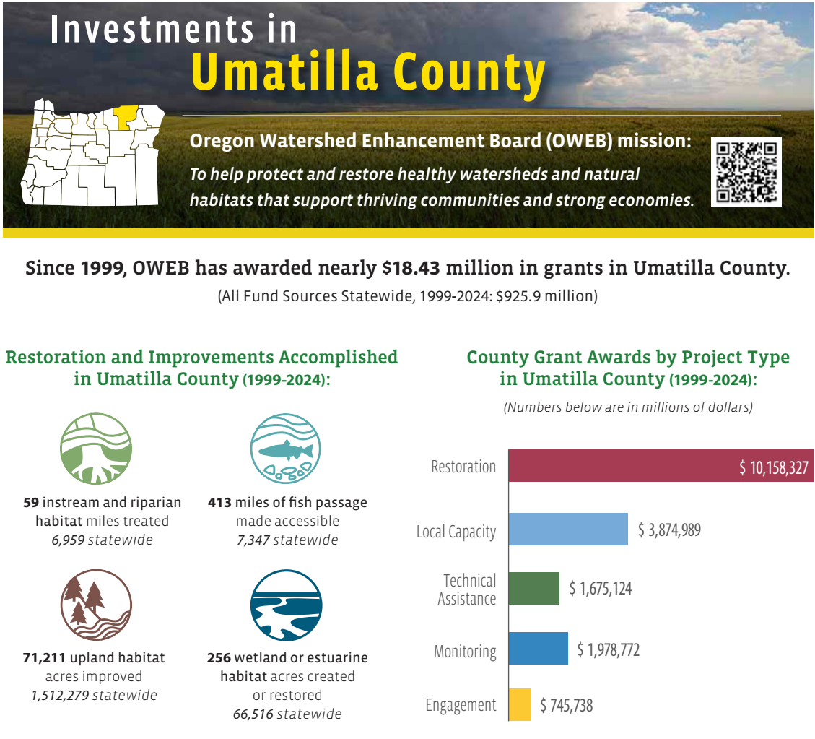
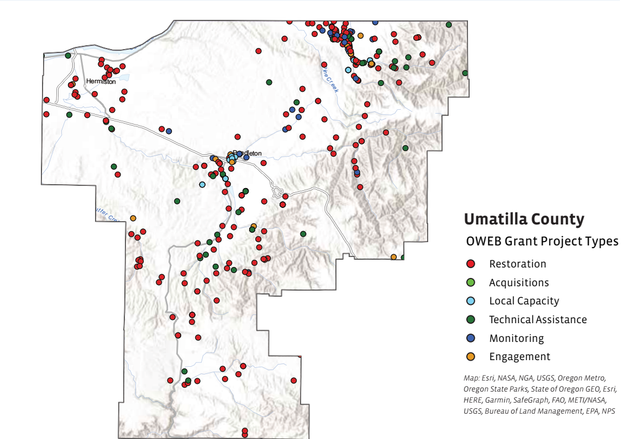
Reporting – Communicating Investments

Slide 14
Upcoming
Changes
Small Grants
Capacity

Slide 15
Connecting Project Outcomes to Constitutional Requirements
Article XV (4b) Constitution & ORS 541.956: Moneys shall be used only to...
Acquire from willing owners
interests in land or water
that will protect or restore
fish & wildlife habitat
Carry out projects to protect or restore fish & wildlife habitat
Carry out projects to protect
or restore natural watershed
functions to improve water
quality or stream flows
      Technical Assistance
      Engagement/Outreach
      Monitoring
Activities Necessary for Projects

