Slide 1

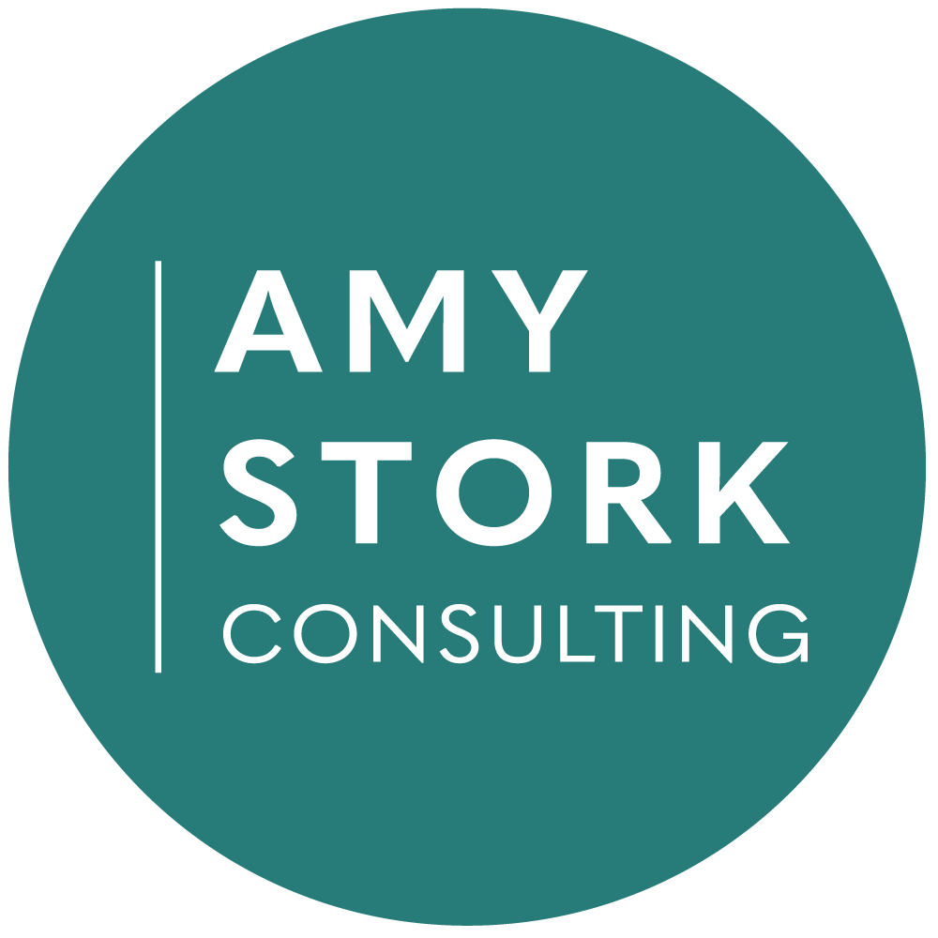
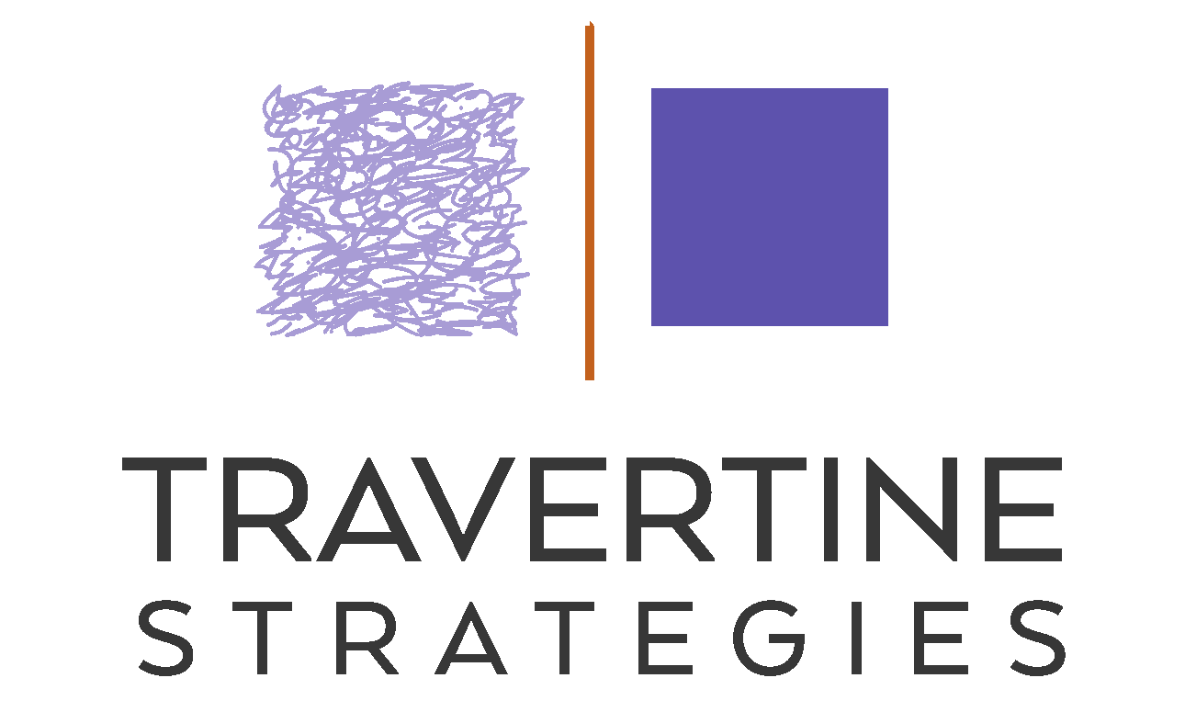
Shared Wisdom: A Best Practices Framework for Oregon SWCDs Conference Kickoff 2025
Notes:
Shared Wisdom: Building a Best Practices CAYUSE
Framework for Oregon SWCDs
From budgets to HR to planning, each district has some approaches
you think are spot on and some that make you groan. This fall, OACD
launches a project to identify best practices in various aspects of district
operations; your feedback is the first step. At this kickoff session you will
provide feedback and insights about your highest priority needs, existing
assets, and how to bring the OACD community together to create a
strong and supportive best practices framework for critical operations
needs, Amy Stork and Allison Handler, OACD Consultants

Slide 2
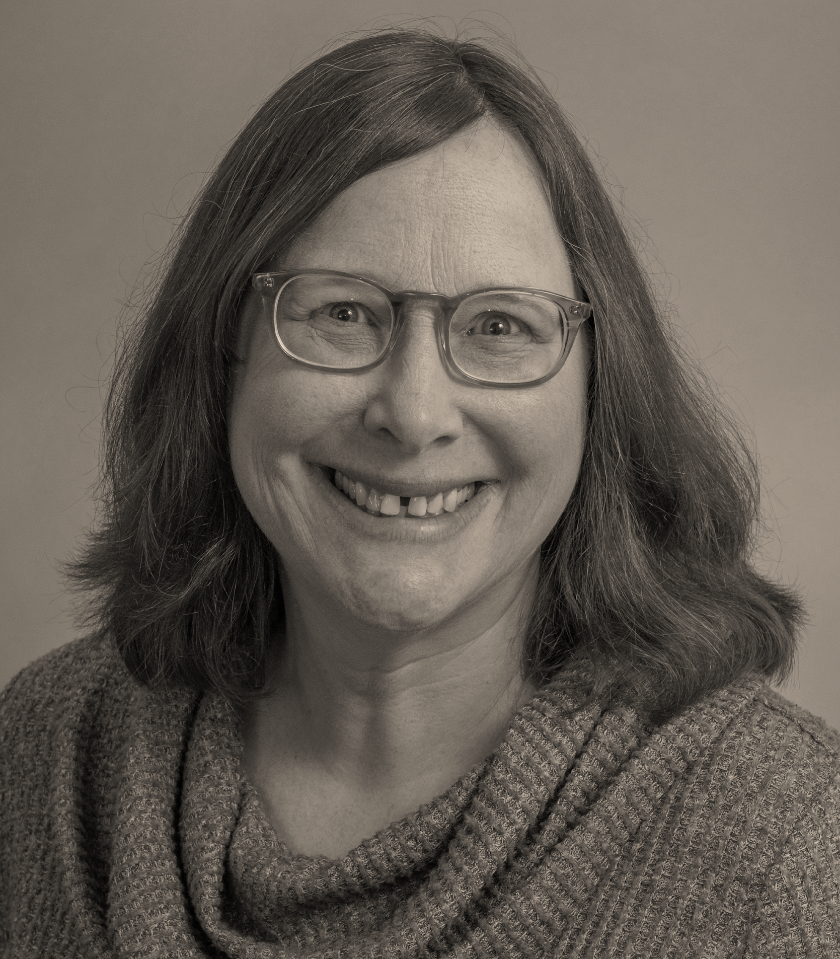
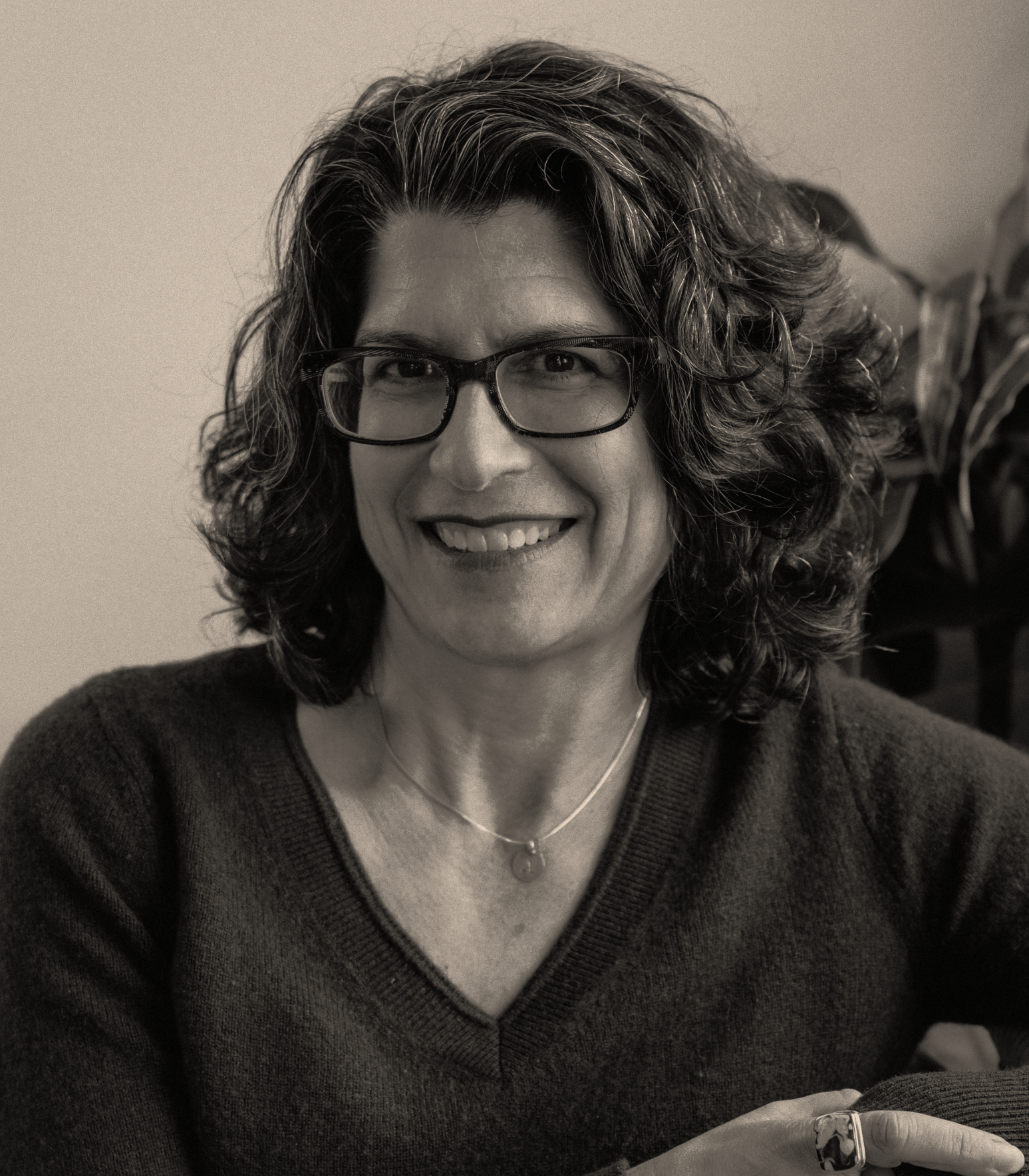
Allison Handler
20+ years as a consultant, executive staff, and volunteer leader
Nonprofit and public sectors
Organizational assessment, strategic planning, staffing planning, leadership development
25+ years in land use planning, land conservation, affordable housing, community development
Nonprofit and public sectors
Strategic planning, board development, collaboration & merger
Climate resilience and inclusion as driving concerns

Slide 3

OACD Best Practices Framework - Overview
What do we mean?
Plans, policies, processes, practices
That have proven effective for Districts
And have been vetted by the SWCD community

Slide 4
OACD Best Practices Framework - Overview
Why?
Operational excellence
Increased efficiency (less reinventing the wheel)
Share wisdom and experience across the SWCD community

Slide 5
Example of Best Practices Framework
Example: Advocacy best practices
Advocacy Committee with a clear set of responsibilities
Advocacy policy
Building positive relationships with decision-makers

Slide 6


OACD Best Practices Framework - Process
October 2025
November-December 2025
January- April 2026
May-June 2026
OACD Conference 2026
Present and discuss
Collect and review practices
Compile best practices
Form
four workgroups
Survey + Conference
OACD Library

Slide 7
WHO RESPONDED
41 responses
25 districts
Rural: 9
Mostly rural, some urban/suburban: 13
Mostly urban/suburban [by population]: 3
13 with tax base, 12 without
Survey Results

Slide 8
WHERE DISTRICTS WANT HELP
Succession planning | 72%
HR services and personnel policies | 64%
Strategic and annual planning | 48%
Employee recruitment and development | 48%
Advocacy | 32%
Board meetings and board engagement | 24%
Budgeting | 20%
Financial management and audits | 16%
Survey Results

Slide 9
WHERE DISTRICTS FEEL STRONG
Budgeting | 84%
Financial management and audits | 76%
Board meetings and board engagement | 68%
Strategic and annual planning | 40%
Employee recruitment and development | 32%
Advocacy | 16%
Succession planning | 8%
HR services and personnel policies | 4%
Survey Results

Slide 10
OACD Best Practices Framework - Workgroups
Four workgroups
Employee recruitment and development / succession planning
HR services and personnel policies
Strategic and annual planning
Board development/functioning
*Advocacy will be served through other trainings

Slide 11
OACD Best Practices Framework - Workgroups
October 2025
November-December 2025
January- April 2026
May-June 2026
OACD Conference 2026
Present and discuss
Collect and review practices
Compile best practices
Form
four workgroups
Survey + Conference
- Confirm participation
- Schedule meetings
- Two 2- hour virtual meetings
- “Homework” between
- Review at CONNECT **or** additional virtual meetings
Volunteers compile the workgroup- recommended practices
About 16-20 total hours
OACD Library

Slide 12
OACD Best Practices Framework - Workgroups
October 2025
November-December 2025
January- April 2026
May-June 2026
OACD Conference 2026
Present and discuss
Collect and review practices
Compile best practices
Form
four workgroups
Survey + Conference
About 16-20 total hours
Interested?
Let us Know Today or Contact Andrea by 10/31

