Slide 1
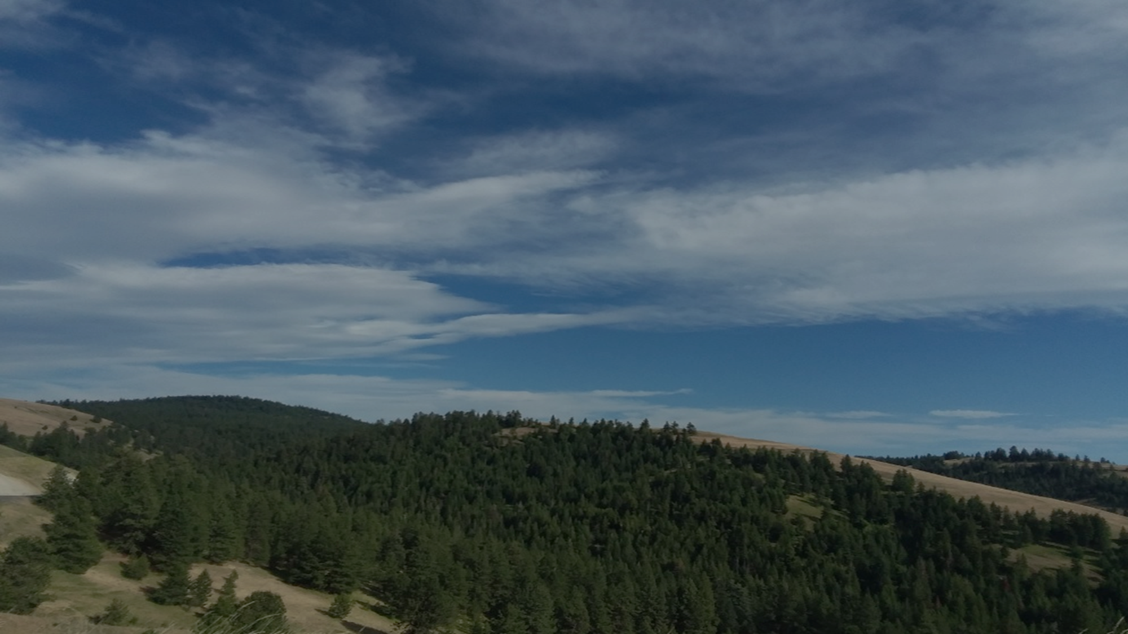
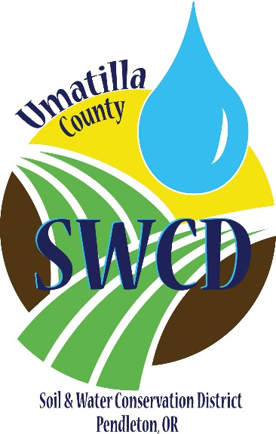
Protecting Habitats and Homes
Synthesizing flood protection and natural floodplain functions in Umatilla County

Slide 2

Overview
Umatilla County overview
Summary of 2020 and other flood events
Floodplain restoration challenges
Proposed solutions and lessons learned

Slide 3
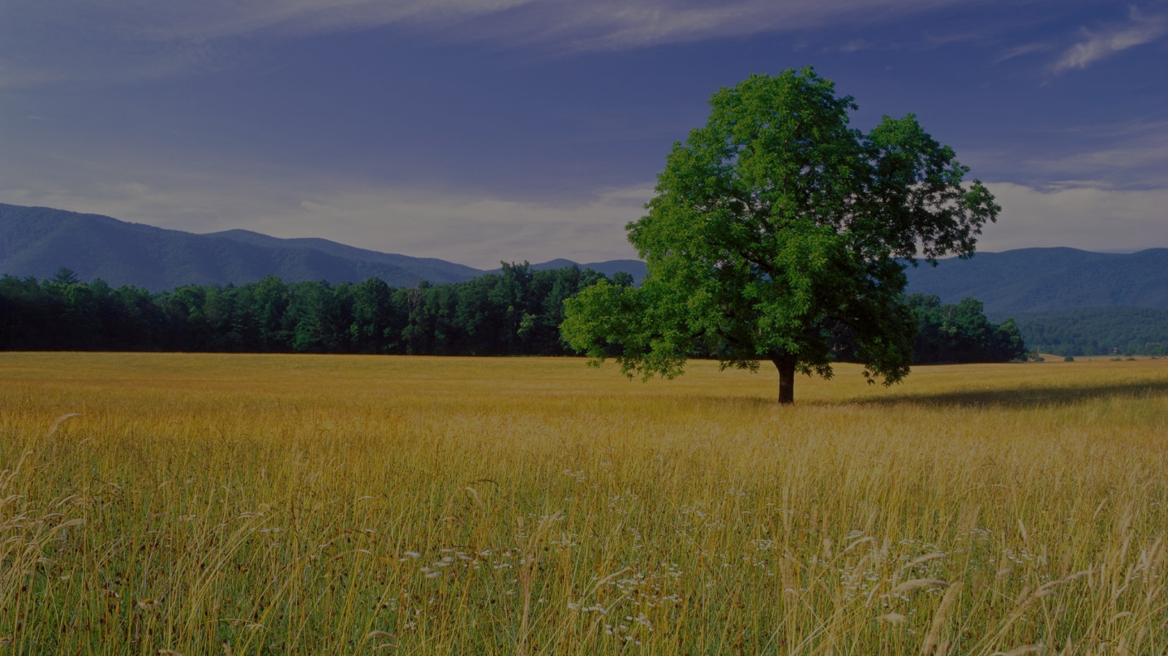
Our Focus: Conservation
Our Mission:
To conserve, protect, and develop natural resources for the environmental and economic benefit of Umatilla County
The District accomplishes conservation in three ways:

Slide 4
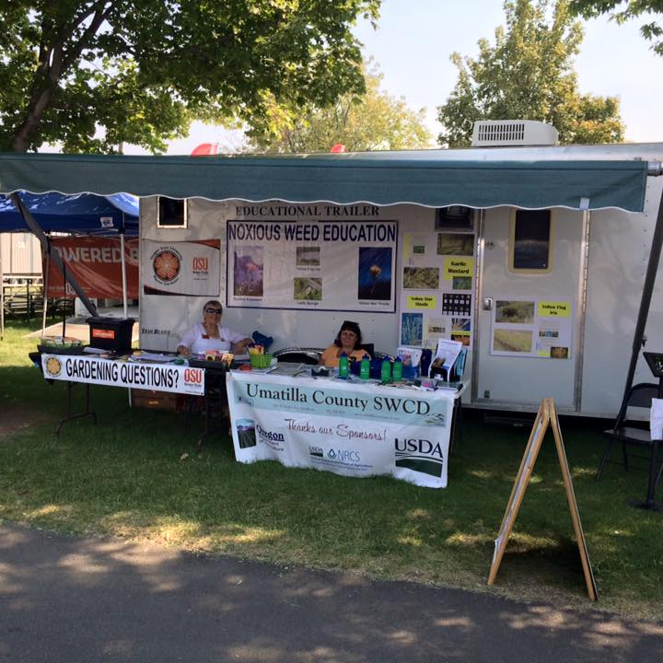
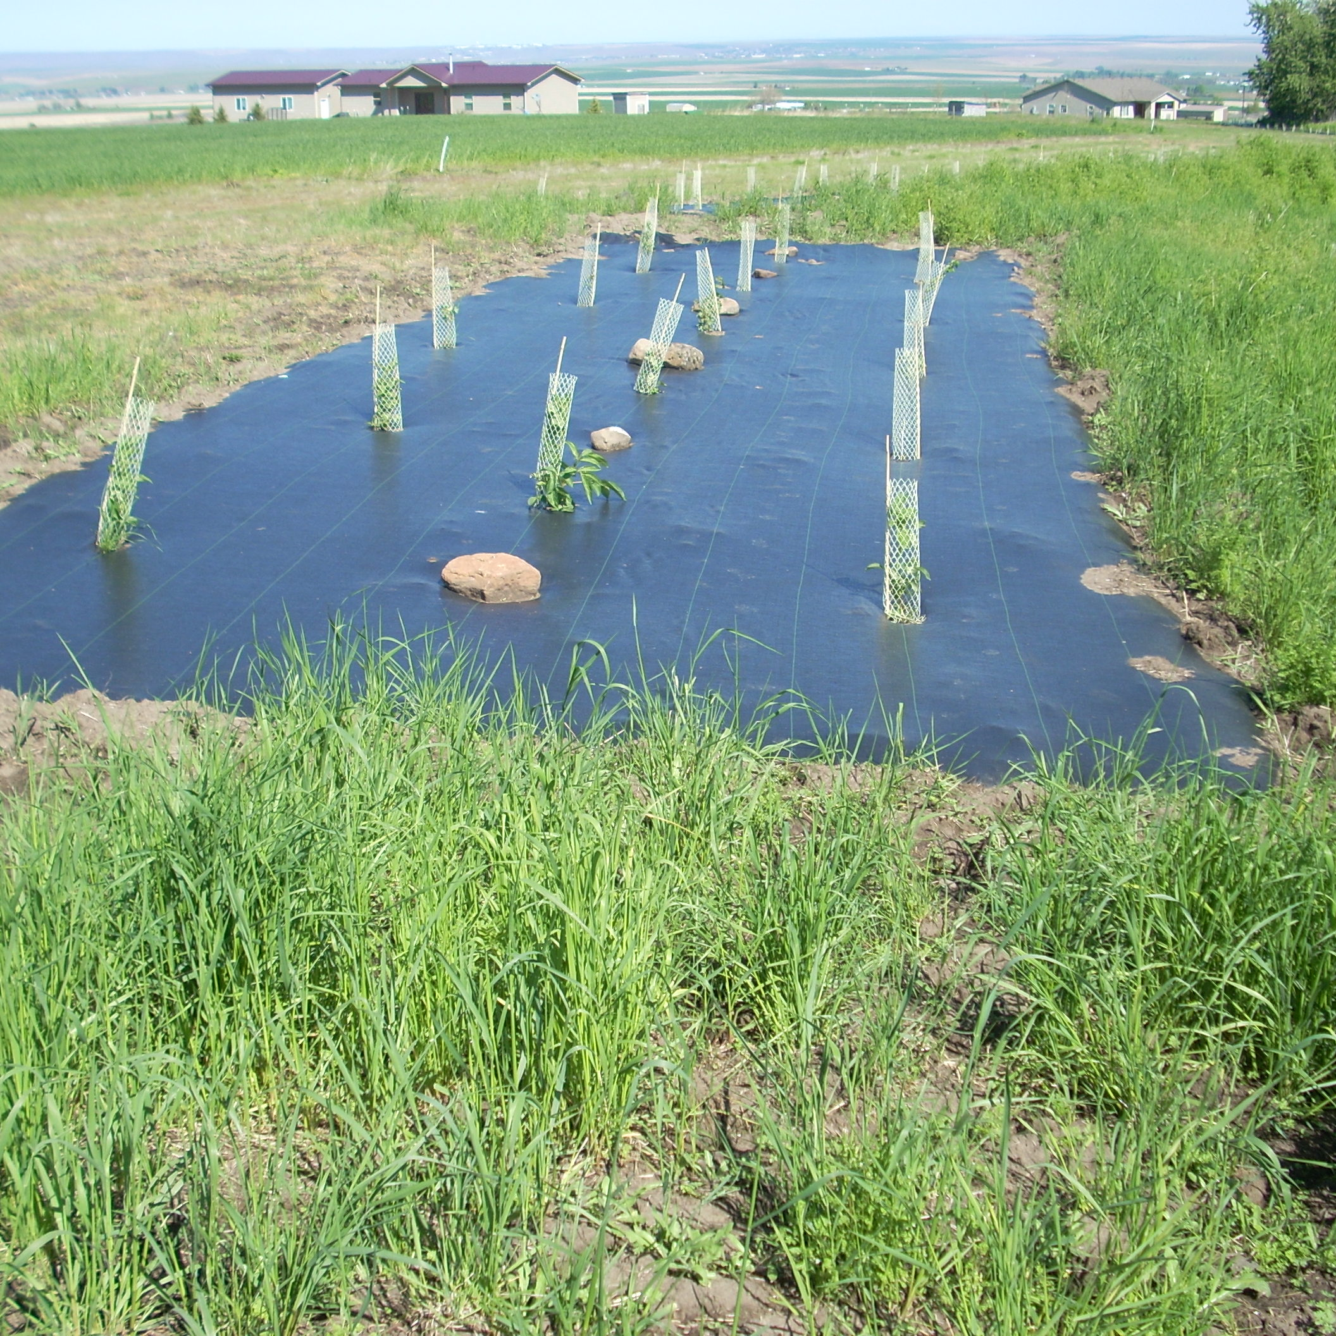
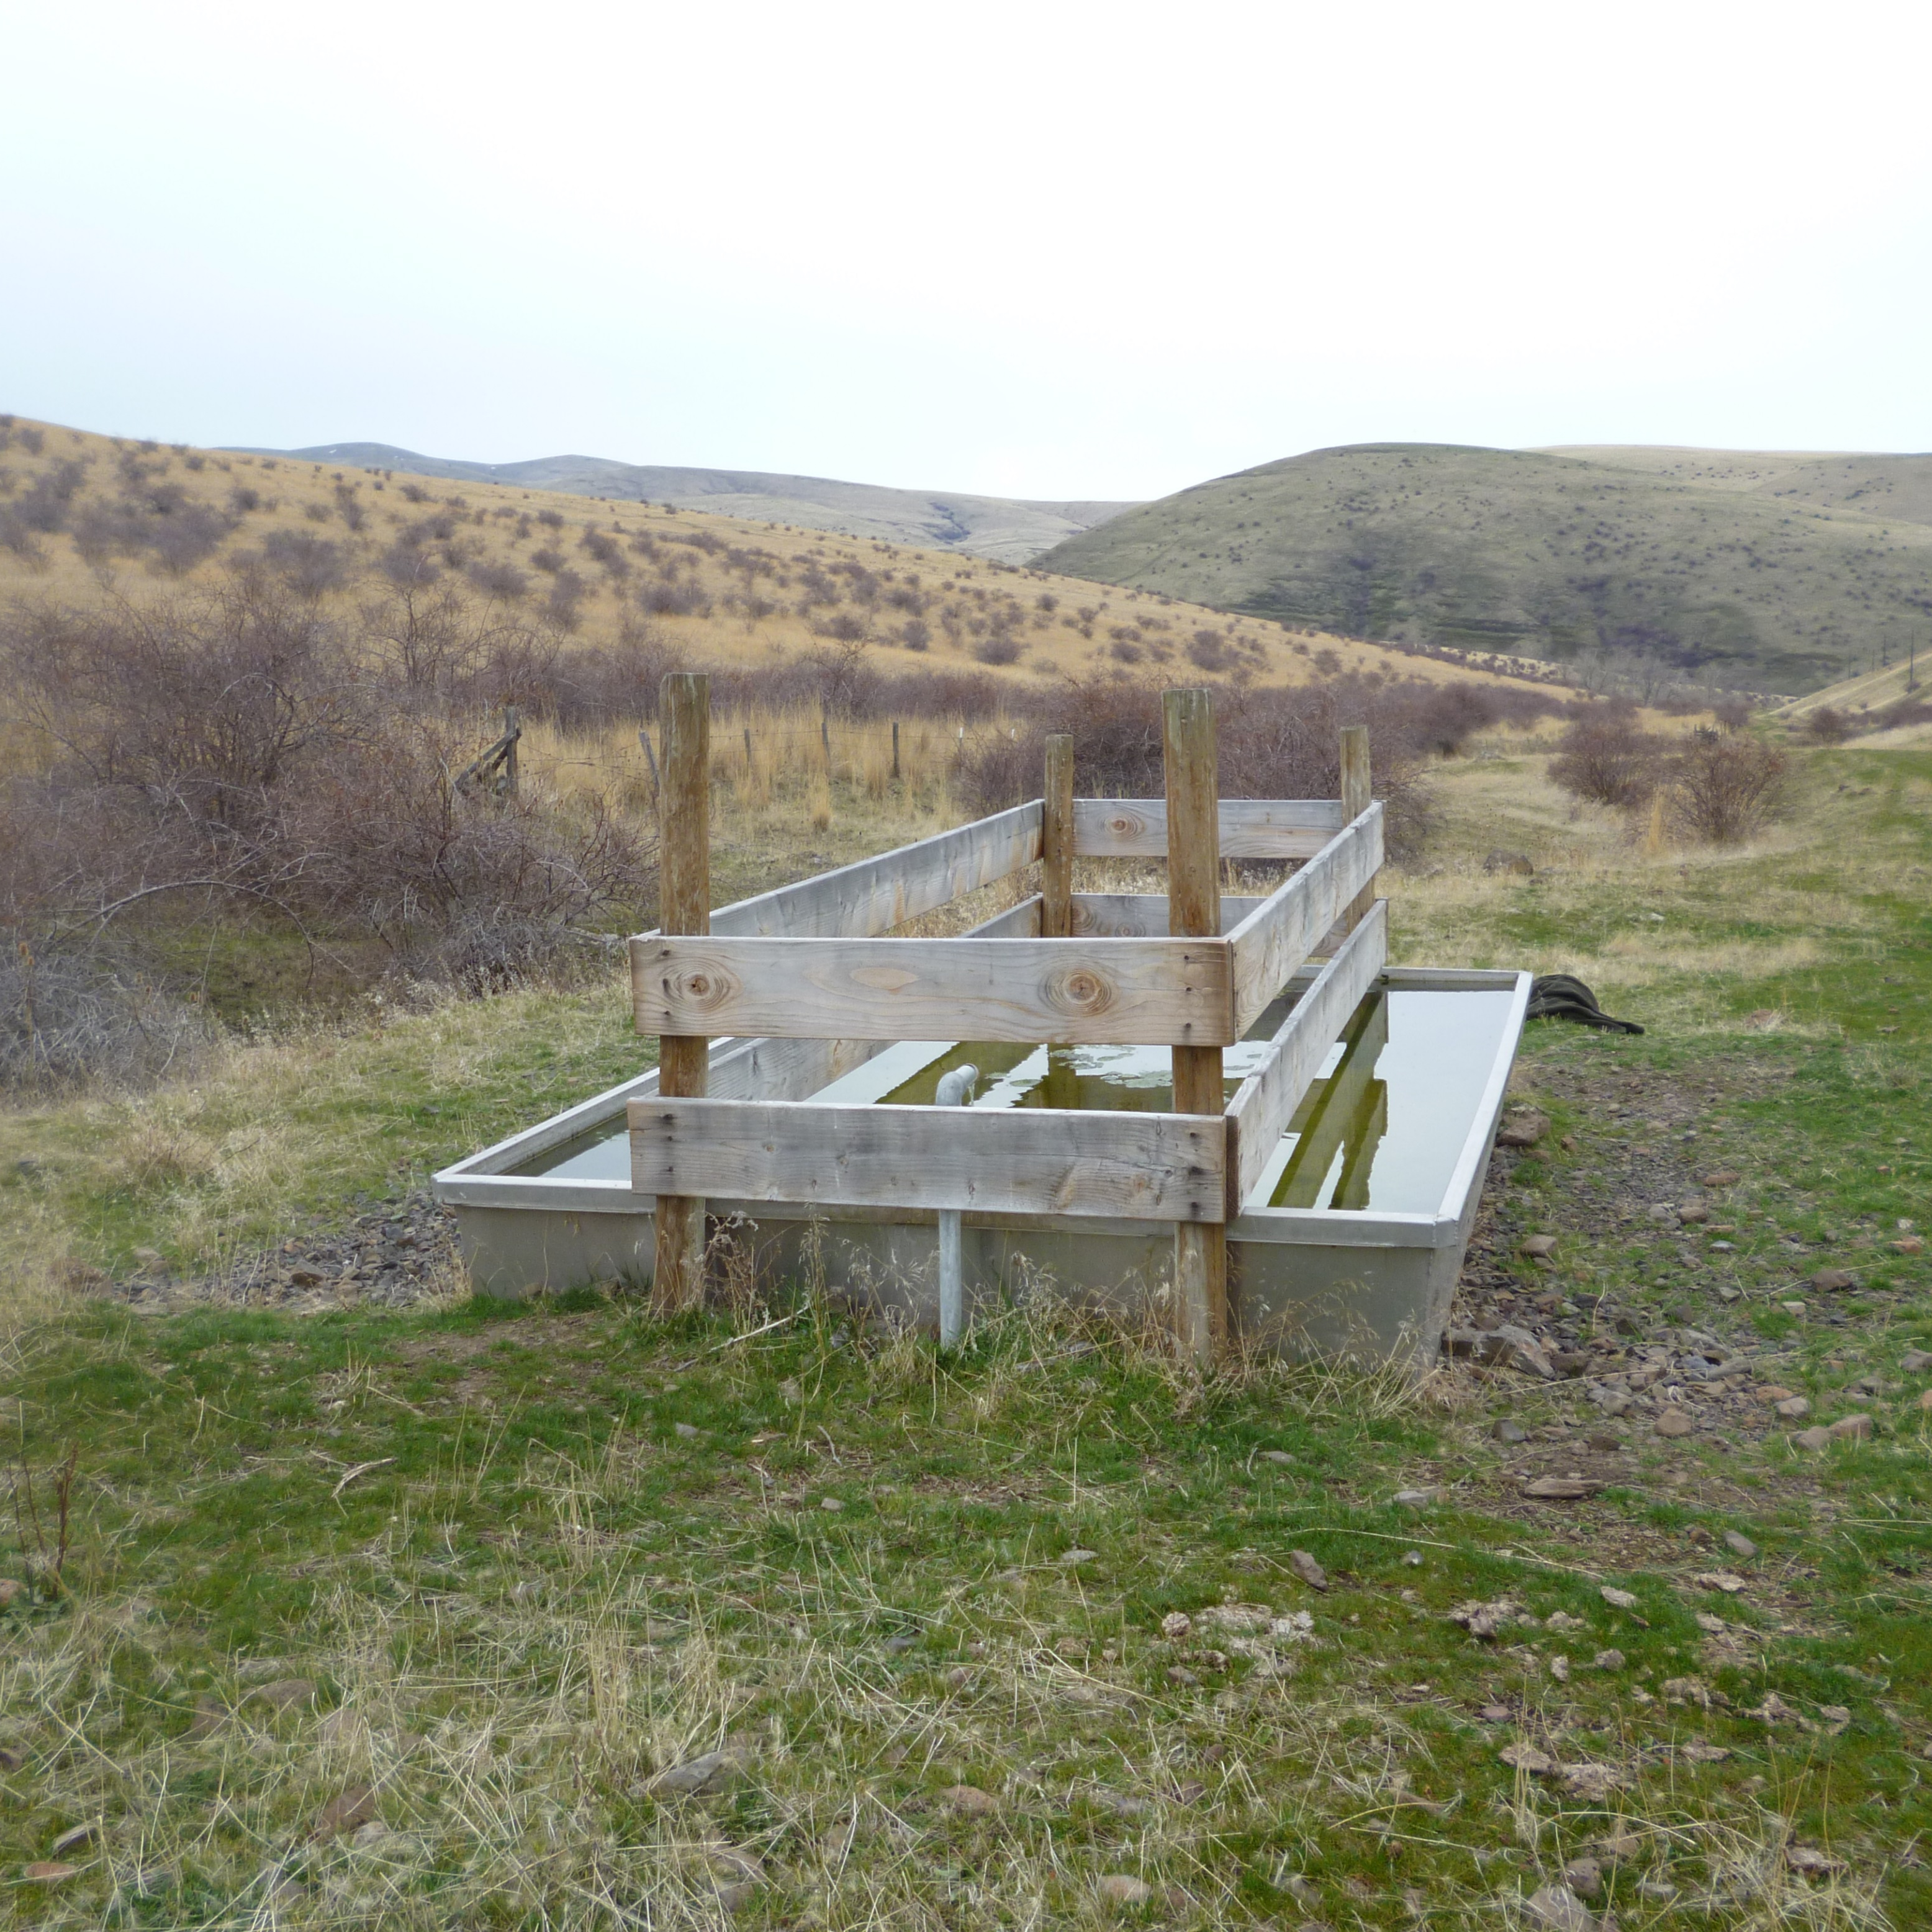
Outreach and Education
Grant Project Writing and Implementation
Technical Assistance and Collaboration

Slide 5
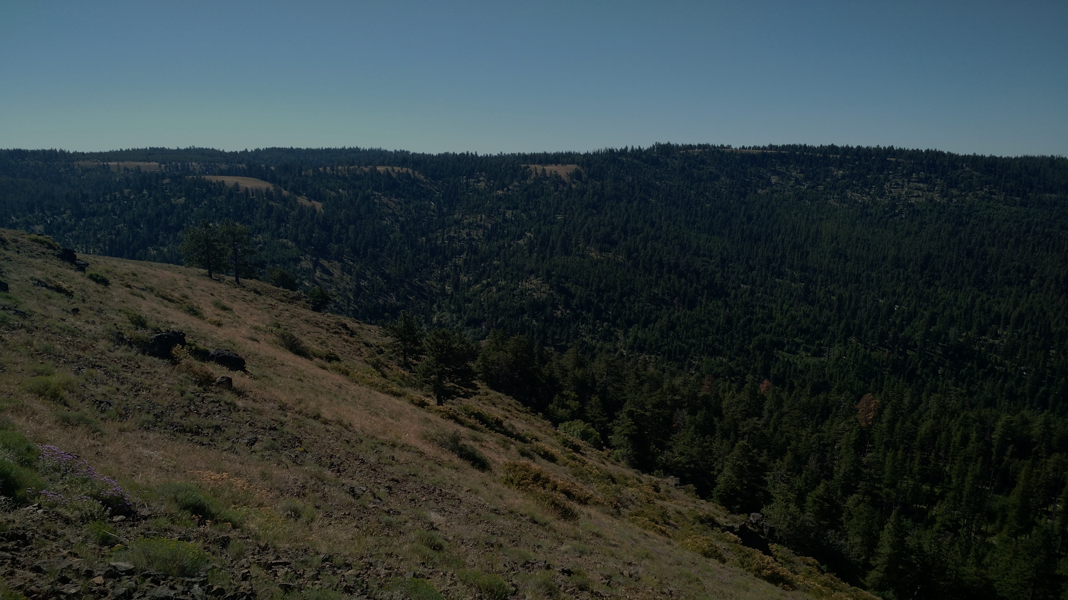
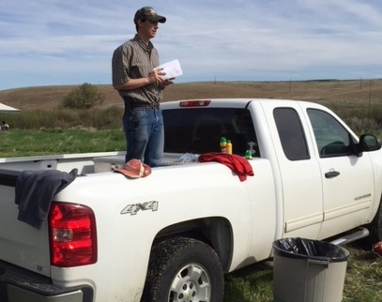
Outreach and Education
-Watershed Field Days
-Presentations/Landowner Education
-Event Information Booths
-Trainings
-”Information Hub” for available programs, dollars, and permitting

Slide 6
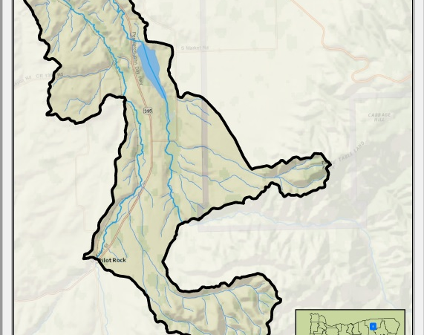
Grant Project Writing and Implementation
-OWEB Grants
-Small Grants (6 cycles)
-Large Grants (2 cycles)
-ODA Focus Areas
-ODA Strategic Implementation Areas
-FEMA, USDA, and others

Slide 7
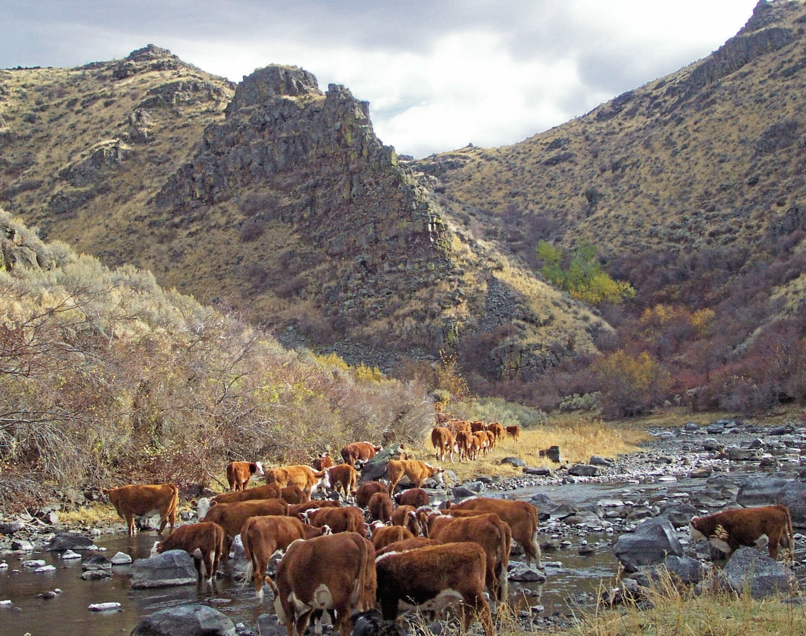
Technical Assistance and Collaboration
Working to serve the people of Umatilla County by:
-Performing Drone Mapping/Imagery Services
-Site Visit Consultations
-Contracted Project Management
-Flood Coordinator Contract with County

Slide 8
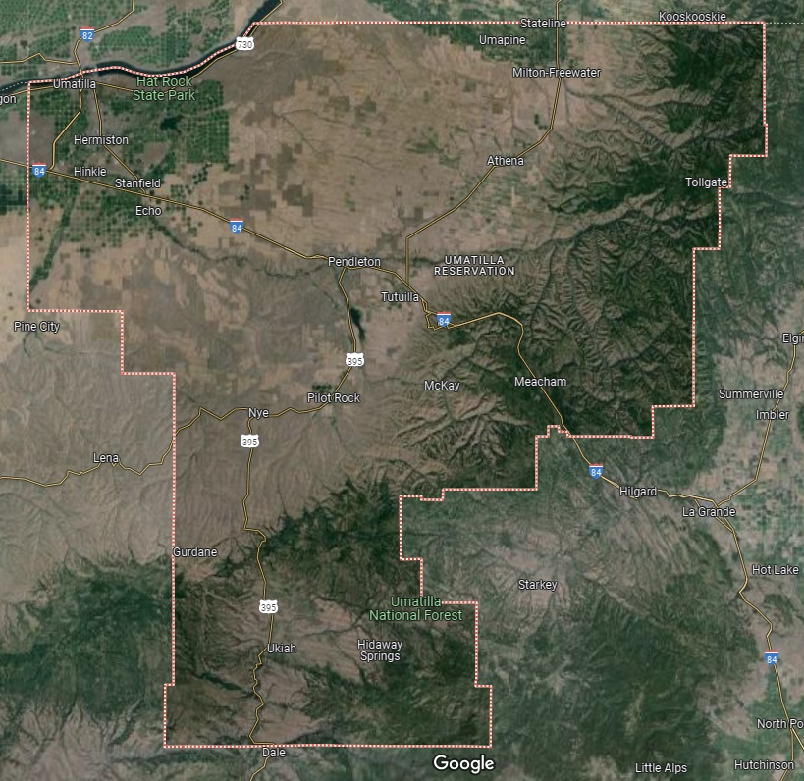
Dryland Ag
(wheat, canola)
Irrigated Ag
Greenhouse Ag
Dairies
Industrial
CAFOs
Specialty Crops
Viticulture
Orchards
Irrigated Ag
Greenhouse Ag
Specialty Crops
Rangeland and Pasture
(cattle, sheep, goats)
Irrigated Alfalfa/Grass Hay

Slide 9
2020 Flood Events
An atmospheric river dumped unprecedented rain on an already full or near-normal snowpack in February 2020.
Every stream in Umatilla County flooded, including both the Umatilla and Walla Walla River systems.
Post-event estimates record the event as a 120-year event up to a 150-year event for some streams.
Roughly $26,651,582.00 dollars in damage estimated from PDA for public infrastructure damage
$4,335,518.00 in private property damage affecting 399 homes
https://storymaps.arcgis.com/stories/cb570e3df4e14e03a096b0b920534db9

Slide 10
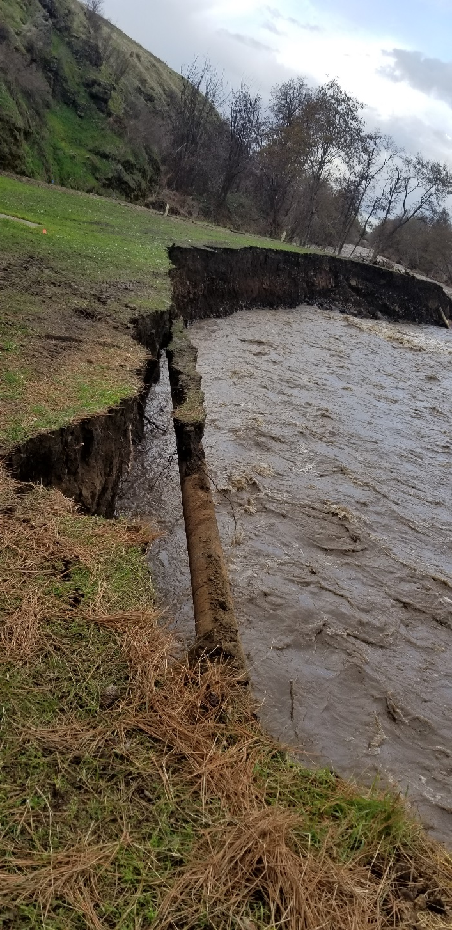
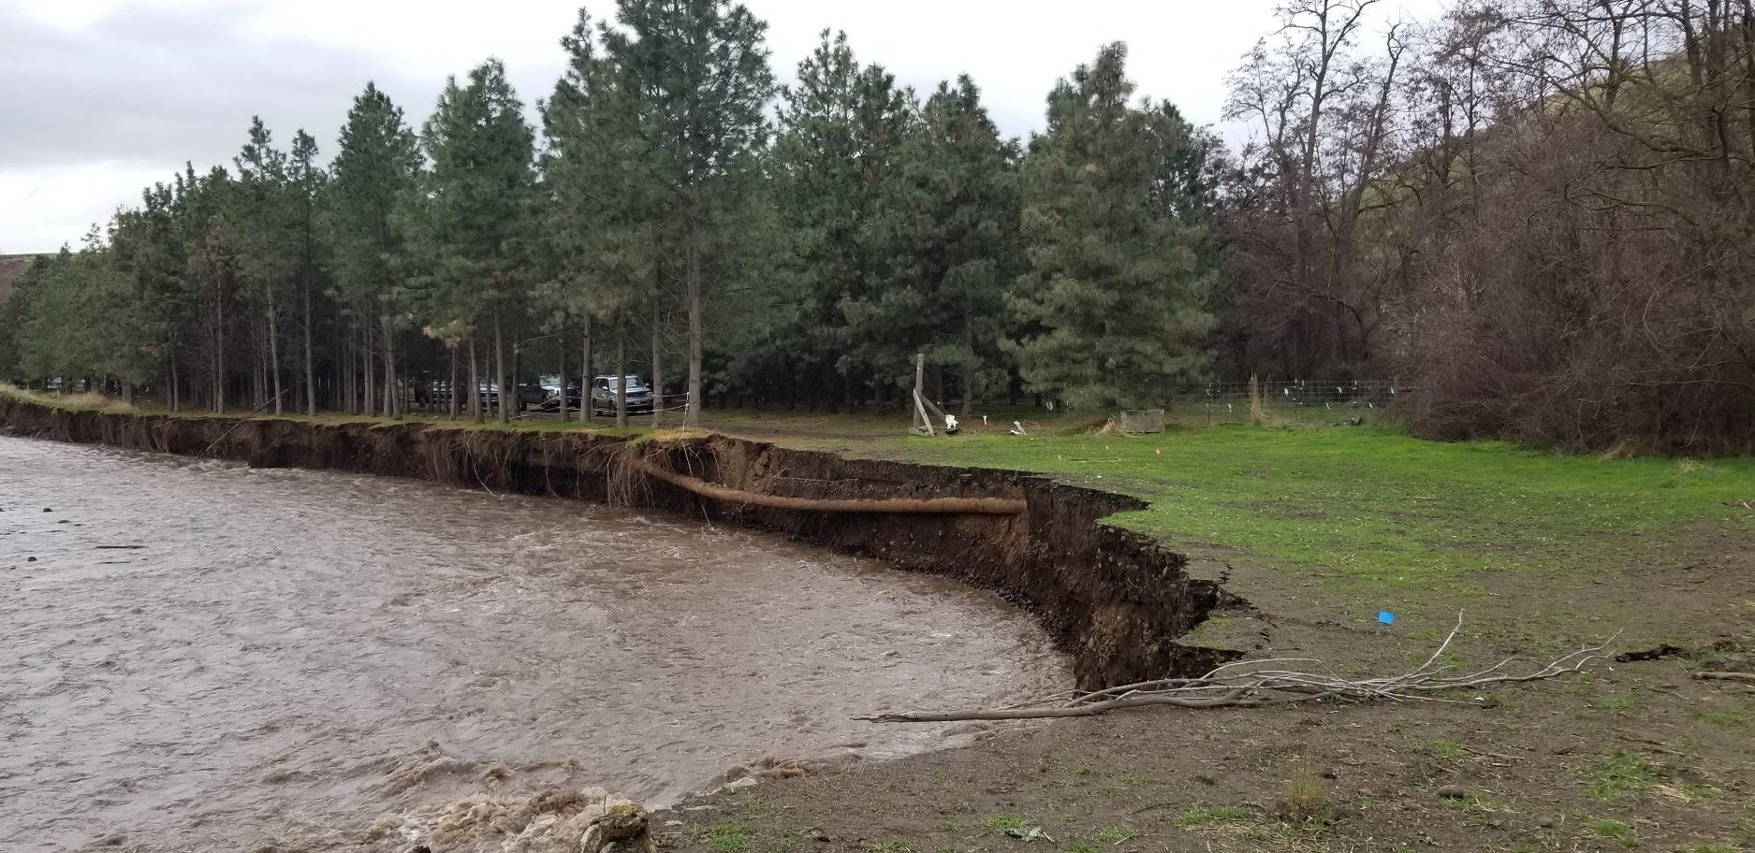
2020 Flood Event Photos
https://storymaps.arcgis.com/stories/cb570e3df4e14e03a096b0b920534db9

Slide 11
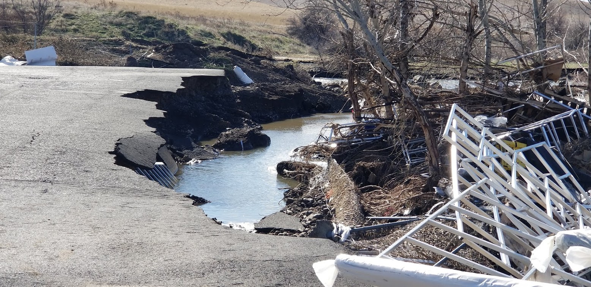
2020 Flood Events
https://storymaps.arcgis.com/stories/cb570e3df4e14e03a096b0b920534db9

Slide 12
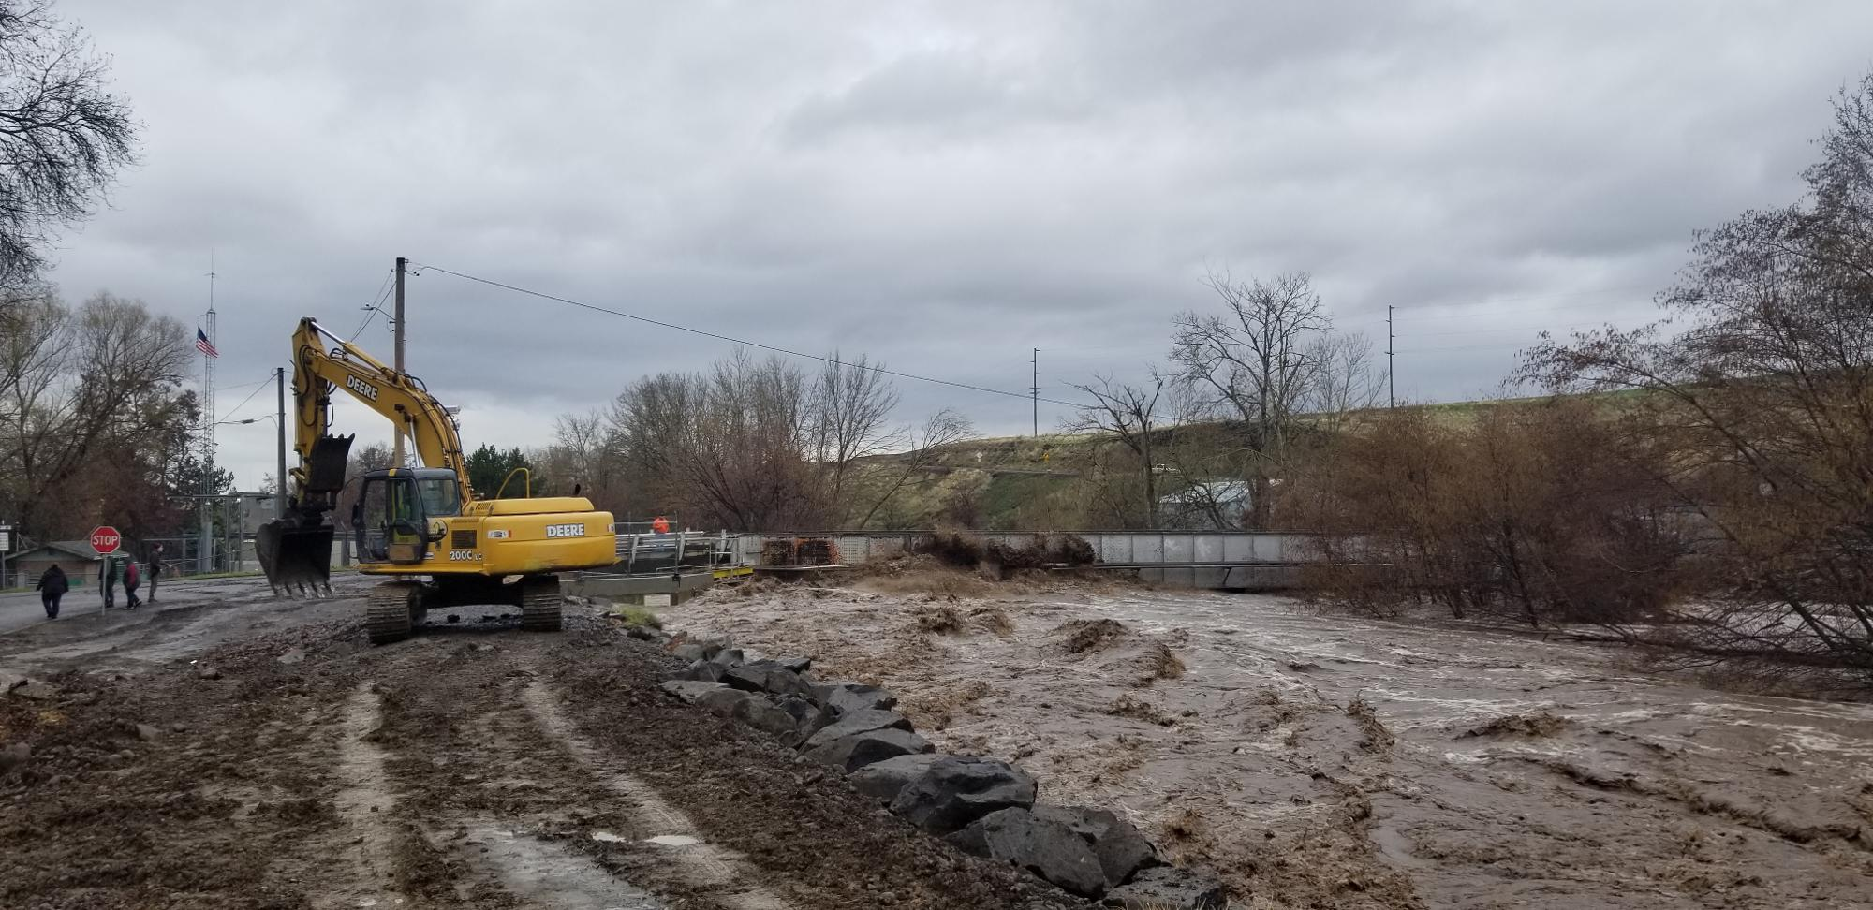
2020 Flood Events
https://storymaps.arcgis.com/stories/cb570e3df4e14e03a096b0b920534db9

Slide 13
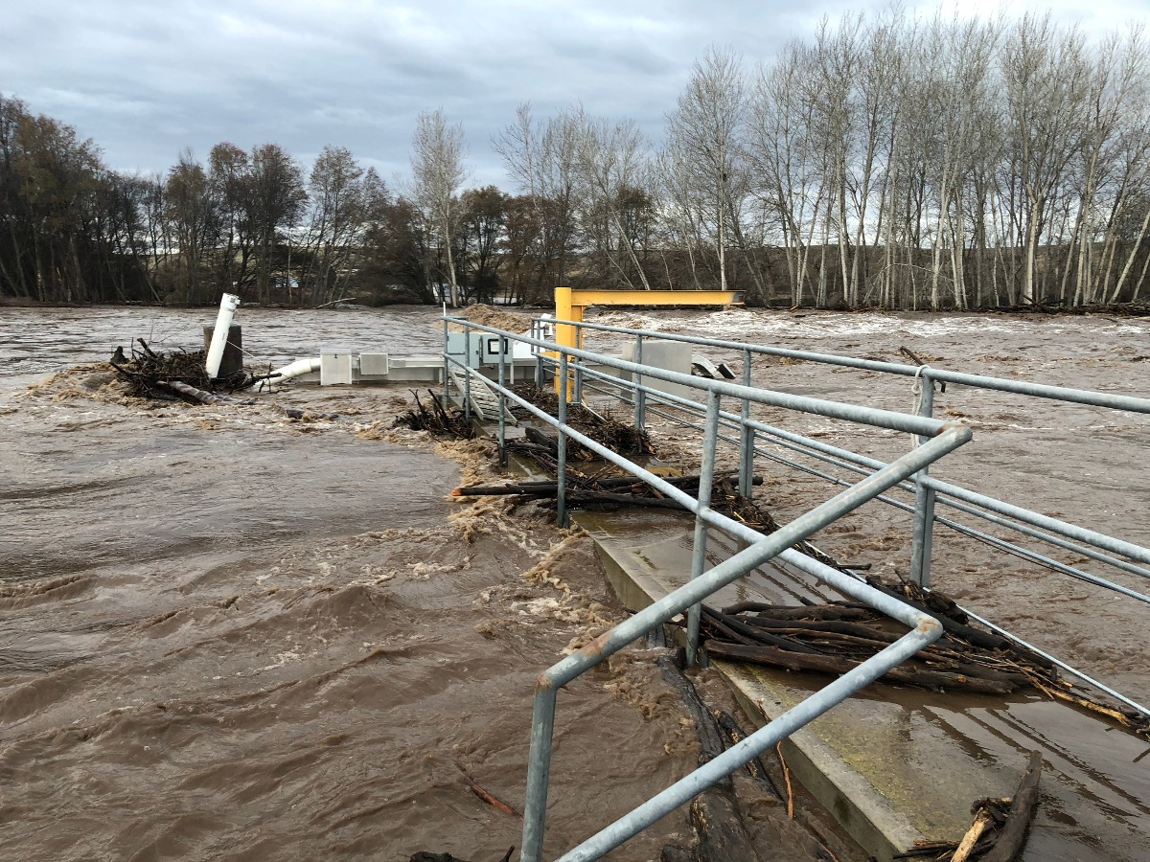
2020 Flood Events

Slide 14
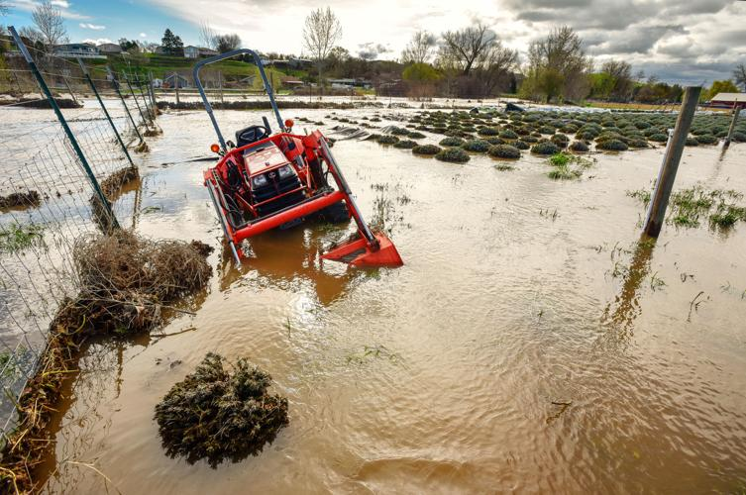
Post-Event and SWCD Involvement
Post-event, the Umatilla SWCD recognized the need for a collaborative, all-hands-on-deck approach to achieve lasting restorative solutions that protected property while also ensuring habitat restoration and expansion.
To that end, we proposed and secured an agreement with Umatilla County to take the lead on all flooding restoration projects in the county, which allowed us to act as the “point of the spear” for both landowners and municipalities affected by the flood.
Image from the East Oregonian
https://www.google.com/url?sa=i&url=https%3A%2F%2Fwww.eastoregonian.com%2Fnews%2Flocal%2Fnever-again-becomes-rally-cry-for-mckay-creek-flooding%2Farticle_c5435ffe-6142-11e9-8e4f-cf11c74494b0.html&psig=AOvVaw1MZYtQRGgWKfEPPztppHhC&ust=1724270172973000&source=images&cd=vfe&opi=89978449&ved=0CBcQjhxqFwoTCPD6iouthIgDFQAAAAAdAAAAABAE

Slide 15
Challenges
Recognizing that we needed all players at the table to tackle such a task, we called together a Umatilla County Flood Restoration Town Hall and invited all regulatory authorities, landowners, water control districts, cities, and federal authorities.
We quickly discovered that there were differing perspectives on what the restoration response to the flood should look like. However, through multiple group meetings, we were able to nail down a united approach towards some solutions.
We learned that there are four primary challenges to large-scale floodplain restoration:

Slide 16
Partnerships Permitting Cost Time
Floodplain Restoration Challenges

Slide 17
Partnerships, Permitting, Cost, and Time Expanded
Partnerships: Work within the floodplain requires excellent communication and relationships between the myriads of regulatory authorities and stakeholders, and teamwork is essential for success. Oftentimes, many of the stakeholders come to the table with entirely different goals and objectives, which may seem to oppose others.
Permitting: Work within the floodplain requires navigation of multiple permits and agencies, requiring a high level of knowledge to successfully and quickly achieve permitting authority to implement a project. The permitting process is difficult and can cost a lot of money, which can make it feel out of reach for many.
Cost: Limited grant or funding opportunities for stabilization projects coupled with the high cost of consultation and construction can make many projects unrealistic for landowners or small municipalities.
Time: Dynamic river systems and the permitting difficulties lengthen the time from project start to implementation, often preventing project achievability before the river or stream changes enough to invalidate the project.

Slide 18
Solutions

Slide 19
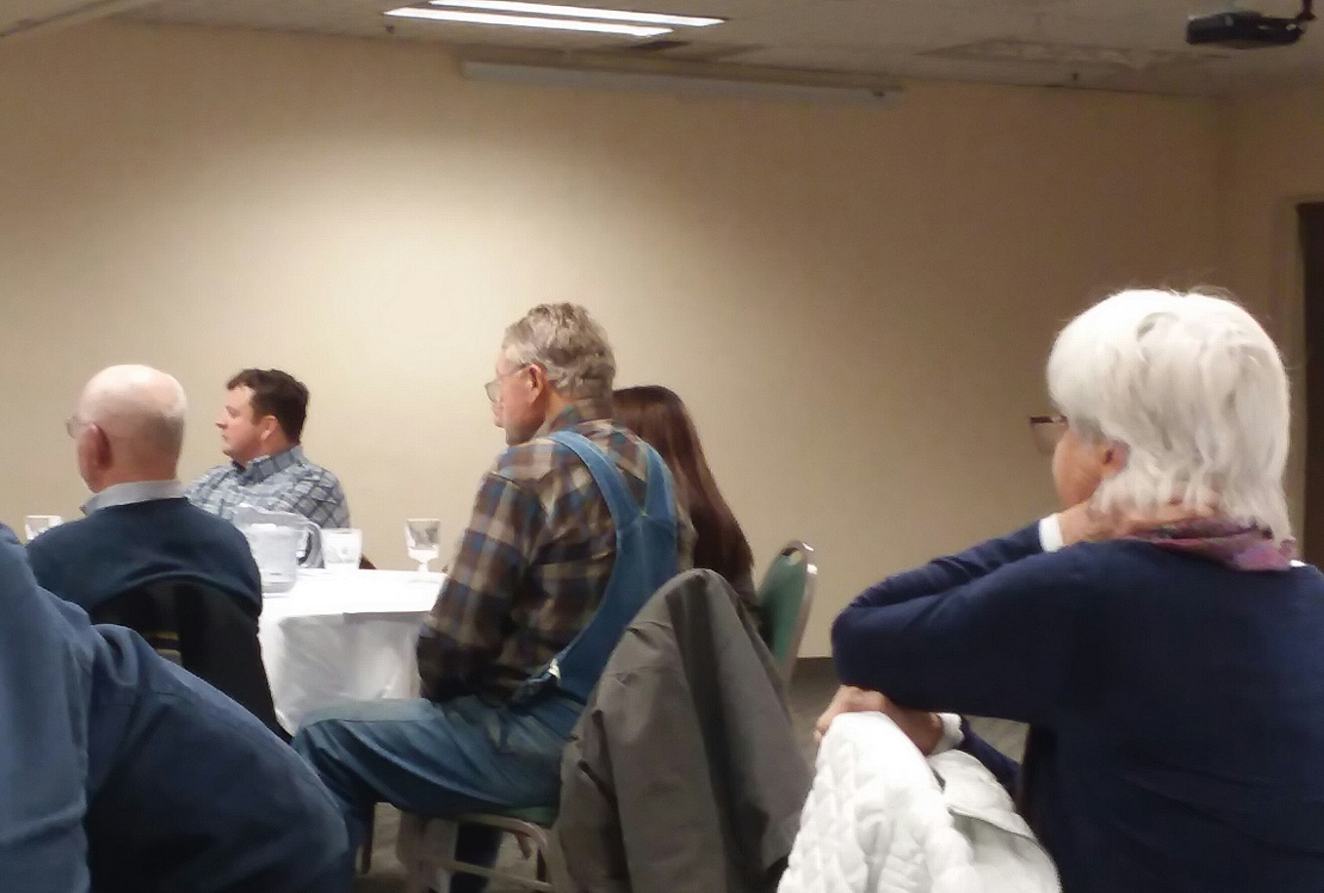
Bring All Partners to the Table
Make sure all stakeholders are included
Consider applying for a partnership grant
Designate a lead entity
This action helps address partnerships, permits, costs, and time constraints (hint: all of them!).

Slide 20
Strategize and Prioritize
Break project area down into watersheds, reaches, etc.
Develop goals for both short- and long-term solutions
Hold a brainstorming session and vet each proposed solution before the entire group, moderating decisions as needed to achieve a prioritized “to-do” list going forward
Develop a meeting schedule (e.g., Umatilla County SWCD hosts our partnership meeting about twice a year) and check on progress for each of the items and agreed-upon tasks
This action helps address partnership and time constraints.

Slide 21
Milton-Freewater
2024
Echo and Lower Umatilla
2020
Helix
2022
Athena/Weston
2026
Pilot Rock
2024
Mission/Upper Umatilla
2028
Pendleton (McKay)
2020
Ukiah
2026
Pendleton (Riverside)
2022

Slide 22
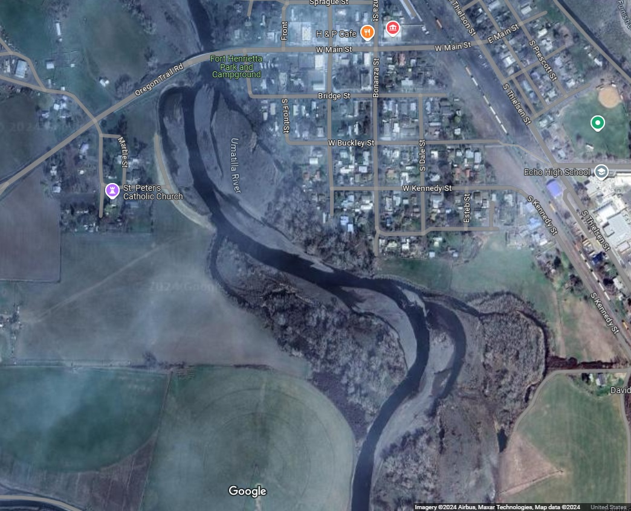
Short- and Long-Term Strategy Example: The Echo Project

Slide 23
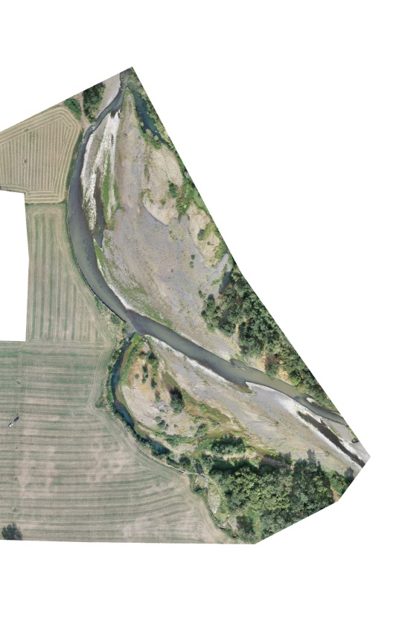
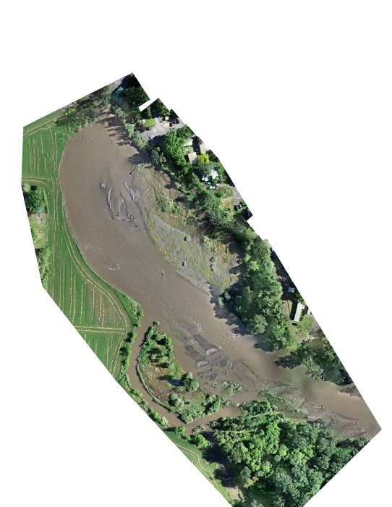
Dec 2020
April 2022

Slide 24
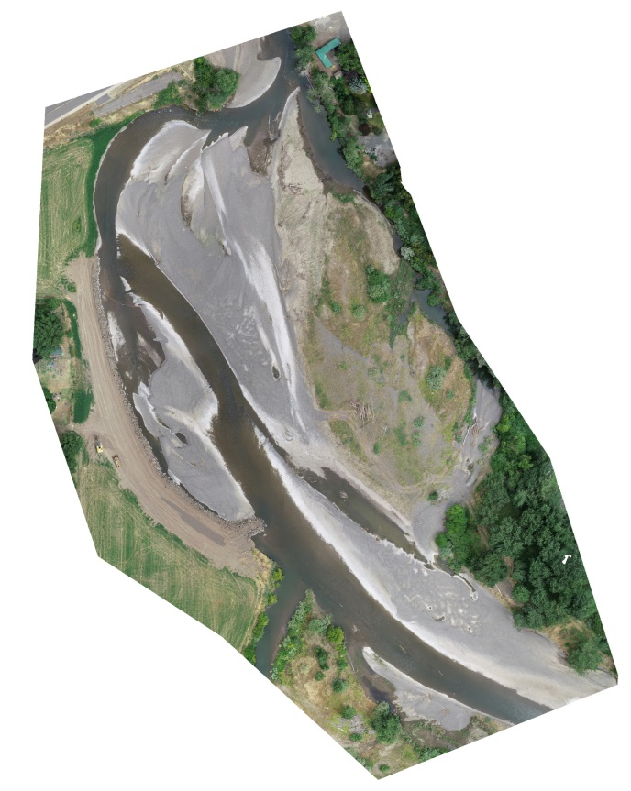
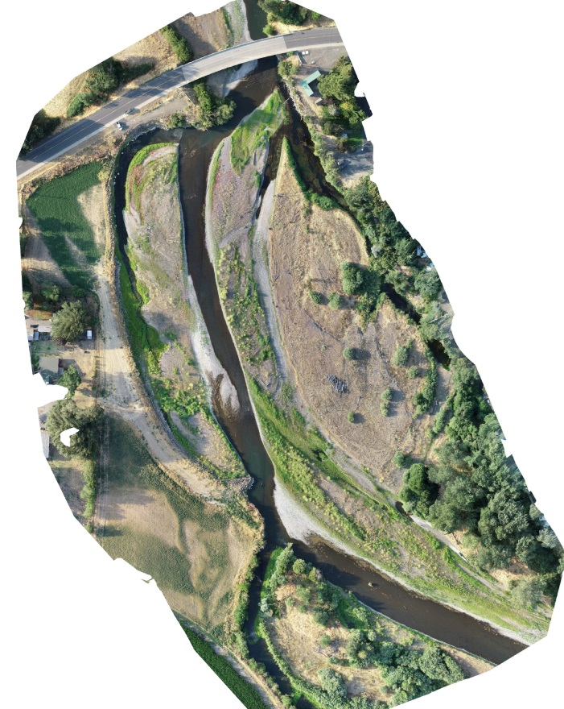
July 2022
Aug. 2024
April 2022
Emergency Implementation
Ongoing Recovery

Slide 25
Short- and Long-Term Strategy Example: The Echo Project
Short-Term
Emergency Stabilization
Long-Term
Levee Project
Long-Term
17-Mile Floodplain Reconnection and Habitat Projects

Slide 26

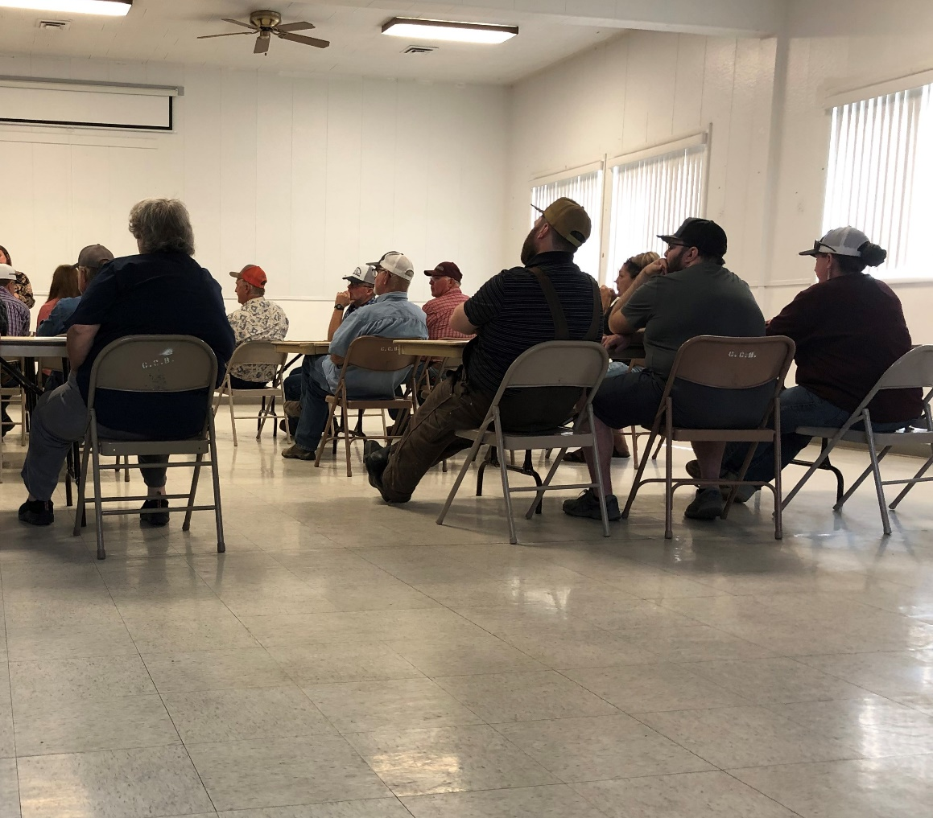
Host Permit Workshop Days
Work with the Department of State Lands, Army Corps of Engineers, County Floodplain Development, and relevant permitting/regulatory authorities to host education and outreach days
Many landowners feel powerless since they do not feel like they are capable of submitting a permit. Arming them with the knowledge of the system not only strengthens trust in the partnership but also gives them all the data to make the best decisions for their property in the larger watershed context.
Host engineering firms at the event for projects that require major design
Pursuing this solution helps address partnership, permitting, and time constraints.

Slide 27
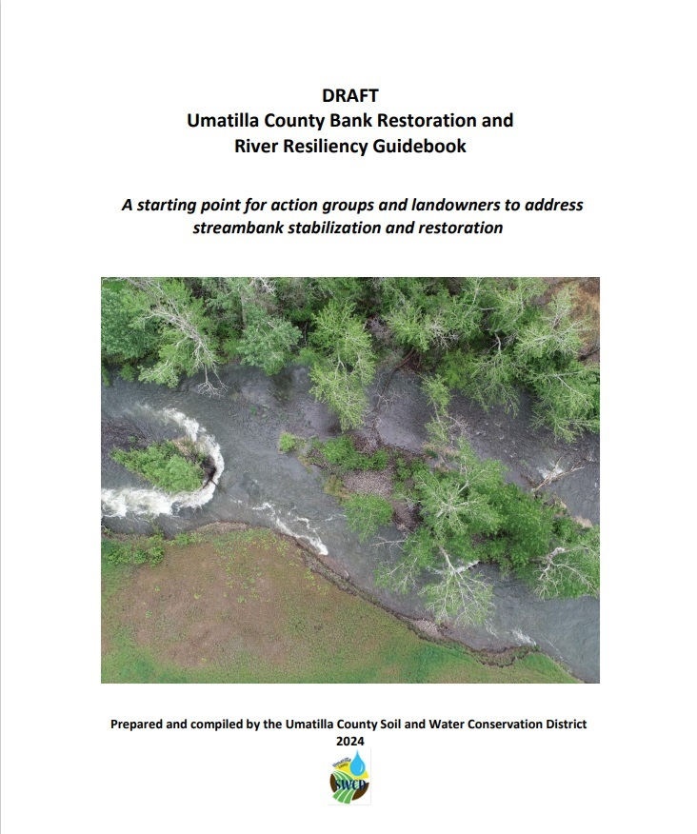
Develop an Outreach and Education Tool
Work with regulatory and notification agencies to develop a guidebook that can help an individual or municipality with no prior permit exposure to bring a project idea to a working permit design. This helps reduce the need to hire an engineering/consultant firm, which, in turn, reduces cost and time.
Beyond breaking down the basic permitting rules and condensing them into a comprehensive all-in-one source, the guidebook could contain biological opinion-approved designs and detailed drawings that meet all agency requirements with explanations of when and where to use such designs.
Pursuing this action would help address prohibitive cost and time as well as permitting challenges.

Slide 28
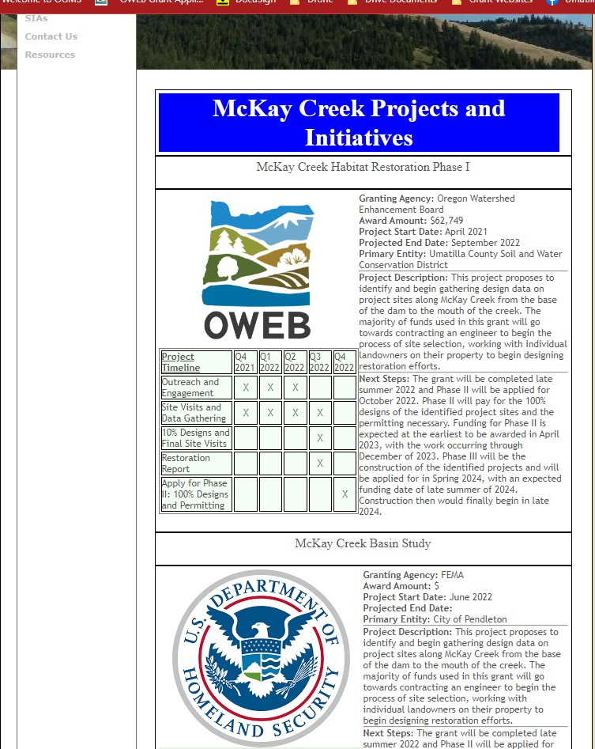
Flood Project Tracker Website
Ask lead agency to act as the host
Create a repository of all restoration and flood-recovery projects
Update monthly

Slide 29
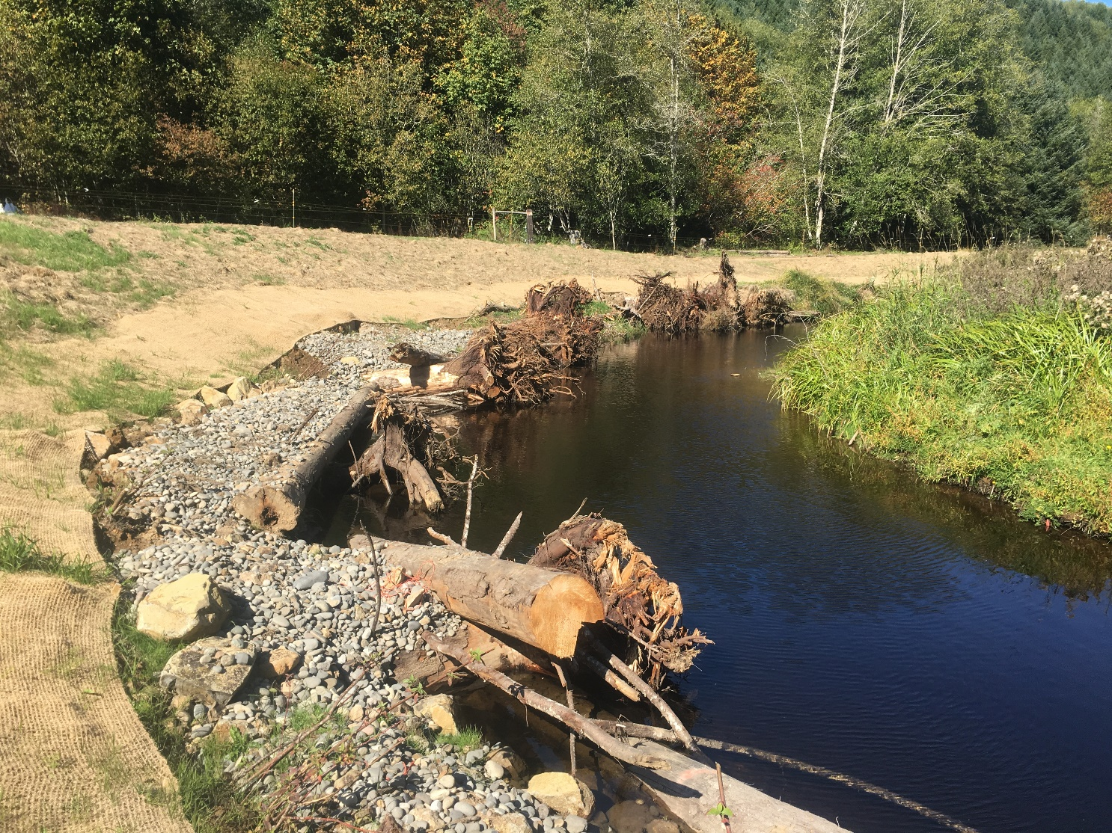
Prioritize and Apply for Funding with Partners
Partner with entities that represent a perspective you lack
Utilize partnership strategy goals, designate projects in priority, and submit projects by type:
Watershed Analysis or Assessment Project
Stakeholder Engagement Project
Design and Permit Technical Project
Restoration/Implementation Project
Don’t forget short- and long-term goals!
Pursuing this solution would help address prohibitive cost and time challenges.

Slide 30
Implement and Adapt!

Slide 31
Any Questions?
Contact:
Kyle Waggoner, District Manager
Umatilla County SWCD
1 SW Nye Ave Ste 130
Pendleton, OR 97801
541-969-0423
kwaggoner@umatillacountyswcd.com

