Slide 1

Special Districts Health Insurance Program
October 22, 2025

Slide 2

Oregon Market Overview
Notes:
To change the image on this slide, select the picture and delete it. Then click the Pictures icon in the placeholder to insert your own image.

Slide 3
Oregon Group Market
Market Segments
Small Group (1–50 employees): Community-rated, ACA-compliant plans with set benefits; limited ability to customize or manage costs.
Large Group (51+ employees): Experience-rated; more flexibility with plan design, funding (self-funded, level-funded), and wellness strategies.
Major Carrier Options
Medical: Regence, Providence, Kaiser, PacificSource, Moda, Cigna, Aetna among others
Dental/Vision: Delta Dental of Oregon, Willamette Dental, Ameritas, Lincoln, Principal, VSP, EyeMed
Ancillary/Life/Disability: The Standard (based in Oregon), Unum, MetLife, Principal, Lincoln, Hartford
Public Employees’ Benefit Board (PEBB) - Conservation Districts for the most part are eligible to participate. PEBB offers broad, standardized benefits with strong statewide networks. However, higher cost structure and limited flexibility make PEBB less attractive for smaller districts with budget constraints.
Notes:
To change the image on this slide, select the picture and delete it. Then click the Pictures icon in the placeholder to insert your own image.

Slide 4
Oregon Group Market
Considerations
Cost Pressures – Rising medical and pharmacy trends as well as network contracts
Flexibility – many districts avoid PEBB due to its standardized and costly approach, opting instead for local or group association health programs
Alternatives – Self-funded programs, associations plans or captives can provide more stability and long-term cost control
ICHRAs – Individual Coverage Reimbursement Arrangements have become more popular allowing employers to offer benefit programs to employees
Around 30 years ago, there were a few special districts that were granted membership into CIS. Currently, only cities and counties that are members of the League of Oregon Cities and Association of Oregon Counties are eligible to be members of CIS. Conservation Districts are not eligible for CIS membership, just like Cities and Counties aren’t eligible for Special Districts membership.
Conservation Districts are eligible for PEBB (Public Employees Benefit Board)
Notes:
To change the image on this slide, select the picture and delete it. Then click the Pictures icon in the placeholder to insert your own image.

Slide 5
Oregon Individual Market
Market Structure
Oregon operates in the federal marketplace (HealthCare.gov) for individual and family plans.
Carriers are required to offer standardized ACA-compliant plans (no medical underwriting; coverage guaranteed regardless of health status).
Major Carriers in 2025
Providence Health Plan
Kaiser Permanente
Moda Health
Regence BlueCross BlueShield of Oregon
PacificSource
BridgeSpan
Plan Features
Essential Health Benefits (EHBs) included in all plans (preventive care, maternity, mental health, Rx, pediatric dental/vision).
Premiums based on age, tobacco status, and geography; no variation by gender or health status.
Trends
Stable but rising premiums.
Plans offer narrow network plans designed to keep premiums competitive.
Growing use of ICHRA (Individual Coverage HRA) by small and mid-sized employers as a cost-control strategy.
Notes:
To change the image on this slide, select the picture and delete it. Then click the Pictures icon in the placeholder to insert your own image.

Slide 6
Oregon Individual Market
Affordability considerations
Enrollees may qualify for federal premium tax credits and cost-sharing reduction if income is with ACA subsidy ranges
ACA Subsidy Eligibility (2025)
Premium Tax Credits (subsidy for monthly premiums):
Available if household income is between 100% and 400% of the FPL.
Cost-Sharing Reductions (lower deductibles, copays, OOP max):
Available if household income is between 100% and 250% of the FPL.
Must enroll in a Silver-tier plan to access these benefits.
2025 Federal Poverty Level ranges (lower 48 and D.C.)
Household Size | 100% FPL | 250% FPL | 400% FPL
1 person | $15,060 | $37,650 | $60,240
2 people | $20,440 | $51,100 | $81,760
3 people | $25,820 | $64,550 | $103,280
4 people | $31,200 | $78,000 | $124,800
5 people | $36,580 | $91,450 | $146,320
Notes:
To change the image on this slide, select the picture and delete it. Then click the Pictures icon in the placeholder to insert your own image.

Slide 7
SDIS Medical – Regence and First Choice Heath
Notes:
To change the image on this slide, select the picture and delete it. Then click the Pictures icon in the placeholder to insert your own image.

Slide 8
SDIS Medical
Carrier Options - Regence BCBS of Oregon and First Choice Health administered by EBMS
16 Plan options under Regence BCBS of OR (15 PPO plans, 1 HSA qualified plan)
16 Plan options under FCH (15 PPO plans, 1 HSA qualified plan)
Deductible levels range from $200 – 5,500 per year for PPO Plans and $3,300 for HSA qualified plans
Features include:
$0 Telehealth visits for both medical and behavioral health through integrated virtual care providers
Massage therapy for medically necessary care (services billed through a licensed medical provider)
EAP through Canopy for all districts not already covered through the Public Safety EAP program
Virtual Physical Therapy
Enhanced Chiro and Acupuncture benefits - 30 visits
Fertility Support Benefit – NEW as of 7/1/2025
Plans include Prescription drug coverage and Vision coverage.
Notes:
To change the image on this slide, select the picture and delete it. Then click the Pictures icon in the placeholder to insert your own image.

Slide 9
SDIS - Delta Dental of OR and Willamette Dental
Notes:
To change the image on this slide, select the picture and delete it. Then click the Pictures icon in the placeholder to insert your own image.

Slide 10
SDIS Dental
2 Carrier Options – Delta Dental of Oregon and Willamette Dental
Delta Dental plans offer the Premier network (which is their broadest network option), 2 plan options with a $1,500 annual maximum and 2 plan (options with a $2,000 annual maximum (Orthodontia coverage available for districts with 15 or more enrolled employees)
Willamette Dental plans offer coverage at Willamette Dental Group facilities in our region. The plan designs don’t have an annual maximum; the coverage is available as long as you need it and you pay cost shares according to the services you receive.
Notes:
To change the image on this slide, select the picture and delete it. Then click the Pictures icon in the placeholder to insert your own image.

Slide 11
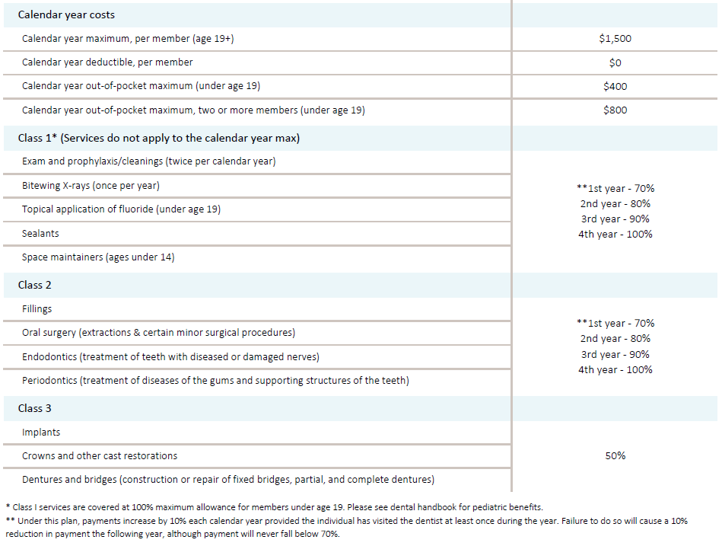
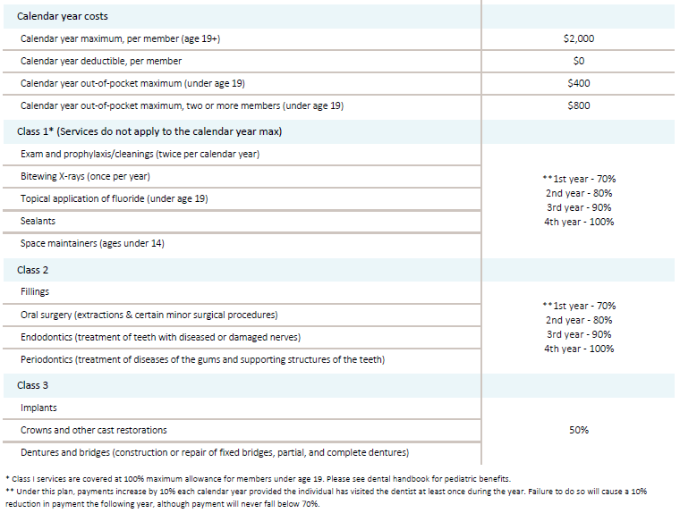
Dental Plan/Benefit Highlights
Incentive Plan $1,500
$0 calendar year deductible
$1,500 annual maximum
Incentive Plan $2,000
$0 calendar year deductible
$2,000 annual maximum
Optional: 50% up to $1,500 orthodontia lifetime maximum
Optional: 50% up to $2,000 orthodontia lifetime maximum

Slide 12
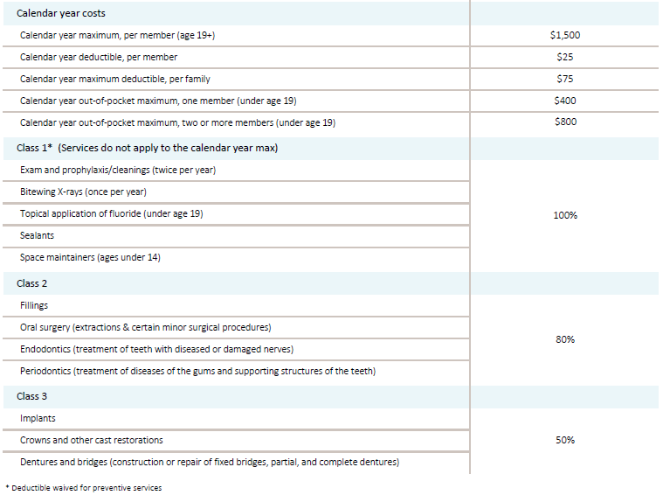
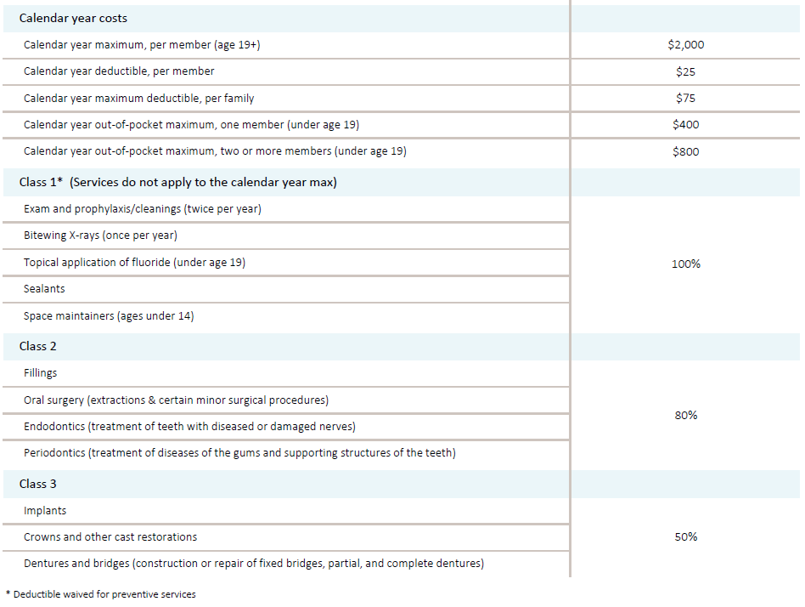
Dental Plan/Benefit Highlights
Constant Plan $1,500
$25 calendar year deductible per member, $75 per family
$1,500 annual maximum
Constant Plan $2,000
$25 calendar year deductible per member, $75 per family
$2,000 annual maximum
Optional: 50% up to $1,500 orthodontia lifetime maximum
Optional: 50% up to $2,000 orthodontia lifetime maximum

Slide 13
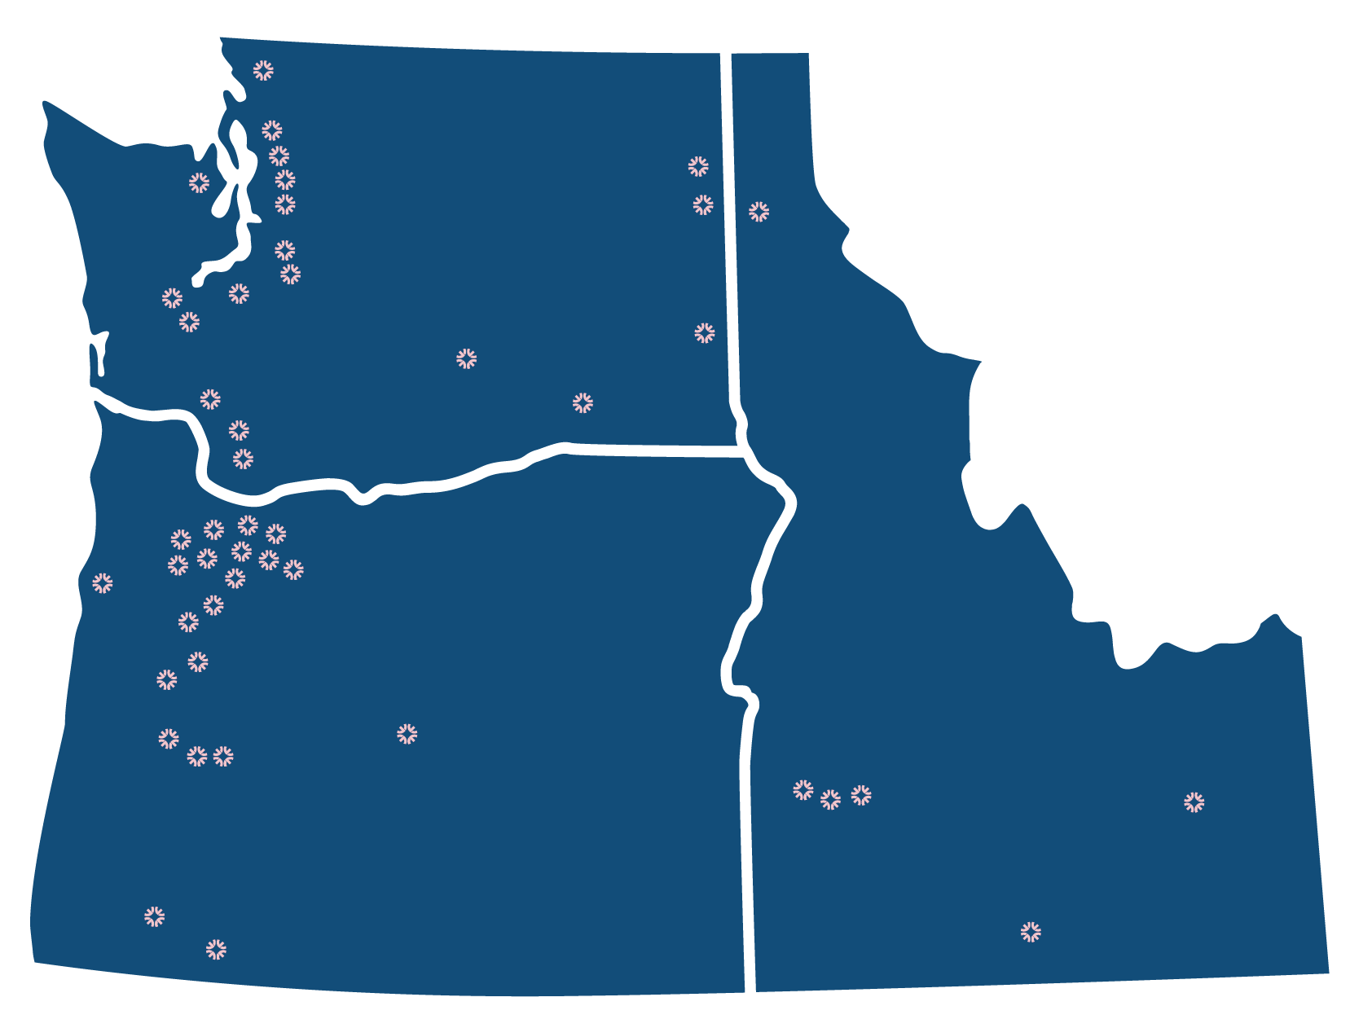
Office locations and hours
EXTENDED OFFICE HOURS M-F, 7:00 AM – 5:30 PM SELECT SATURDAYS
Washington 19 offices Locations from Bellingham to Vancouver, Silverdale to Spokane
Oregon 21 offices Locations on the I-5 corridor, from Portland to Medford, Bend to Lincoln City
Idaho 6 offices Boise, Nampa, Meridian, Twin Falls, Idaho Falls, Coeur d’Alene
General Care All offices Our general dentists provide outstanding care
Specialty Care Select offices Highly trained specialists including orthodontists, endodontists, oral surgeon & periodontists

Slide 14
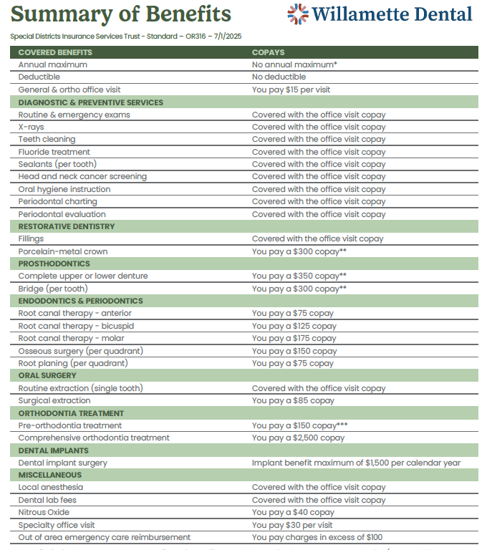
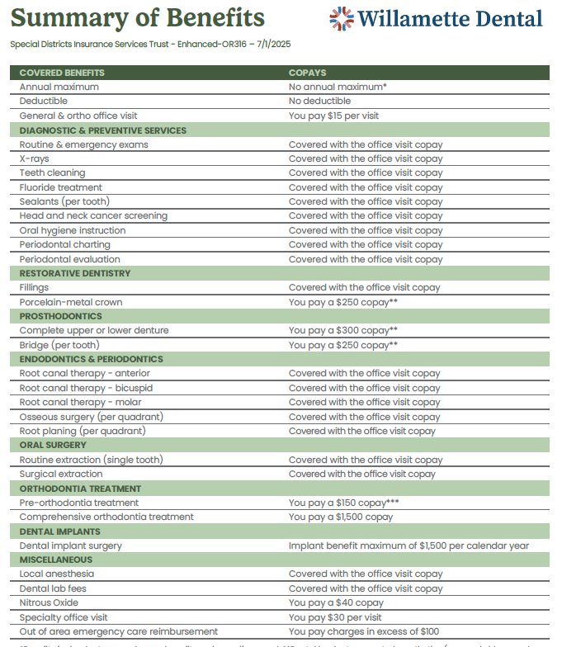

Slide 15
SDIS - Life Insurance and Disability Insurance / The Standard
Notes:
To change the image on this slide, select the picture and delete it. Then click the Pictures icon in the placeholder to insert your own image.

Slide 16
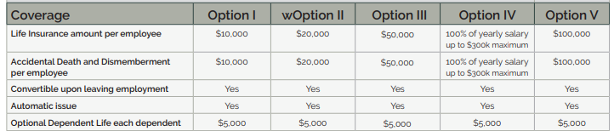
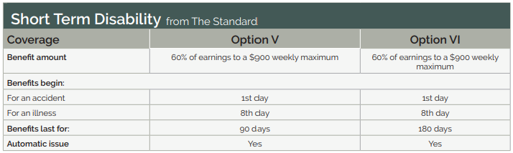
SDIS Life Insurance and Disability Insurance
Coverage offered through The Standard
Group Life Options
Group Short Term Disability Options
Notes:
To change the image on this slide, select the picture and delete it. Then click the Pictures icon in the placeholder to insert your own image.

Slide 17
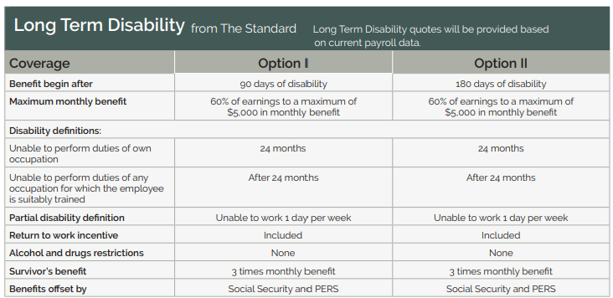
SDIS Life Insurance and Disability Insurance
Coverage offered through The Standard
Group Long Term Disability
Notes:
To change the image on this slide, select the picture and delete it. Then click the Pictures icon in the placeholder to insert your own image.

Slide 18
SDIS - Canopy EAP
Notes:
To change the image on this slide, select the picture and delete it. Then click the Pictures icon in the placeholder to insert your own image.

Slide 19
Canopy EAP
All districts enrolled in an SDIS medical plan (not already covered under the First Responder EAP) are eligible for the Canopy EAP program
There is NO ADDITIONAL CHARGE!
Notes:
To change the image on this slide, select the picture and delete it. Then click the Pictures icon in the placeholder to insert your own image.

Slide 20














UPDATED - Canopy Service Summary
Free and Confidential
Resources for Life
Mental Health Counseling
Up to six (6) counseling sessions per incident, per year
Behavioral Coaching
Up to six (6) coaching session to support personal goal
Crisis Counseling 24/7/365
Member Site Register with Company Name:
SDIS
Childcare
Adult care
Unlimited financial coaching
Legal referrals and forms
Identity theft services
Fertility health support
Pet insurance discounts
Home ownership program
Wellness & gym membership discounts
Resource retrieval

Slide 21

Information and Contacts:
Introduction to Program and Services
https://www.sdao.com/introduction-to-programs-and-services
Shelly Barker, SDAO - Benefits Manager
sbarker@sdao.com
Rey Perez, TPG - Program Promotion
rperez@tpgrp.com
503.941.4367 for regional webinar in March; ad
Notes:
To change the image on this slide, select the picture and delete it. Then click the Pictures icon in the placeholder to insert your own image.

Slide 22
Administered By Special Districts Association of Oregon
1.800.285.5461
sdao@sdao.com
For more information about our services available to our member districts, visit:
www.sdao.com

