Slide 1

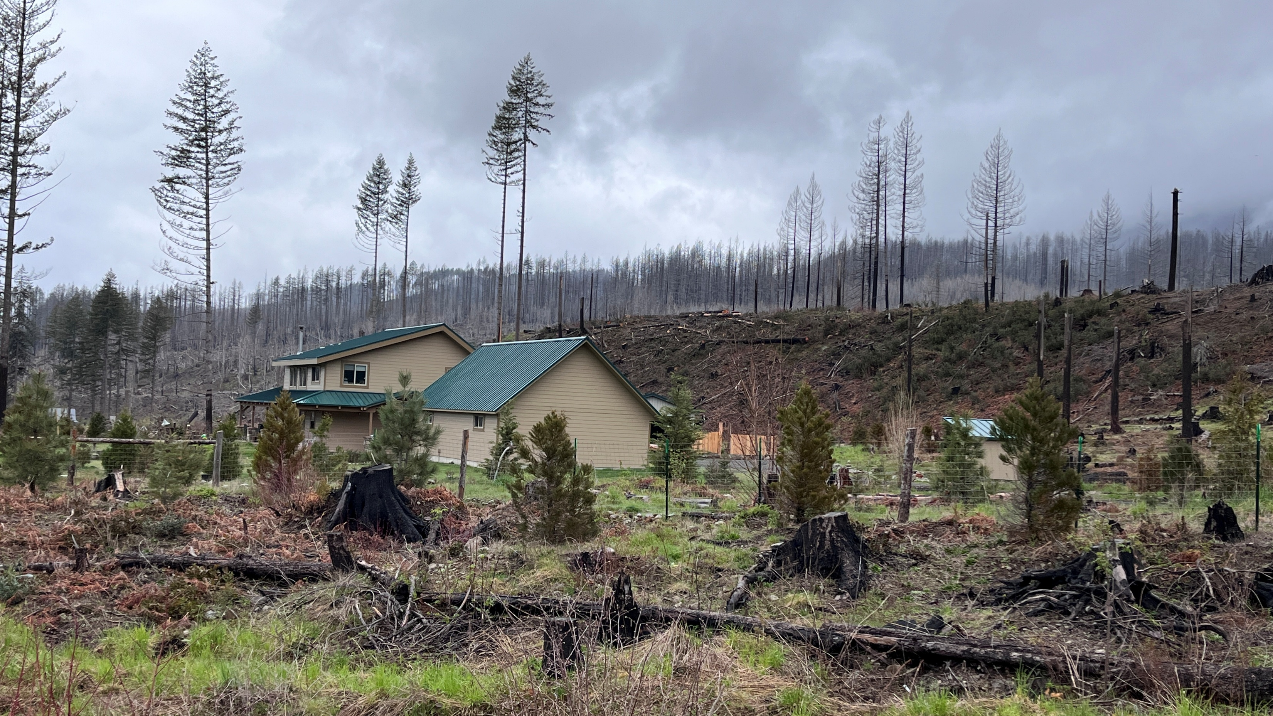

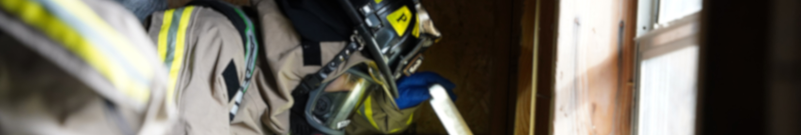
OREGON STATE FIRE MARSHAL
Community Wildfire Risk Reduction Unit
Jen Warren
Statewide Program Coordinator
Presenter

Slide 2
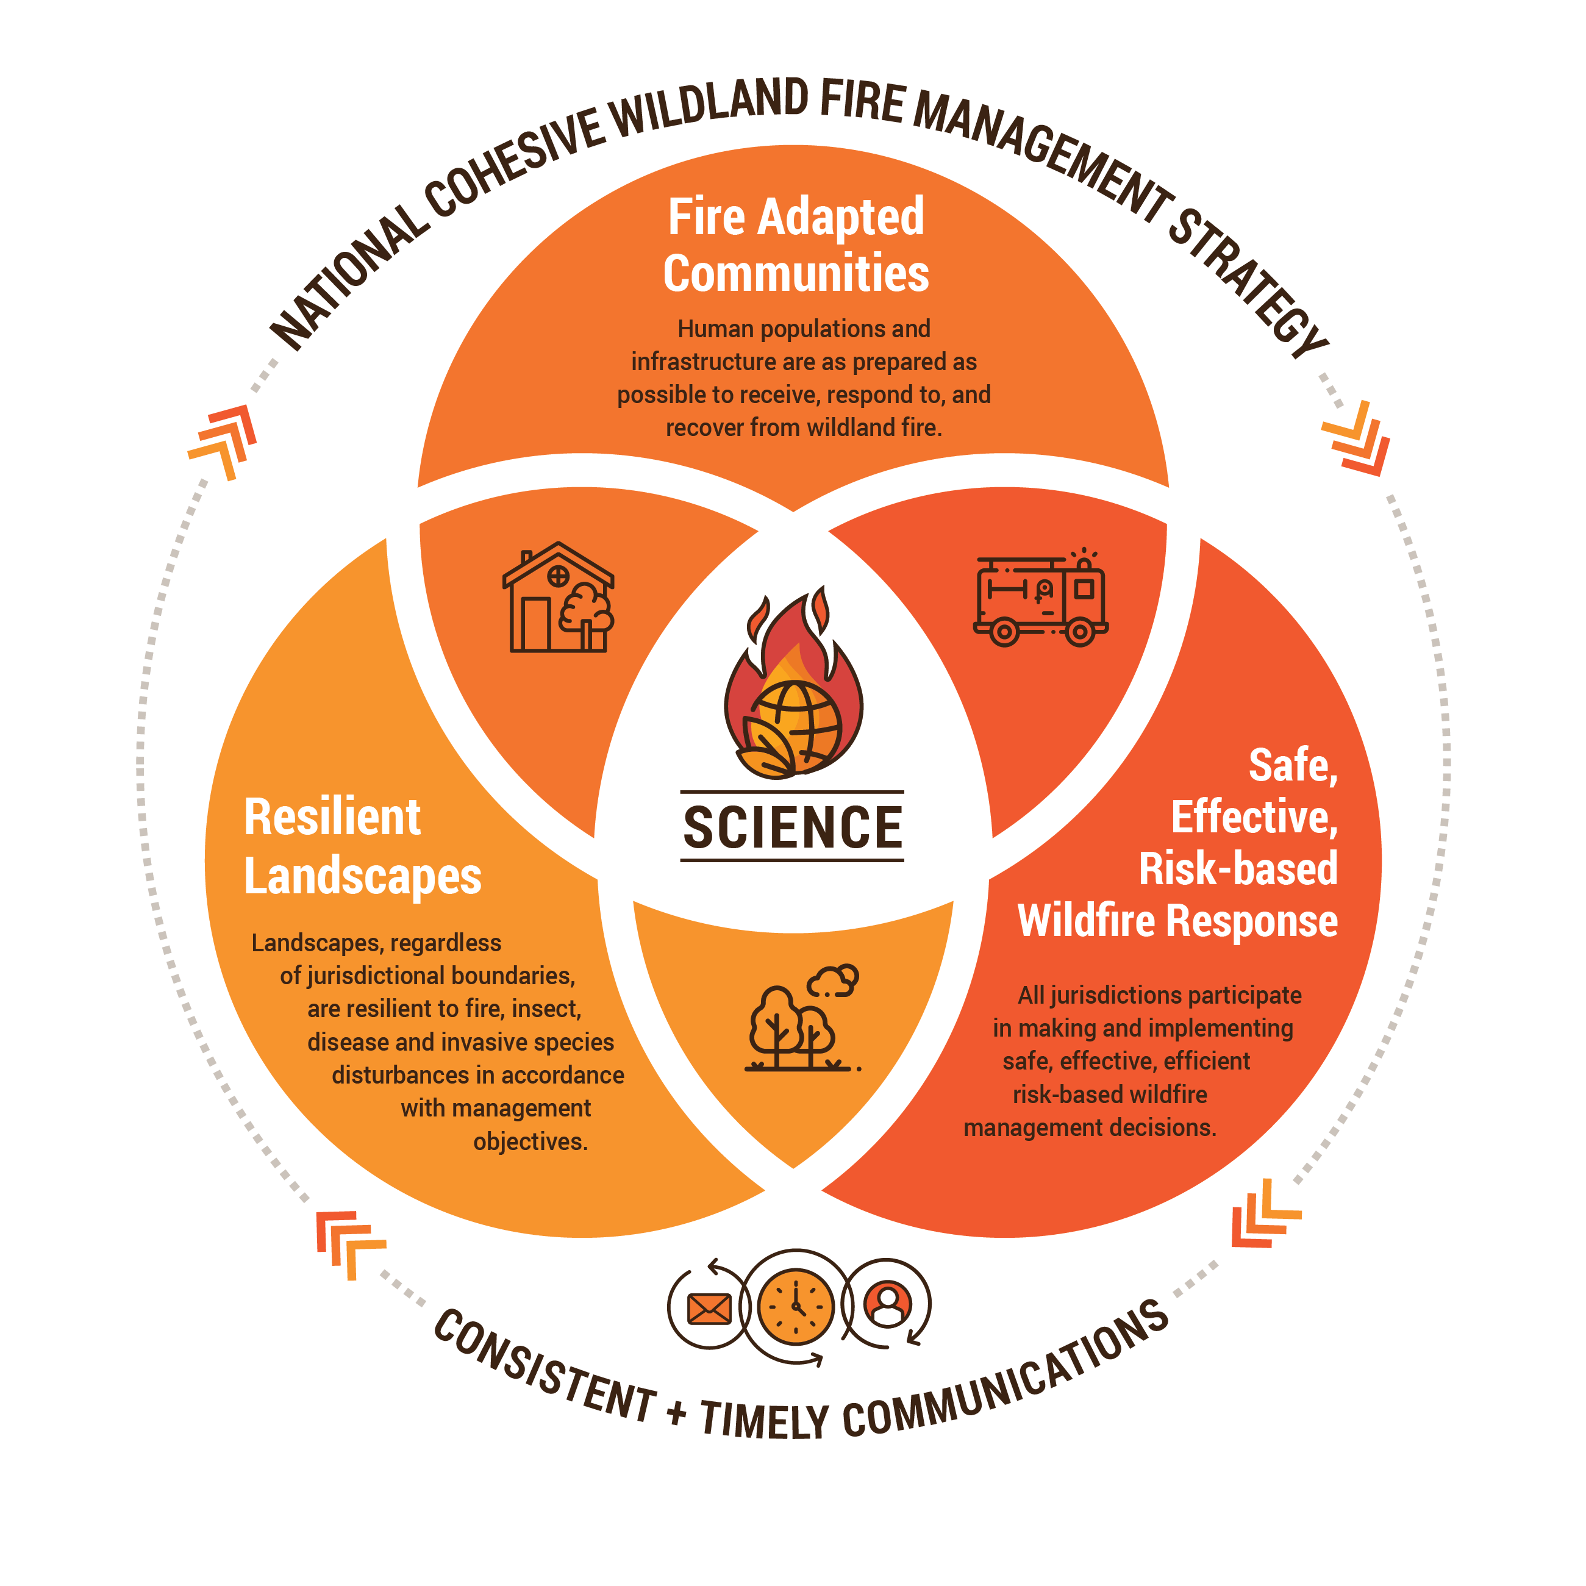
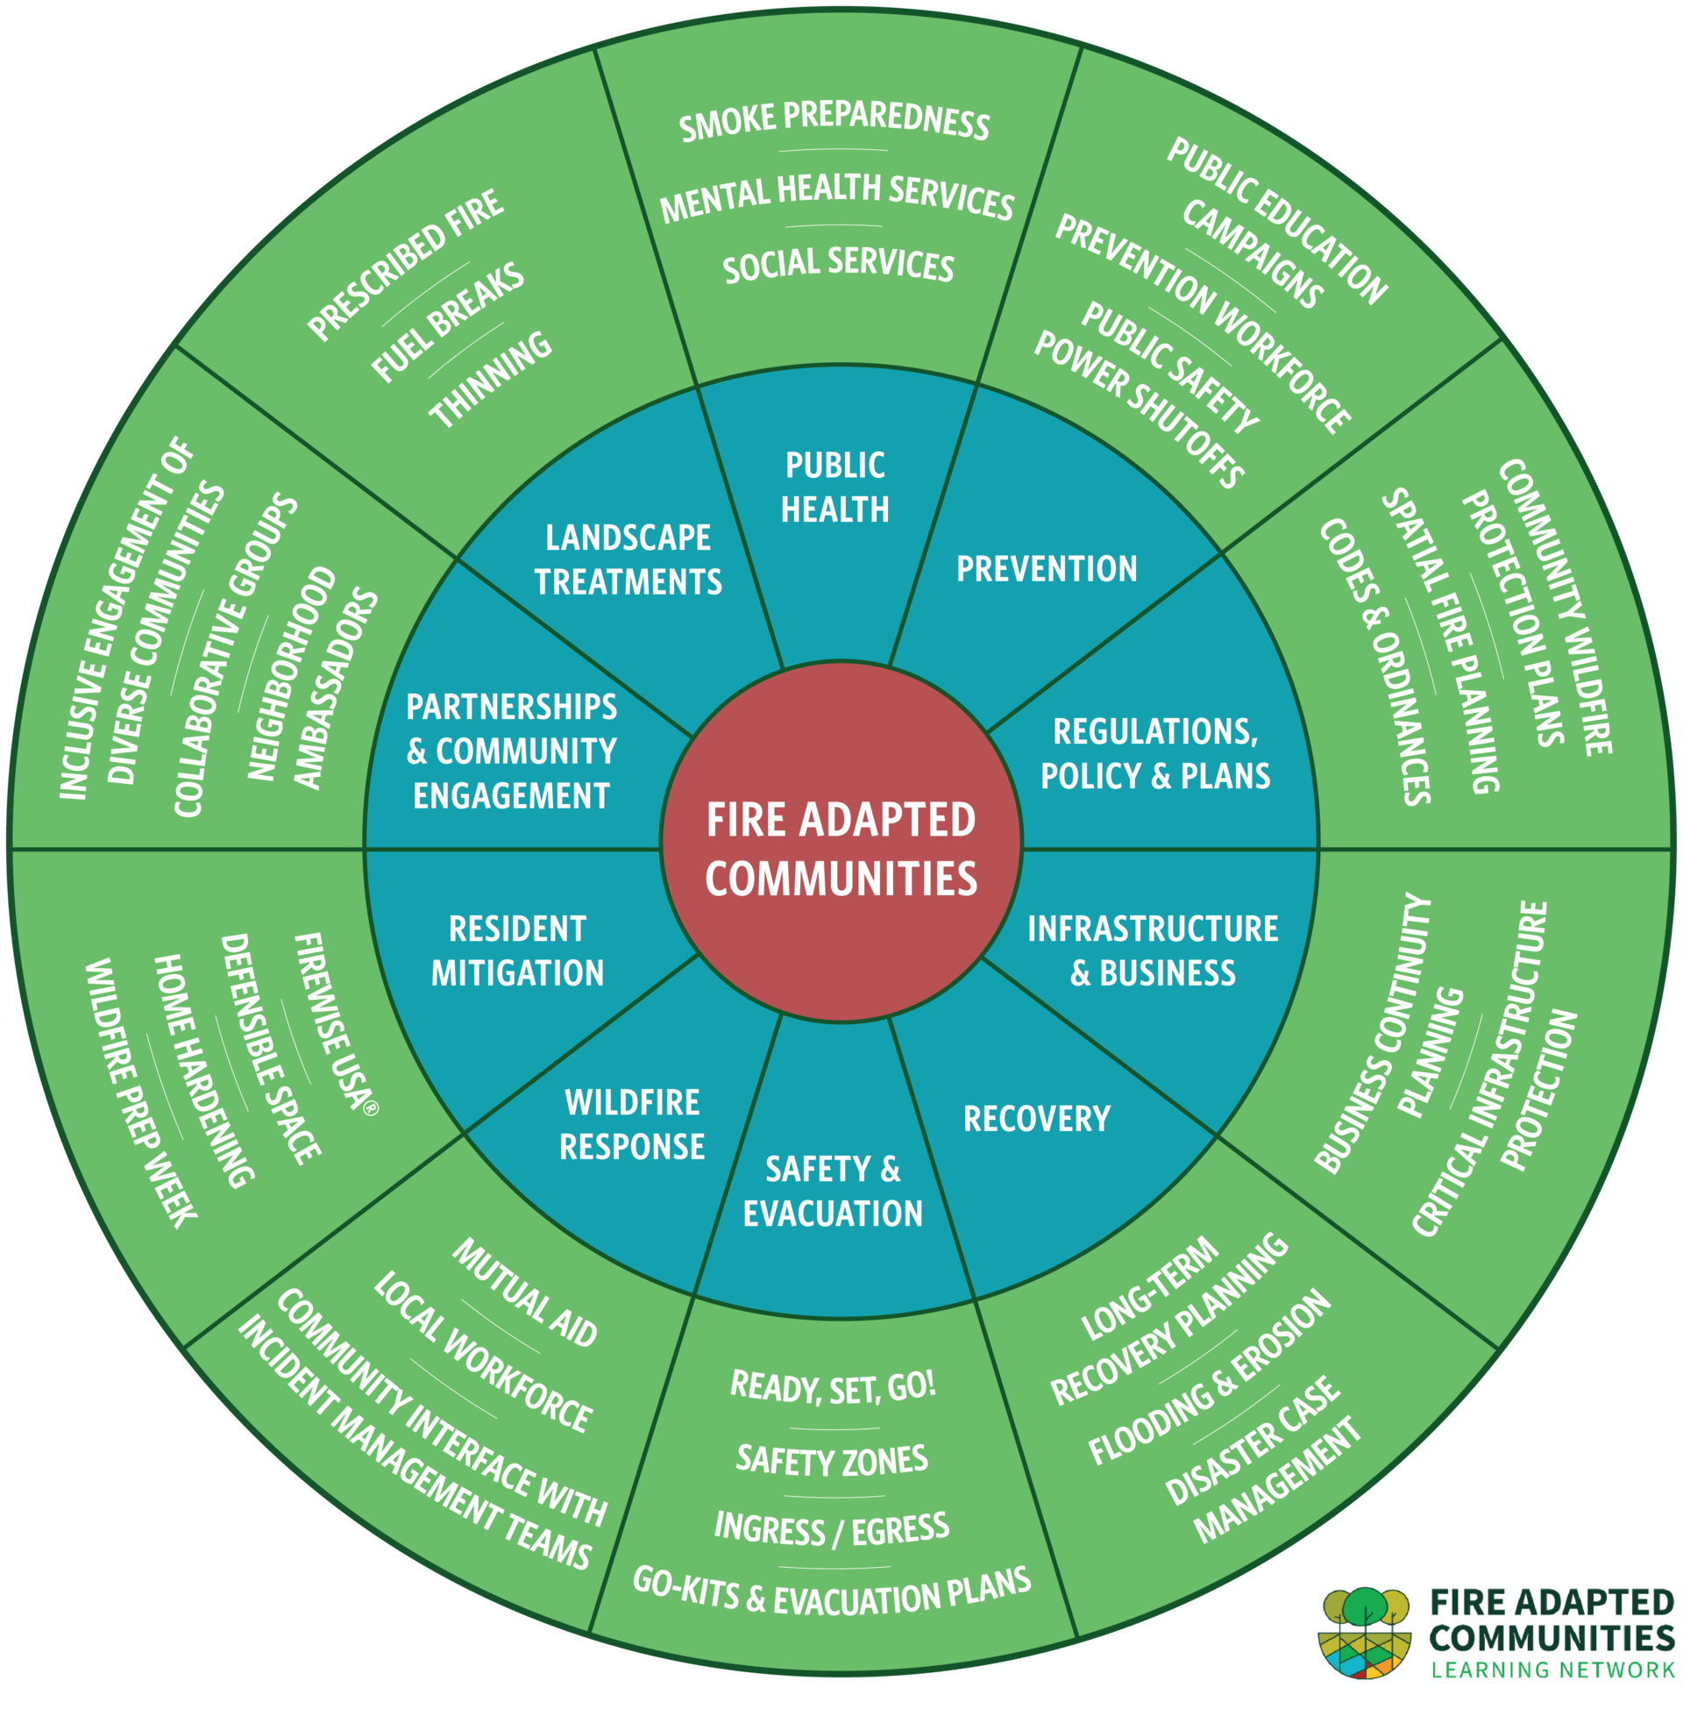

HIGH LEVEL STRATEGIES

Slide 3
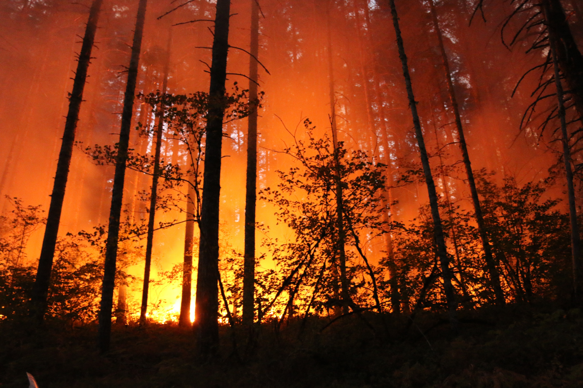

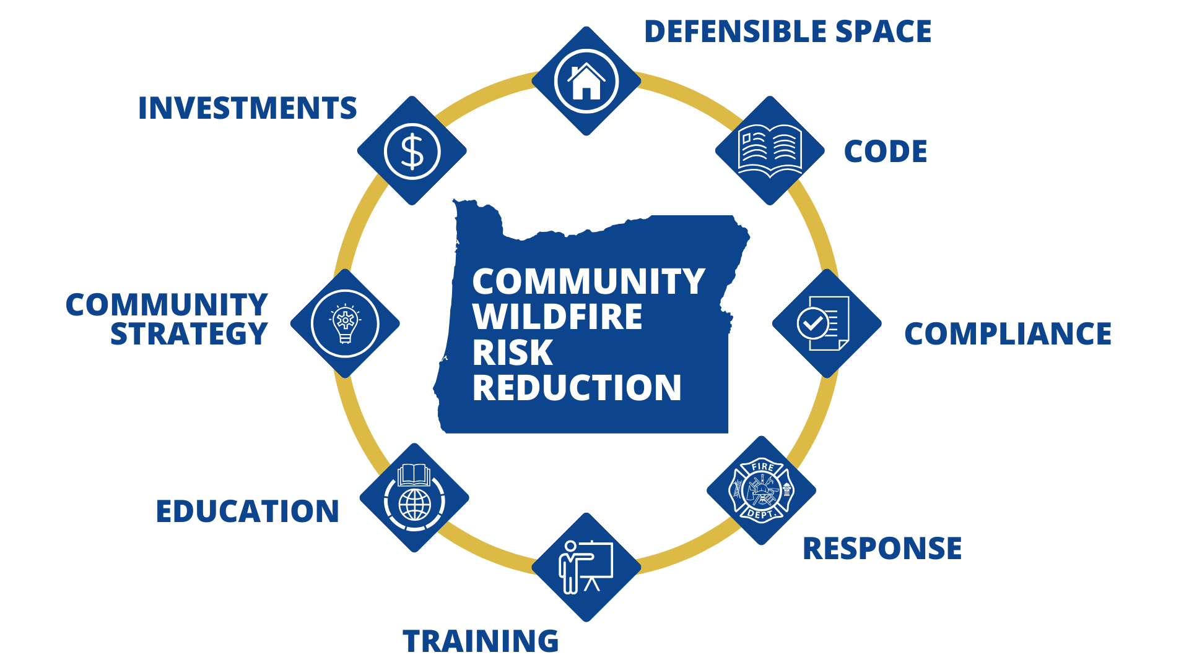
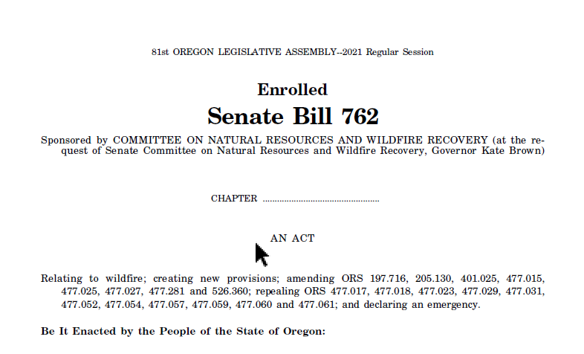
OREGON STRATEGY

Slide 4
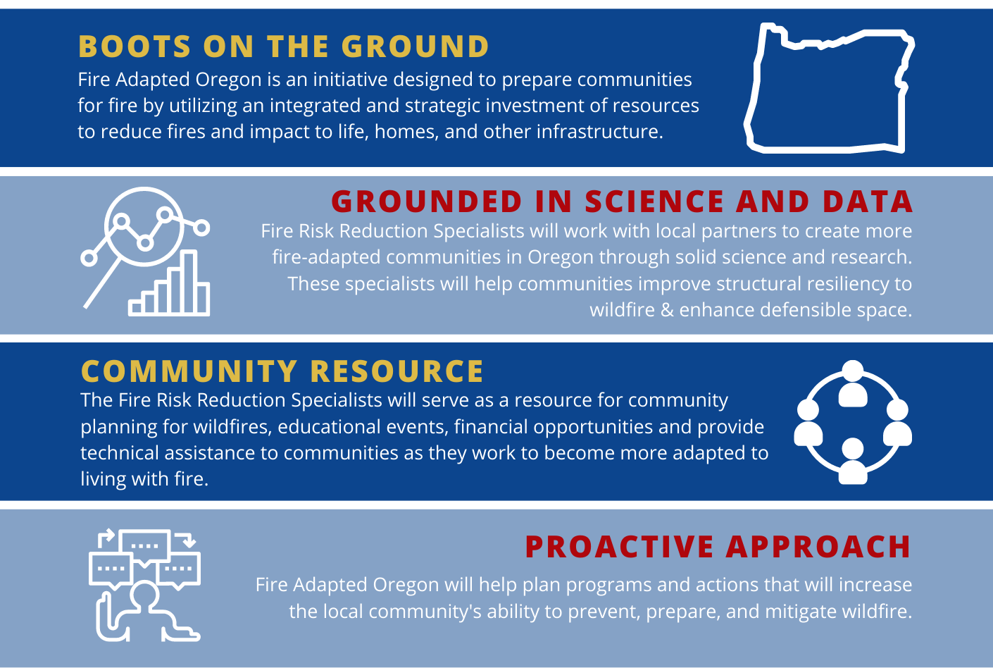
CWRR UNIT

Slide 5
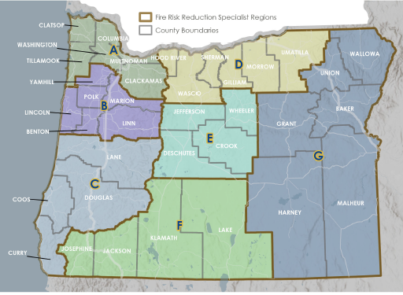
WHO WE ARE
REGIONAL CONTACTS
A – Simone Cordery-Cotter
B – Stephanie Stafford
C – Kelsey Scandle
D – Andy Dwyer
E – Heather Miller
F – Teresa Vonn
G – Chris Paul
STATEWIDE CONTACTS
Program Coordinator – Jen Warren
Manager – Chris Sutton

Slide 6
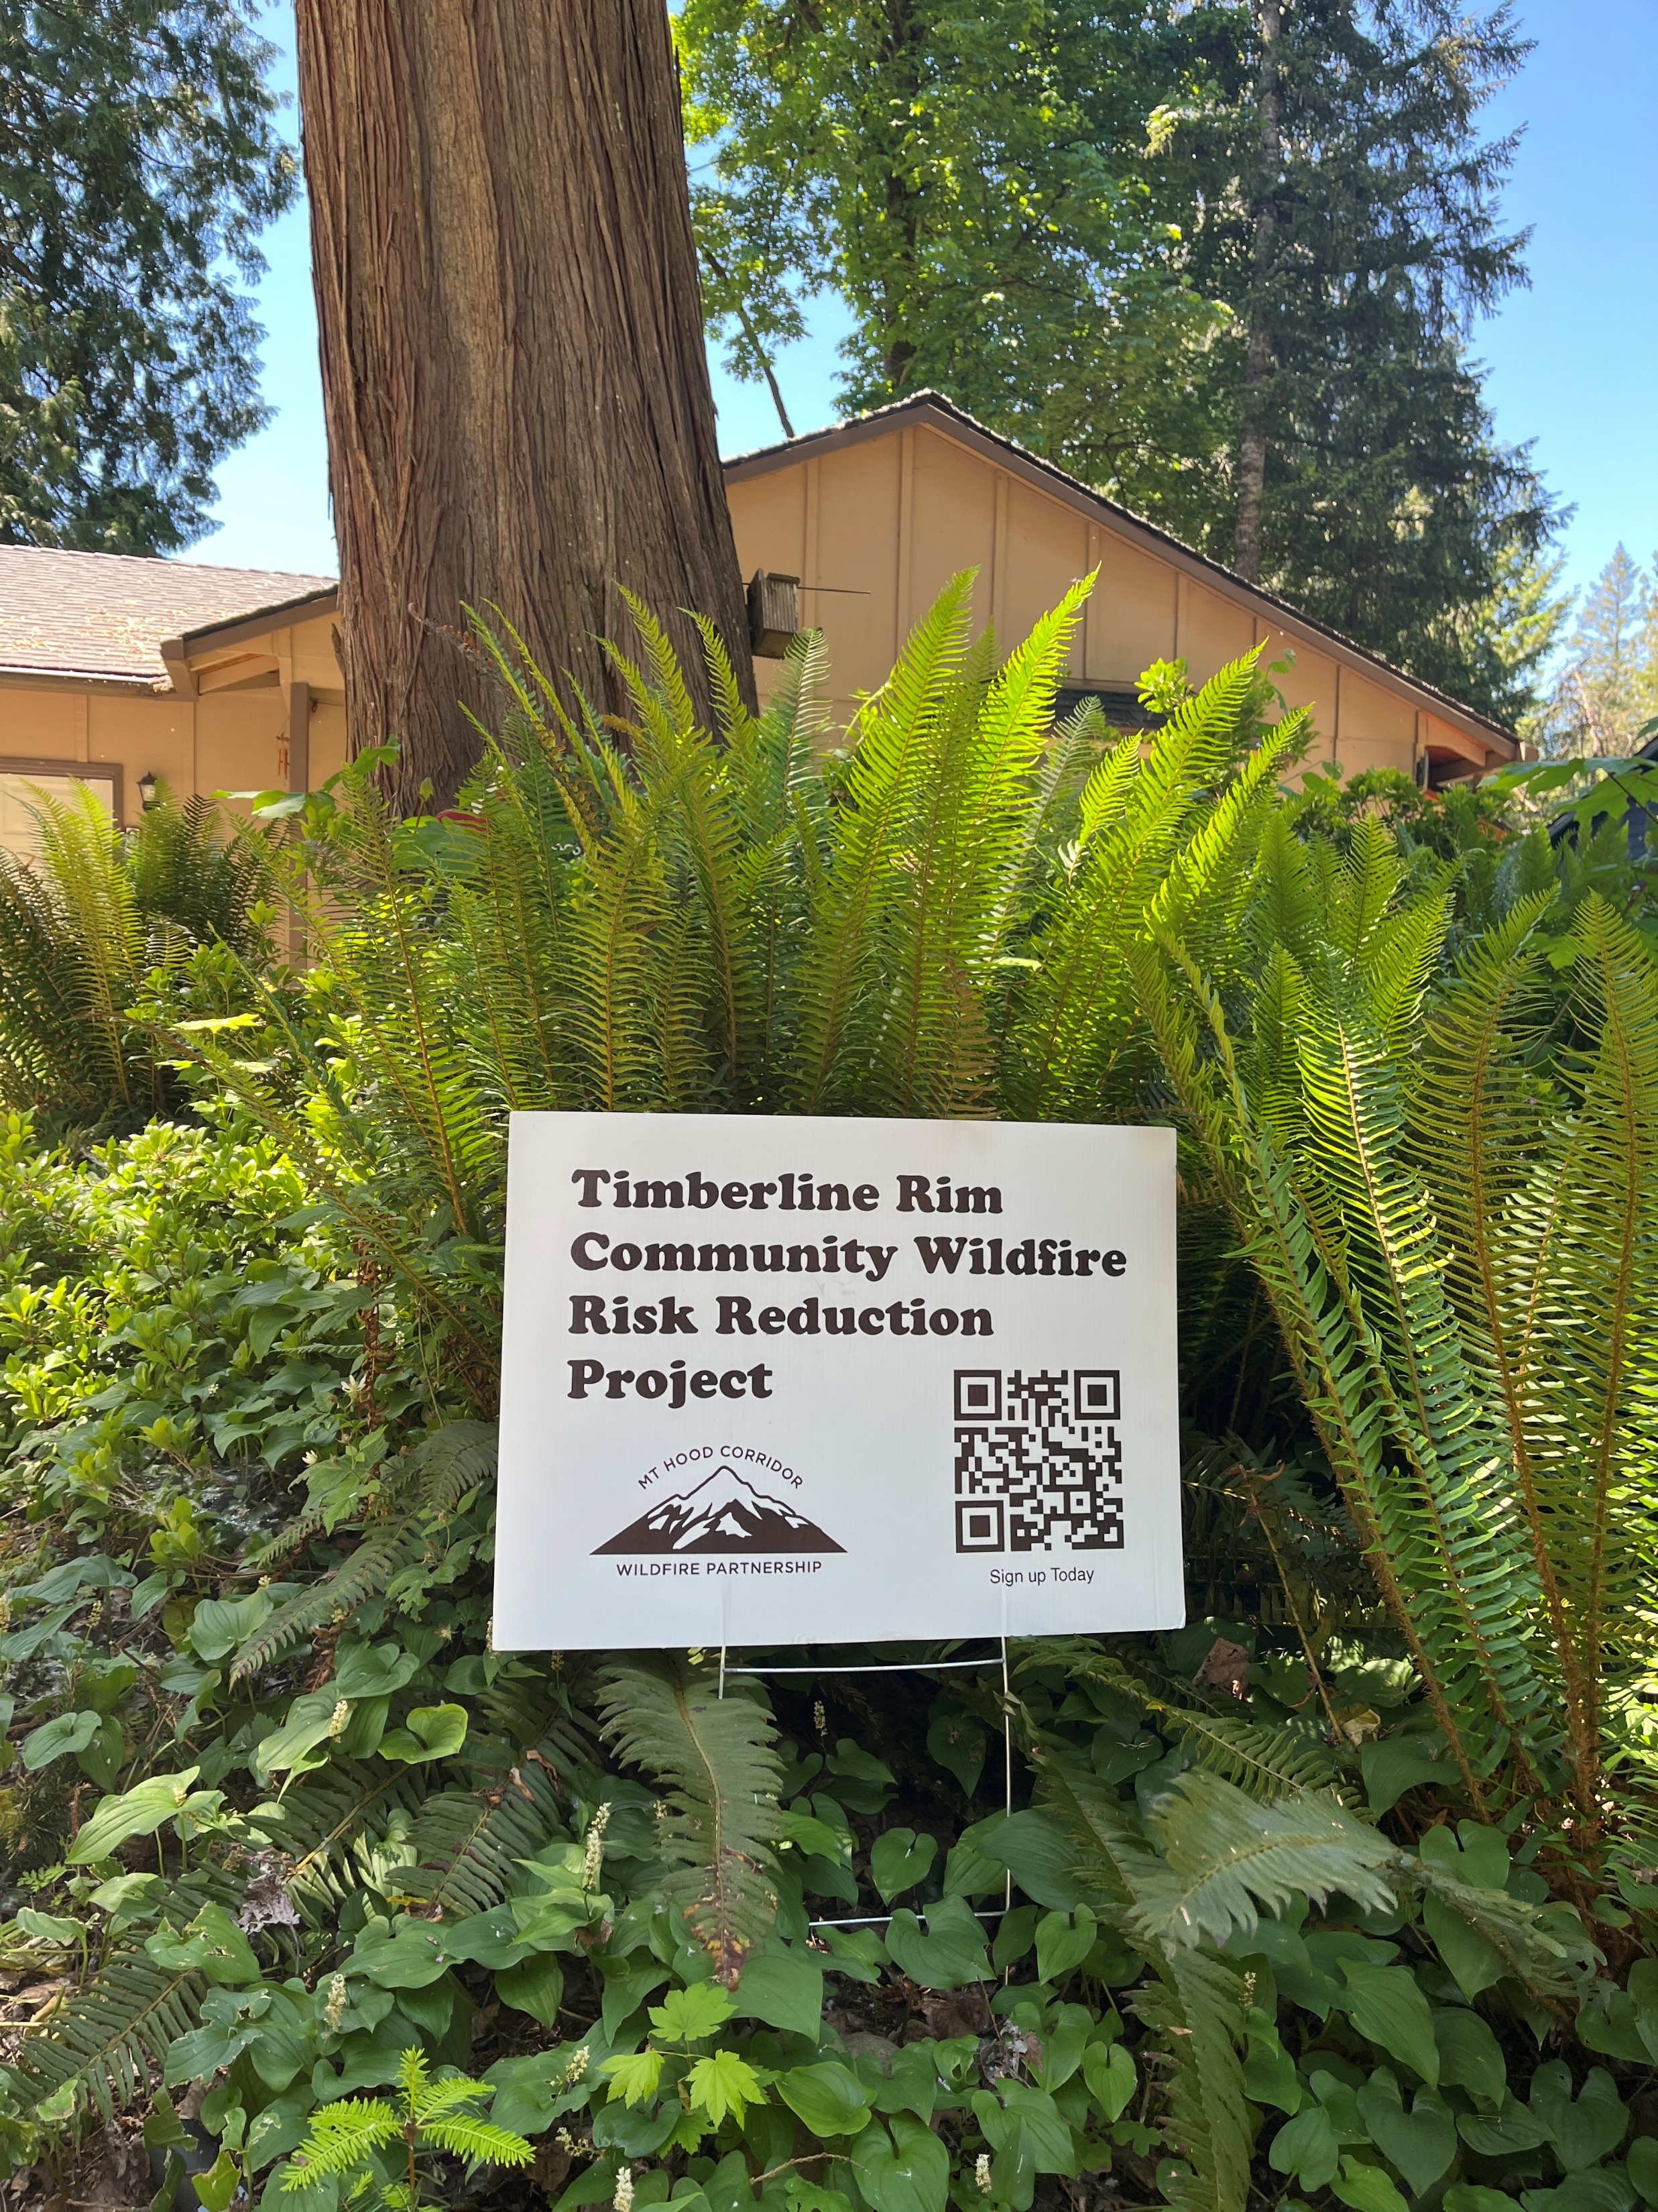
EXAMPLES OF OUR WORK
FUNDING
Support and coordination of OSFM funded mitigation projects
Support project planning for non-OSFM funding
Assistance with identifying potential funding sources

Slide 7
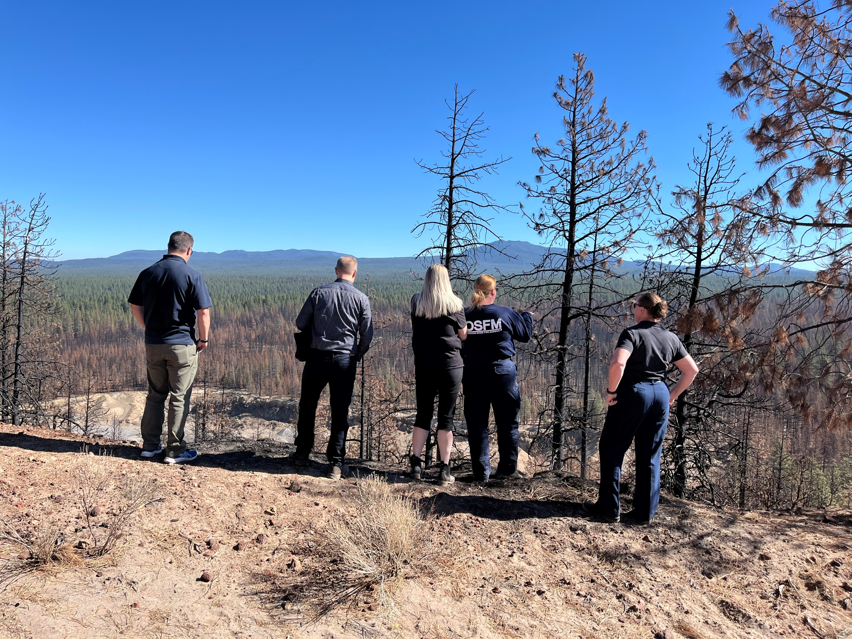
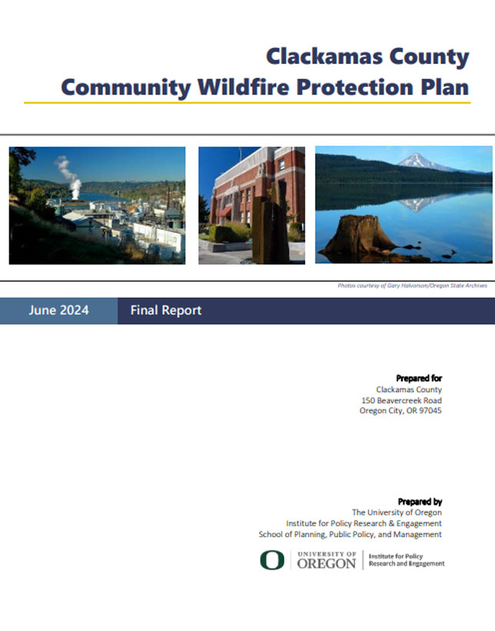

EXAMPLES OF OUR WORK
PLANNING
Support local wildfire mitigation planning efforts
Community Wildfire Protection Plans (CWPPs)
Firewise community planning and support

Slide 8
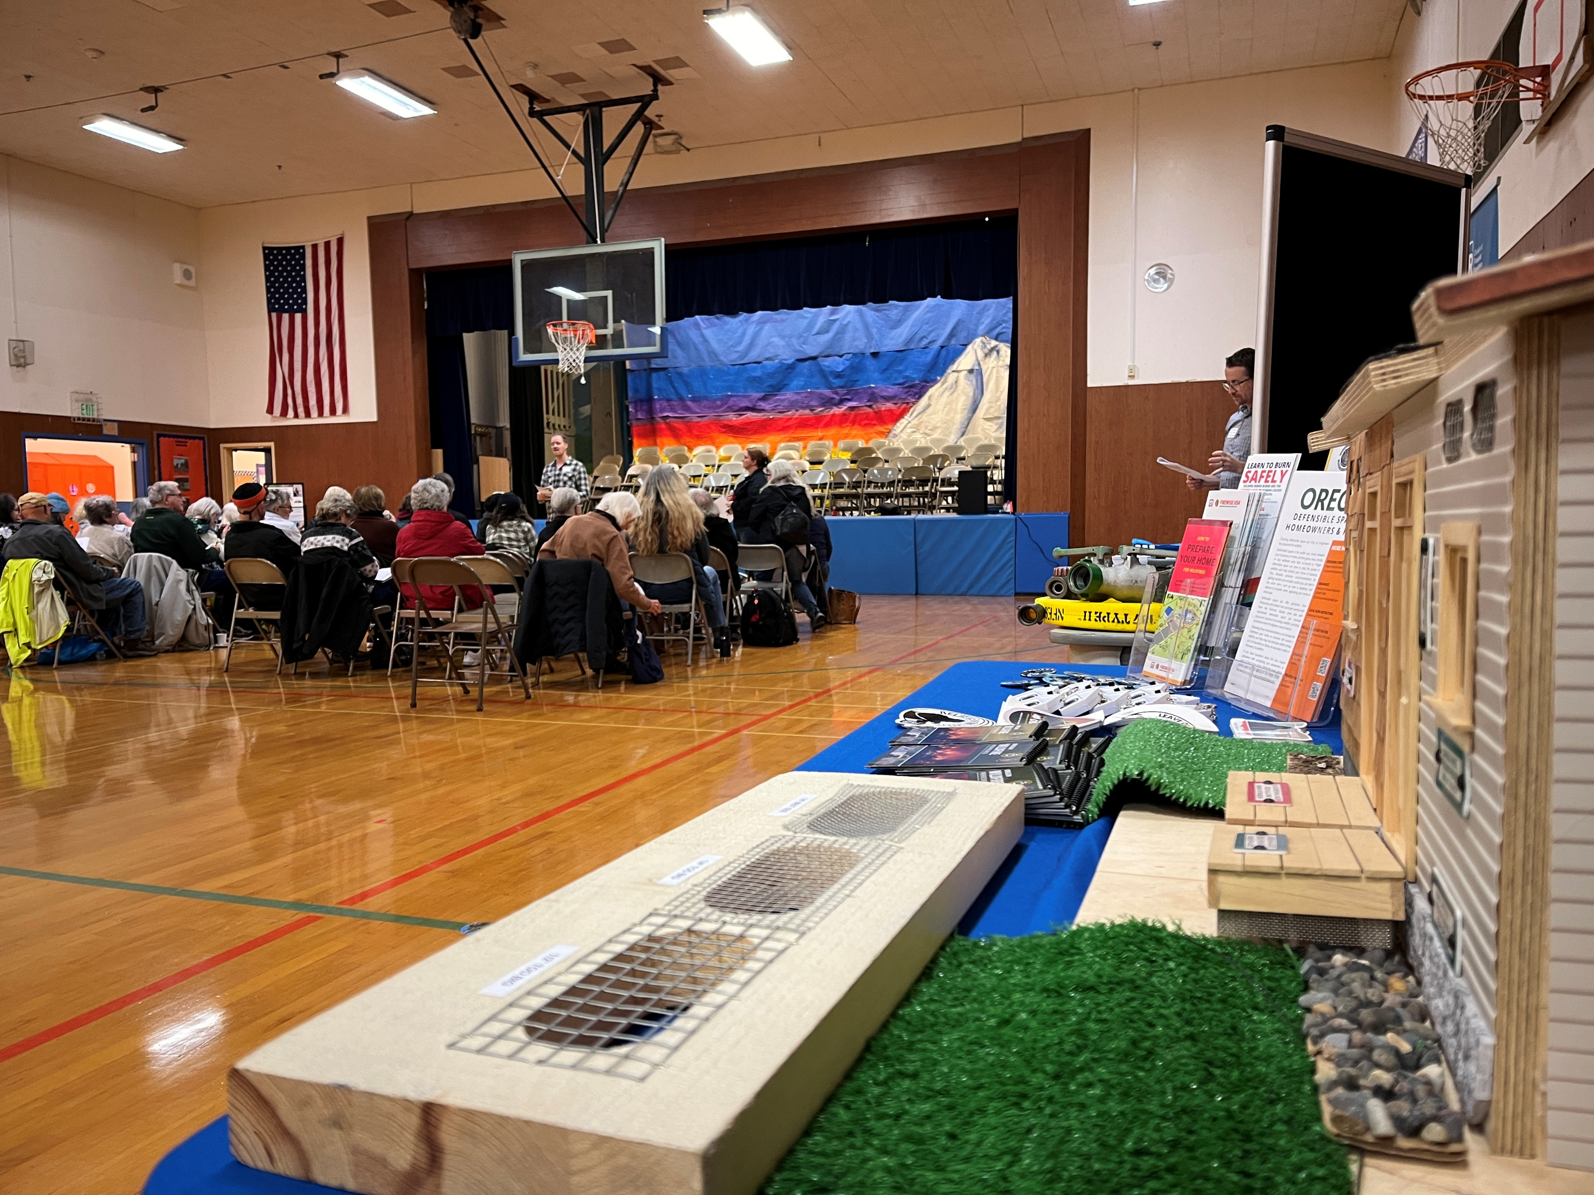
EXAMPLES OF OUR WORK
EDUCATION & OUTREACH
Outreach and education related to wildfire preparedness and mitigation
Workshops
Publications and resources
Tabling events

Slide 9
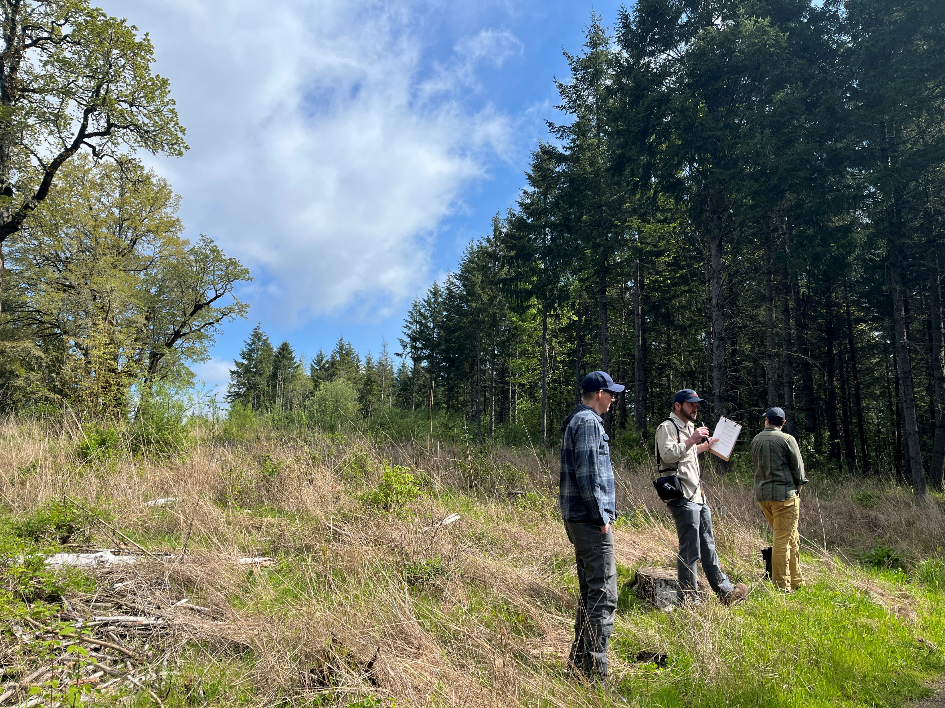
EXAMPLES OF OUR WORK
PARTNERSHIPS & COLLABORATIVES
Build and support local partnerships and collaborative groups
Facilitation for partnership groups
Support local wildfire mitigation practitioners and partnership facilitators
Strategic planning support for partnership groups

Slide 10
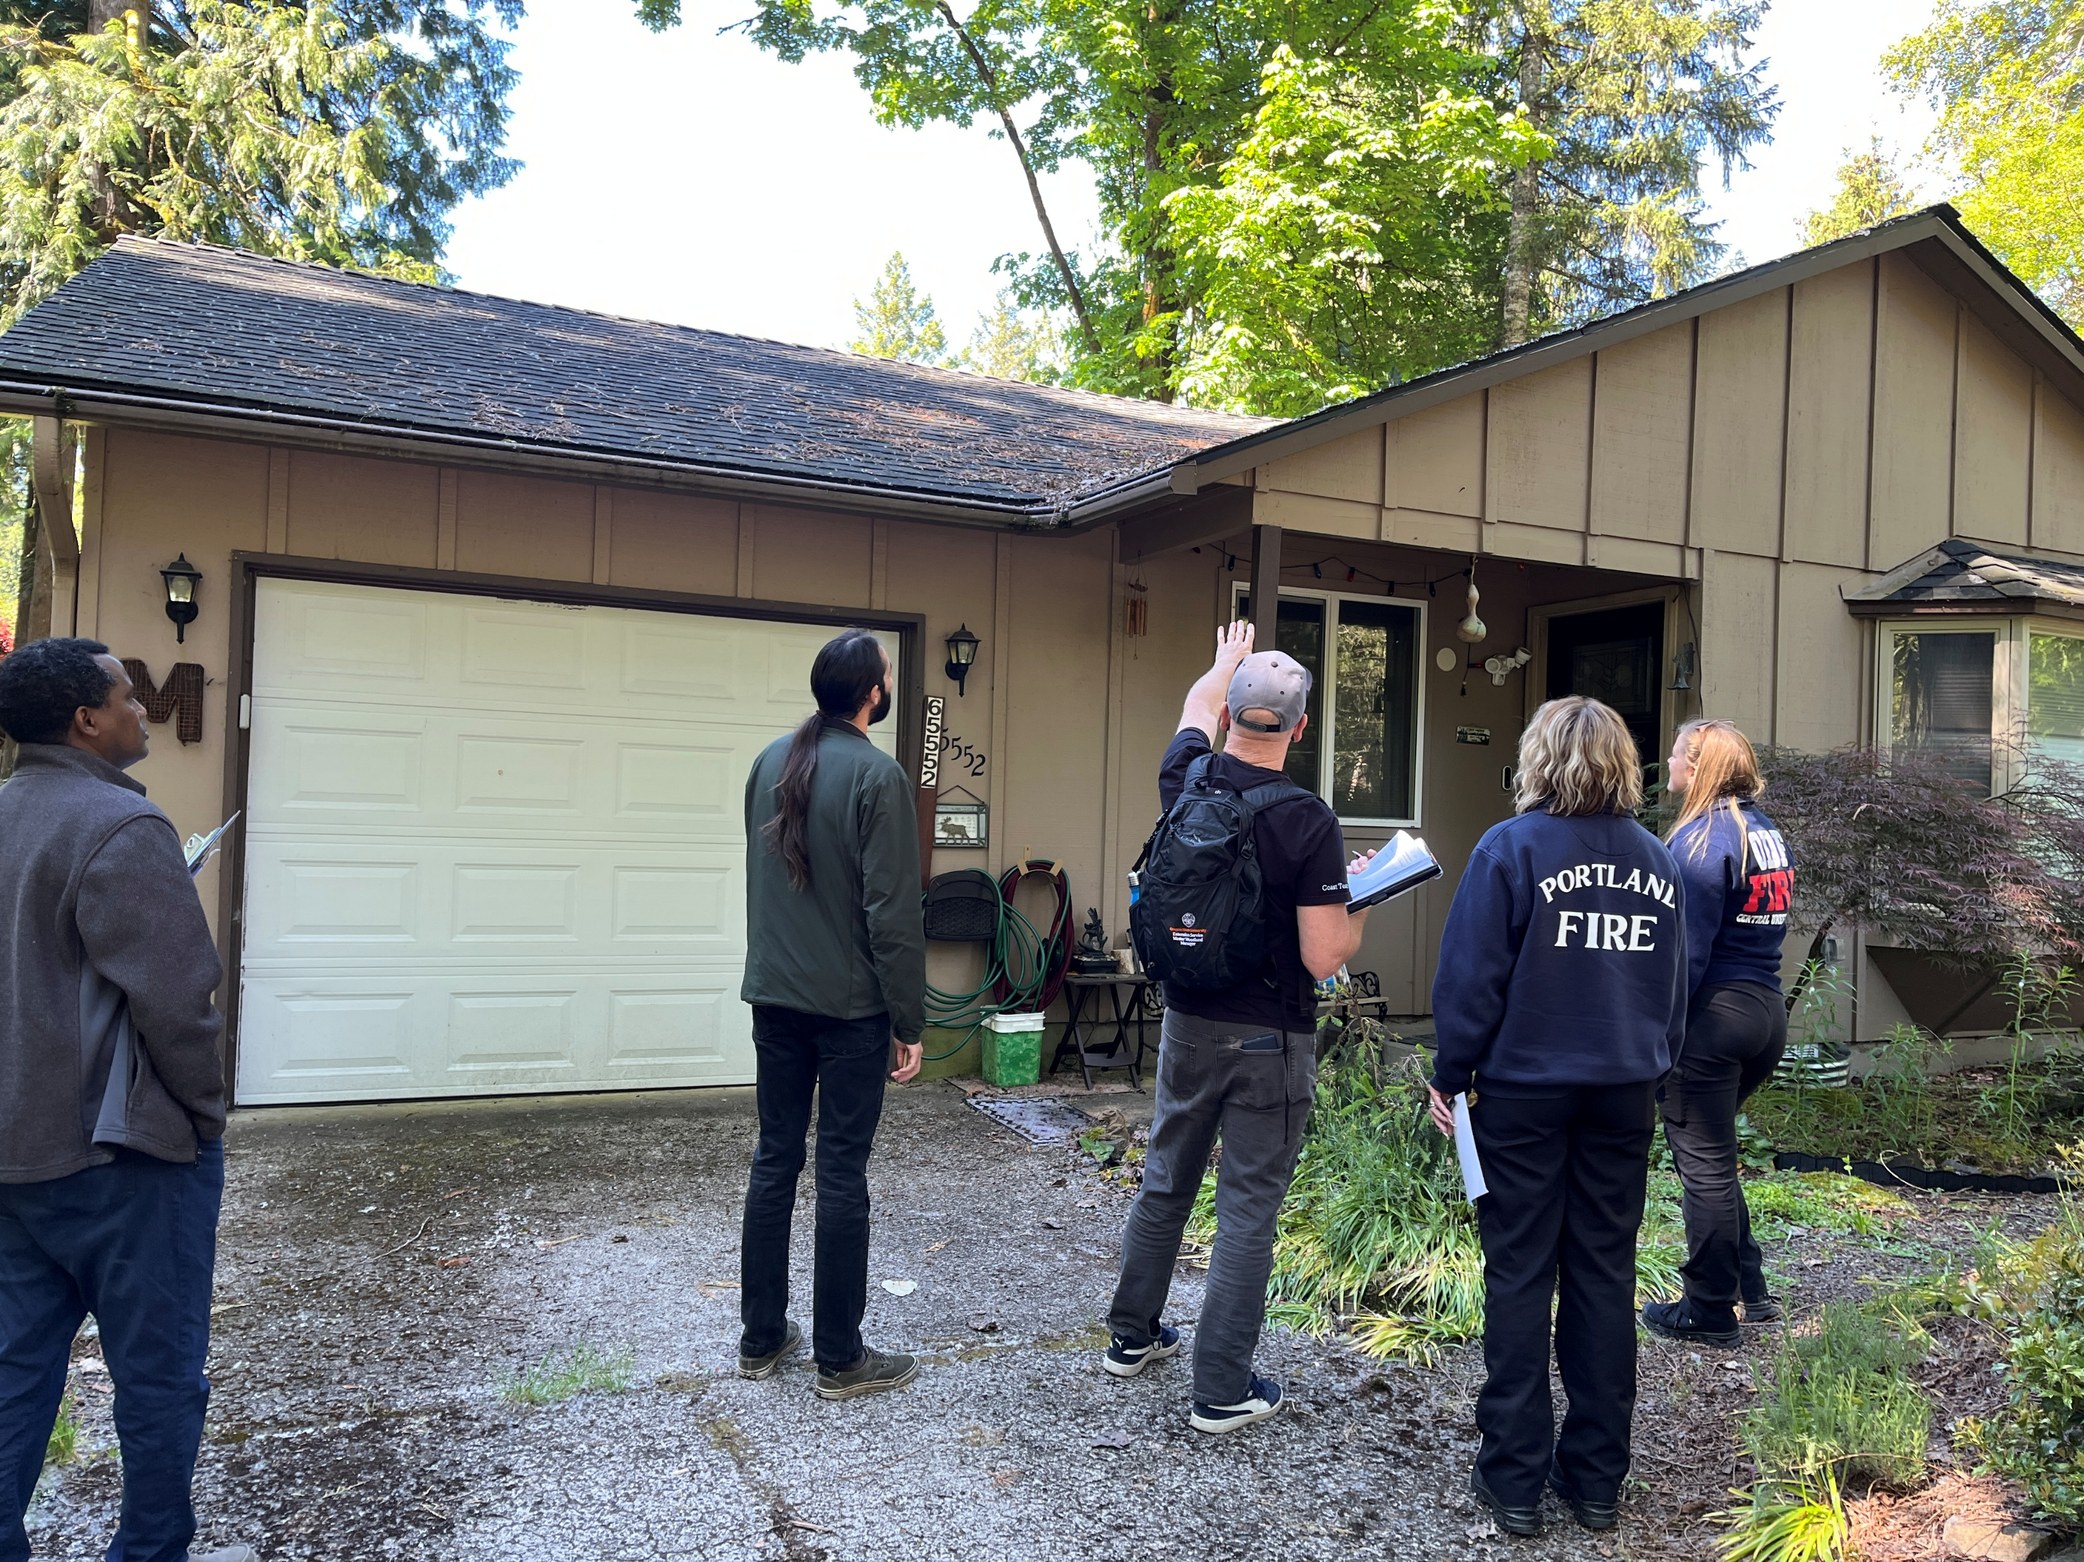
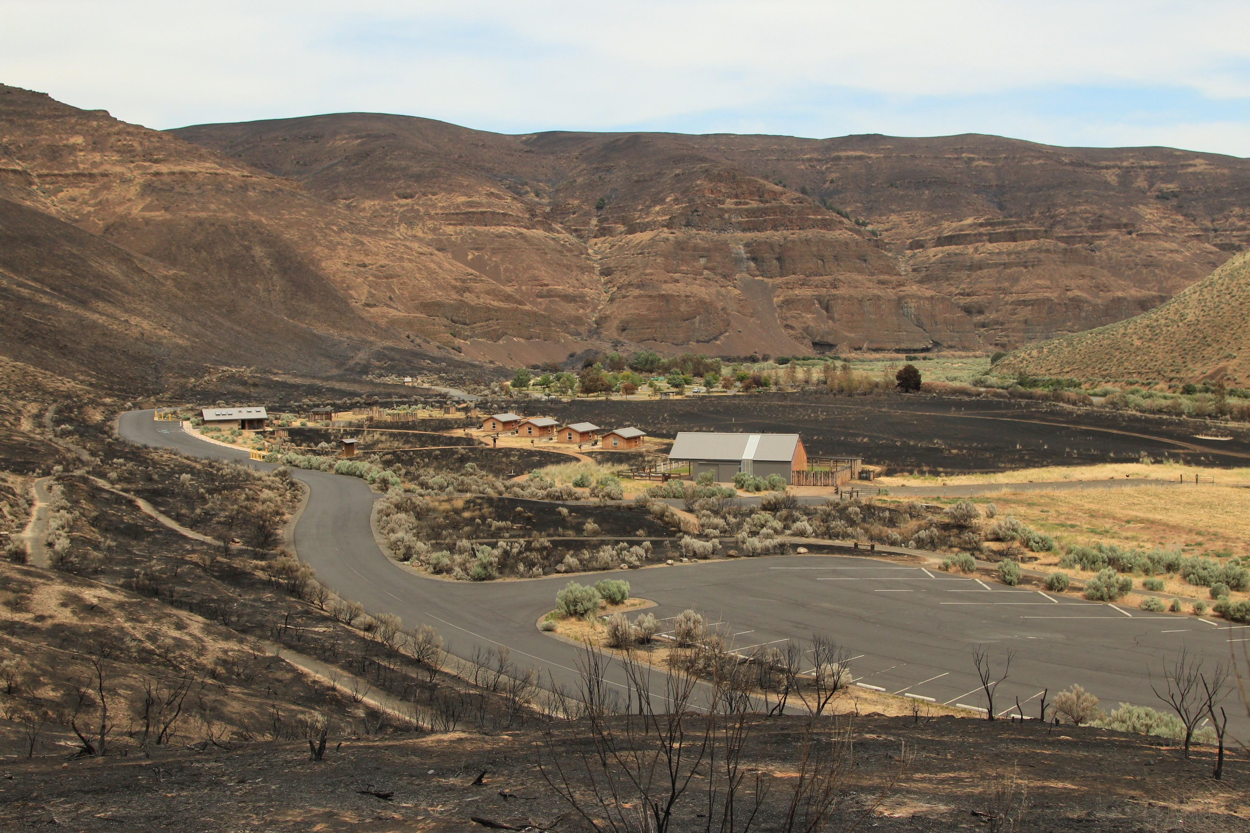
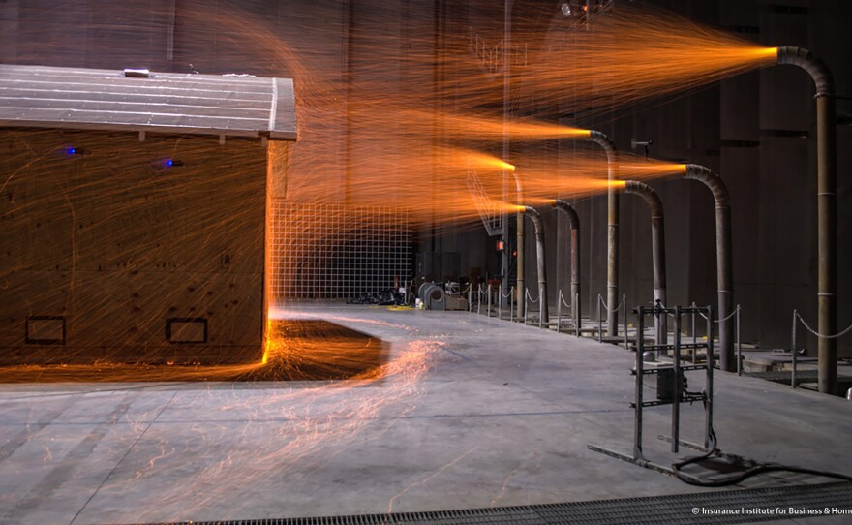
EXAMPLES OF OUR WORK
TECHNICAL SUPPORT
Technical support on wildfire mitigation strategies
Leverage partnerships with research organizations
Internal data analytics support
Linkage to other specialties

Slide 11
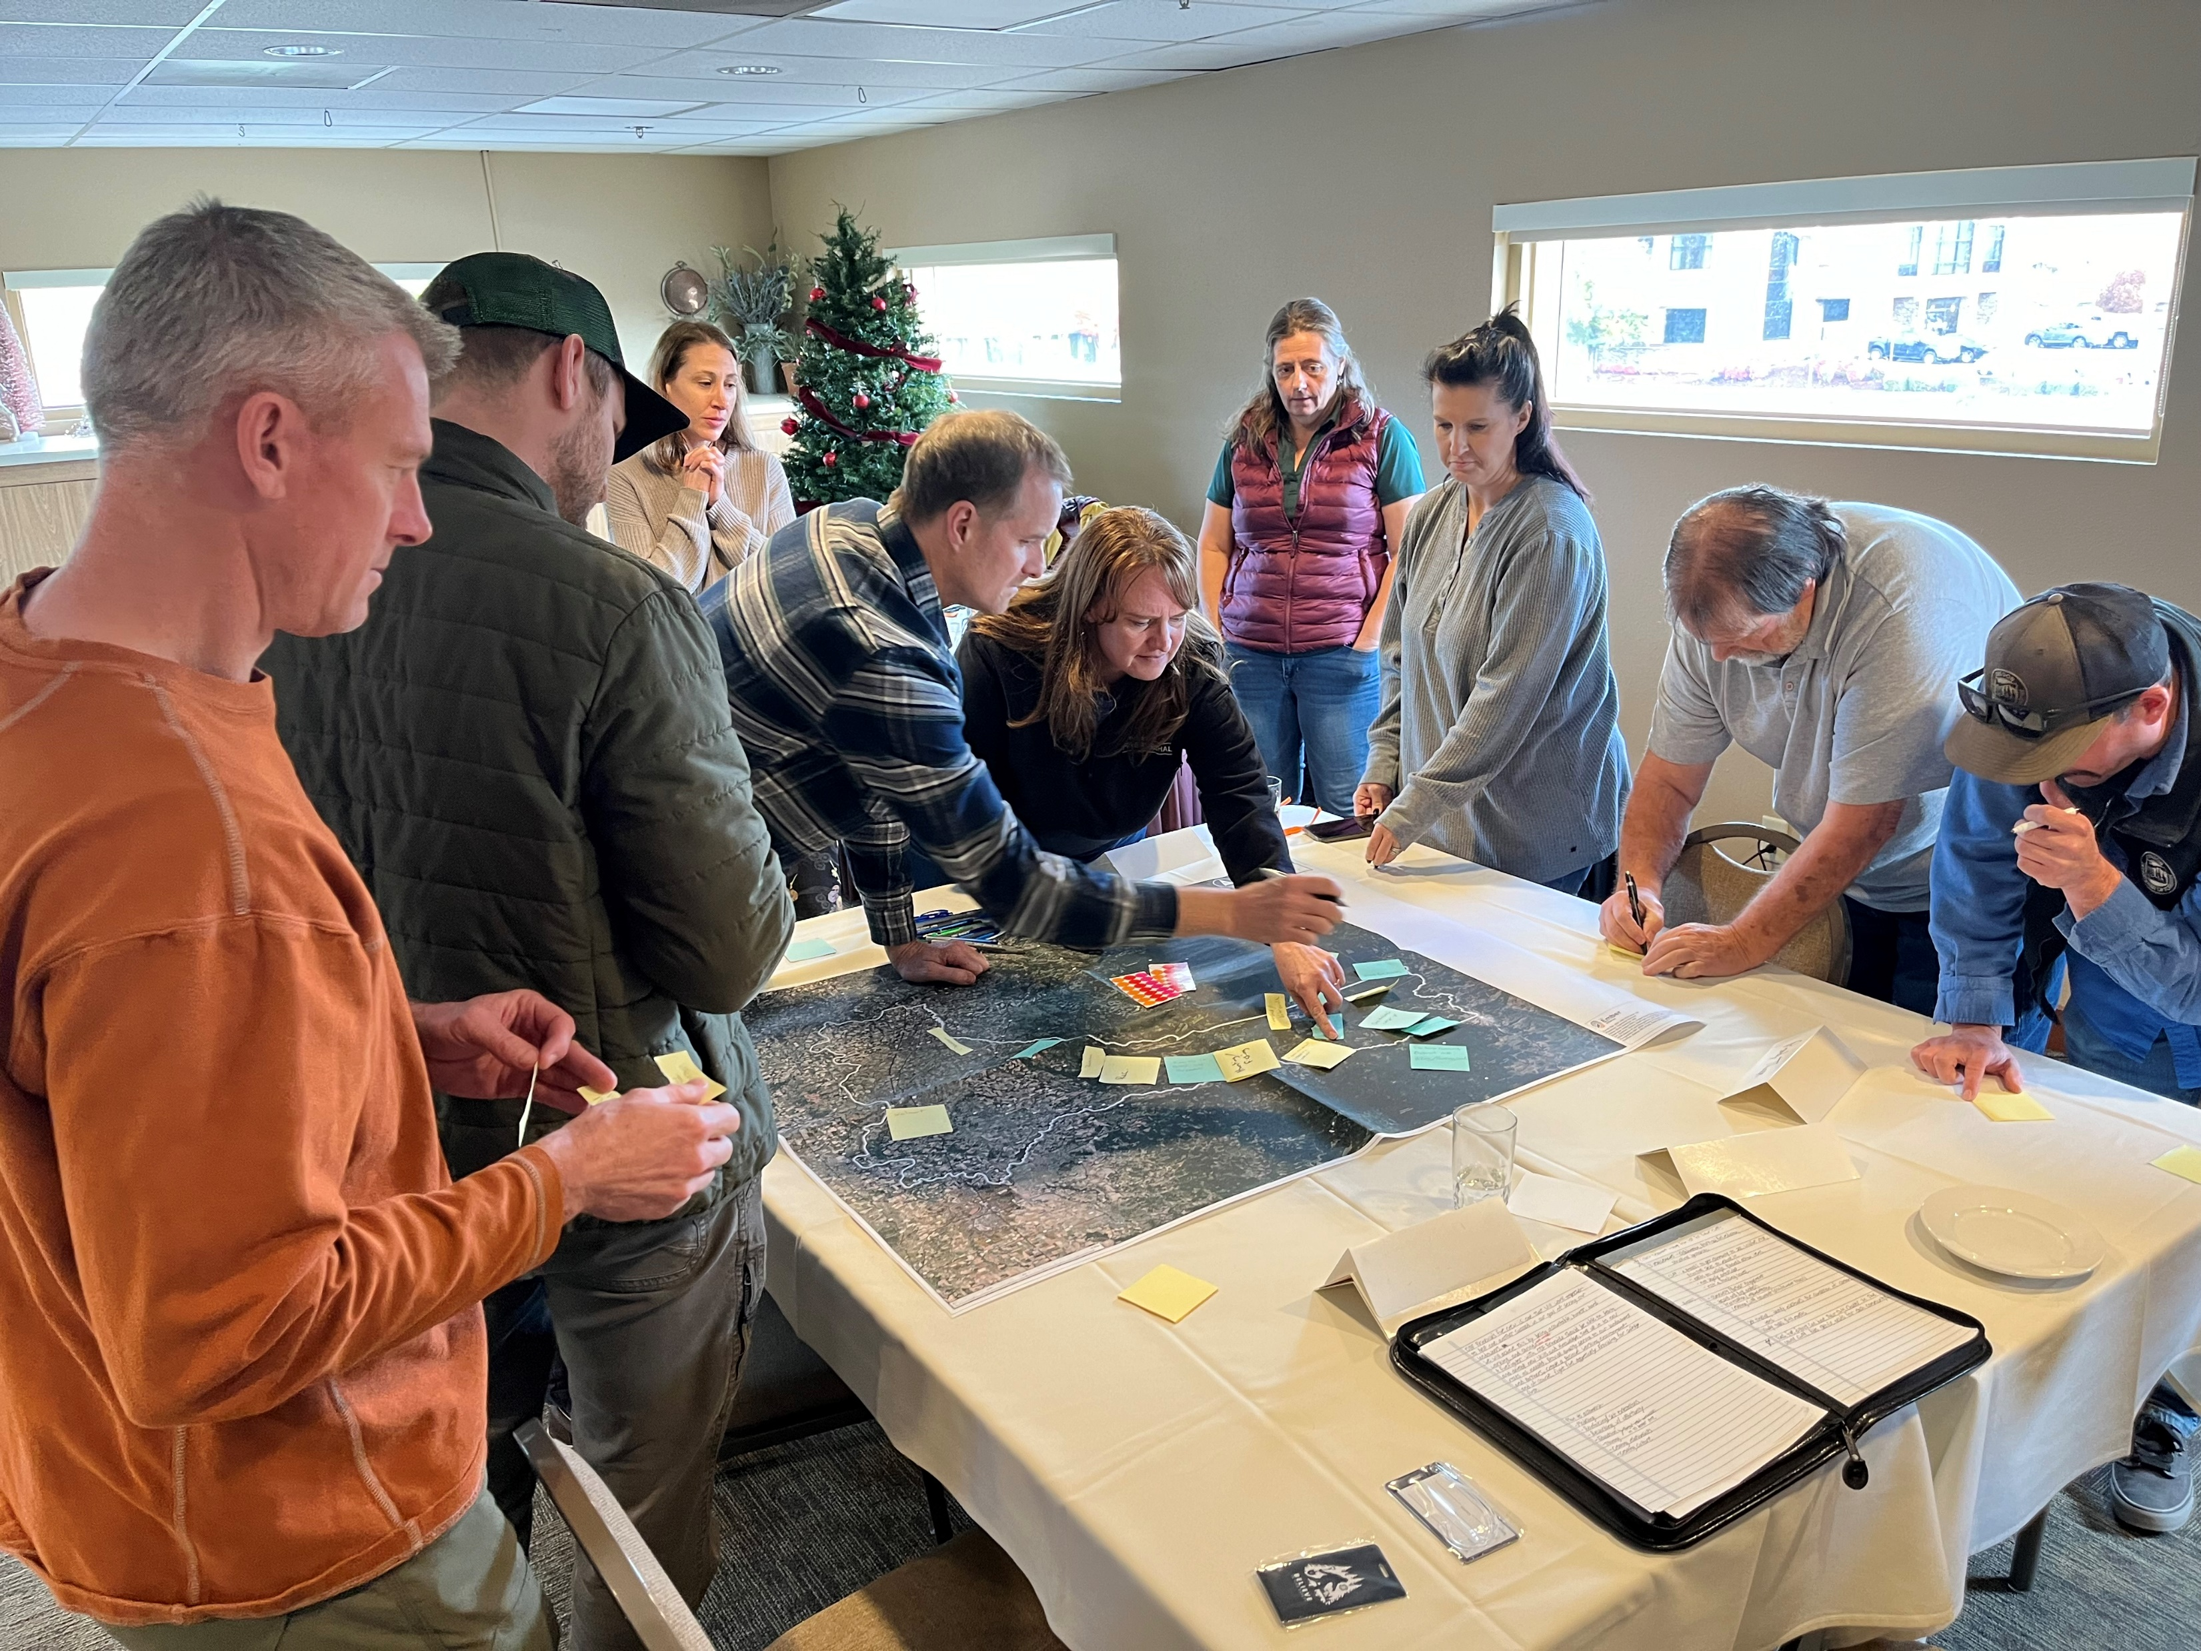
EXAMPLES OF OUR WORK
TRAINING
NFPA Assessing Structure Ignition Potential (ASIP)
Coalitions and Collaboratives (CoCo) Community Wildfire Mitigation Best Practices
The Ember Alliance Leading The Modern CWPP Process
Oregon Community Wildfire Adaptation Training (OCWAT)

