Slide 1

Navigating A Path To Wildfire Recovery September 30, 2025
Glenn Ahrens, OSU Extension Forester,
Clackamas, Marion, & Hood River Co.
Kara Baylog, Outreach Program Coordinator,
Jackson Co.

Slide 2
Navigating a path to wildfire recovery Agenda
OSU Extension – Landowner Experience After Fire (LEAF) Study results
LEAF implications for SWCD and other local providers
Importance of preparing for post-fire recovery before the fire
For collaborators in landowner assistance
For Landowners
Q&A

Slide 3
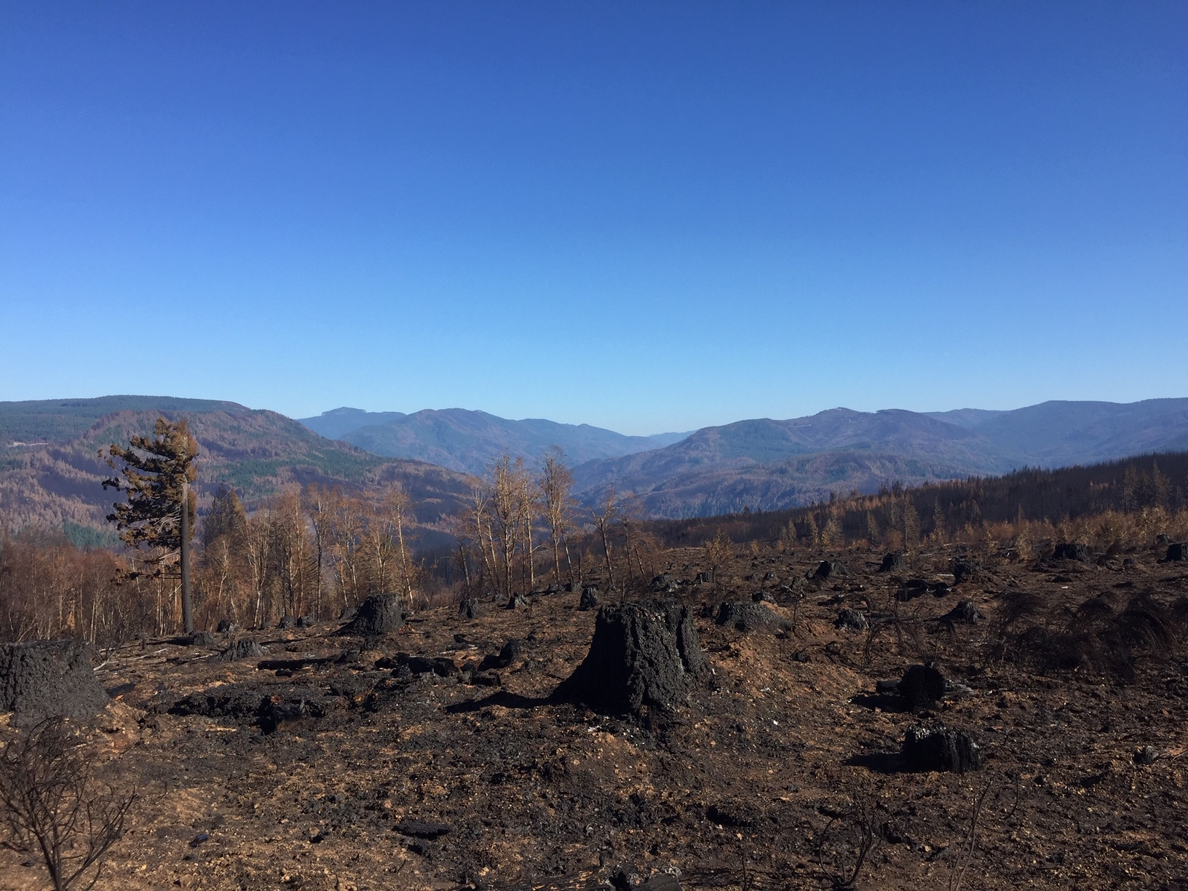
2020 Labor Day Fires - Acres
USFS | BLM | State | Private Industry | Small Private | Total
364,300 | 129,300 | 25,200 | 271,400 | 180,700 | 970,900

Slide 4
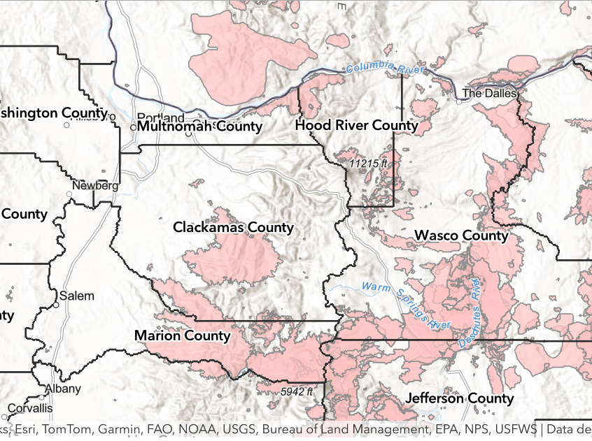
County | Total Forest (acres) | 2020 fires (acres) | Percent burned
Clackamas | 832,000 | 176,400 | 21.2
Marion | 401,000 | 211,900 | 52.8
Total | 1,233,000 | 388,300 | 31.5
Notes:
The 2020 wildfire footprints cover over half of all forestland in Marion County and 21 percent in Clackamas County. Very significant portion of our forest. What will regeneration look like across this area? A lot depends on the land owner and the reforestation effort they were/are able to put forth. Extension is working mostly with private woodland owners, but we can also learn from progress on large private, State, and federal forests.

Slide 5
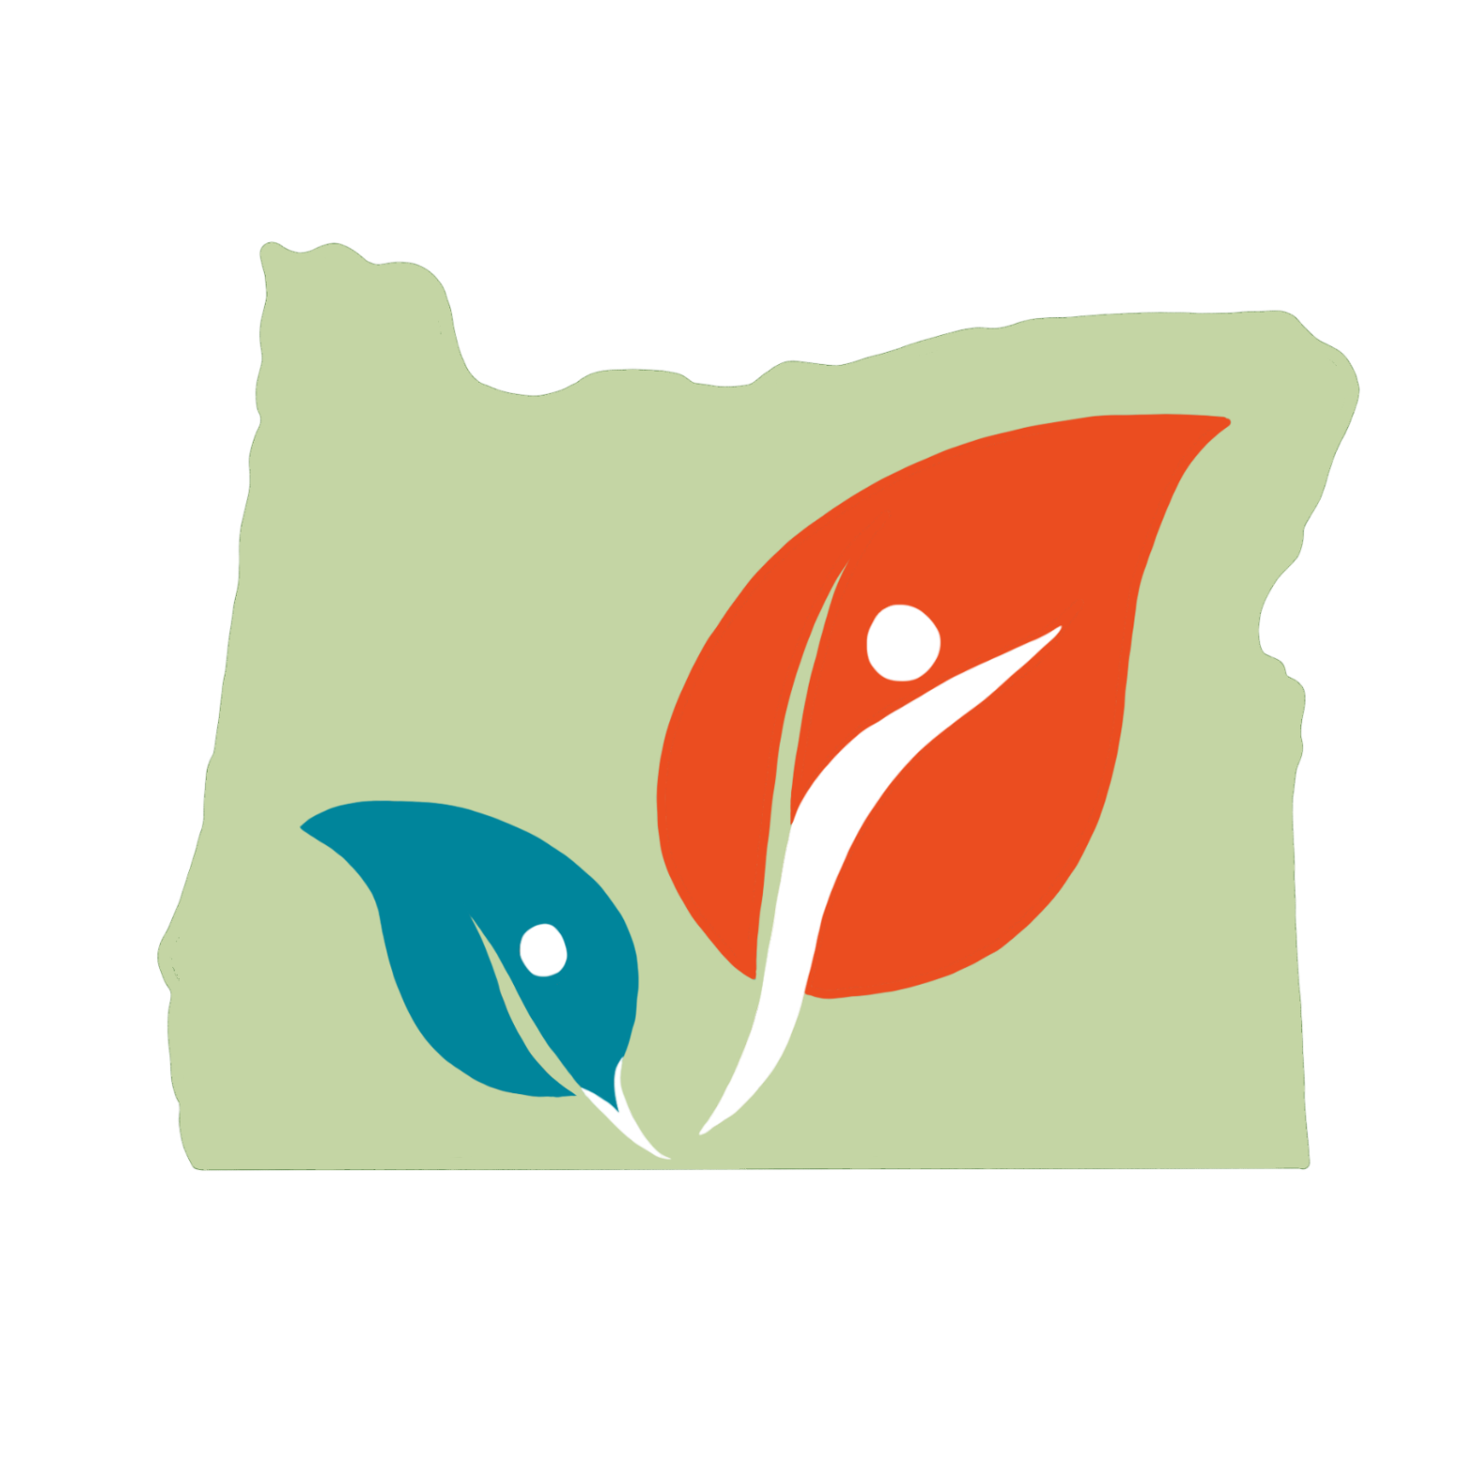
What is LEAF?
2020 Labor Day Fire Respondents
Echo Mountain Complex | 2
Pike Road Fire | 2
Dowty Road Fire | 5
Wilhoit Fire | 1
Unger Fire | 1
Beachie Creek Fire | 56
Riverside Fire | 15
Lionshead Fire | 1
Holiday Farm Fire | 27
Archie Creek | 15
Obenchain Fire | 15
242 Fire | 8
Slater Fire | 1
Statewide survey of wildfire-impacted woodland landowners about restoration (2024 -223 responses)
Objective #1
Determine challenges and obstacles to restoration
Objective #2
Objective #3
Identify useful resources and pathways to success
Determine with whom fire-impacted woodland owners are working
Notes:
The first part of the LEAF project was the LEAF Study, This was a statewide survey offered over the course of about 8 months between 2023 and 2024. We distributed the survey through our contact lists, through our partner contact lists, and in some cases, through direct mailings. While the Labor Day fires were the inspiration to this study, we did not limit responses to only those impacted by the Labor Day fires. However, since our outreach focused mostly on those who had been in those Labor Day fire footprints, overwhelmingly, our response came from those landowners. Of the 223 people who responded, 149 were from the Labor Day fires. And of the participants coming from the Labor Day fires, the majority came from the northwestern part of the state, in the footprint of one of the 3 mega fires or several other fires that made up the Canyon Complex, illustrated here in the box. However we had significant responses from the other 2 mega fires, Holiday Farm and Archie, as well as another significant, but not “mega” fire, Obenchain in southern Oregon.
What we were mostly interested in finding out was to learn about the process landowners were going through in order to restore their forests. Specifically, we wanted to understand the challenges and obstacles they faced in achieving their restoration goals, what useful resources and pathways were they taking advantage of to overcome these challenges, and with whom they were working with throughout it all.

Slide 6
Findings of the LEAF Study
Landowners want to restore their forests
Negative emotions not a barrier for most
Local organizations play a critical role in restoration
Finances remain a barrier for some, but others need only educational/technical/ logistical support
Collaboration between local and non-local groups is essential.
Prior experience increased future success
Notes:
What we found:
Overwhelmingly, when people get help they get work done on the ground
This is true despite traumatic emotions from the fire. Impacted landowners reported an increased level of attention to their woodlands over those reporting reduced interest.
Experience doing work and planning prior to wildfire is a strong predictor for successfully doing similar planning and work after the wildfire.
Most interactions with landowners are reported as organizations with a strong local presence, including those not necessarily working in post-wildfire recovery, but those who have expanded services as a direct result of community action in response to wildfire
However, research suggests finances as a significant barrier.
Also, not just funding programs are helping landowners to complete work on the ground. Other forms of assistance should also be supported (Educational, technical and logistical)
Non-local groups interested in supporting post wildfire recovery have options to interface with local organizations that develop from within the community which helps to interface with the needs on the ground.
For more in-depth information on this study, keep an eye out for our upcoming journal publication

Slide 7
What do people want to do?
Top three actions already taken
Site preparation
Removing hazard trees
Planting trees
Notes:
Just to expand on some of these points to tease out how the LEAF survey can inform the way we assist post-wildfire impacted landowners, I’m going to expand on a couple of these points
In the LEAF Survey, most landowners were able to have completed something on the ground moving their forest toward restoration. But some landowners had completed even one action, and most still had goals they still hadn’t met after 3-4 years.
Of those who reported doing at least one action, the top 3 most common actions were site preparation for replanting, removing hazard trees and planting trees.
We asked them what they wanted to do but couldn’t. Invasive species topped that list. Second was plantings of both shrubs and trees. So planting trees was both a top action done as well as a top action people wanted to do but couldn’t.
We then asked them what obstacles they experienced that prevented them from progress. High tree seedling mortality topped the list. We will get to explain more on that in a bit. Unsurprisingly, financial barriers were second and last of the top three are not being sure who to turn for help.
And when we look at landowner success rates, we found that when landowners had done similar work in the past, they were more likely to be successful at it after a wildfire. Those who harvested timber were more likely to be successful at a salvage log. Those who had forest management plants were more likely to have successfully developed a wildfire reforestation/restoration plan.

Slide 8
What do people want to do?
Top three barriers
Tree seedling mortality
Lack of financial resources
Not sure who to turn to for help
Notes:
Just to expand on some of these points to tease out how the LEAF survey can inform the way we assist post-wildfire impacted landowners, I’m going to expand on a couple of these points
In the LEAF Survey, most landowners were able to have completed something on the ground moving their forest toward restoration. But some landowners had completed even one action, and most still had goals they still hadn’t met after 3-4 years.
Of those who reported doing at least one action, the top 3 most common actions were site preparation for replanting, removing hazard trees and planting trees.
We asked them what they wanted to do but couldn’t. Invasive species topped that list. Second was plantings of both shrubs and trees. So planting trees was both a top action done as well as a top action people wanted to do but couldn’t.
We then asked them what obstacles they experienced that prevented them from progress. High tree seedling mortality topped the list. We will get to explain more on that in a bit. Unsurprisingly, financial barriers were second and last of the top three are not being sure who to turn for help.
And when we look at landowner success rates, we found that when landowners had done similar work in the past, they were more likely to be successful at it after a wildfire. Those who harvested timber were more likely to be successful at a salvage log. Those who had forest management plants were more likely to have successfully developed a wildfire reforestation/restoration plan.

Slide 9
What do people want to do?
Top three actions landowners want to but unable to do
Planting native species
Invasive species removal
Erosion control plantings
Notes:
Just to expand on some of these points to tease out how the LEAF survey can inform the way we assist post-wildfire impacted landowners, I’m going to expand on a couple of these points
In the LEAF Survey, most landowners were able to have completed something on the ground moving their forest toward restoration. But some landowners had completed even one action, and most still had goals they still hadn’t met after 3-4 years.
Of those who reported doing at least one action, the top 3 most common actions were site preparation for replanting, removing hazard trees and planting trees.
We asked them what they wanted to do but couldn’t. Invasive species topped that list. Second was plantings of both shrubs and trees. So planting trees was both a top action done as well as a top action people wanted to do but couldn’t.
We then asked them what obstacles they experienced that prevented them from progress. High tree seedling mortality topped the list. We will get to explain more on that in a bit. Unsurprisingly, financial barriers were second and last of the top three are not being sure who to turn for help.
And when we look at landowner success rates, we found that when landowners had done similar work in the past, they were more likely to be successful at it after a wildfire. Those who harvested timber were more likely to be successful at a salvage log. Those who had forest management plants were more likely to have successfully developed a wildfire reforestation/restoration plan.

Slide 10

SWCDs are a big part of the equation
Support from organizations and agencies highly correlated to action
Most likely to approach a local org. or local office of agency
Notes:
So what else helped landowners in the Restoration process? Another big takeaway from the LEAF Survey was that organizational and agency support was highly correlated with accomplishing work on the ground.
I want to have you take a look at the last 4 bars of this graph. The orange bar is the percent of survey participants who selected that they worked with any organization (point) or with no organization (point). The brown bar is what percent of each of those sets completed work on the ground.
So about two thirds of our survey participants reached out to at least one organization, one third did not. But among those distinct groups, the rate of having completed work on the ground for those who worked with at least one organization was over double that of those who worked with none. Any organization correlated with increased likelihood for doing work.
But where are people reaching out? ODF first, OSU Ext, SWCD, WSC round out the top-5. ODF and OSU are State wide organizations, but particularly for OSU Ext, our offices are locally infused into the Community and we intentionally take on that role of Community engagement. Both OSU and ODF often already have deep trust within the community. The others are distinctly local organizations where again, relationships already exist. Still, you will note that all of these organizations boast high rates of work on the ground accomplished. For agencies like NRCS, this might not be surprising. They offer funding to do work on the ground. On the otherhand, local organizations may or may not have direct funding, but they can point landowners to sources of funding and have technical and educational resources. We’ll dig more into how different types of support impacted landowner success.
One short-coming of this survey is that we did not measure how people were first hearing about these organizations, or who made the first move and we recommend any future research to include this question.

Slide 11
Not Just $ enabling work done
 | Received and did work | Received and did not do work
Direct Financial Aid | 35 | 0
Logistical (connect with contractors, financial options, seedlings, etc) | 64 | 0
Work on the ground | 47 | 0
Technical Assistance | 80 | 2
Education | 43 | 1
Notes:
We asked what type of help landowners took advantage of and looked at how that correlated with work done on the ground. You will notice, all types of assistance did. Even when landowners received only one type of help, they were more likely to have also completed work on the ground.
Financial help and direct on the ground programming is essential for many landowners, but it isn’t the only limiting factor to success. For some landowners, it isn’t a barrier at all, but other factors, like “knowing what to do next”, “knowing what I don’t know” and “knowing where to find contractors/seedlings/equipment etc” are a barrier.
So even if your organization doesn’t have a lot of funding post-wildfire, just being able to get on the property and help landowners assess the burn, brainstorm restoration strategies and prioritize tasks will help transform a motivated but stuck forest landowner into a motivated and active landowner.

Slide 12
Discussion Questions
Do LEAF findings match your experiences? Do you find that in general the landowners you work with end up completing post-wildfire restoration work?

Slide 13
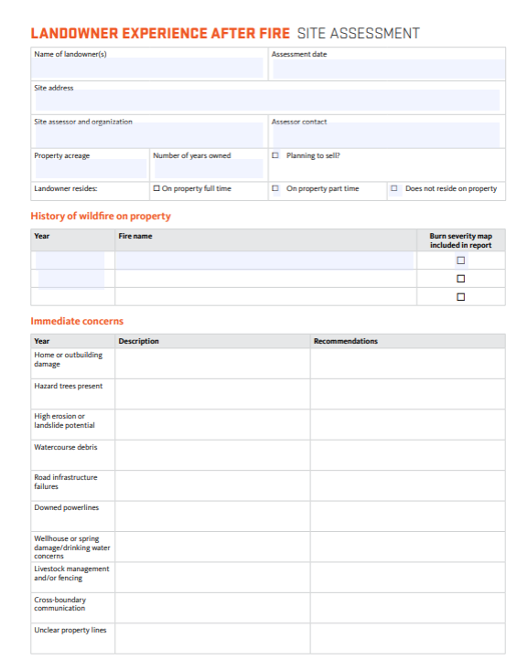
Post-fire Site Assessment Template
Make starting post-wildfire restoration easier
Identify and prioritize
Increase knowledge of resources by landowners
Start conversation about next steps
Who will use it?
Local organizations working with post-wildfire impacted landowners
Site assessors with at least a basic knowledge of forestry and fire
Technical experts needing guidance on effective landowner engagement post-wildfire
Notes:
On that note, OSU Extension recently published a free template and guide to conducting these initial site assessments following a wildfire. We’ve compiled it as a first stab designed to get an initial understanding of the damage and opportunities presented by the wildfire, establish priorities, and give landowners tangible next steps and Resources to meet those goals.
The site assessment covers immediate/emergent concens, on the ground conditions such as mortality rates, burn severity and erosión potential, a limited action plan made up of strategies to approach the landowners’ top priorities, and Resources, inclduing funding sources and partnering organizations who can Help the landowner reach their goals.

Slide 14
The typed out template serves as a report for the landowner.
Includes photos with caption descriptions.
Adds any additional resources discovered after the visit and confirmed contact information where applicable.
Includes contact information for the assessor for future questions.
Newly Published! EM 9605
Digital product in the works
https://extension.oregonstate.edu/catalog/em-9605-postfire-follow-using-leaf-assessment-template

Slide 15
Discussion Question
Would you find the LEAF Site Assessment Template to be a useful tool in initial post-wildfire conversations with your forest landowners?

Slide 16
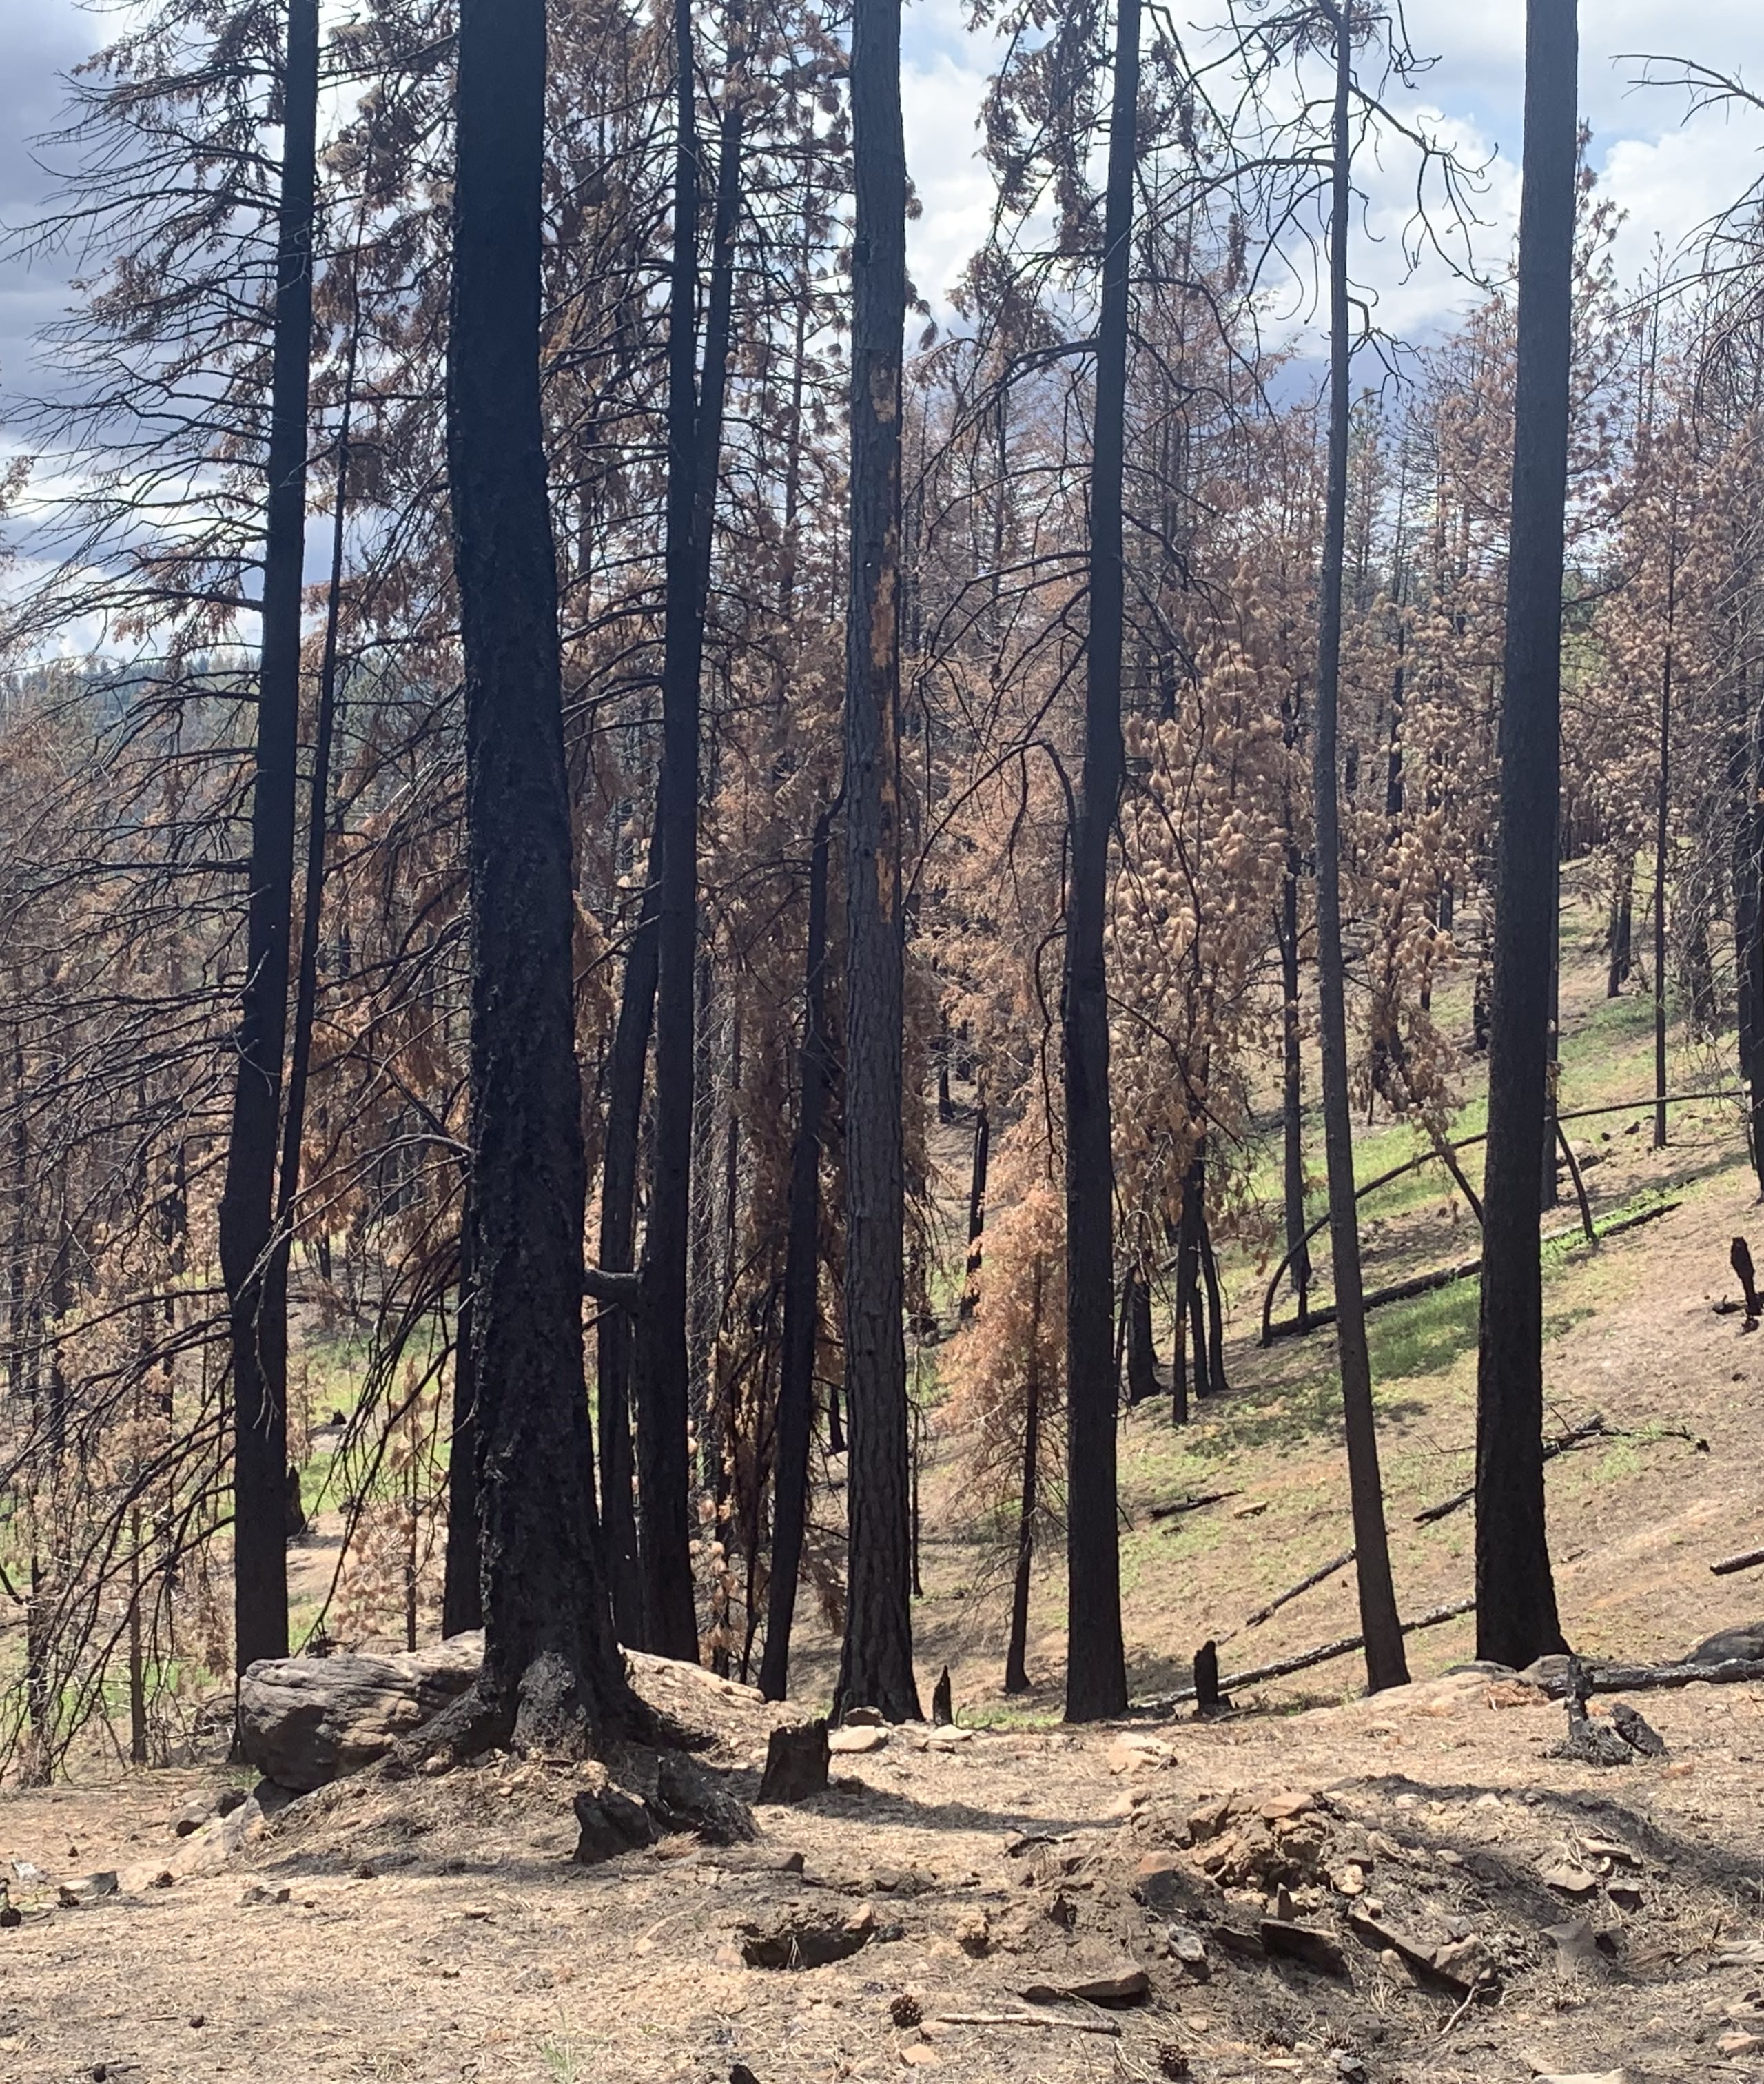
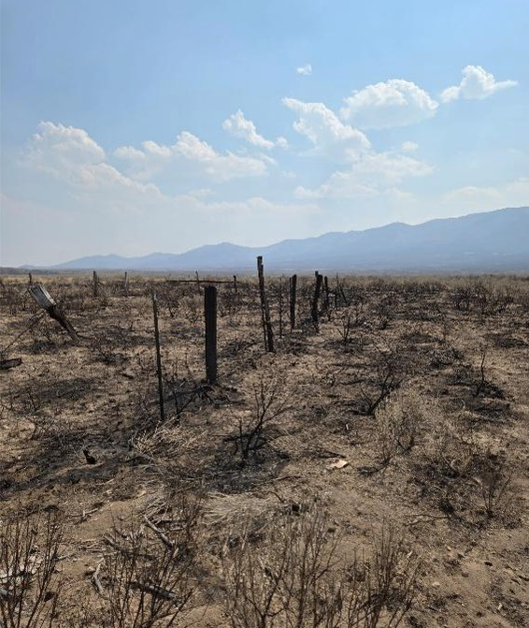
From forests to rangelands
Notes:
LEAF isn't the only post-wildfire project done by OSU and we found different take home messages across our projects that are applicable to SWCDs as well as OSU Extension.
2024 was a significant fire year for Malheur county and OSU Ext was a part of the recovery effort after the fires had passed. While in the past fire-recovery may have looked like reseeding rangelands according to wherever seed could be obtained, OSU Extension and partners worked together to identify priority areas for restoration to make the most of limited resources. This is a conversation SWCDs can and should be a part of as well.

Slide 17
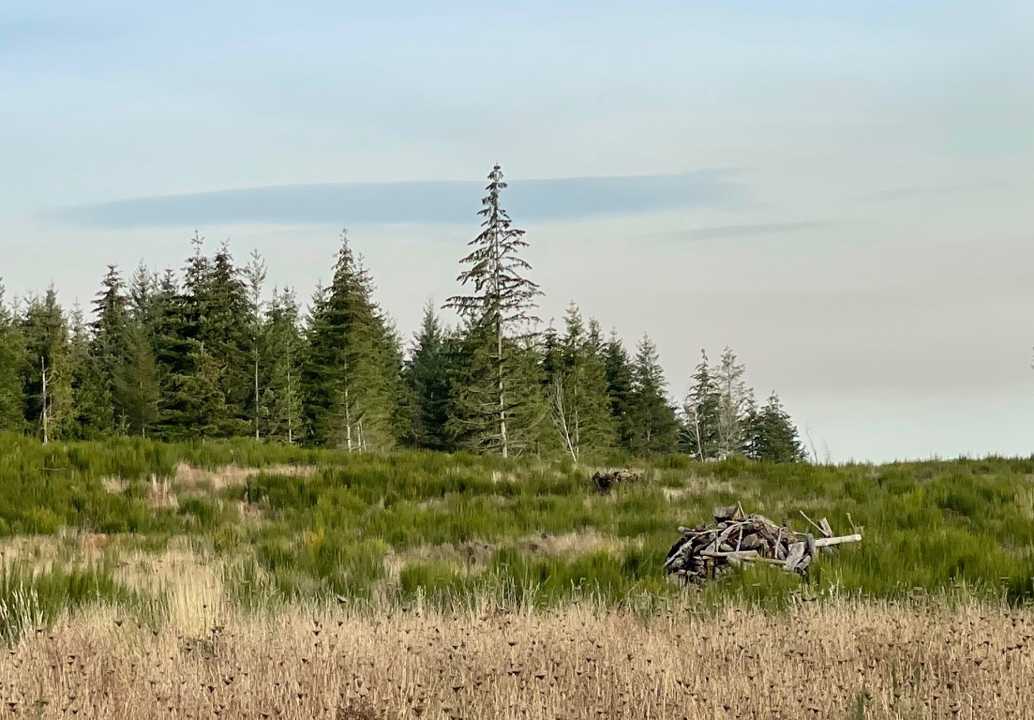
Notes:
Extensive scotch broom invasion in a post-fire reforestation area. Year 4 post-fire.

Slide 18
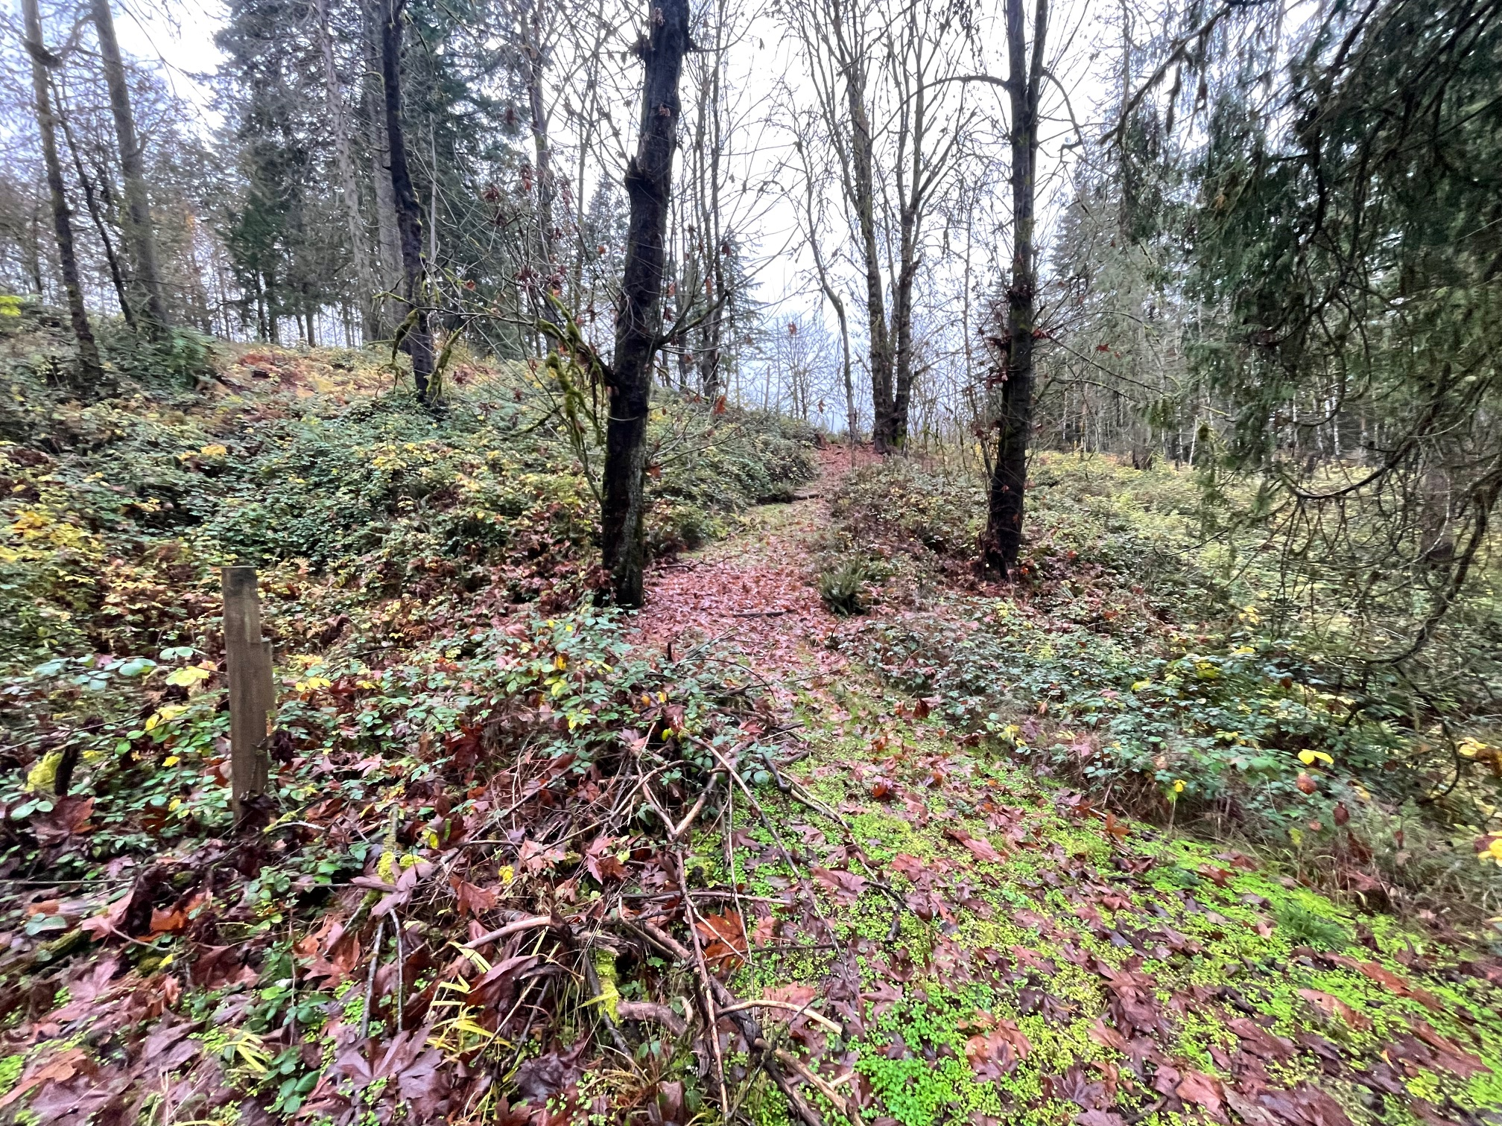
Notes:
Himalayan blackberry took over this post fire area that was previously hardwoods with some scattered conifer. The landowner had planted and made several attempts to control blackberry, but the regeneration has failed.

Slide 19
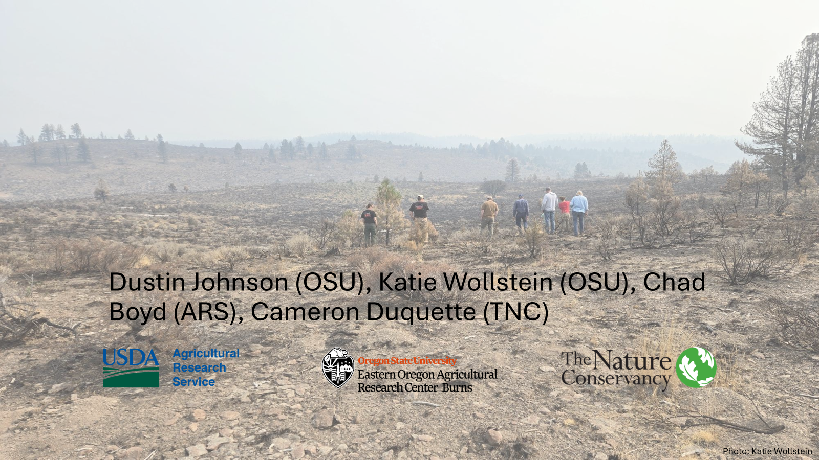
Threat-Based Strategic Conservation to inform post-fire planning

Slide 20
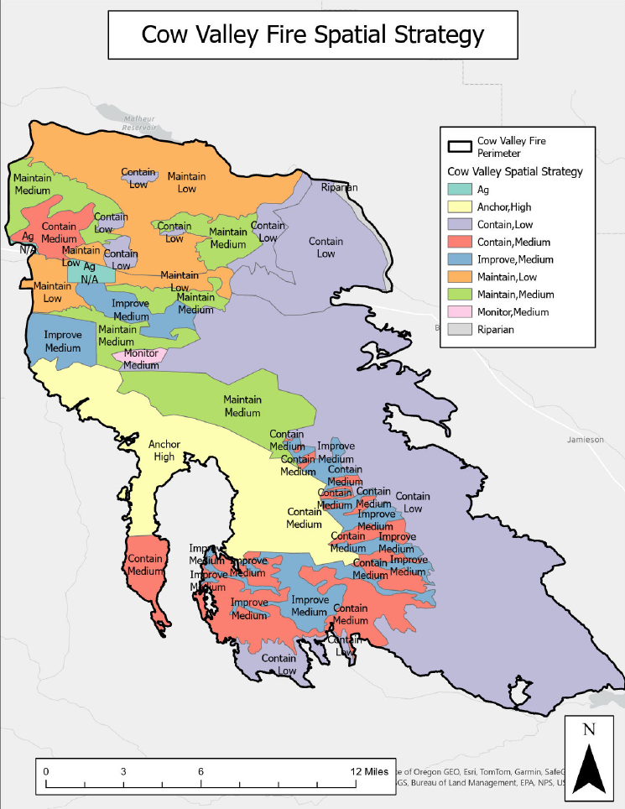
Threat-Based Strategic Conservation (TBSC) program. post-fire planning framework
Uses 5 categories to make the decision space smaller
Anchor
Maintain
Improve
Contain
Monitor
The “Why” behind a spatial strategy
https://rangelands.app/
Notes:
Partners worked together using tools like the rangelands app to identify opportunities for success in reseeding and prioritizing where seed should go.
Anchor: “Where is success likely and sustainable?”
Maintain: “Where do we have the most to lose?”
Improve: “Where are we pretty certain we can make gains?”
Contain: “Where were landscapes in poor condition before the fire and not likely to have much success after the fire?”
Monitor: We need more info to figure out what bin it should go into

Slide 21
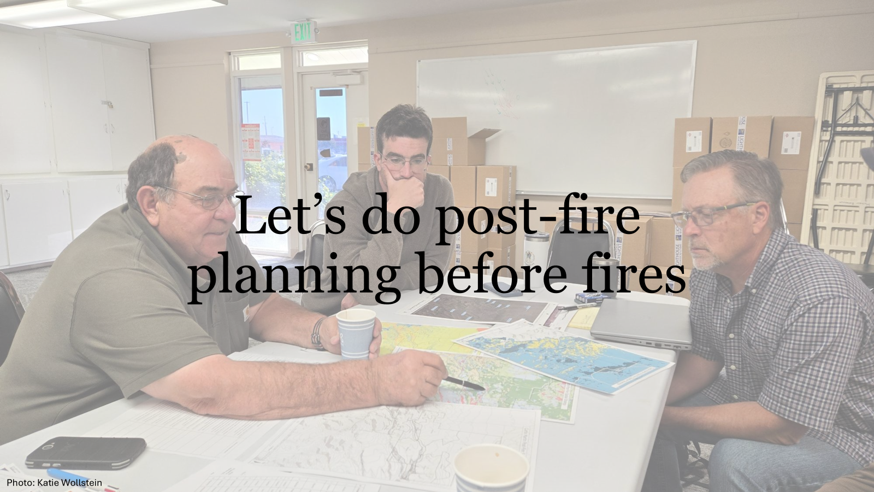
Notes:
Post-wildfire restoration priorities and opportunities don’t have to be determined only after a fire. While burn severity and fire footprints will ultimately impact where restoration work should be done, some of the decision making can be done before fire ever touches the ground.
Focus on prioritization, opportunities, challenges likely to exist after wildfire; both on the landscape itself and based on landowner knowledge and capacity.

Slide 22
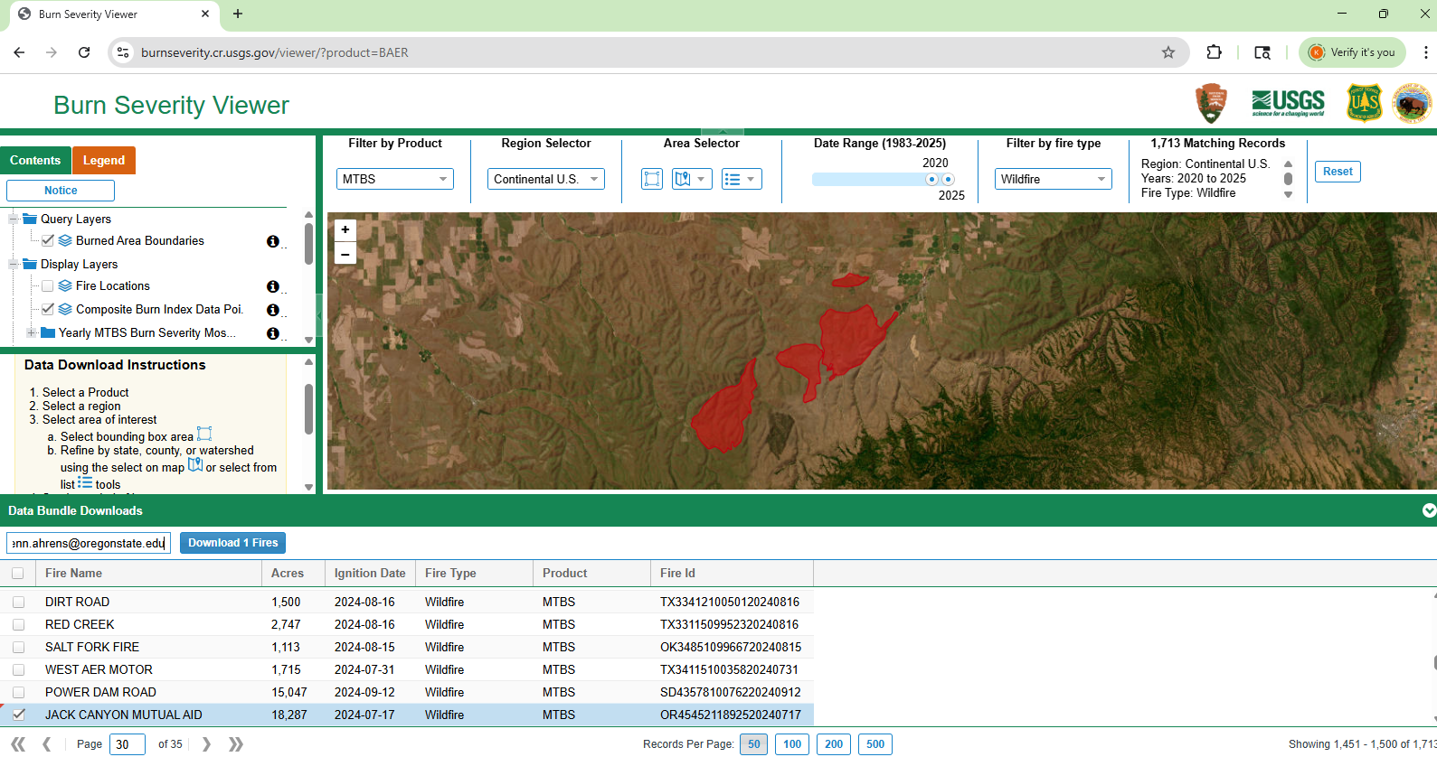
Rapid Response capacity Identify affected landowners and local partner capacity
Fire footprint & BAER data
Taxlot data
Vegetation data
Take stock of local partner capacities, form local working groups
https://burnseverity.cr.usgs.gov/viewer/?product=BAER
Notes:
LEAF didn't identify how landowners were initially engaging with SWCDs and other organizations, so outreach may be part of the puzzle to being more effective. It is important to maintain a well representative mailing list and taxlot data, vegetation data. GIS capacity within your office or through partners is crucial! It can take time to get information on burn severity, especially when fires do not impact public lands. For fires that do, BAER is a useful tool. For those that don’t, ODF will often produce their own burn severity maps.
American Forests is also developing a tool that potentially will make a one stop shop for all of this data.

Slide 23
What to expect when you aren’t expecting (wildfire)
Deliver post-fire education before the fire
Include post-fire plan in Forest Management Plans
Add post-wildfire language to your technical assistance conversations pre-wildfire , i.e.
“What do you see for this forest if it were to burn?”
“Even if you wouldn’t do a timber harvest now, would you salvage log?”
Get landowners familiar with programs and funding sources that can help them post-wildfire
Notes:
Given that one of the major stumbling blocks for landowners is not knowing what they don’t know, LEAF showed that Education is one of the tools we can use to increase Restoration success. OSU extension has a variety of educational resources including recorded webinars and post-wildfire checklists as a part of our Fire Aware Fire Prepared series. We are working on updating these resources which came about following the 2020 Labor Day fires and can be shared by SWCDs to landowners looking for help. This will include topics like how to assess for burn severity, mortality, where to turn to for help and financial assistance, salvage logging, planting, etc

Slide 24
Discussion Question
Do you have connections with the organizations you think would need to be involved in post-wildfire prioritization?

Slide 25
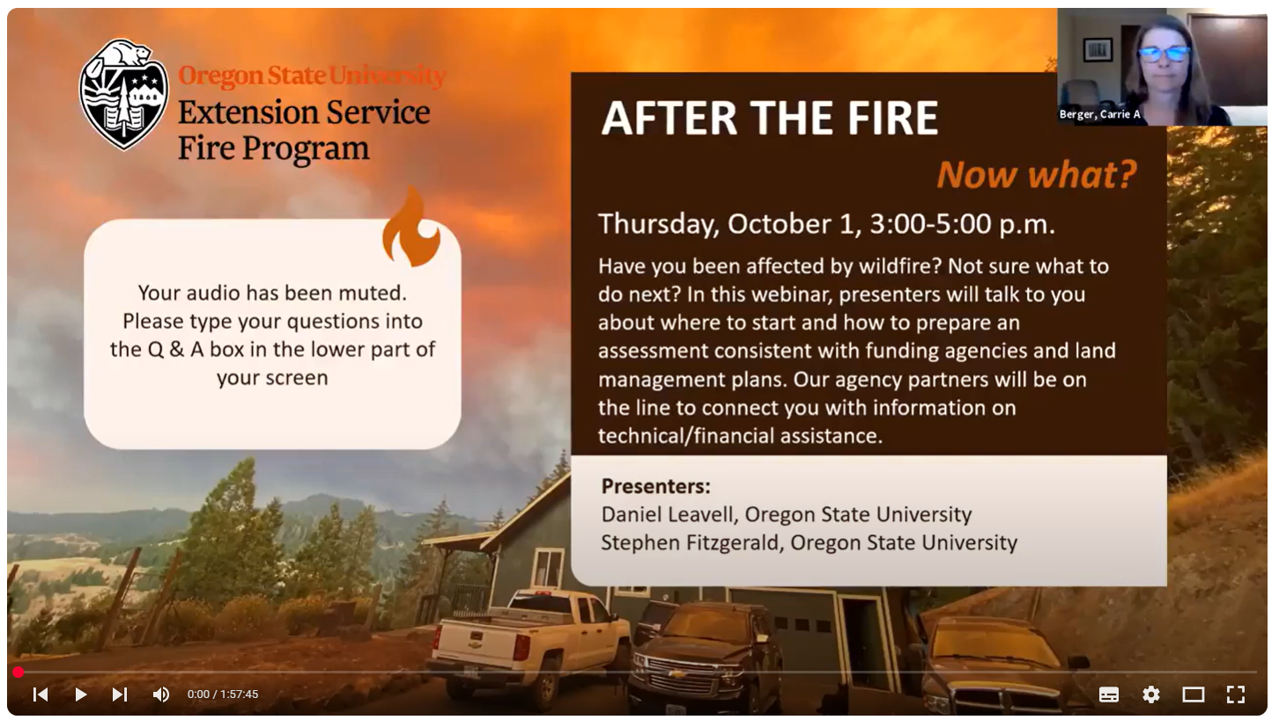
The Role of Education
OSU Resources on Post-wildfire Education
Notes:
Given that one of the major stumbling blocks for landowners is not knowing what they don’t know, LEAF showed that Education is one of the tools we can use to increase Restoration success. OSU extension has a variety of educational resources including recorded webinars and post-wildfire checklists as a part of our Fire Aware Fire Prepared series. We are working on updating these resources which came about following the 2020 Labor Day fires and can be shared by SWCDs to landowners looking for help. This will include topics like how to assess for burn severity, mortality, where to turn to for help and financial assistance, salvage logging, planting, etc

Slide 26
OSU Extension Forestry and Natural Resources Post-fire Recovery & Reforestation - Next steps
Publication - Navigating a path to wildfire recovery
Update OSU Extension “After the Wildfire” education resources – online resources, videos, workshops.
Facilitate local and Statewide partnerships and collaboration for effective landowner assistance with fire-recovery and reforestation.
Work with Sustainable Northwest and American Forests on the Pacific Northwest Reforestation Network
Notes:
Given that one of the major stumbling blocks for landowners is not knowing what they don’t know, LEAF showed that Education is one of the tools we can use to increase Restoration success. OSU extension has a variety of educational resources including recorded webinars and post-wildfire checklists as a part of our Fire Aware Fire Prepared series. We are working on updating these resources which came about following the 2020 Labor Day fires and can be shared by SWCDs to landowners looking for help. This will include topics like how to assess for burn severity, mortality, where to turn to for help and financial assistance, salvage logging, planting, etc

Slide 27
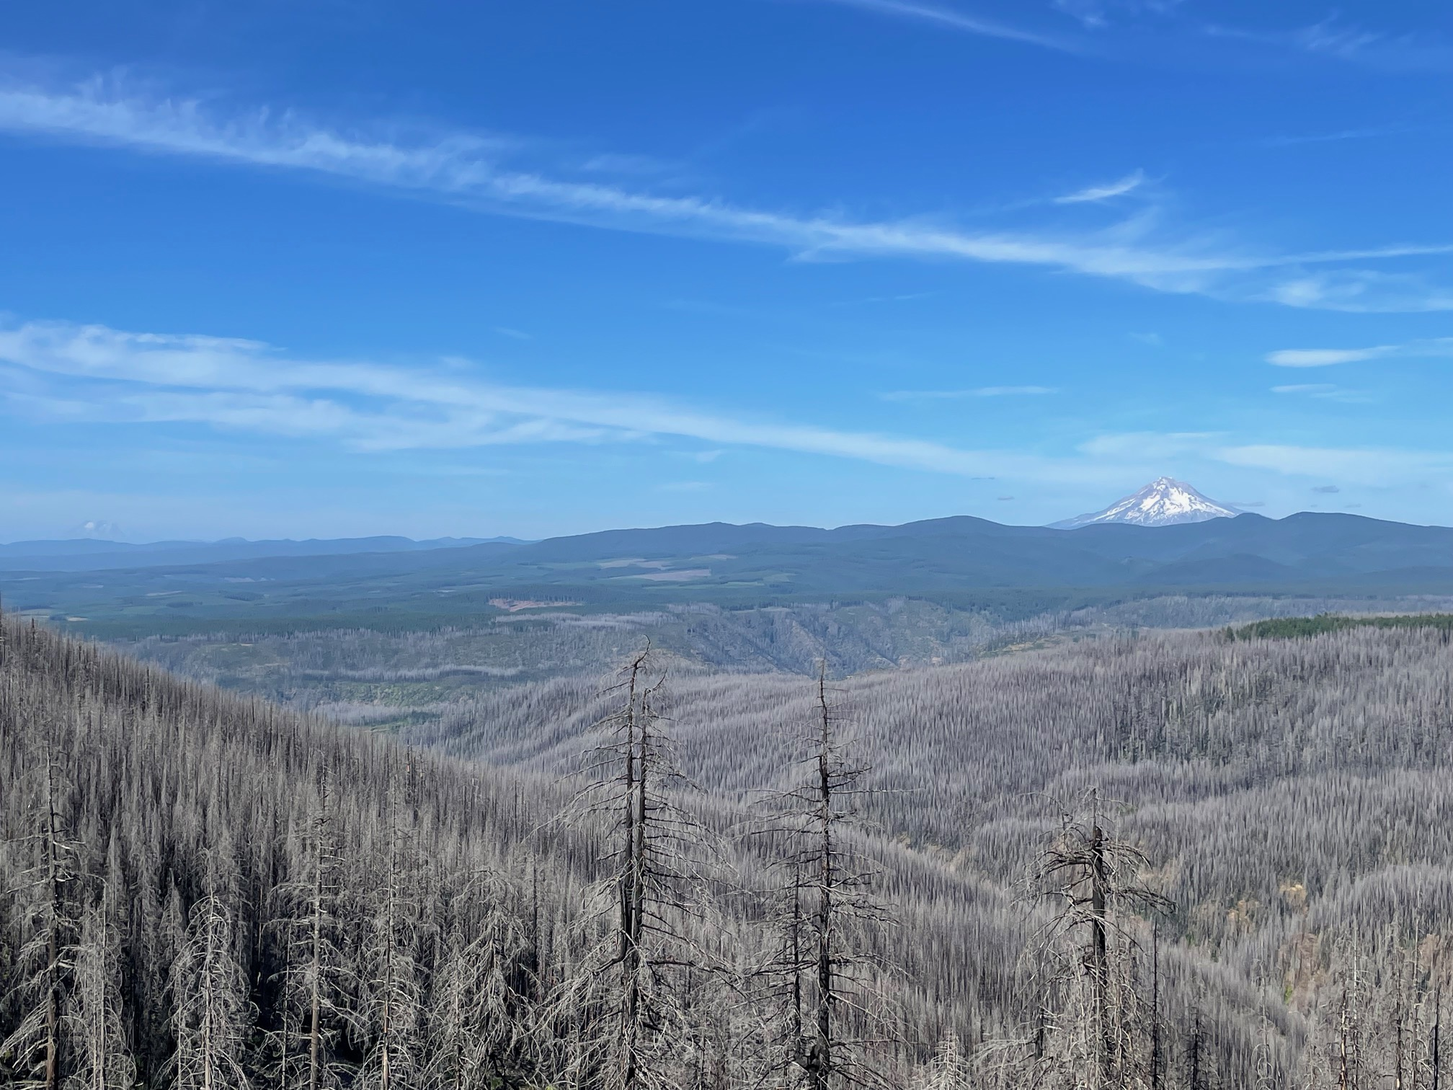
Questions

