Slide 1

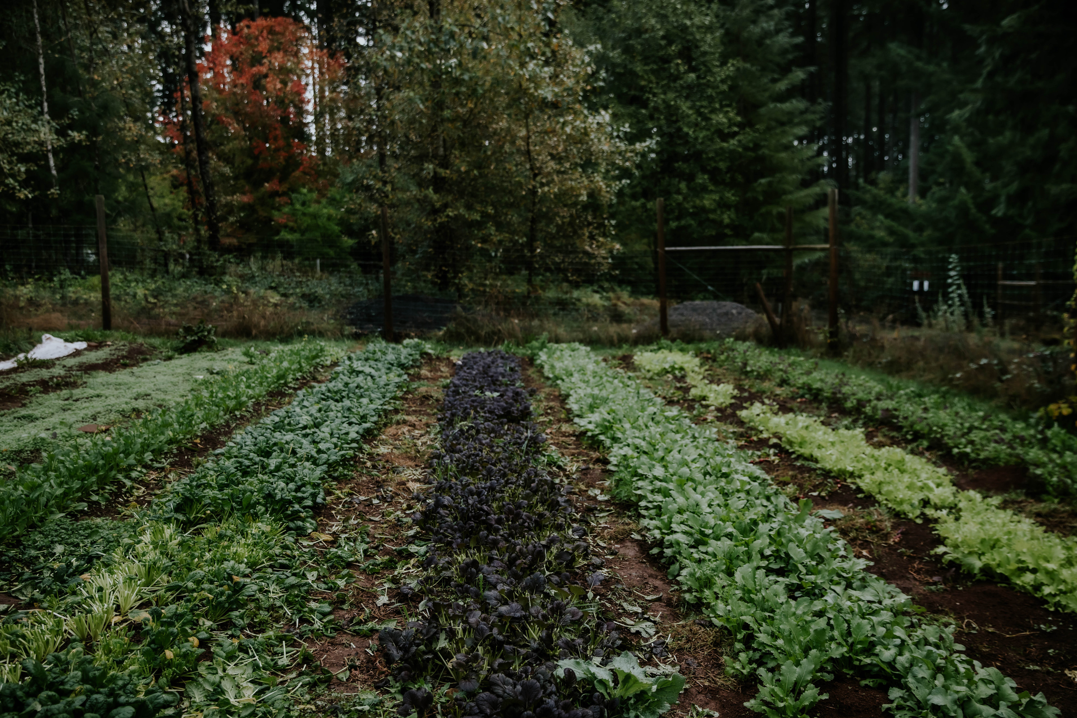


OACD 2025 annual conference
Oregon’s Statewide Soil Health Network
Sage Fairman, Program Manager
Oregon Climate & Ag Network (OrCAN)
Notes:
Read the room: who is familiar with our work?

Slide 2

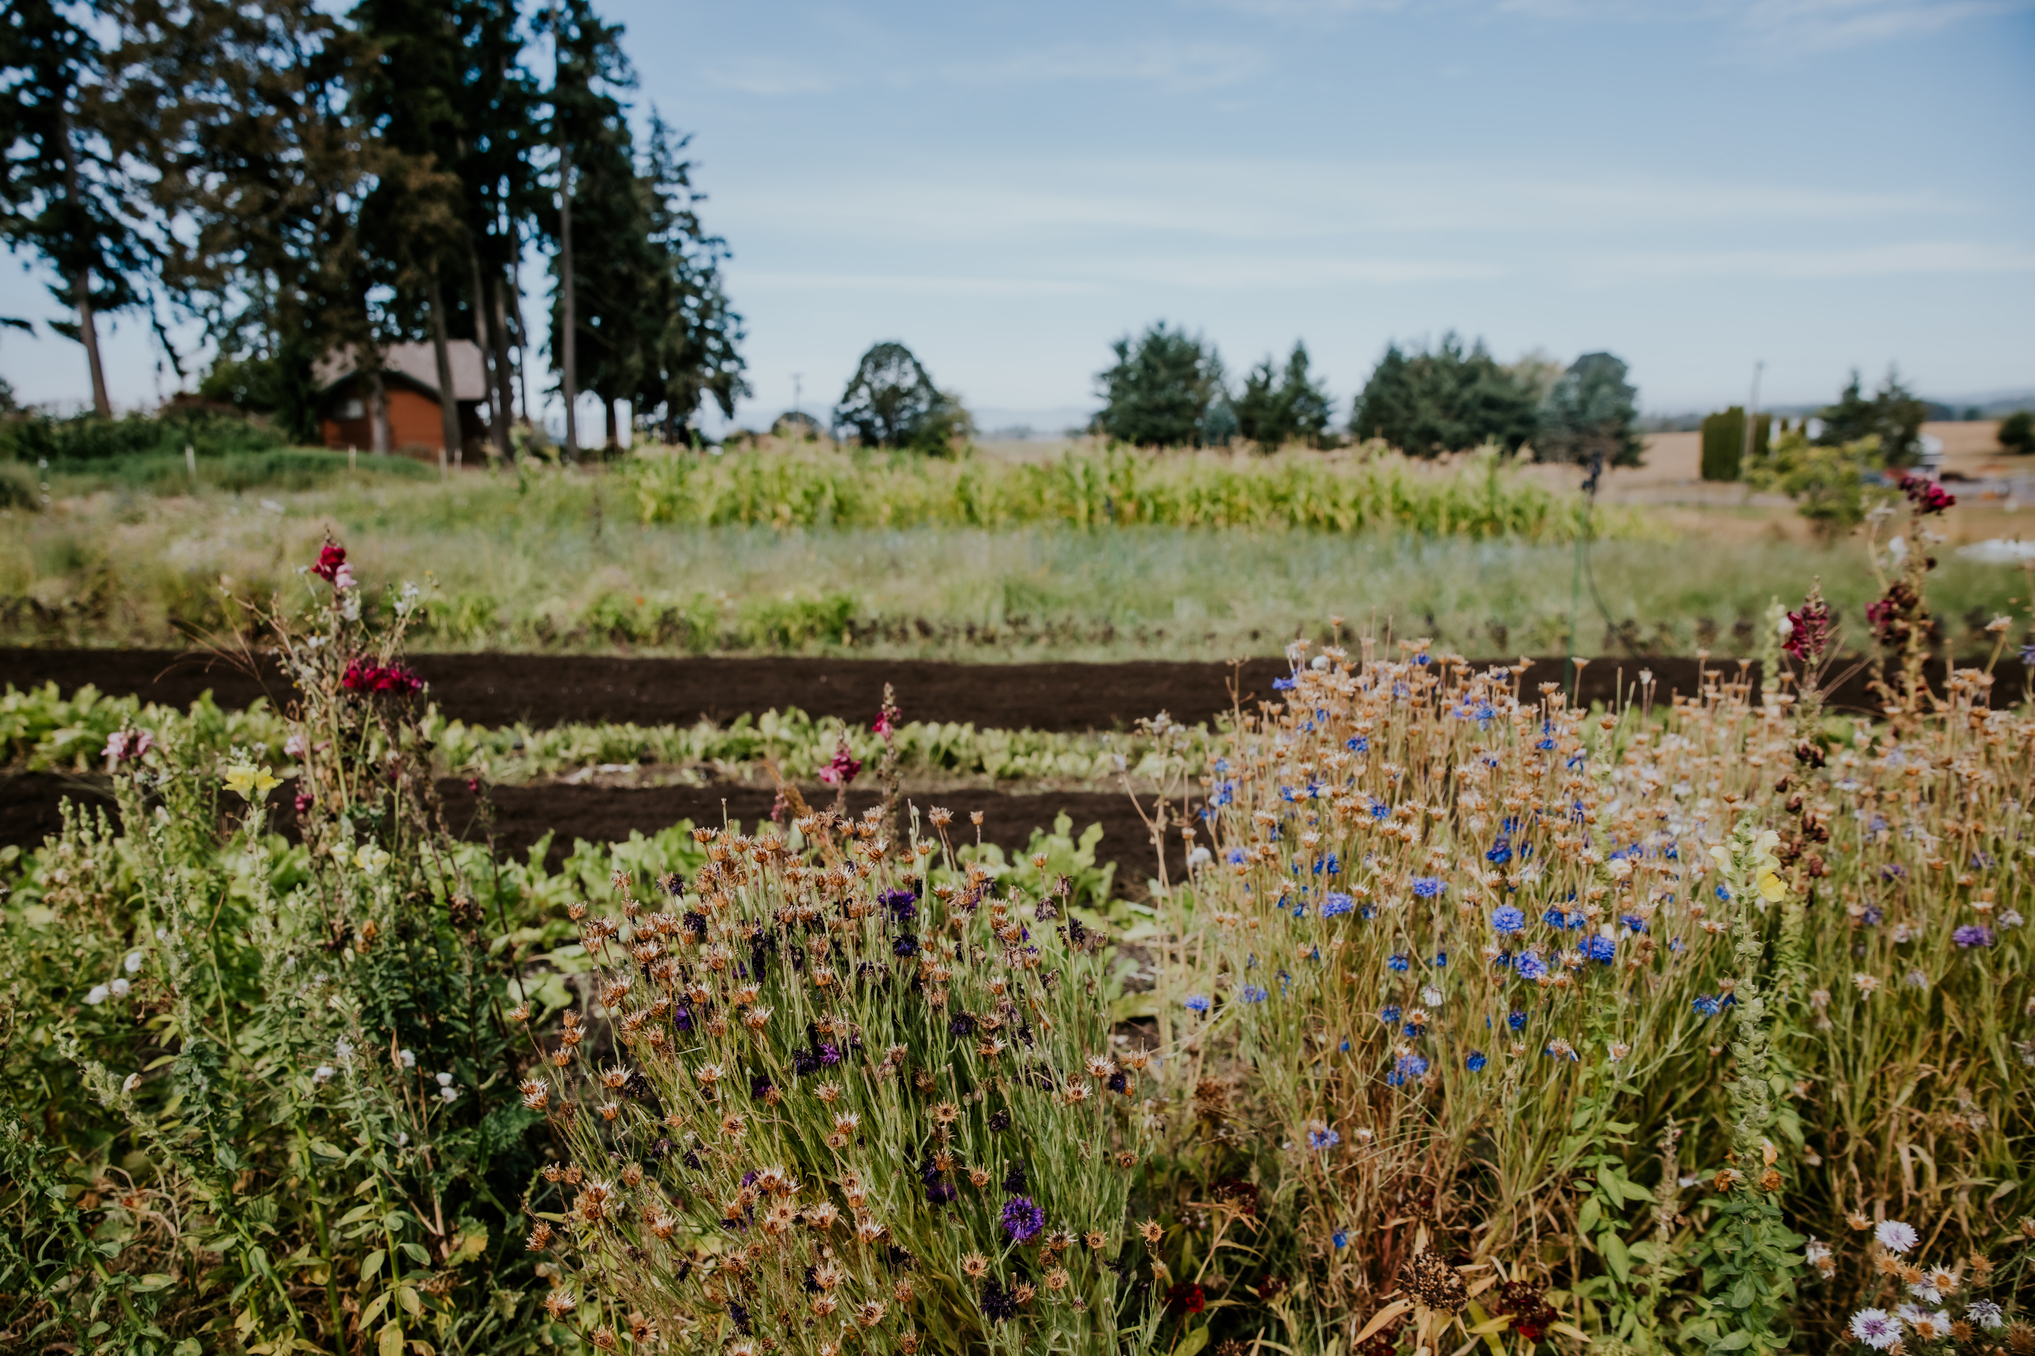
Because their work is directly tied to land and water, Oregon’s farmers and ranchers are on the frontlines of disasters and of climate change.
Farmers and ranchers can play a key role in mitigating climate change and building disaster resilience by cultivating healthy soil.
As we face increasing threats from heat domes, drought, floods, wildfires, and unpredictable weather, soil health practices are more important than ever.
Notes:
healthy soil builds climate resilience by:
-improving water infiltration
-water holding capacity
-biodiversity,
-plant health and productivity
-reducing fire fuels,
all creating resilience to extreme weather, pests, and diseases.

Slide 3




OrCAN’s Vision and Mission
Our Vision
Our Mission
We envision a future where healthy soils are the foundation of thriving food systems in Oregon–reconnecting healthy ecosystems, economies, and communities.
OrCAN’s mission is to convene an inclusive, producer-centered network to promote soil health and climate resilience across Oregon through collaboration, education, and advocacy.
Notes:
As we work to promote soil health and climate resilience, we are committed to honoring the leadership, knowledge, and sovereignty of Indigenous communities across Oregon.
We acknowledge that all of our work takes place on the ancestral lands of Oregon’s Tribal nations. We recognize the leadership of Indigenous communities in land stewardship and soil health practices, and we are committed to honoring these contributions through intentional relationship-building, collaboration, and representation in our work

Slide 4

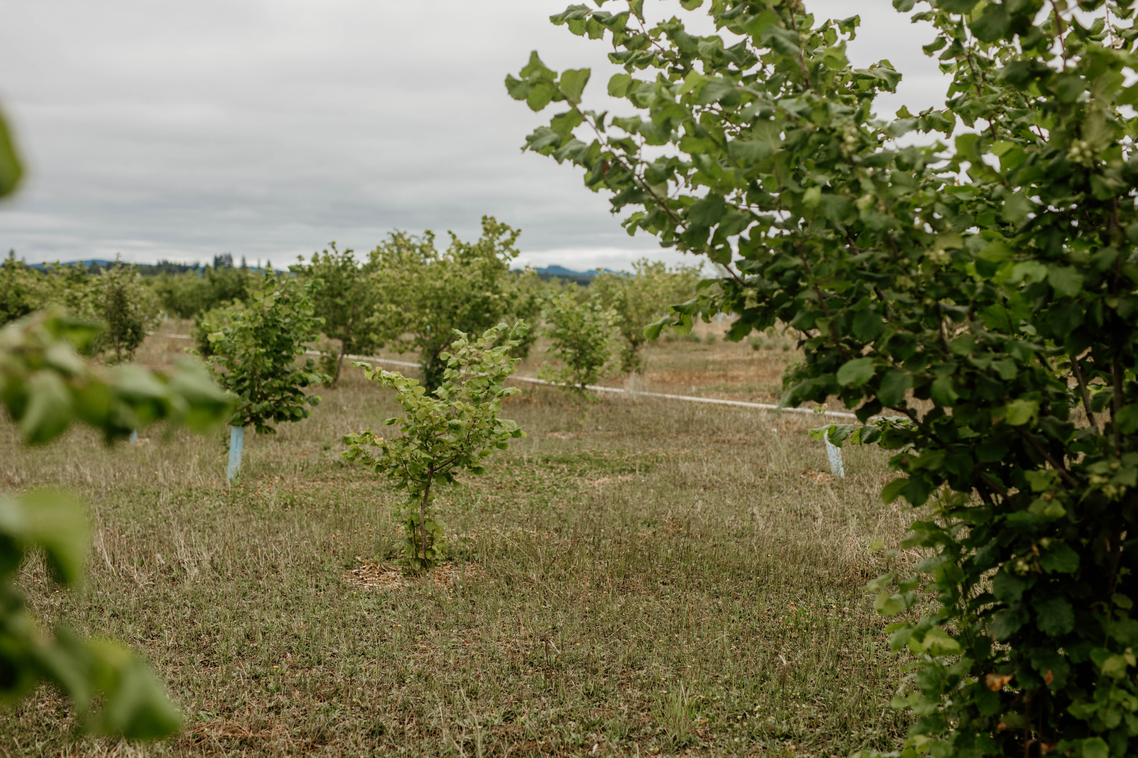


Soil Health Network
The statewide Soil Health Network cultivates soil health for climate resilience–connecting farmers, ranchers, and farm service providers.
It offers place-based, bioregion-specific resources, connection and culturally specific support.
The goal is to ensure all of Oregon’s producers have the support they need to improve soil health and build climate resilience.
Notes:
From January-May 2024, twenty-five Oregonians worked together to clarify the structure

Slide 5
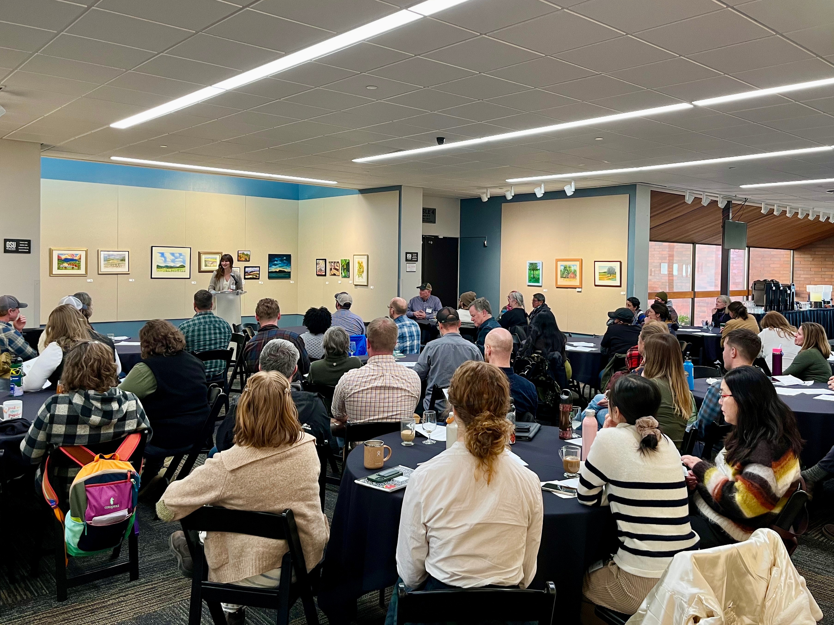
January 2025
Soil Health Summit
Notes:
How we recently engaged our network. Who attended?

Slide 6
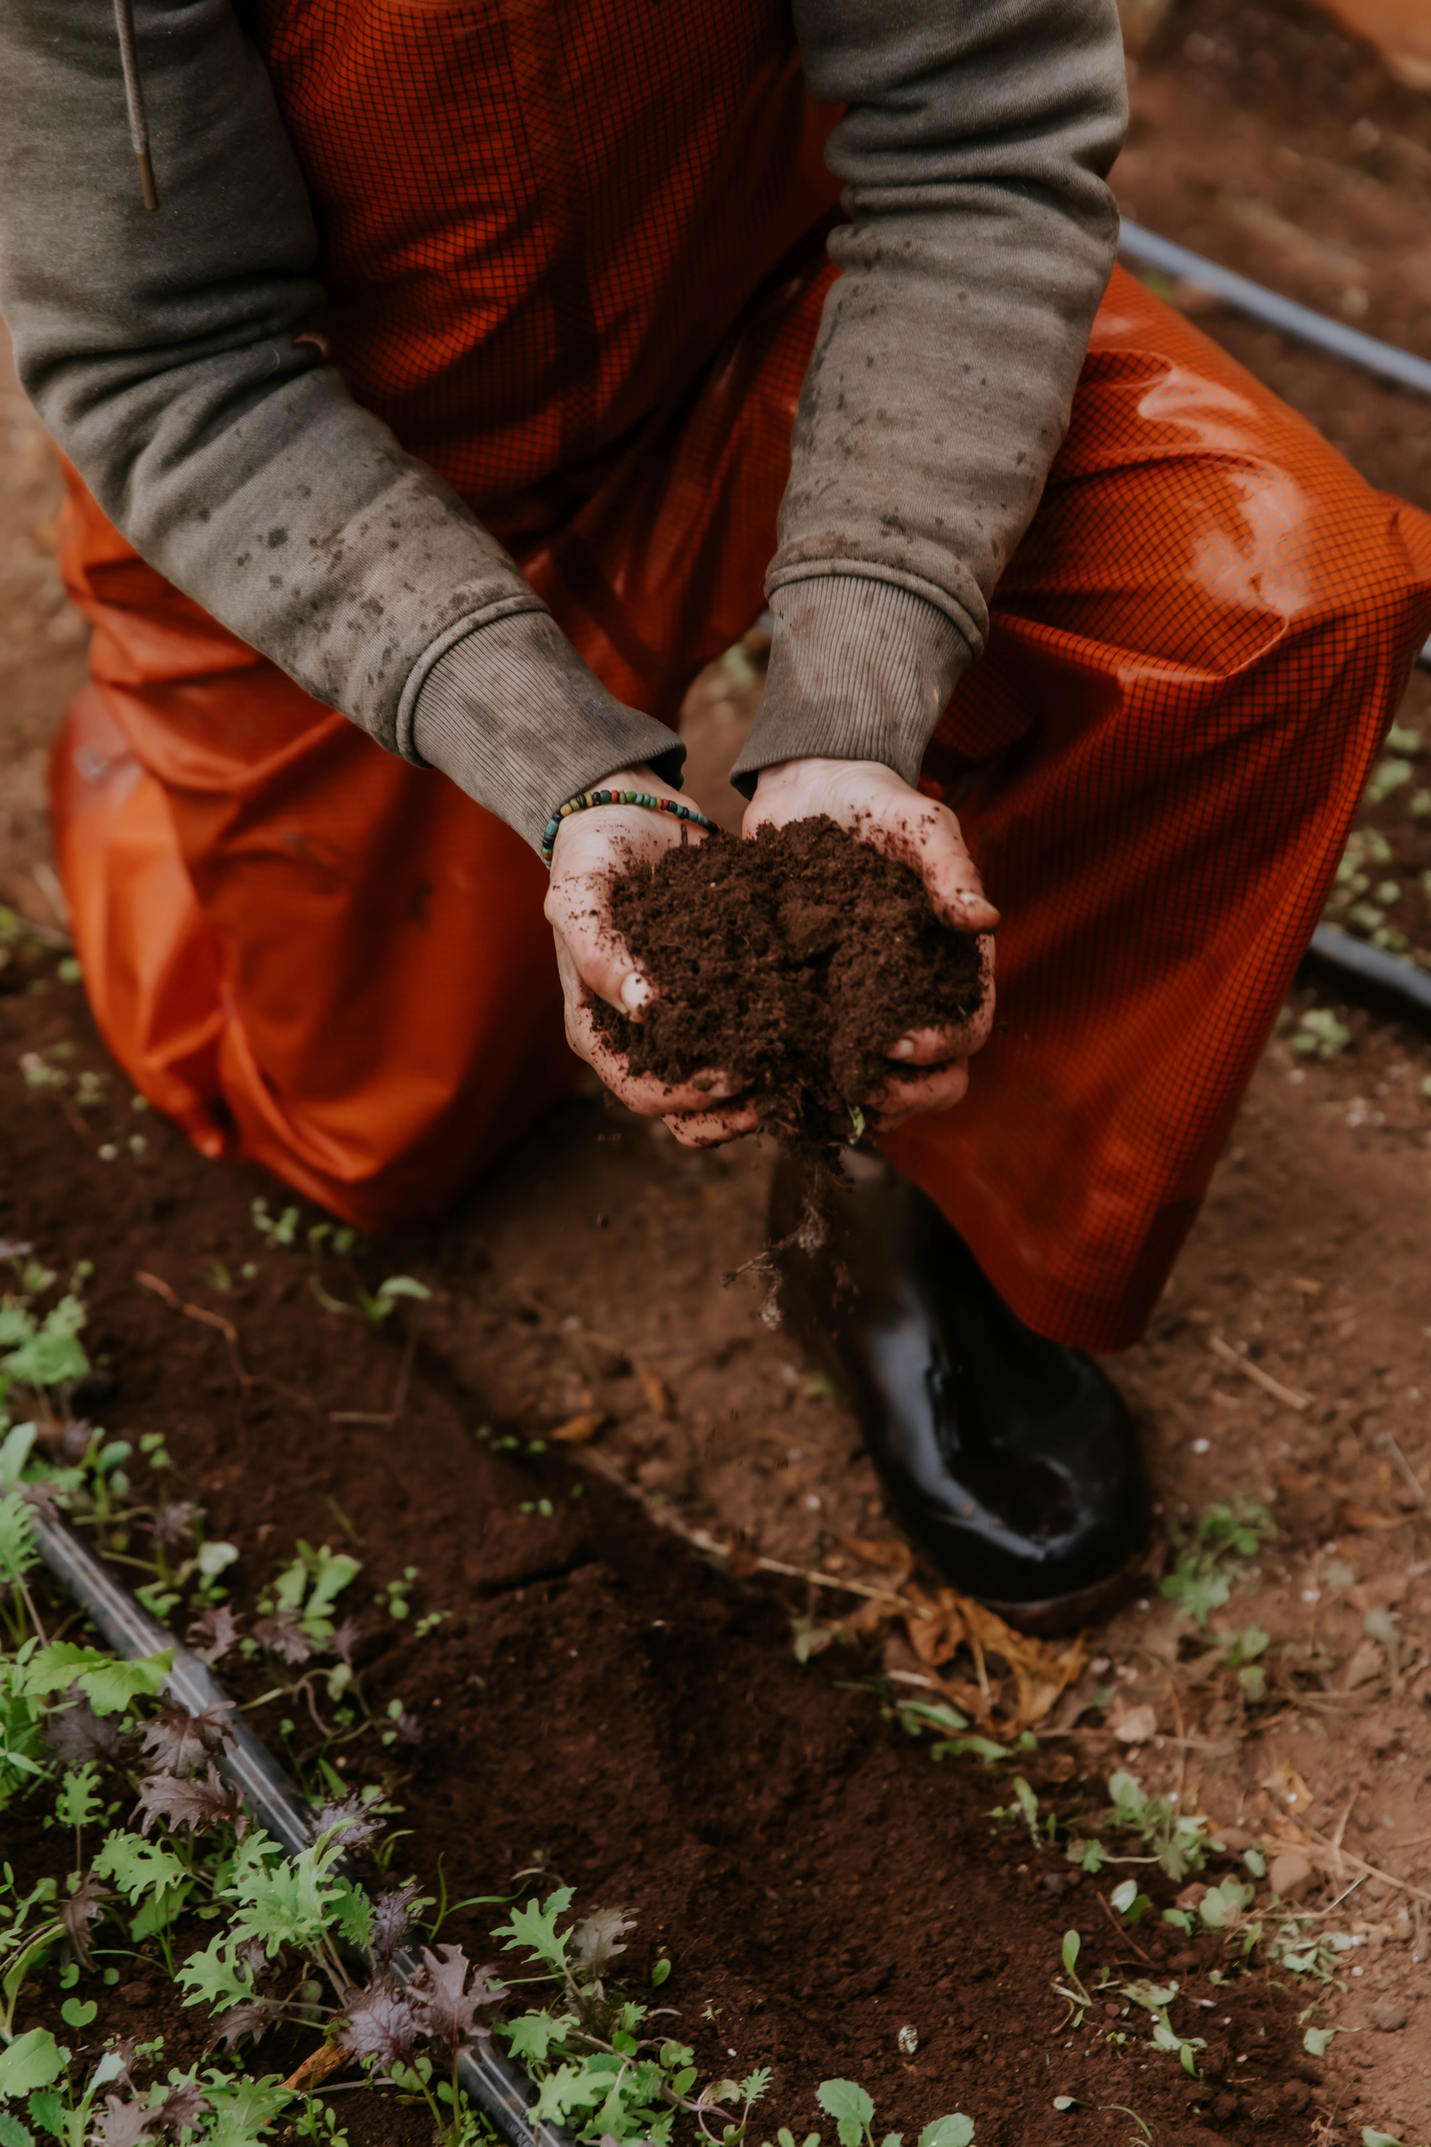
Key Partner Gathering Takeaways
  While we have different audiences of producers and different services across the state, we are all working in the same direction and could support each other to reach complementary groups
  As individuals, there are a lot of capacity constraints. With a network structure, we could leverage relationship building and pool resources
  A network structure could offer a space to share best practices and lessons learned
Notes:
The day before the summit, we hosted the Key Partners Gathering, including many of the network leads. Here's what we took away from the gathering,

Slide 7
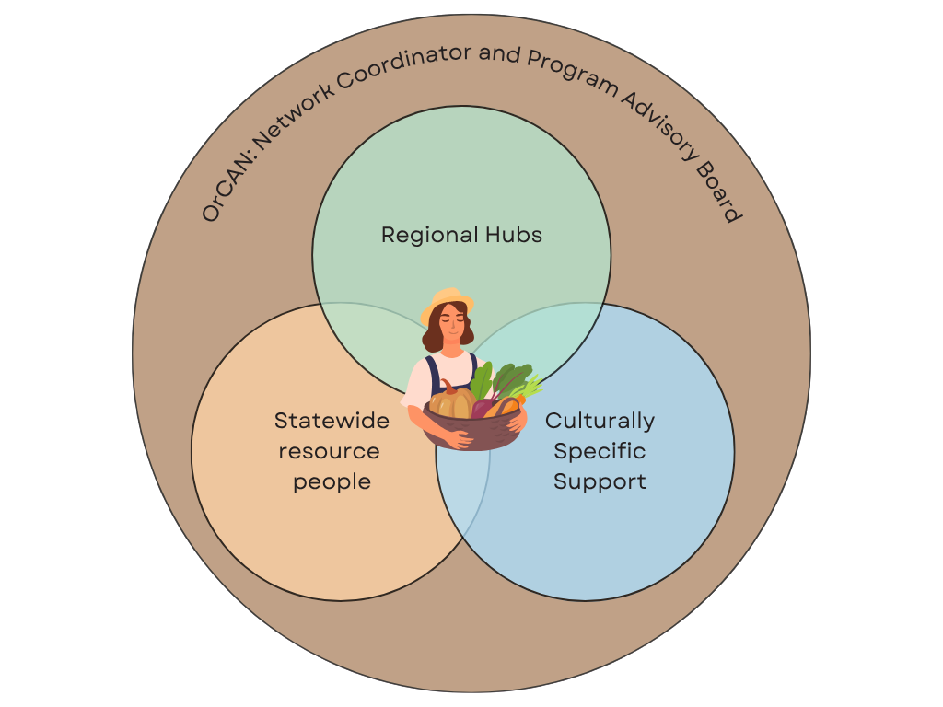
Who?
  OrCAN: Stewards the overall Network
  Regional Hub Leads: Go-to people in each region for soil health support and referrals on the ground
  Culturally-Specific Support: Provides support referrals, and specialized expertise for BIPOC producers
  Statewide Resource People: Those with technical/institutional expertise, tools, & resources on soil health practices
  Producers: Farmers, ranchers, or farmworkers interested in maintaining or improving their soil health
  Other Farm Service Providers (FSPs): Those providing technical assistance, resources, education, or other services to producers
Notes:
Who?
Network Coordinator, Oregon Climate and Agriculture Network (OrCAN): Stewards the overall Network, coordinates RHLs and ASOs, and maintains statewide connections
Regional Hub Leads (RHLs): Go-to people in each region for soil health support and referrals on the ground
Culturally-Specific Support Organizations (CSSOs): Provides culturally-specific support, referrals, and specialized expertise for BIPOC producers
Statewide Resource People: Those with technical and/or institutional expertise, tools, and resources on soil health practices
Producers: Farmers, ranchers, or farmworkers interested in maintaining or improving their soil health
Other Farm Service Providers (FSPs): Those providing technical assistance, resources, education, or other services to producers

Slide 8

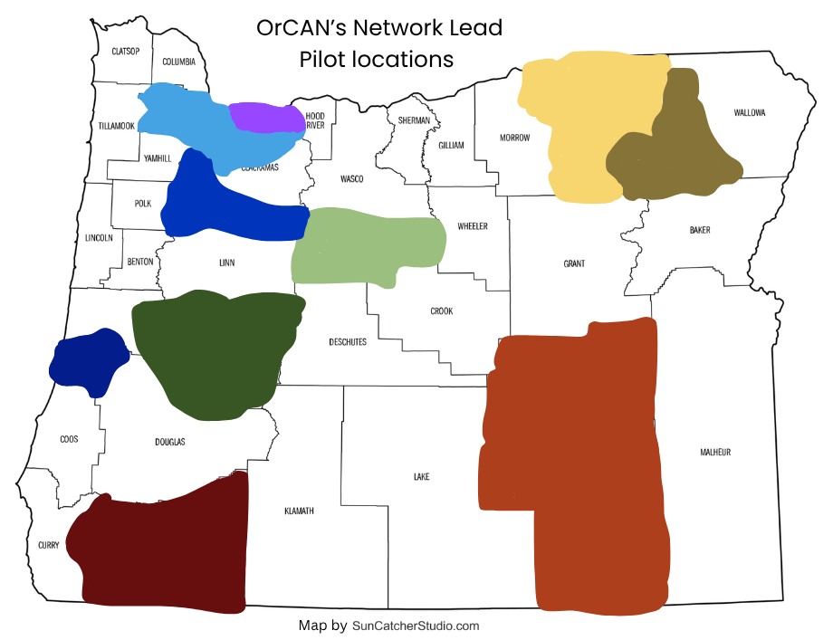


Regional Hub Leads
  Coast Fork Willamette Watershed Council (South Willamette Valley)
  East Multnomah SWCD
  Harney SWCD
  Jefferson SWCD
  Marion SWCD
  Rogue Valley Group: Rogue Valley Food System Network, Jackson SWCD, OSU Extension (Jackson/ Josephine counties)
  Tiichám Conservation District (serving Tribal producers within the ceded boundary of the Cayuse, Umatilla, Walla Walla Tribes in NE Oregon)
  Umpqua SWCD (South Central Coast)
  Union SWCD
Regional Hubs
Auxiliary Support
9
3

Slide 9
Culturally-Specific Support
Statewide Resources
  Practices including cover crops, no-till, perennials, rotational grazing, crop rotation/ diversification, agroforestry, and supporting integration of multiple practices and IPM (OSU Extension, ODA, consultants, crop advisors, nonprofits)
  Crop types including diversified vegetables, orchards, vineyards, livestock, grains, etc. (OSU Extension agents)
  Farm size/scale (OSU Extension Small Farms)
  Funding (NRCS, State agencies, Zero Foodprint and OCFSN)
  Soil testing (OSU Soil Health Lab)
  Workforce development (labor trainers/consultants)
  Black Food Sovereignty Coalition (serving Black and Indigenous producers in Portland Metro area)
  Ecotrust (serving BIPOC producers in Portland Metro area)
  Adelante Mujeres (serving Latine producers in Washington County)

Slide 10
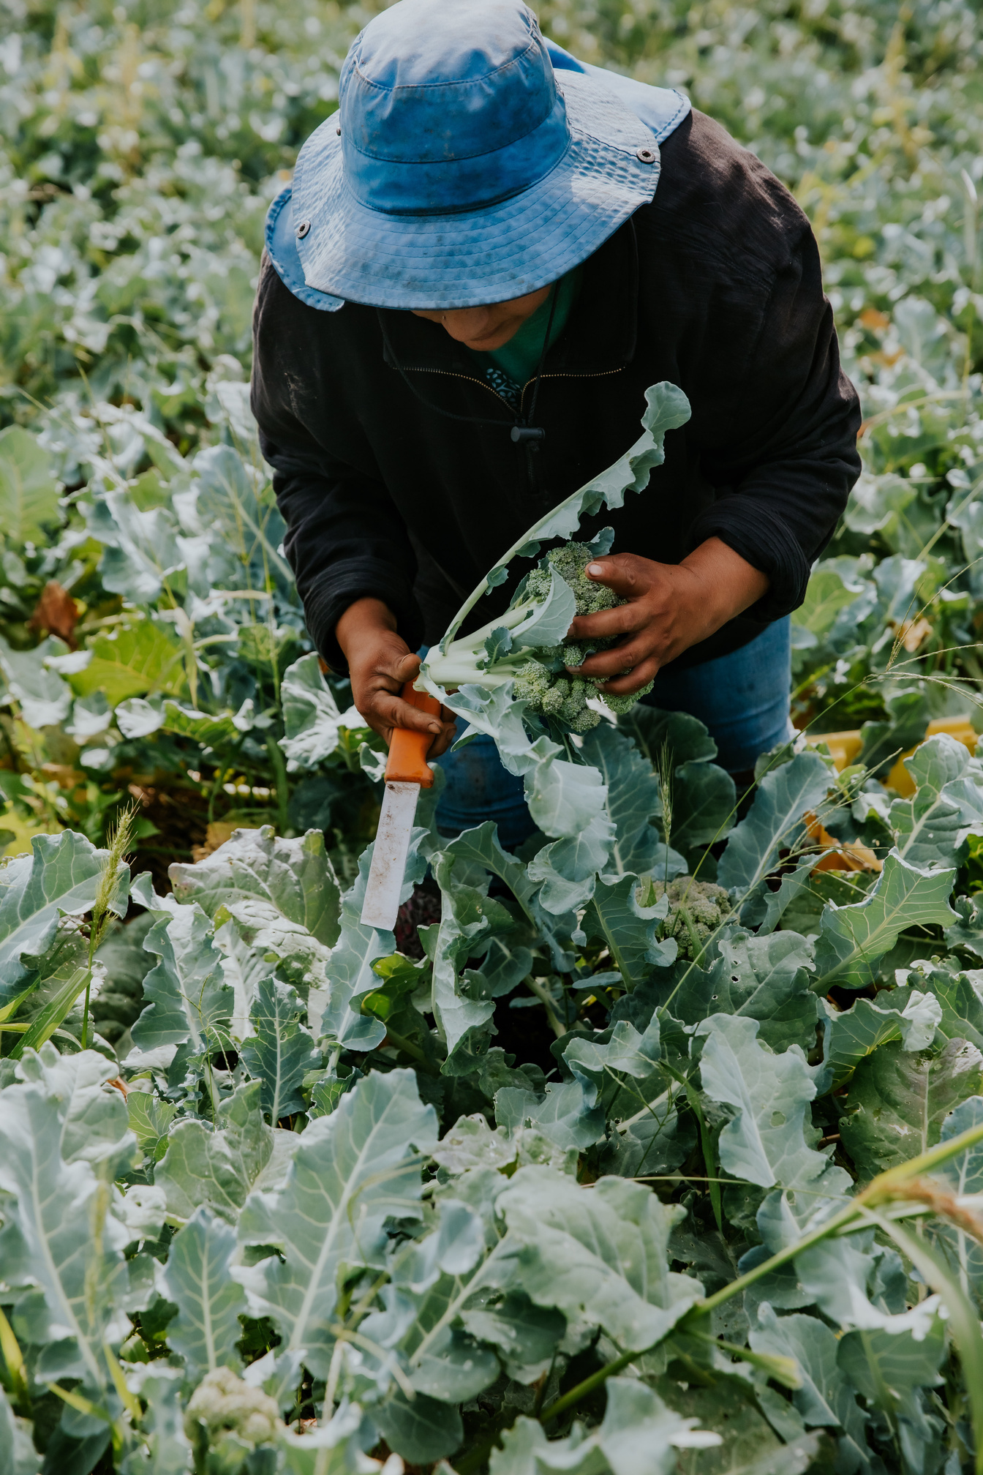
Pilot Year Goals
July 2025- June 2026
Foster connection and align efforts
Convene a statewide Soil Health Network of diverse farm service providers (FSPs) to share knowledge, strategies, and resources, fostering cross-regional learning and collaboration.
Strengthen farm service provider capacity
Partner with place-based and culturally specific FSPs, providing funding, connections, and resources. Provide trainings on soil health science and engagement strategies to help FSPs serve a wider range of producers.
Streamline Relevant Resources
Improve access to resources through OrCAN’s website, and leverage statewide connections to develop new materials based on producer-identified needs.

Slide 11
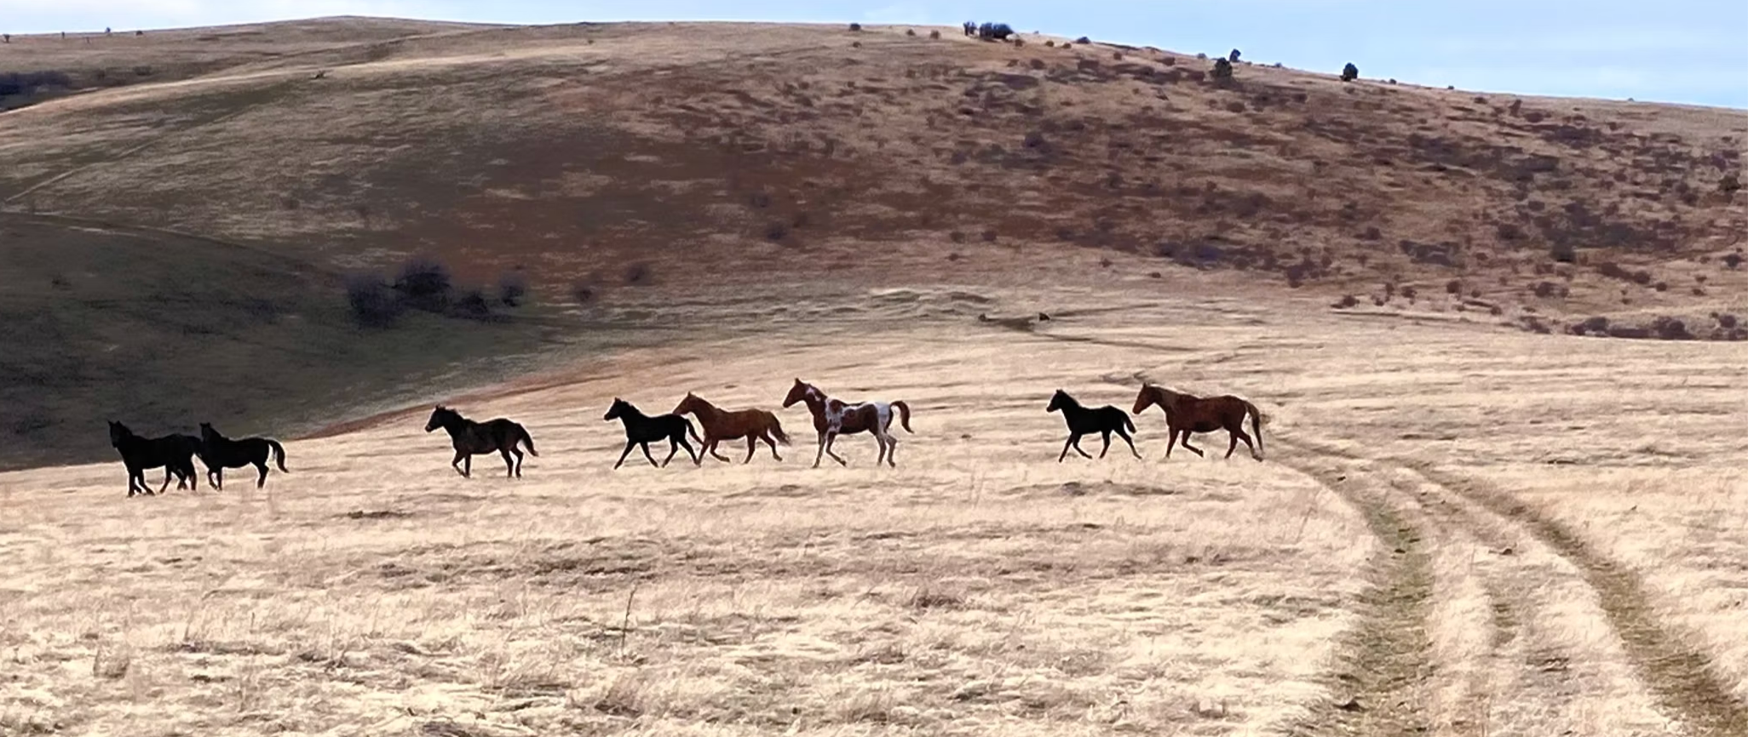
Regional Hub Lead stories: Tiichám CD
Highlights of their Soil Health Network activities and what they hope to acheive:
  Align regional management with cultural values
  Start a soil health baseline & track shifting management practices
  “Share what we learn in this journey and maybe assist others in adopting approaches within their given context”
Why they’re involved:
“It takes a village!”
Something they are excited to gain from participation in the Network:
Knowledge, connection, funding
Notes:
1. We have partnered with Cairnspring Mills, a new flour mill in our area, to better align regional management with cultural values.
We have started a soil health baseline with each of our participating growers to track the trend over time as they shift management.
We hope to share what we learn in this journey and maybe assist others in adopting approaches within their given context.
2. It takes a village! Part of the success that we have seen is in community, locally and regionally. This allows ideas and information to be quickly shared and projects to be more rounded when developed from many perspectives. With so much information out there, it is nice to have a place/group to fall back on to weed out the facts and how to best provide those to land stewards.
3. Knowledge, connection, and (hopefully) funding!

Slide 12
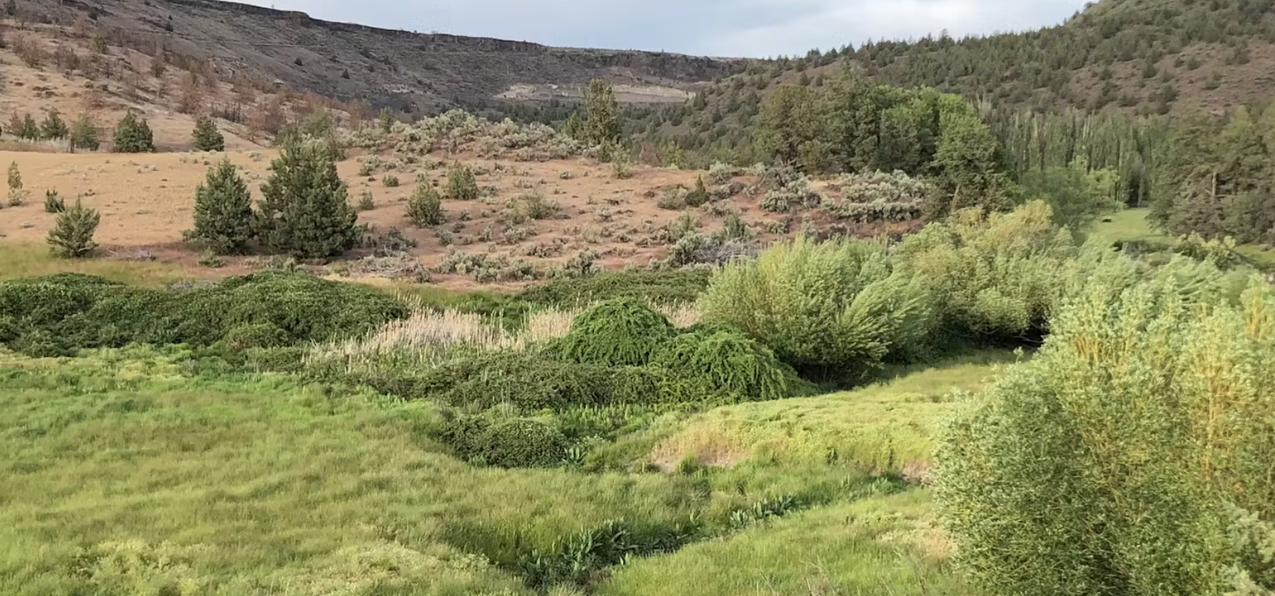
Regional Hub Lead stories: Jefferson SWCD
Highlights of their Soil Health Network activities and what they hope to acheive:
Set up soil health monitoring and a robust outreach program
Why they’re involved:
I don't have the knowledge and the energy to do this on my own, even though I have some local partners
Something they are excited to gain from participation in the Network:
Technical knowledge, ideas from partners, the feeling that I am part of a larger effort

Slide 13
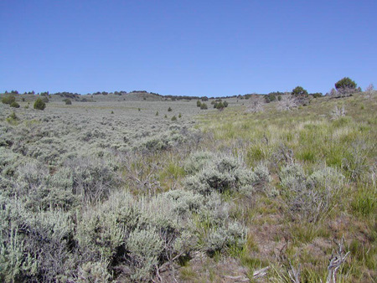
Regional Hub Lead stories: Harney SWCD
Highlights of their Soil Health Network activities and what they hope to acheive:
Just getting started.
Why they’re involved:
Soil is in our title- it’s an important part of how habitat is built. How can we improve our projects by understanding & improving soil condition?
Something they are excited to gain from participation in the Network:
Help landowner improve their operations improving local economics while providing better habitat and water quality for all.
Notes:
1. We haven't really done anything yet. We do have money under oda to do soup testing but have not really rolled this out due to multiple factors including staffing and government shutdown.
2. Soil is in our title and Harney has not done that much over the 6 years I have worked for the agency. It's a important part of how habitat is built and might have been over looked in our past work. The need to learn more and improve our results likely comes back to the soil condition and understand that and what can be done to improve our projects.
3. Staff able to id issues and come up with a plan to address/improve soil quality. Help landowner improve their operations improving local economics while providing better habitat and water quality for all.

Slide 14
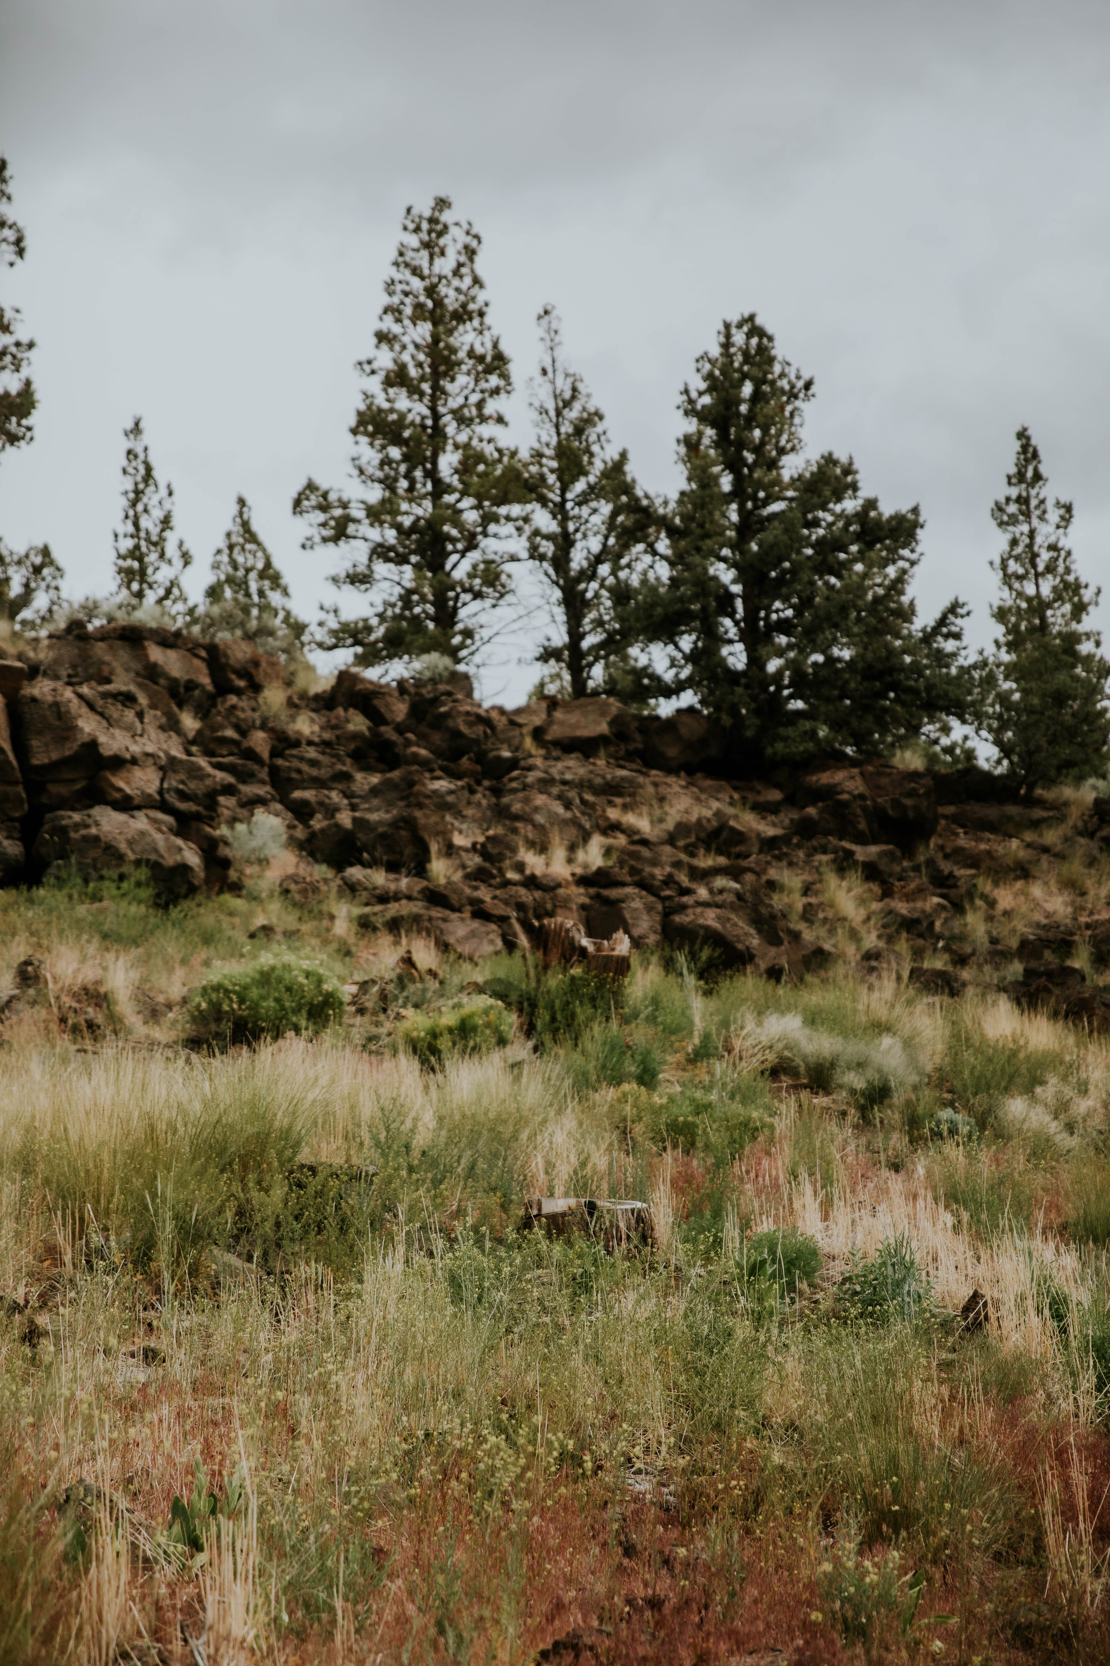

How to support & get involved
Spread the word
Get your district involved as a Regional Hub or partner
Provide input and feedback
Collaborate on and/or share any funding opportunities with us
Notes:
Spread the word: let your district know about the programming.
Get involved: contact me, fill out the network survey
Provide input: Advisory board, set up a meeting with me. Especially around larger regions.
Share funding: Important to collaborate! Letters of support, share funding opportunities so we can support the network the best we can.

Slide 15
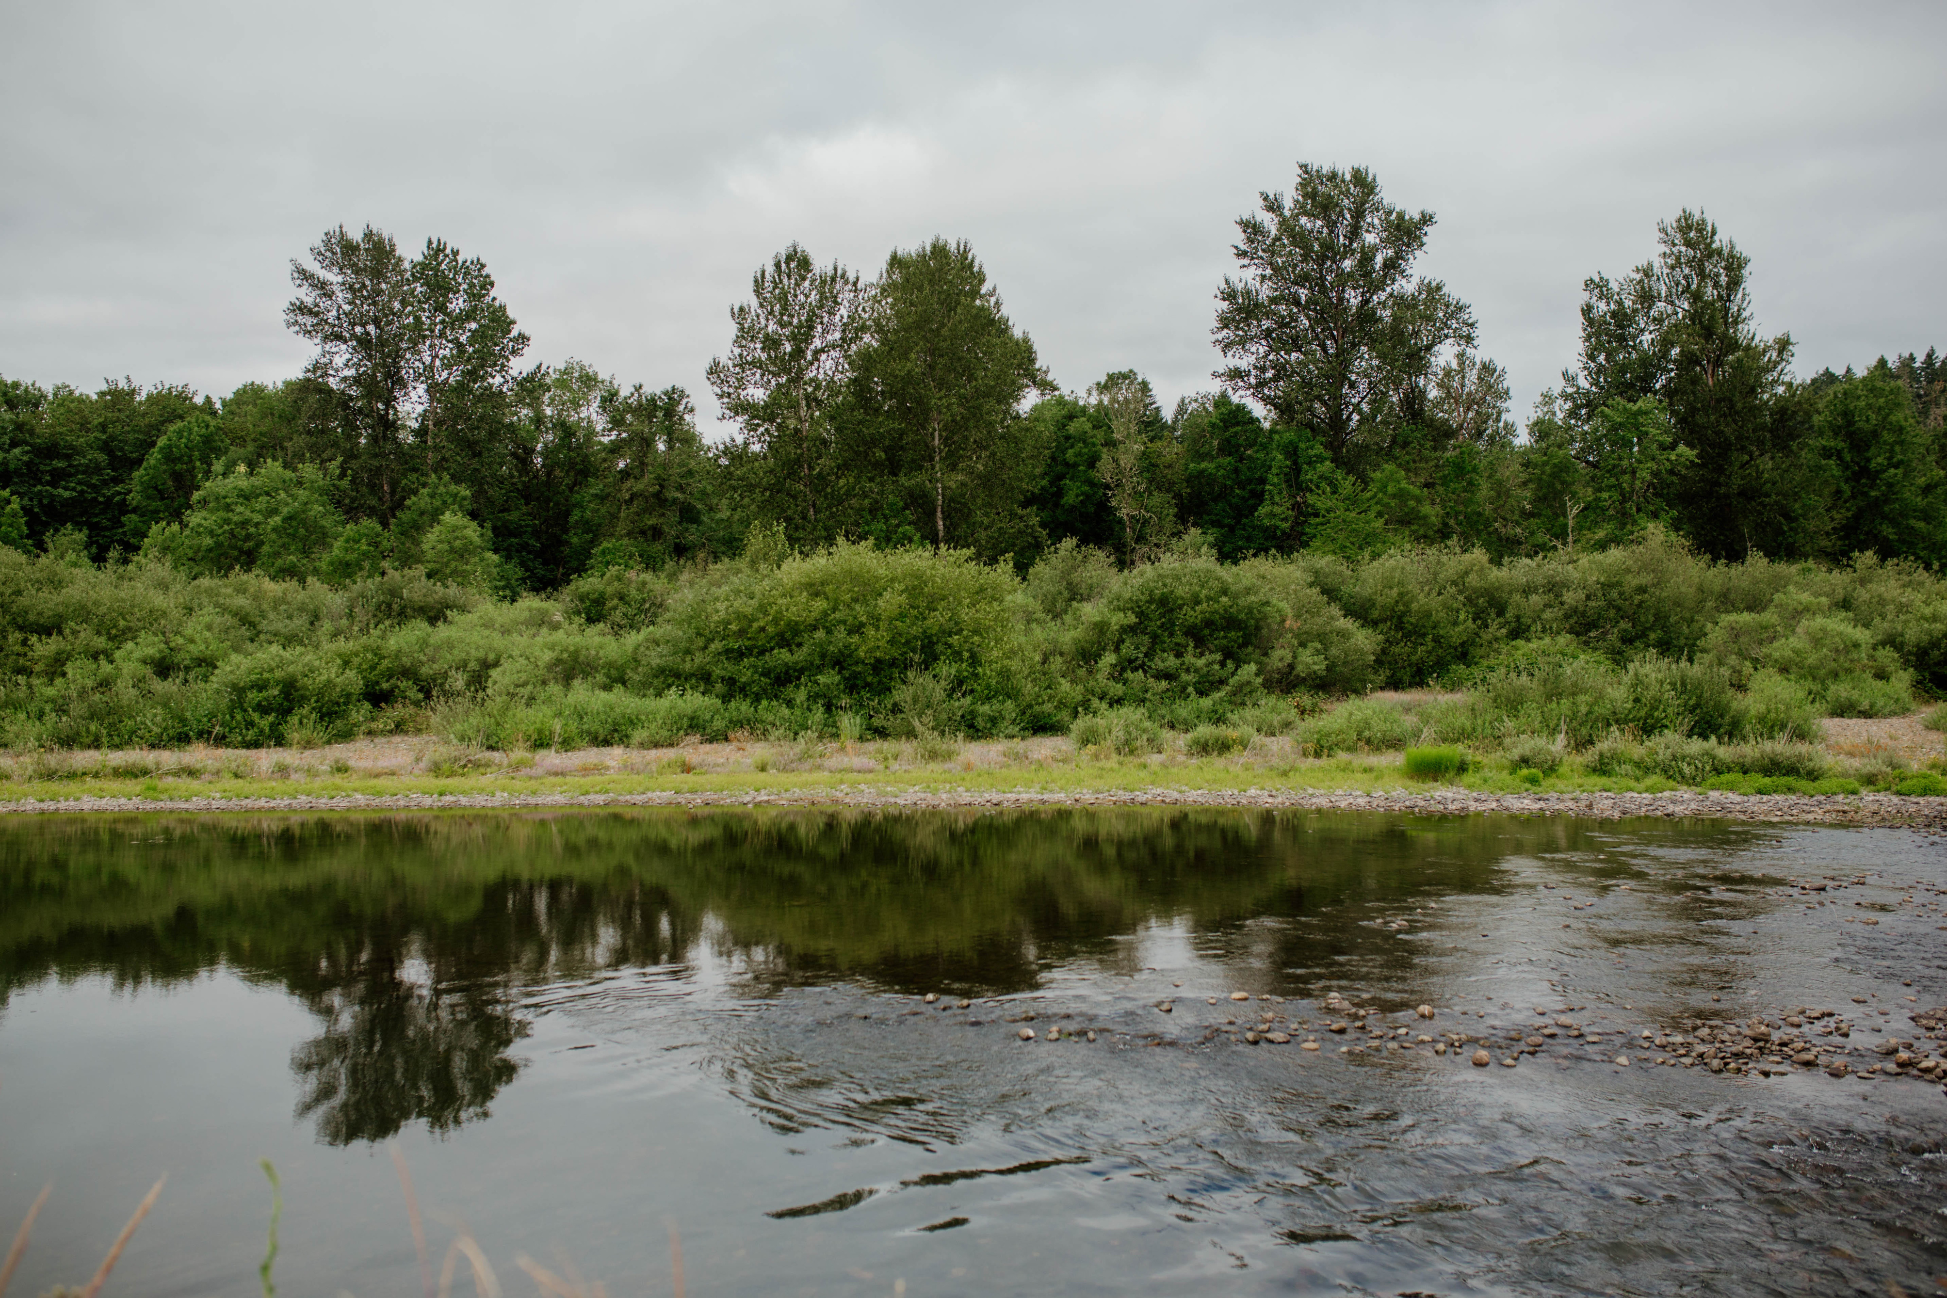
Questions?

Slide 16
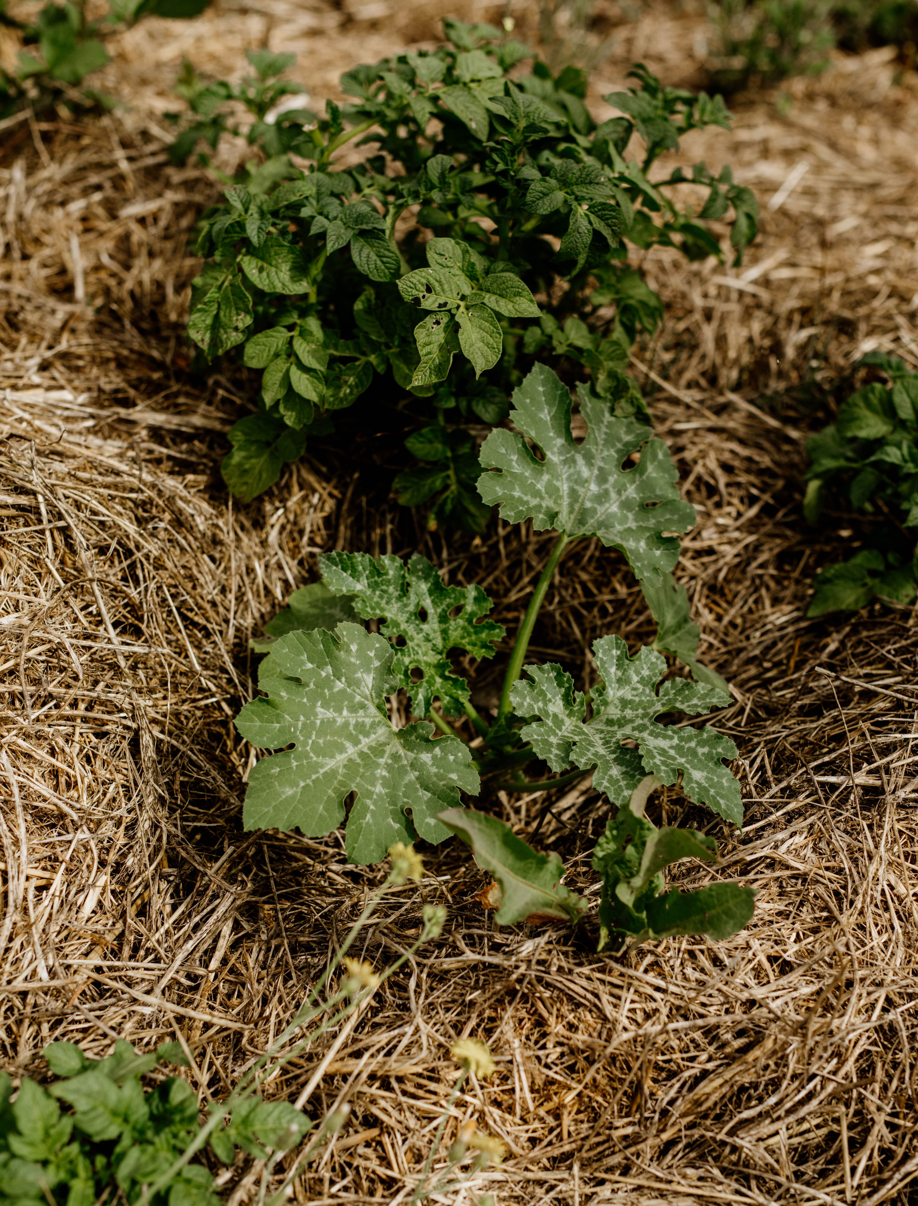

THANK YOU
Join the network
Sage Fairman
sage@oregonclimateag.org
www.oregonclimateag.org

Slide 17
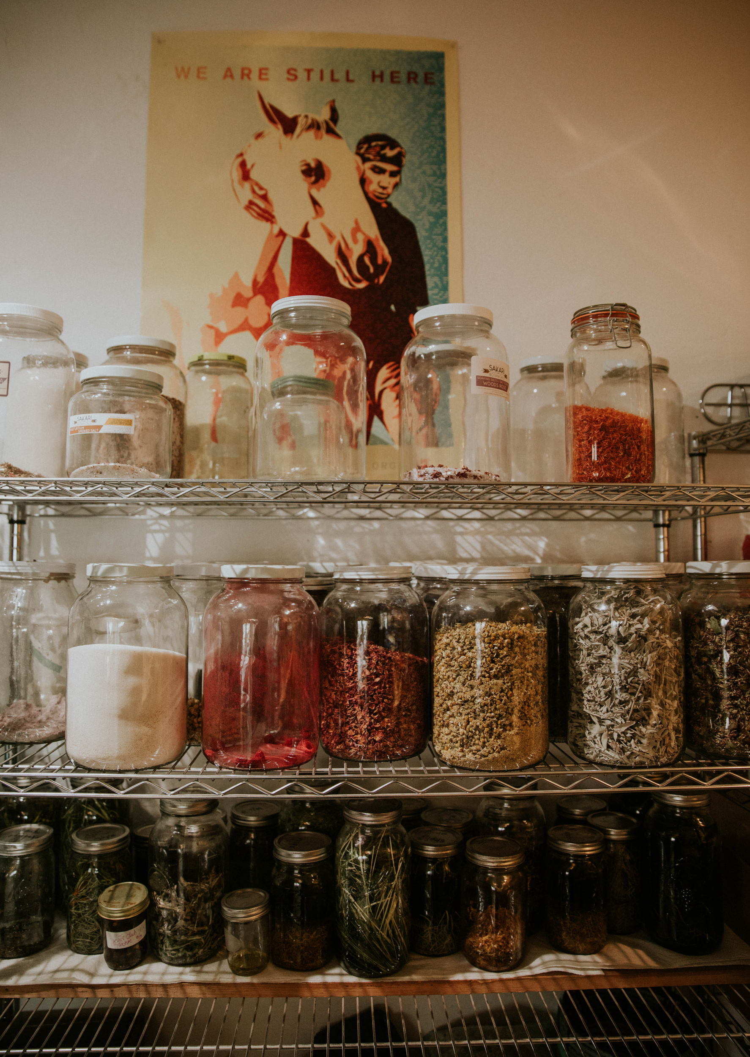
OrCAN’s responsibilities
Coordinate the Soil Health Network
    Establish formal relationships with, and seek funding for/with, network leads
    Convene and support the Network’s Advisory Committee
    Host regular meetings of all network leads
    Provide training on topics identified by and responsive to network leads’ needs
    Facilitate & strengthen connection between network leads
    Provide reporting templates to network leads
    Compile activity data gathered from each network lead as quarterly and annual reports, and share out reports for learning, alignment, and connection

Slide 18
OrCAN’s responsibilities, continued
Create and maintain a user-friendly website for the network
    Host an interactive listing of Regional Hub Leads, Auxiliary Support Organizations, and Statewide resource people
    Share up-to-date statewide resources and funding opportunities
Work to ensure the network is accessible
    Offer virtual training on inclusive producer outreach
    Offer materials and resources in multiple languages, when possible
Advocate to address systemic barriers and institutionalize support for soil health
Provide additional resources/support to the statewide network, as capacity allows
    Support producer-to-producer events and communities of practice
    Offer materials and resources in multiple languages
    Provide interpretation and translation services for network events
    Fill gaps in resources identified by producers and farm service providers
    Work to address barriers to access to resources identified by producers and farm service providers via Regional Hubs

Slide 19
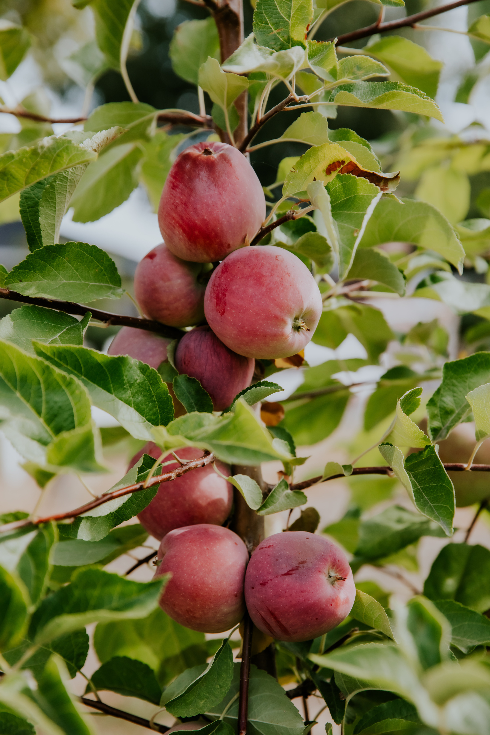
Regional Hub Lead’s responsibilities
  Participate in Network capacity building, connection, and evaluation
  Conduct regional outreach to engage producers interested in maintaining or improving their soil health
  Provide resources and technical assistance and refer to other support services and resources
  Support access to financial incentives for soil health
  Support soil testing by providing referrals to labs, interpretation of results, and recommended actions
  Host and/or support in-person regional gatherings, including producer-to-producer field days, events, and communities of practice
  Identify regional needs, barriers, and success stories and share with OrCAN

Slide 20


Working on securing funding for Regional Hub Lead responsibilities
Funding Updates
Applied & declined: $40,000
Pending: $148,000
Secured: $5,000 + general operating support
Notes:
Declined
$40k from Wright for some RHLs
Pending
$15k from Roundhouse for rural RHLs
$18k OCF for ASOs
$40k from MMT for engaging historically underserved producers in SHN and listening to their needs
$75k from Thriving Comms
Secured
$5k for CFWWC
Planned/strategy
Up to $35k for Marion

