Slide 1


A Land Trust Legacy
25 Years in the Making
By Andy Bleckinger

Slide 2
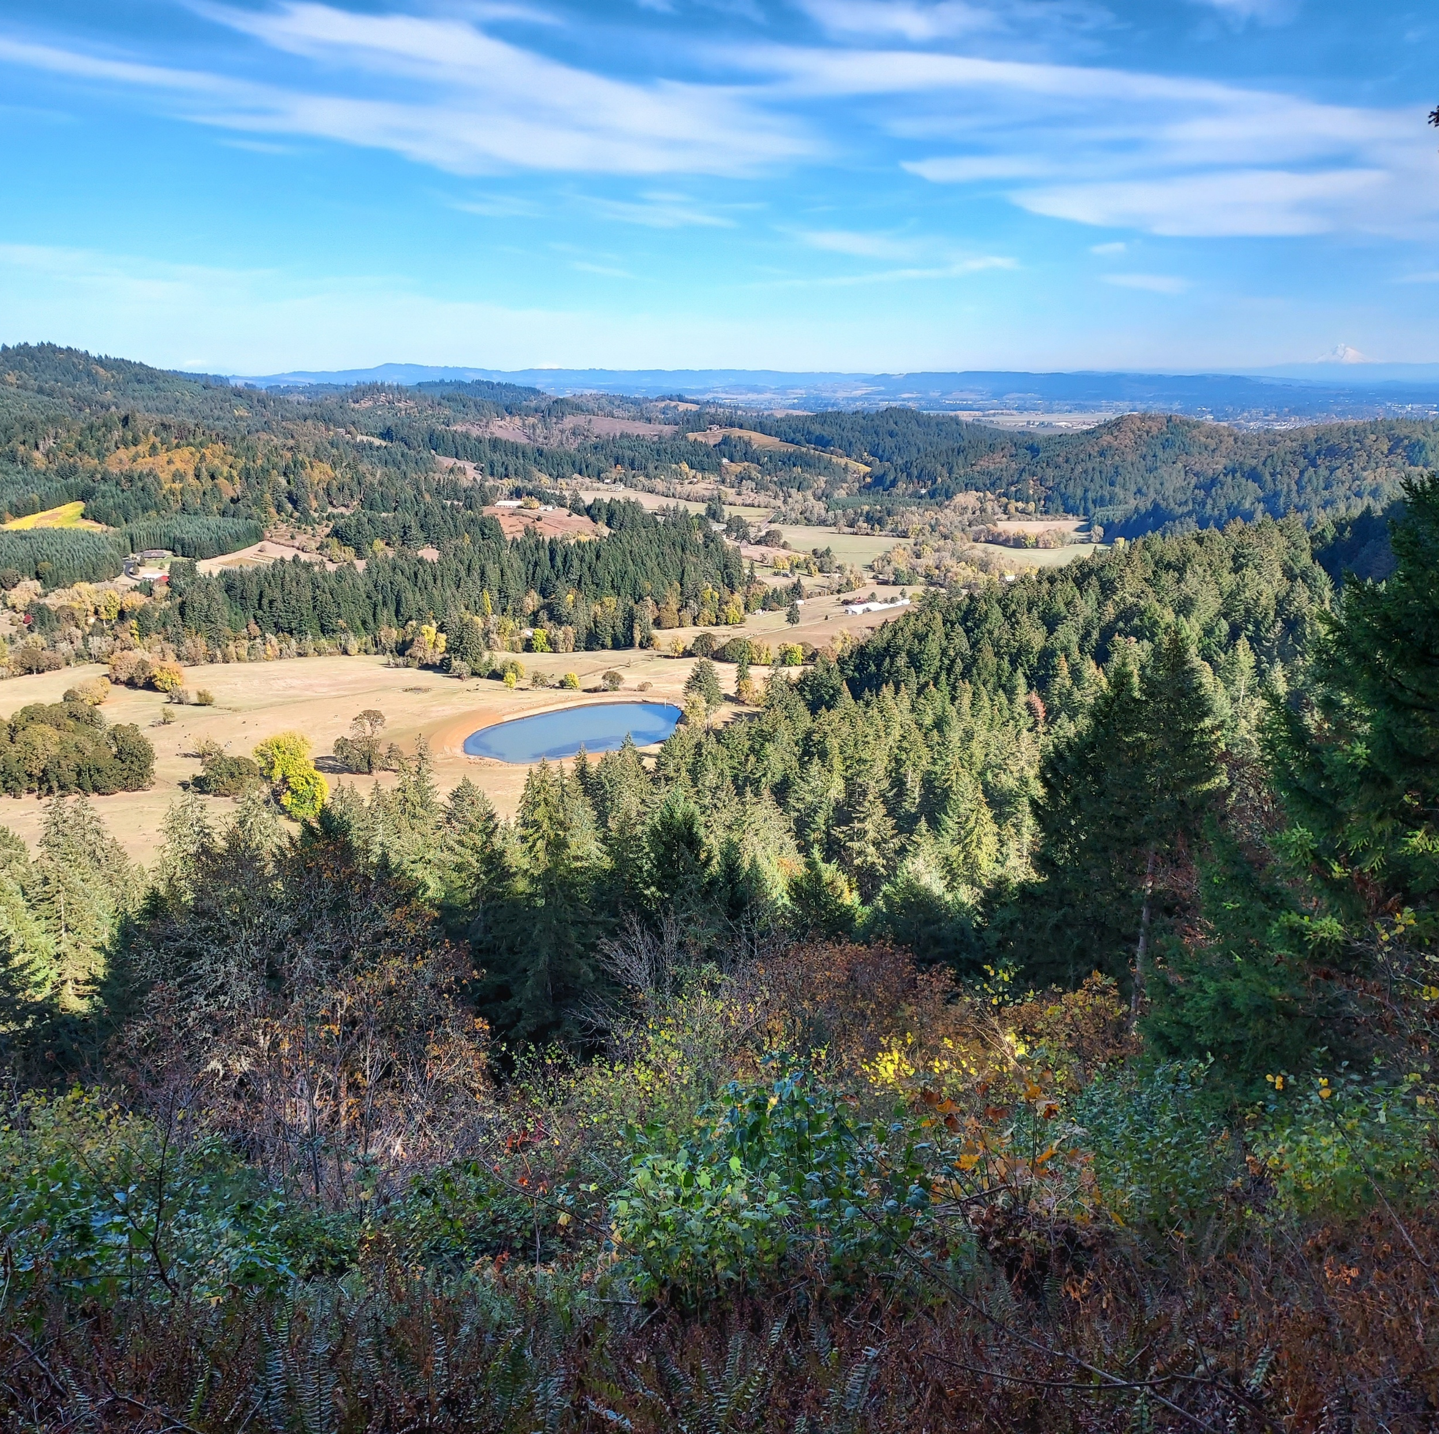
History
First Conservation
Easement in 2002, beginning the Protected Lands Program
  720 acre farm with
  cattle, timber, hay,
  and wildlife habitat
  Hydroelectric Pond

Slide 3
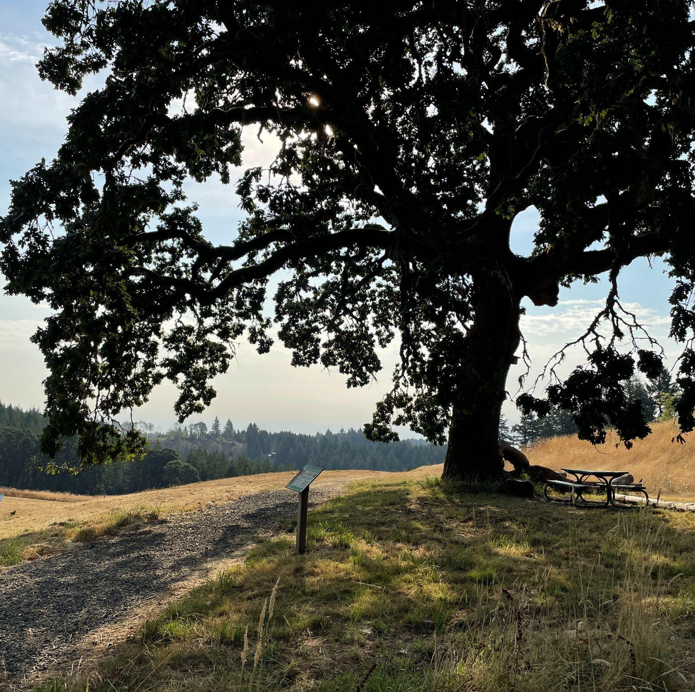
History
First Property
Acquired in 2003
  131 acre public park
  with 5 miles of hiking
  trails, and protected
  oak, forest, and
  riparian habitat.

Slide 4
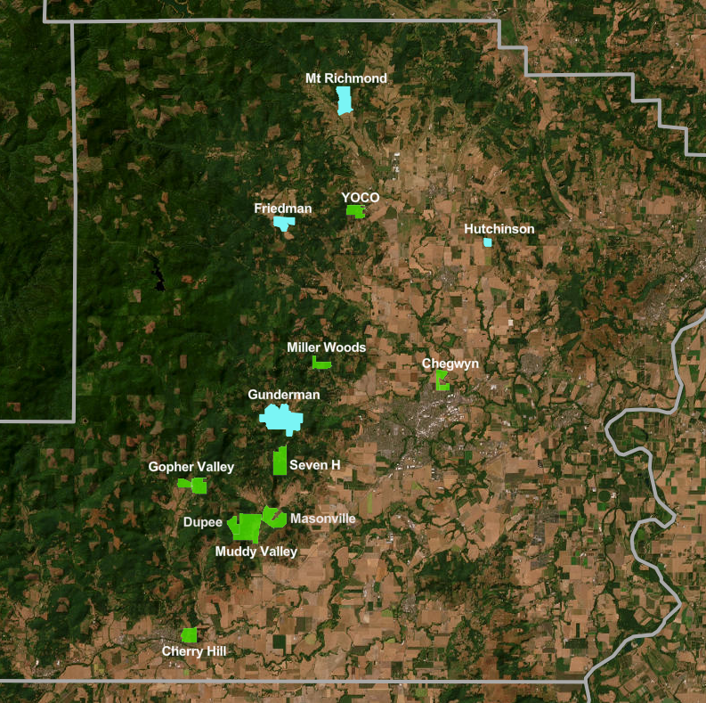
Today
9 Properties
  ~2500 acres
5 Conservation Easements
  ~1000 acres

Slide 5
Challenges
Investment Limitations
No Conservation Easement Insurance
Ineligible for USDA/NRCS and other federally funded programs
Limitations on Tax Deductible Donations
Grant Restrictions for Governments

Slide 6
Possible Solutions – Fix the issues
Investment Limitations
  Work with legislators, NACD, and OACD to change the ORS/Laws.
No Conservation Easement Insurance
  Try to get SDIS or another carrier to begin offering this product.
Ineligible for USDA/NRCS and other federally funded programs
  Work with NACD to change policy and statues at the federal level.
Limitations on Tax Deductible Donations
  Work with NACD to get the IRS to change tax codes to allow SWCDs to receive tax deductible charitable donations similar to a 501c3.
Grant Restrictions for Governments
  Directly encourage individual grantors to open up future grants to SWCDs.

Slide 7
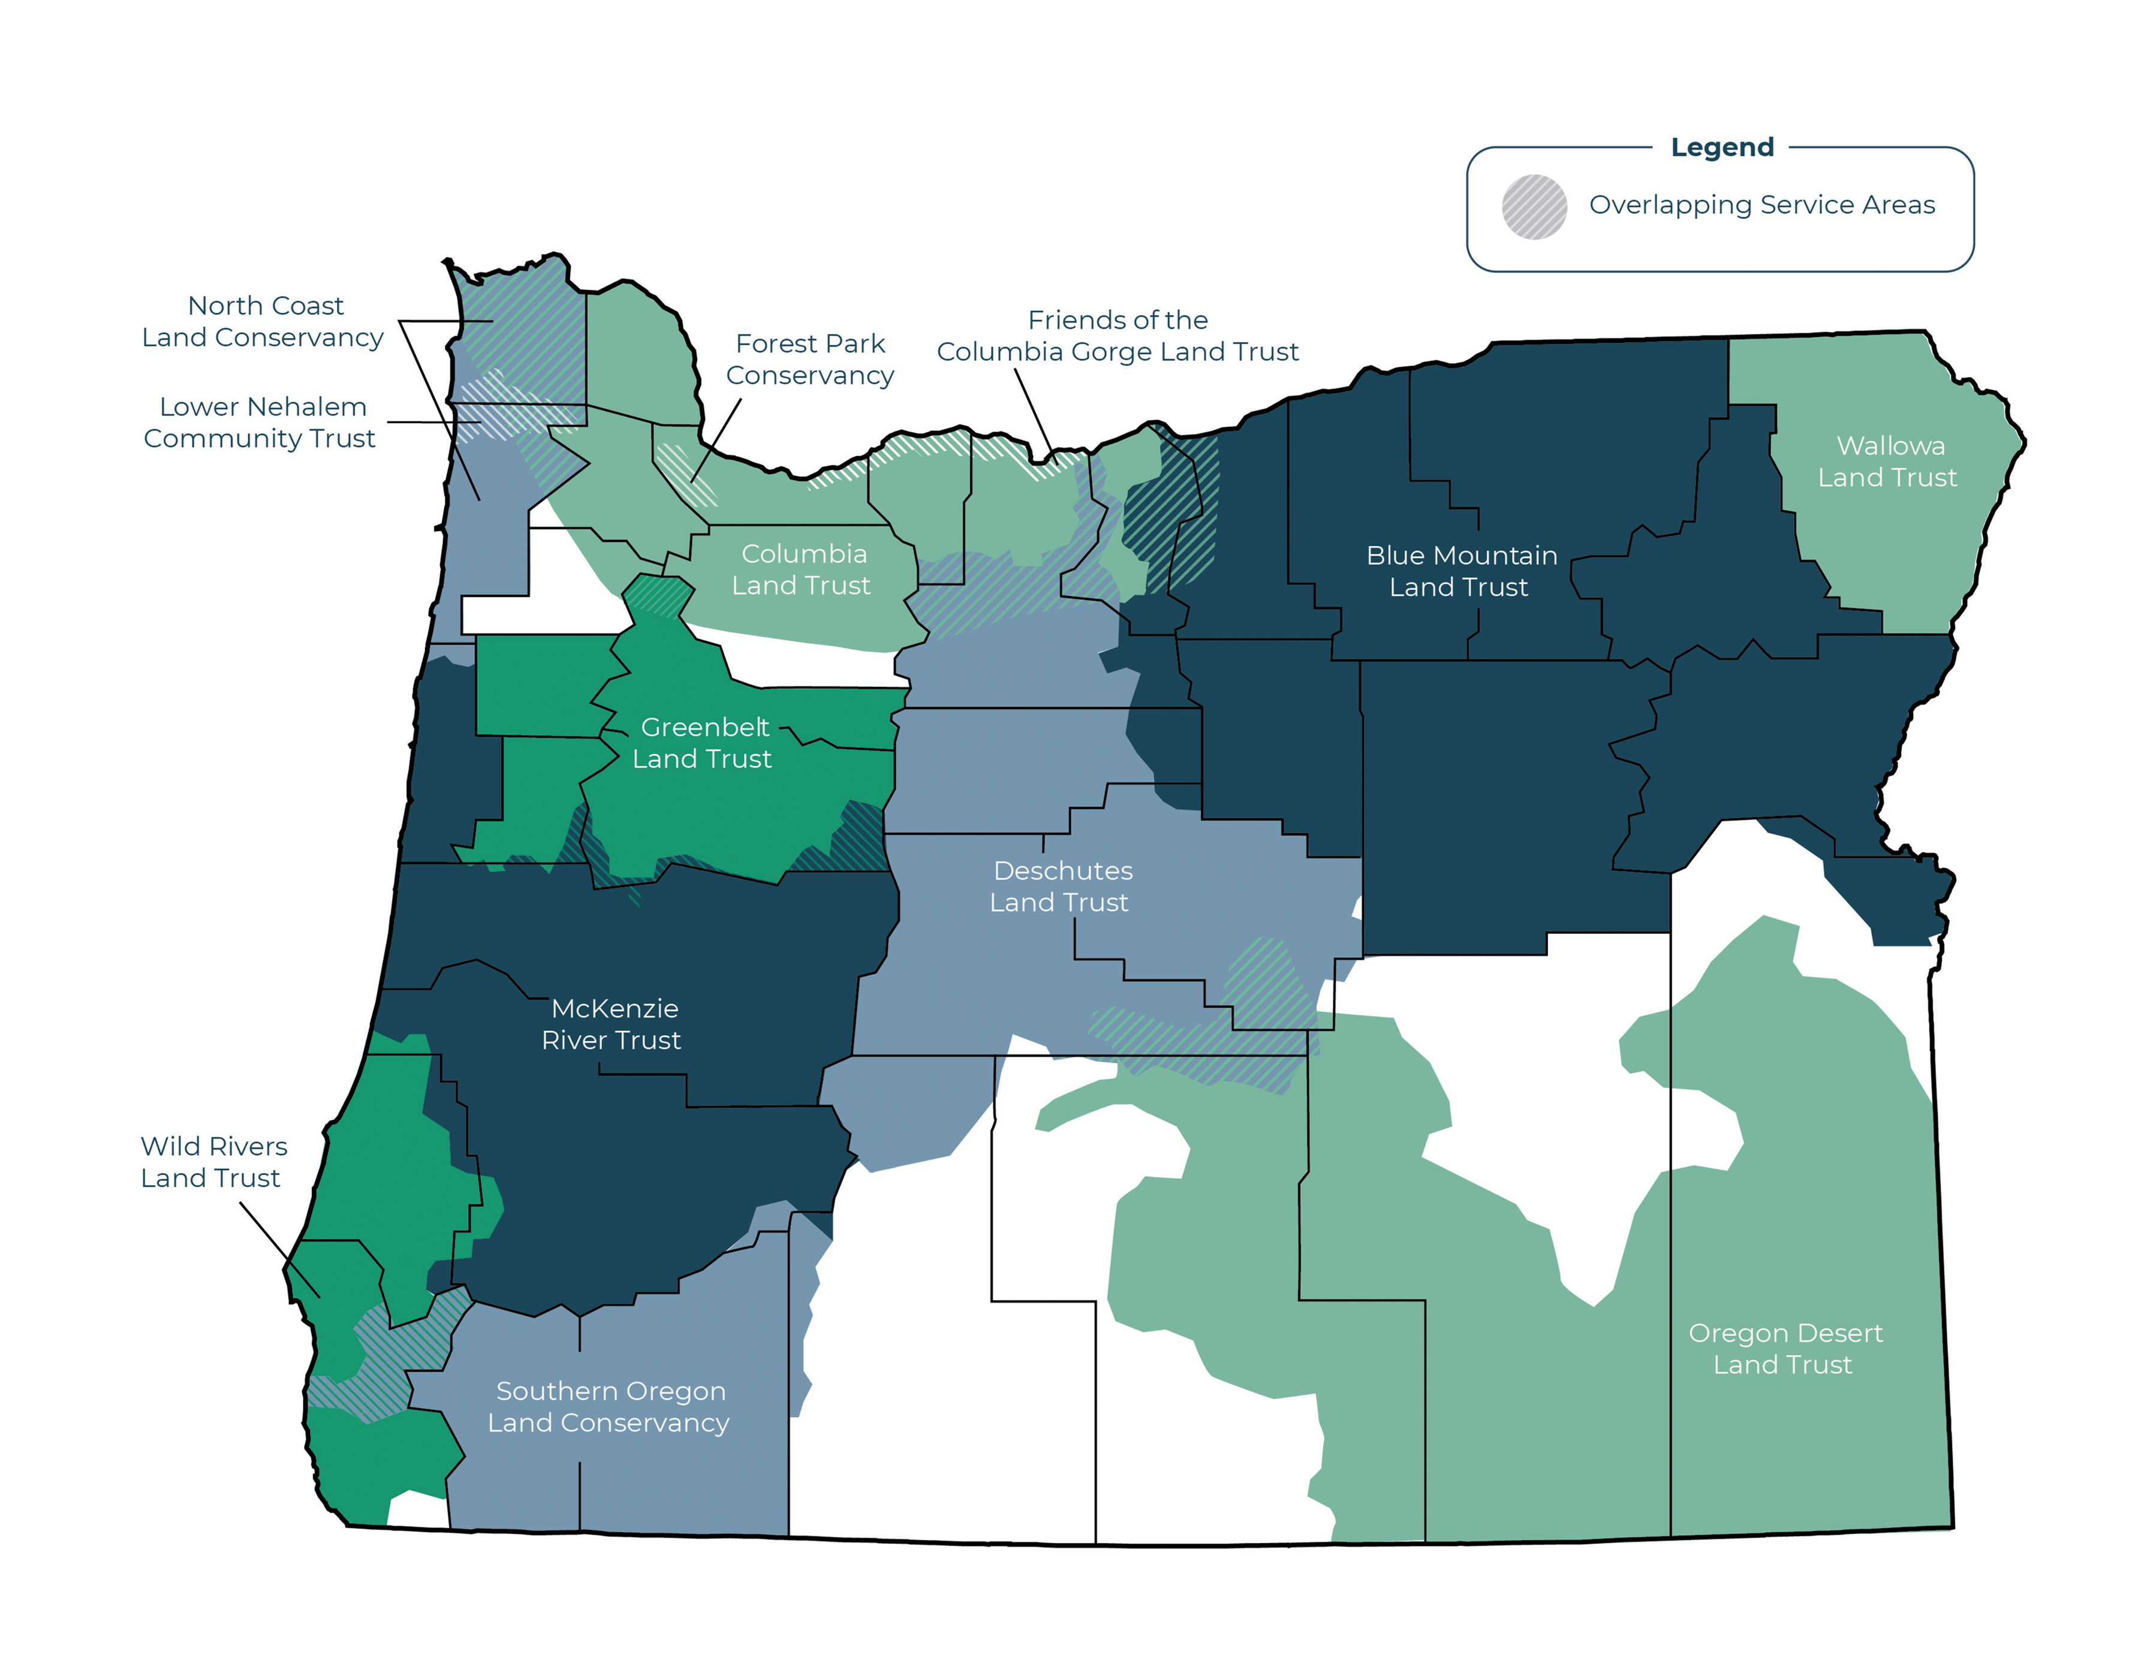
Possible Solutions – Partnerships
Limited land trusts in Yamhill County
Limited Conservation Easement funds
Our properties are restored working
lands, so they require restoration
and maintenance
2014 Study
Photo Credit: Coalition of Oregon Land Trusts

Slide 8
Possible Solutions – New Land Trust
Investment Limitations
No Conservation Easement Insurance
Ineligible for USDA/NRCS and other federally funded programs
Limitations on Tax Deductible Donations
Grant Restrictions for Governments

Slide 9
Say Hello to Yamhill Conservation Trust
Officially formed in October, 2024 (501c3 status still pending)
Board Structure
Received LTA grant to partner with surrounding land trusts and jointly develop a land trust plan for Yamhill County. This partnership model will be integrated into YCT’s business and long-range plans.
A Land Trust 25 years in the making.

Slide 10
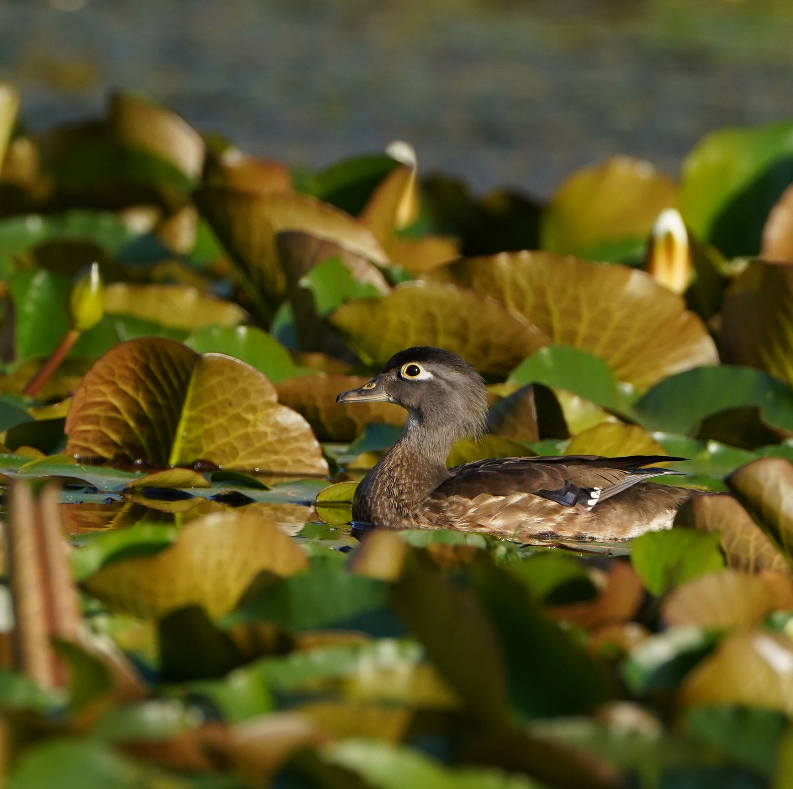
Restructuring the Protected Lands Program
Properties
  Co-Ownership
  50/50 Undivided Tenancy in Common
  Reciprocal Rights of First Refusal
Easements
  Co-Holder or Backup Holder
  Conservation Easement Insurance
Photo Credit: Jacob Argueta, Yamhill SWCD

Slide 11
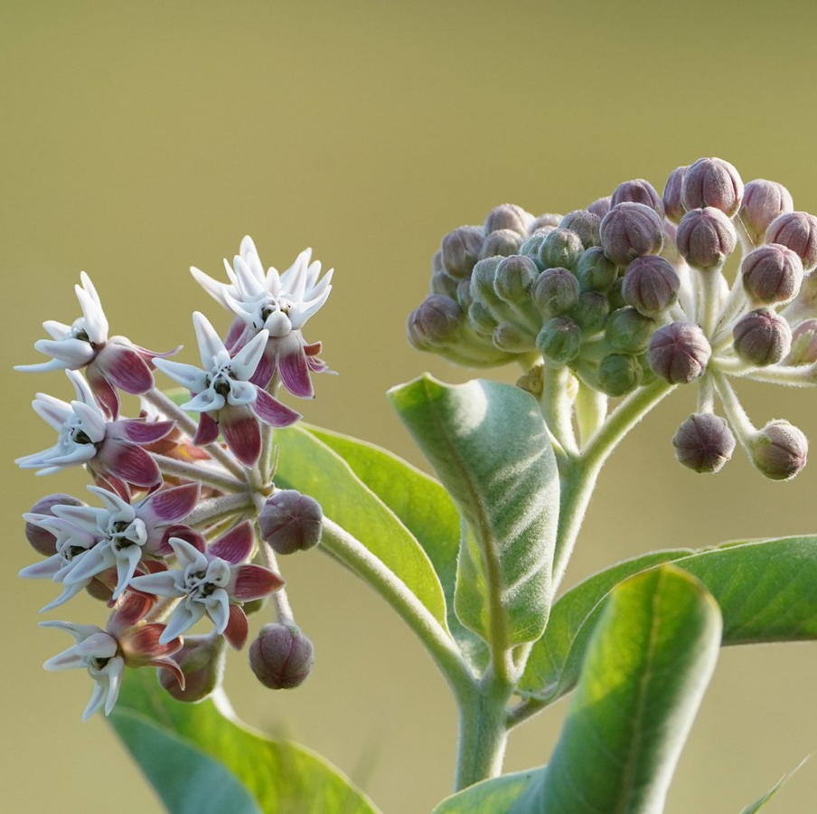
The Future of Land Protection
Yamhill Conservation Trust can fill the need for a land trust in Yamhill County, taking on new properties and easements.
Teach other SWCDs about the benefits and challenges of permanent land protection.
Help other SWCDs find ways to navigate the challenges, potentially expanding beyond Yamhill County as YCT grows.
Photo Credit: Jacob Argueta, Yamhill SWCD

Slide 12
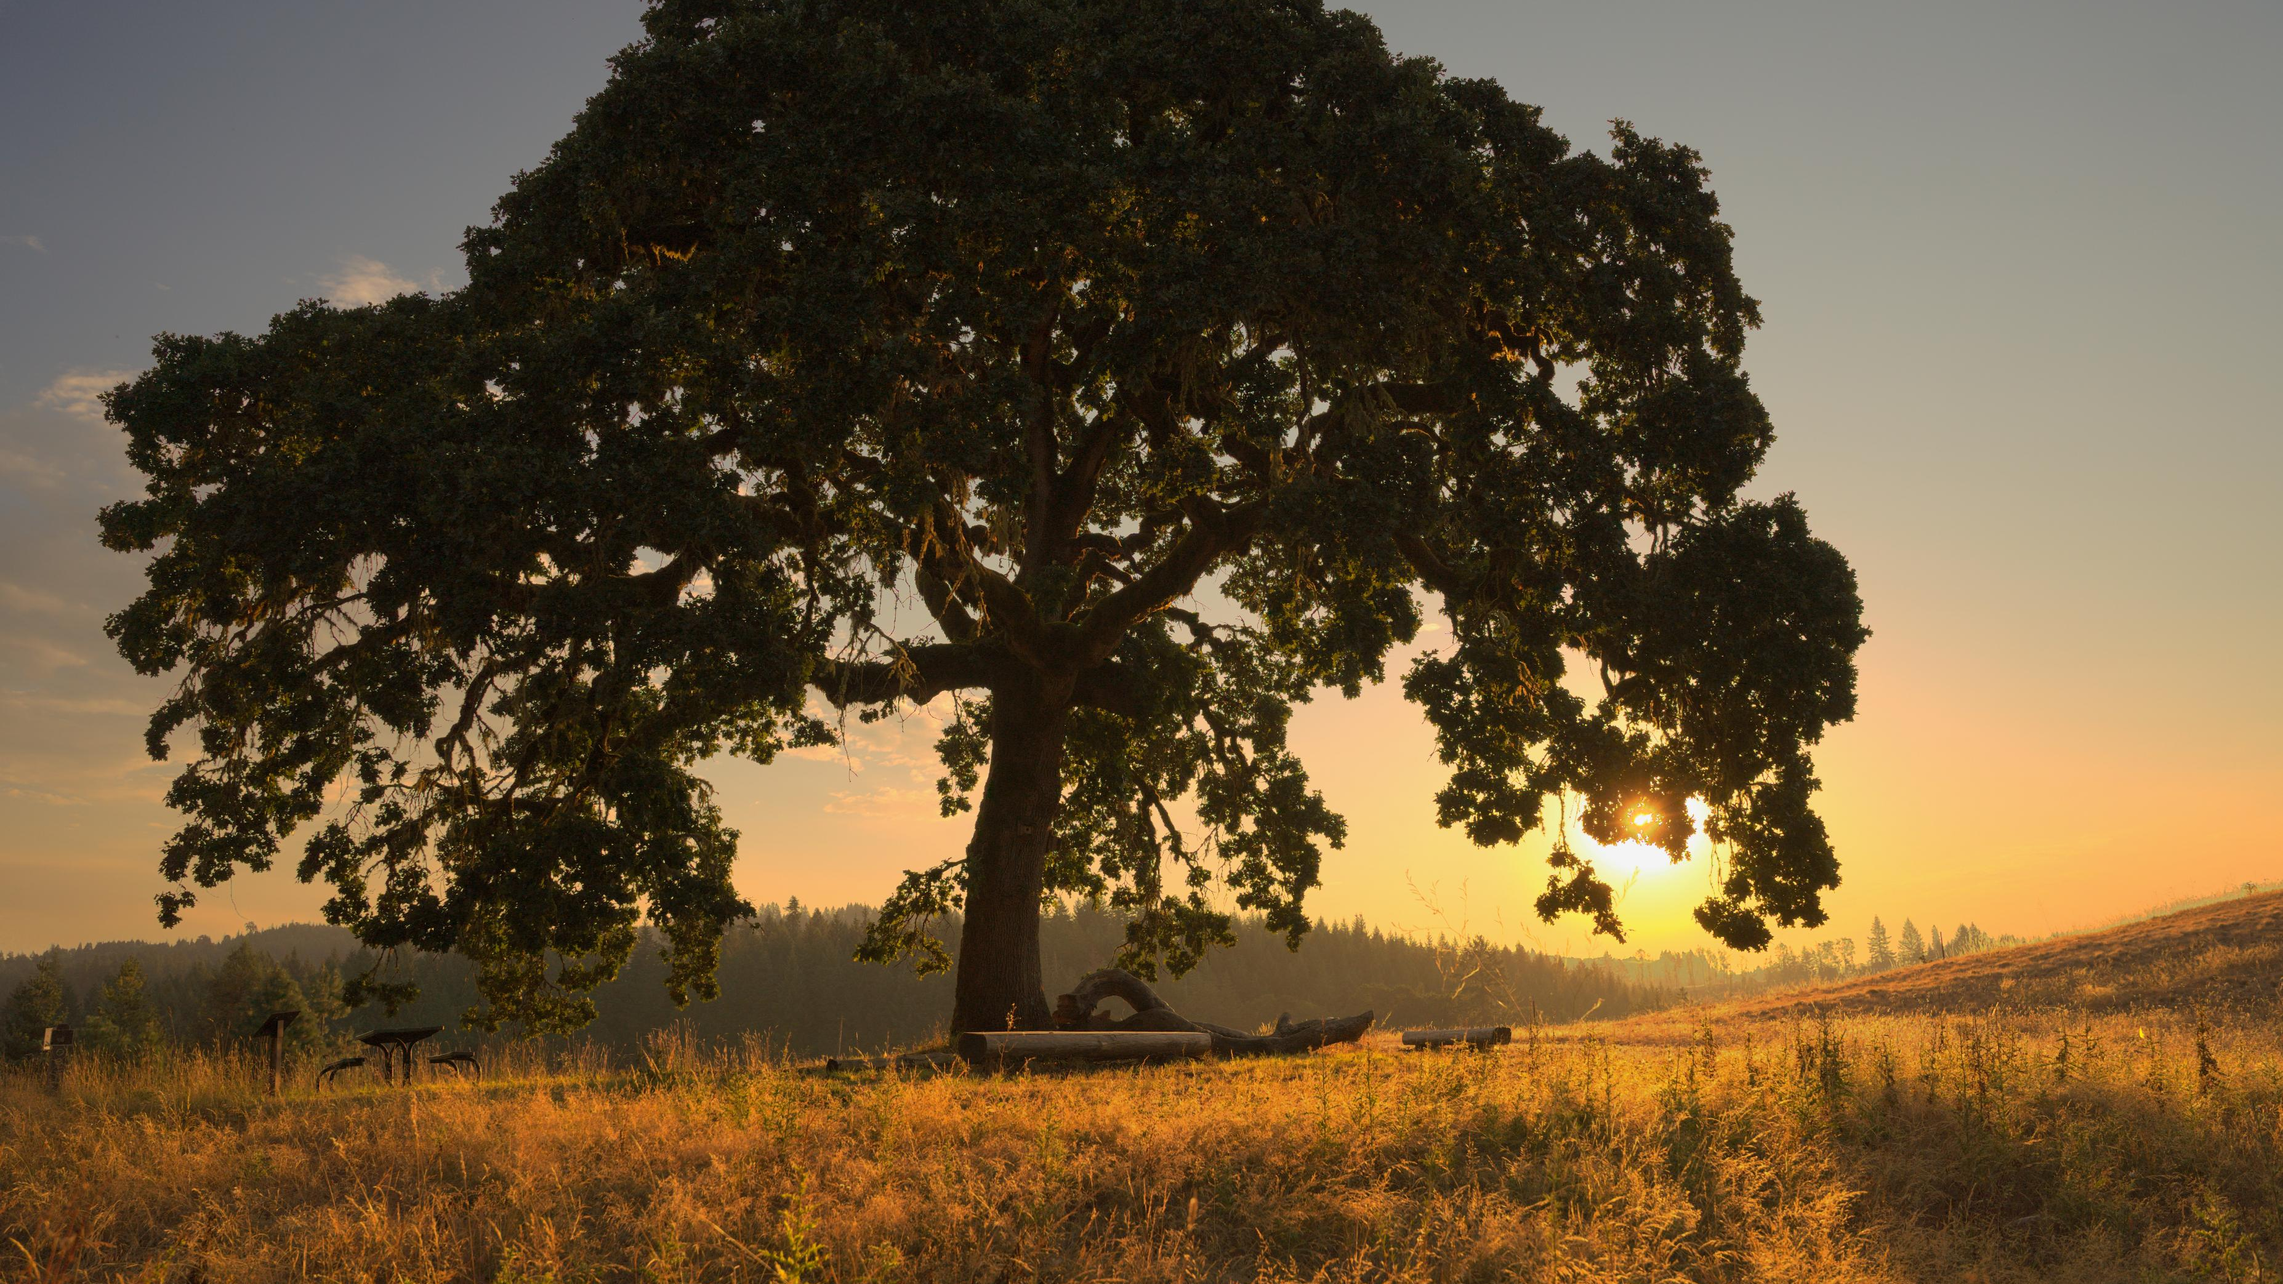
Thank You!
Andy Bleckinger
andy@yamhillswcd.org
503-479-8643
Photo Credit: Jacob Argueta, Yamhill SWCD

