Slide 1
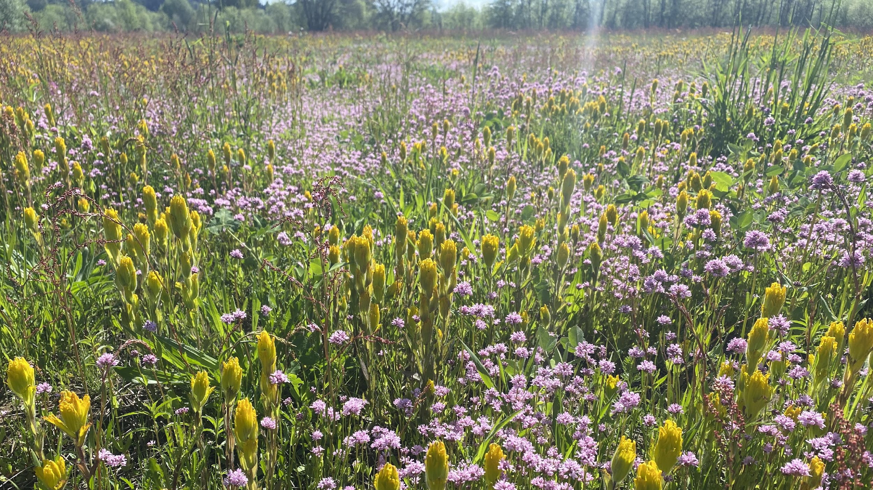


Oregon Native Seed Strategy
A collaborative approach to increasing native plant materials availability and use
Troy Abercrombie
ODA Noxious Weed and Native Plant Conservation Programs Manager
Hilary Doulos
ODFW Natural & Working Lands Biologist

Slide 2
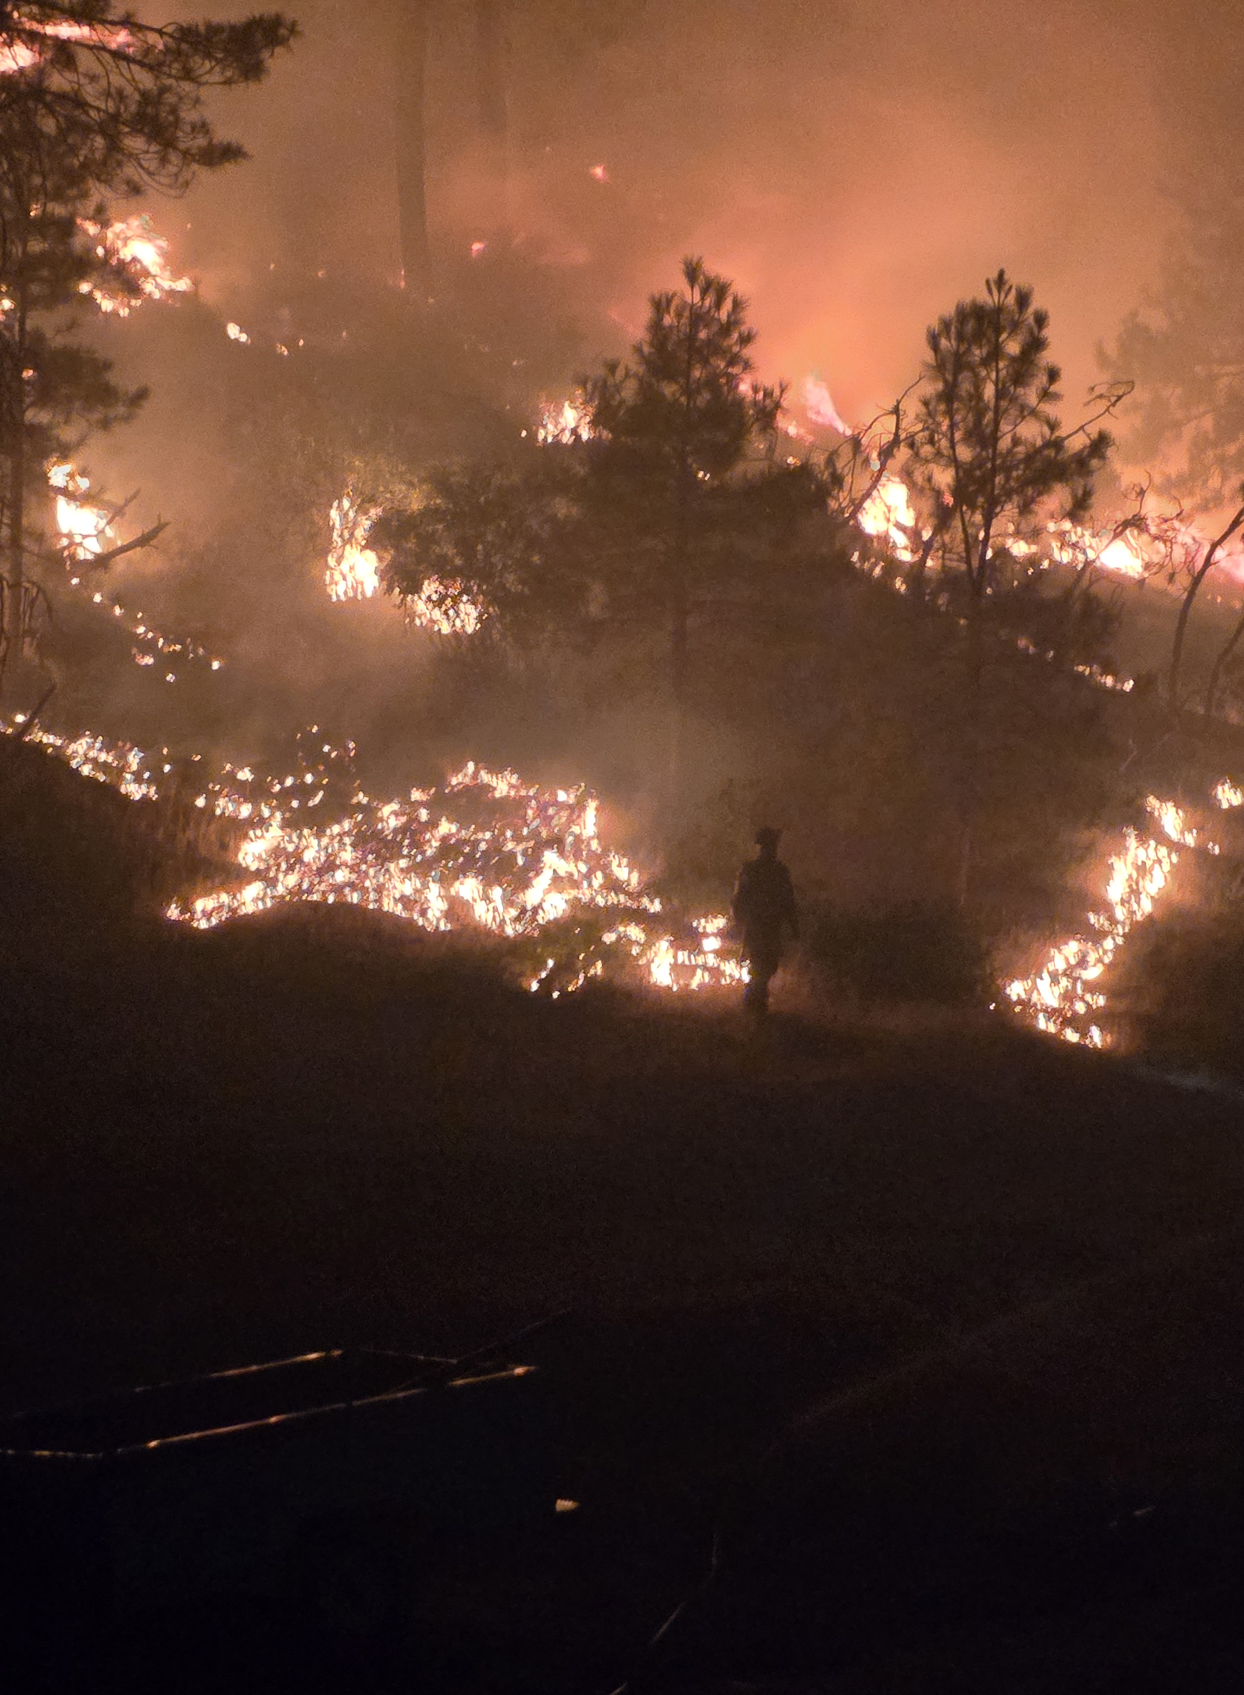
Why Oregon Needs a Native Seed Strategy
Oregon is facing unprecedented environmental pressures
  Devasting wildfire seasons
  Loss/depletion of native seed banks in disturbed landscapes
  Spread of invasive species that hinder recovery of native plant communities
  Altered fire regimes, climate change, habitat modification
Increased demand for large-scale restoration, rehabilitation, and mitigation
Notes:
Oregon’s landscapes are under unprecedented pressure. Each year, wildfires burn hundreds of thousands of acres. In many cases, the native seed banks are gone, which means natural recovery can’t keep pace. At the same time, invasive species spread quickly and fill in the gaps, making it even harder for native ecosystems to bounce back.
On top of that, climate change and habitat loss are altering the conditions our plants depend on. Restoration is needed at a scale we’ve never faced before—but right now, our ability to supply and use native seed simply doesn’t match that demand. That’s why we needed a statewide seed strategy: to make sure Oregon has the tools, partnerships, and seed resources to restore resilient ecosystems.

Slide 3
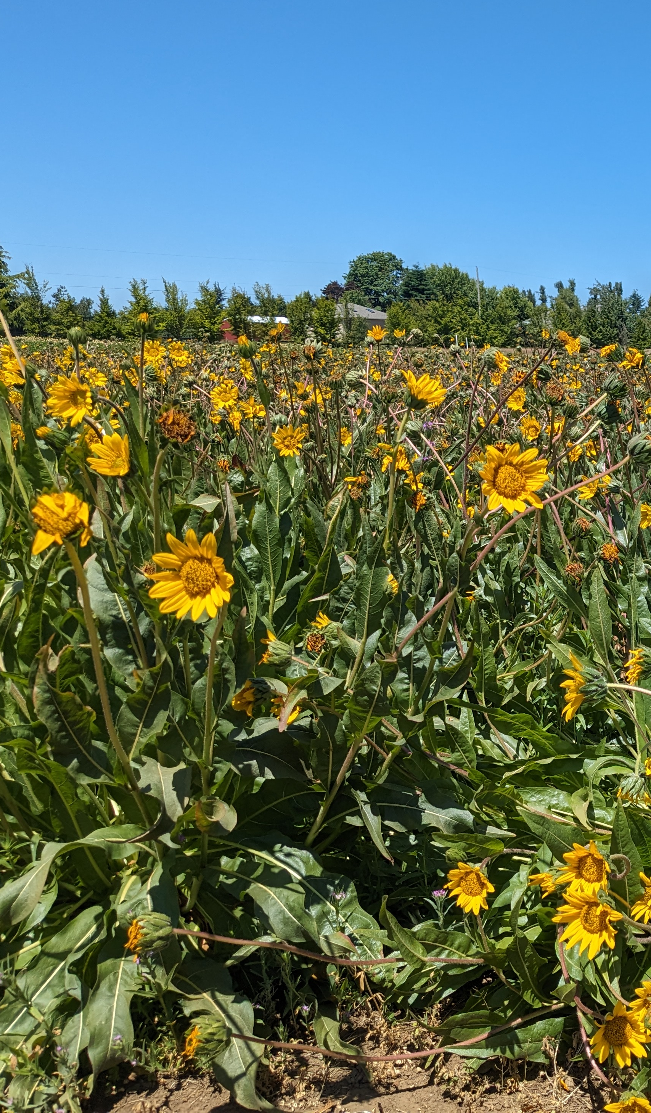
Key Challenges
Limited species diversity
Unstable seed market & supply chain bottlenecks
  High year-to-year variability in demand
  Hesitancy to produce less-common/specialized species
Lack of infrastructure & capacities
  Insufficient seed collection, cleaning, storage, and inventory management capacity
  Gaps in research/protocols for many species
Procurement, coordination, and planning are fragmented
  Limited forecasting of seed needs, poor coordination
  Regulatory/permitting inefficiencies
Notes:
Oregon’s seed system has big gaps. Only a fraction of our thousands of native species are available for restoration work. That means many plant communities are missing the diversity they need to be resilient.
The seed market has also been unstable. After a major fire, demand spikes dramatically, but growers can’t always respond quickly. When the market cools, growers face losses and pull back. That boom-and-bust cycle makes it risky to produce the species we most need.
There are also gaps in infrastructure. We lack enough capacity for seed collection, cleaning, and storage. And for many species, basic research—like germination protocols or guidance on genetic integrity—just doesn’t exist yet. Finally, procurement and coordination have been fragmented, which makes it hard to plan and forecast needs across the state.

Slide 4
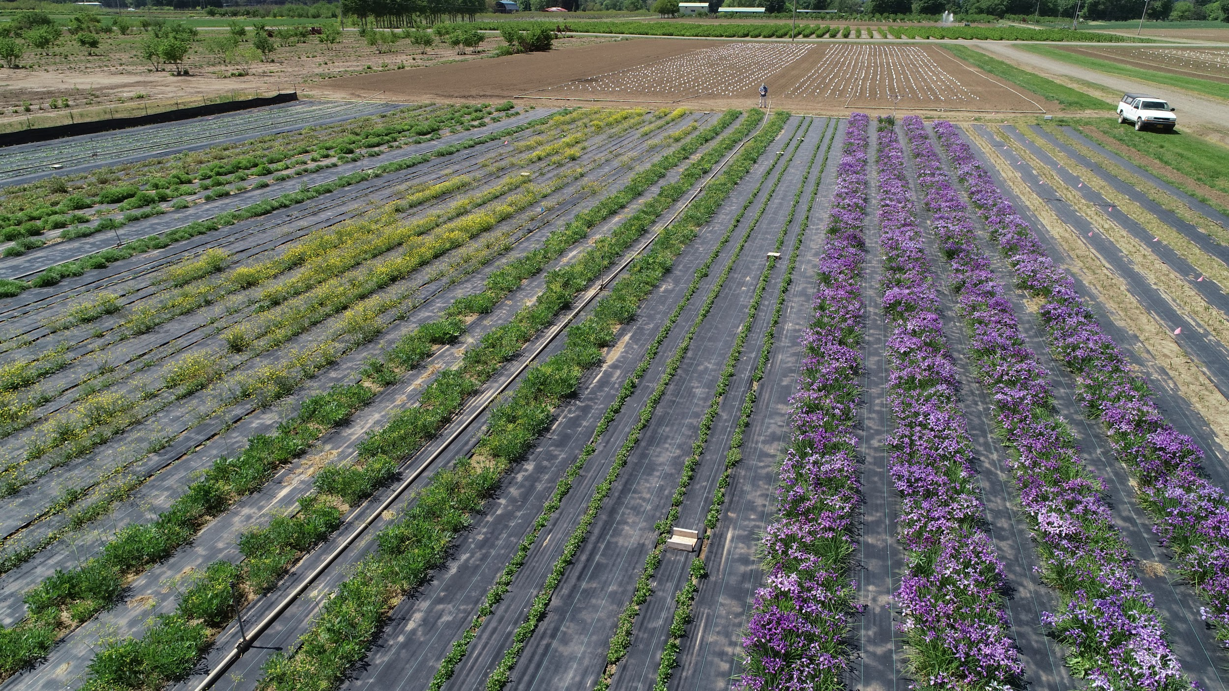
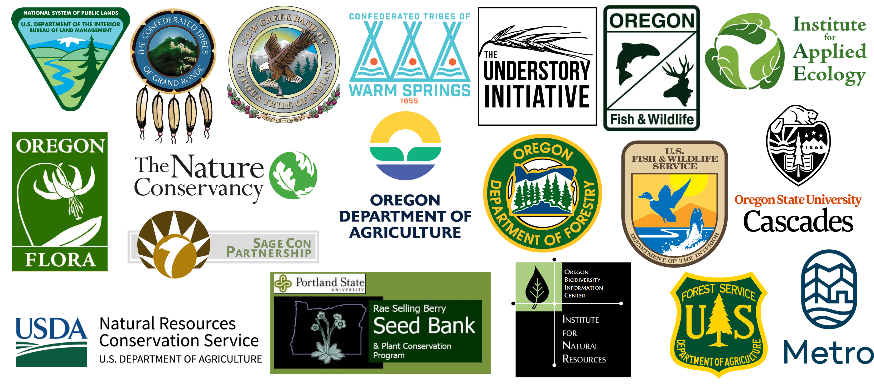
Oregon Native Seed Collective
Photo credit: Institute for Applied Ecology
Notes:
So, to address some of these challenges, in 2022, a group of organizations and agencies began applying for funding to create an Oregon Native Seed Strategy. We were never funded, but in Fall 2023 we began working on our state seed strategy in earnest. We were really lucky to have so many organizations and partnerships already established in Oregon primed to draft and implement a state seed strategy… and now we are the Oregon Native Seed Collective.
We have several non-profit partners that grow natives in-house as well as coordinate regional native seed partnerships such as those in the Willamette Valley, on the coast, and in the Rogue and Umpqua valleys. And we are working to expand these native seed partnerships in the central and eastern part of the state.

Slide 5
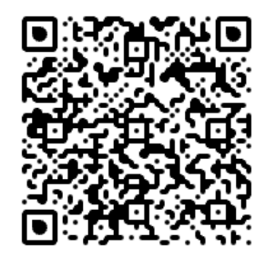
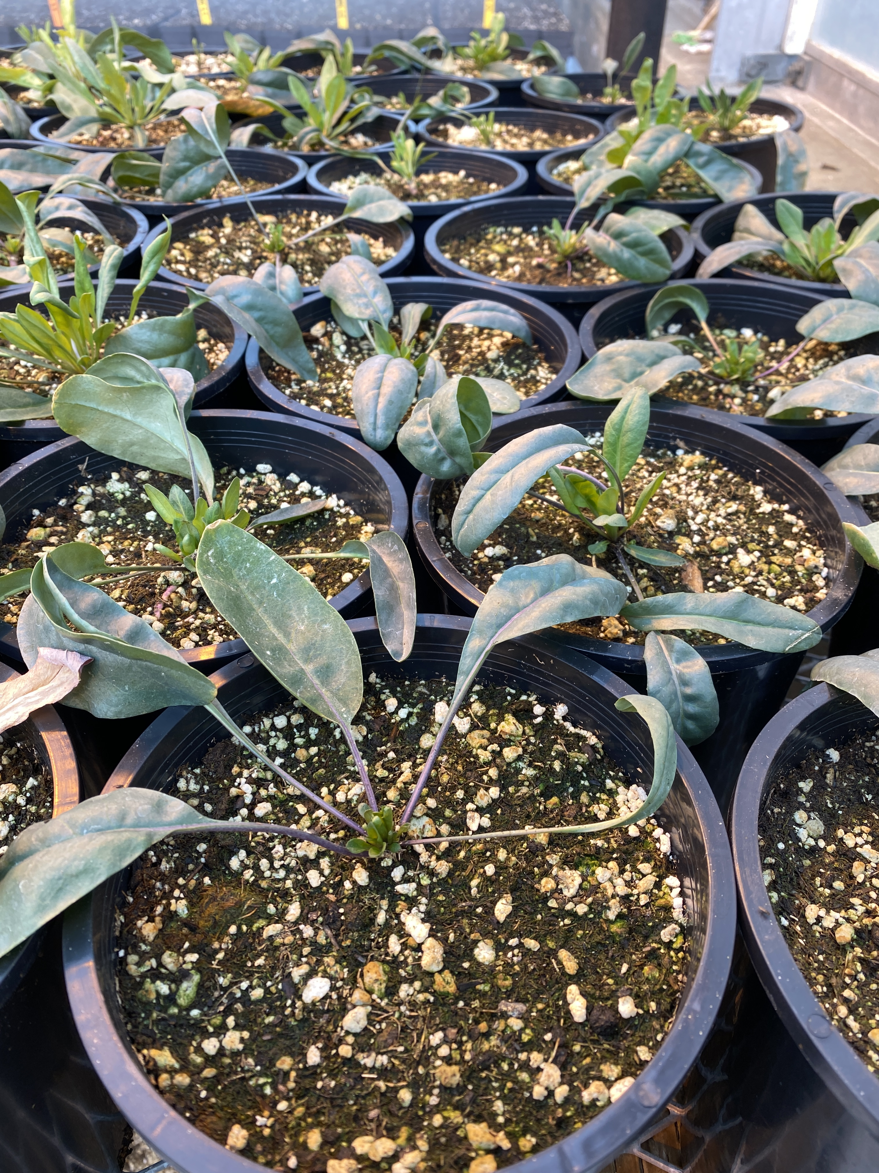
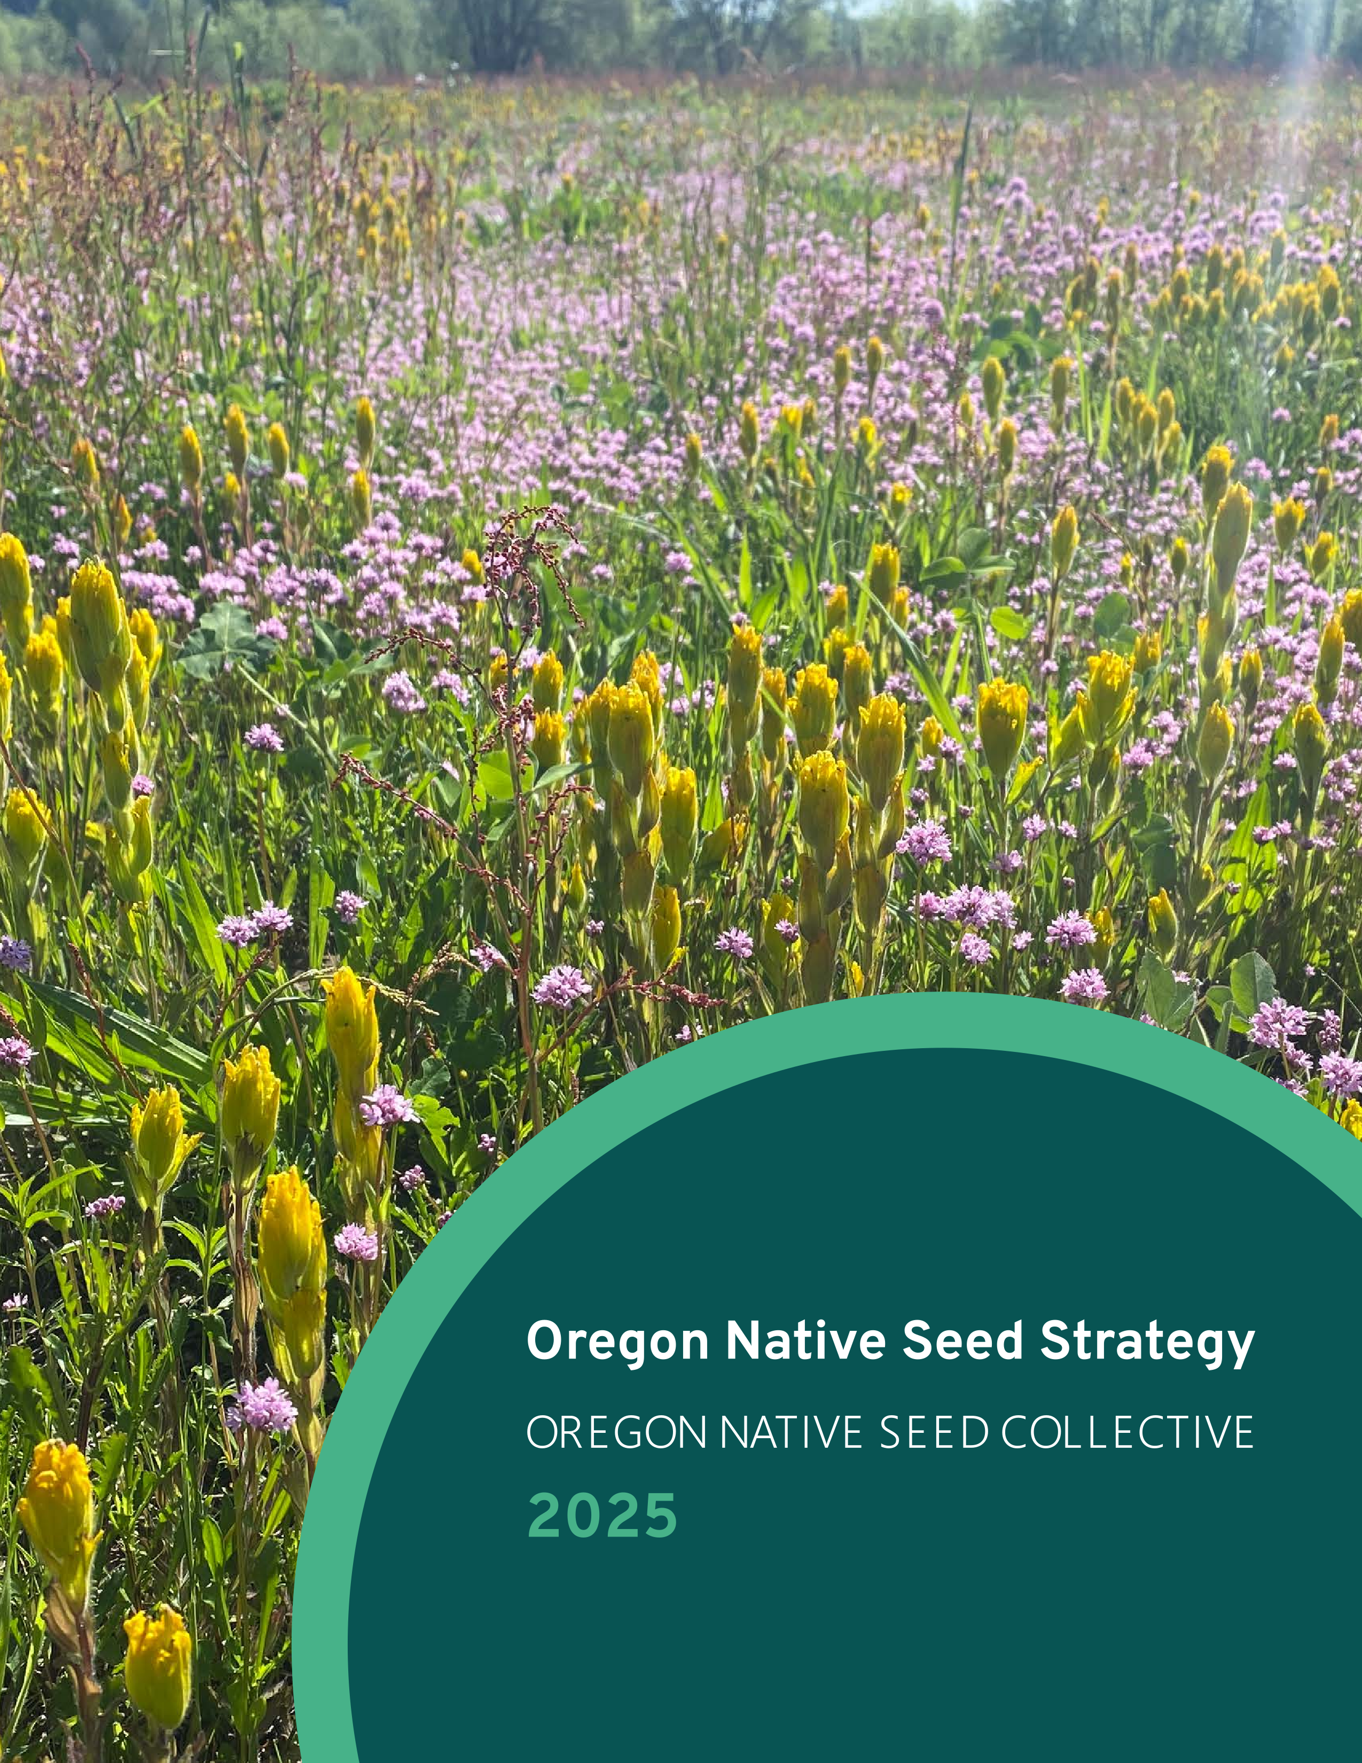
Oregon Native Seed Strategy
VISION
Return Oregon lands to diverse, functional, and resilient ecosystems by using the right seed in the right place at the right time.
MISSION
To ensure the availability of ecologically appropriate seed to conserve and restore diverse native plant communities and sustainable landscapes.
Notes:
In February of 2025, the Oregon Native Seed Strategy was published by the ODA through collaboration with members of the Oregon Native Seed Collective. The collective vision is to return Oregon Lands to diverse, functional and resilient ecosystems by using the right seed in the right place at the right time, and to ensure the availability of ecologically appropriate seed to restore native plant communities and sustainable landscapes. You can check out the QR code here to access the ONSS on the ODA website.

Slide 6
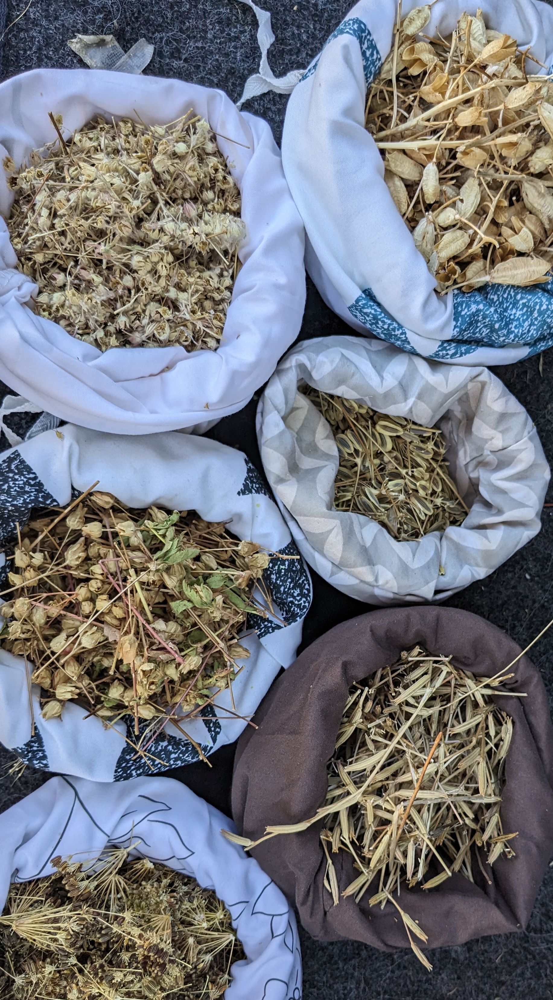
Oregon Native Seed Strategy
Goal 1: Ensure ecologically appropriate native seed is available
Goal 2: Facilitate research to address gaps
Goal 3: Develop resources for informed decisions
Goal 4: Develop conservation seed banking program
Goal 5: Secure funding and develop communication strategies
Partnerships, expanding seed collection/production, increasing seed storage capacity
Research plan, improve seed production/storage, restoration outcomes, delineate seed zones
Decision-making tools, create accessible resources, stabilize seed market
Conservation collections, expand seed bank capacity and research, education/outreach
Stable funding mechanisms, internal coordination, external outreach
Notes:
Within the strategy, there are 5 primary goals, with specific strategies and tactics to get groups and individuals thinking about how to accomplish the ONSS mission.
-Goal 1 focuses on ensuring ecologicaly appropriate native seed is available by creating partnerships, expanding seed collection and propagation efforts, and increasing seed storage and infrastructure capacity.
-Goal 2- facilitate research to address knowledge gaps by developing research plans, how to improve seed production and storage, determine restoration outcomes to inform future restoration efforts, and delineate seed zones for improved seeding successes
-Goal 3- Develop resources for informed decisions by creating decision-making tools and developing pathwasys to stabilize the seed market
-Goal 4- Develop conservation seed banking program- This goal is related to species of conservation concern, and increases conservation collections, expanding seed banck capacity and research , and providing education and outreach for threatened and endangered species.
-Goal 5- Secure funding and develop communication strategies- one of the keys to the success of this will be in identifying stable funding mechanisms for native seed production. This will require internal coordination among agencies and organizations, and external outreach to producers- who are the key to increasing the availability of native seed.

Slide 7
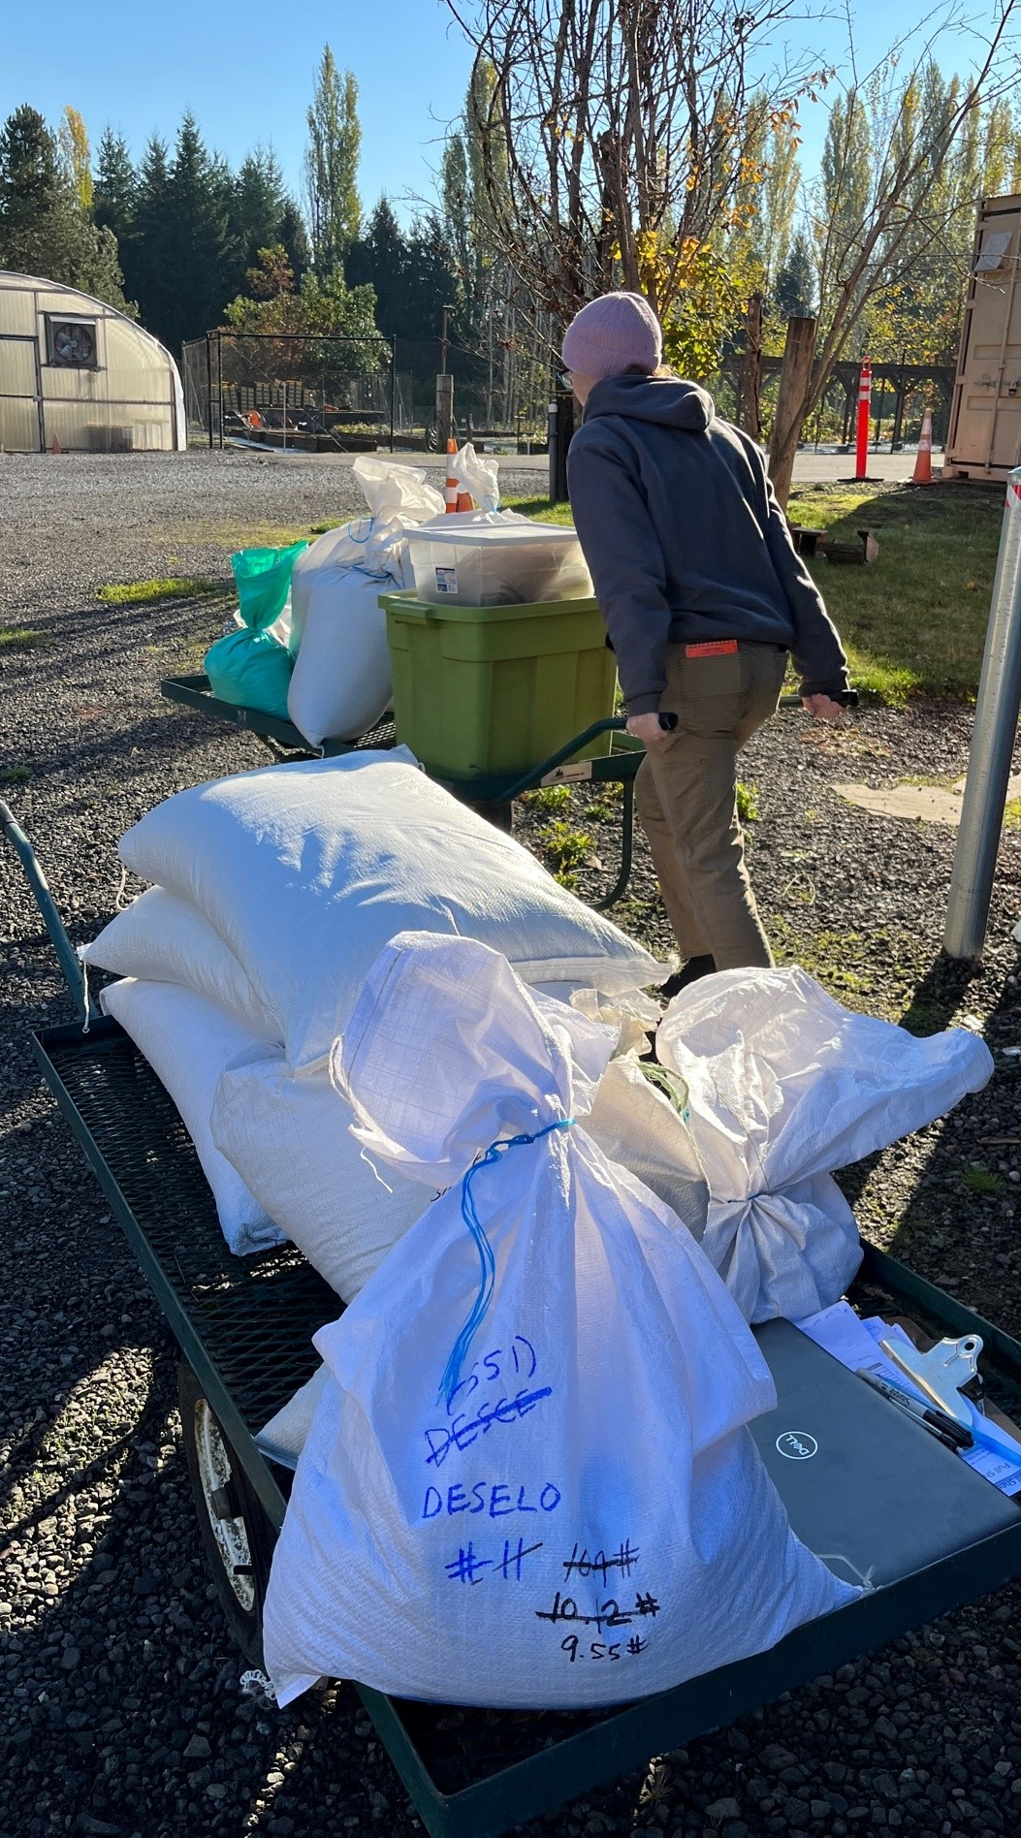
Initial Strategy Implementation
House Bill 3409: Natural & Working Lands Fund
Sensitive species seed collection and banking
Financial assistance for Tribal nurseries, native plant programs, and native plant farms
Conservation collections in 2024 and 2025, across the state
$125,000 to 5 tribes in 2025
Support for native plant programs, restoration infrastructure, farm and seed cleaning equipment, nursery supplies

Slide 8
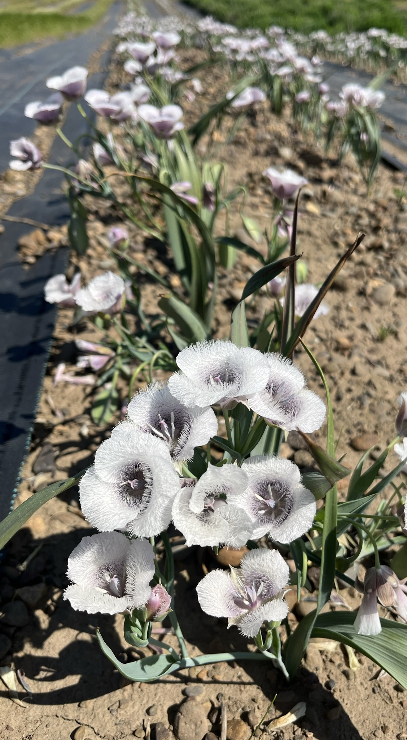
Initial Strategy Implementation
The Understory Initiative & Institute for Applied Ecology
Development of grower hubs or “farmer co-ops”
Seed collection, production, storage of high-priority rangeland restoration species
HB3409 funded
Accrued interest & emerging opportunities
  Learning along the way, building relationships
  RFP for seed amplification forthcoming
Leveraging investments for additional support
Notes:
Expansion of farmer co-op capacity in Rogue and Umpqua Valleys
Creation of new farmer co-op in Willamette Valley
Scoping to establish a co-op in the Oregon coast and/or Great Basin
Outreach and technical assistance with tribal farmers and native seed producers
Foundation seed lot collections
Initiation of new seed production fields to support rangeland restoration projects
Expanded storage capacity in Rogue & Umpqua
Expanded shared equipment library in Umpqua
Improved seed-drying facilities in Willamette Valley

Slide 9
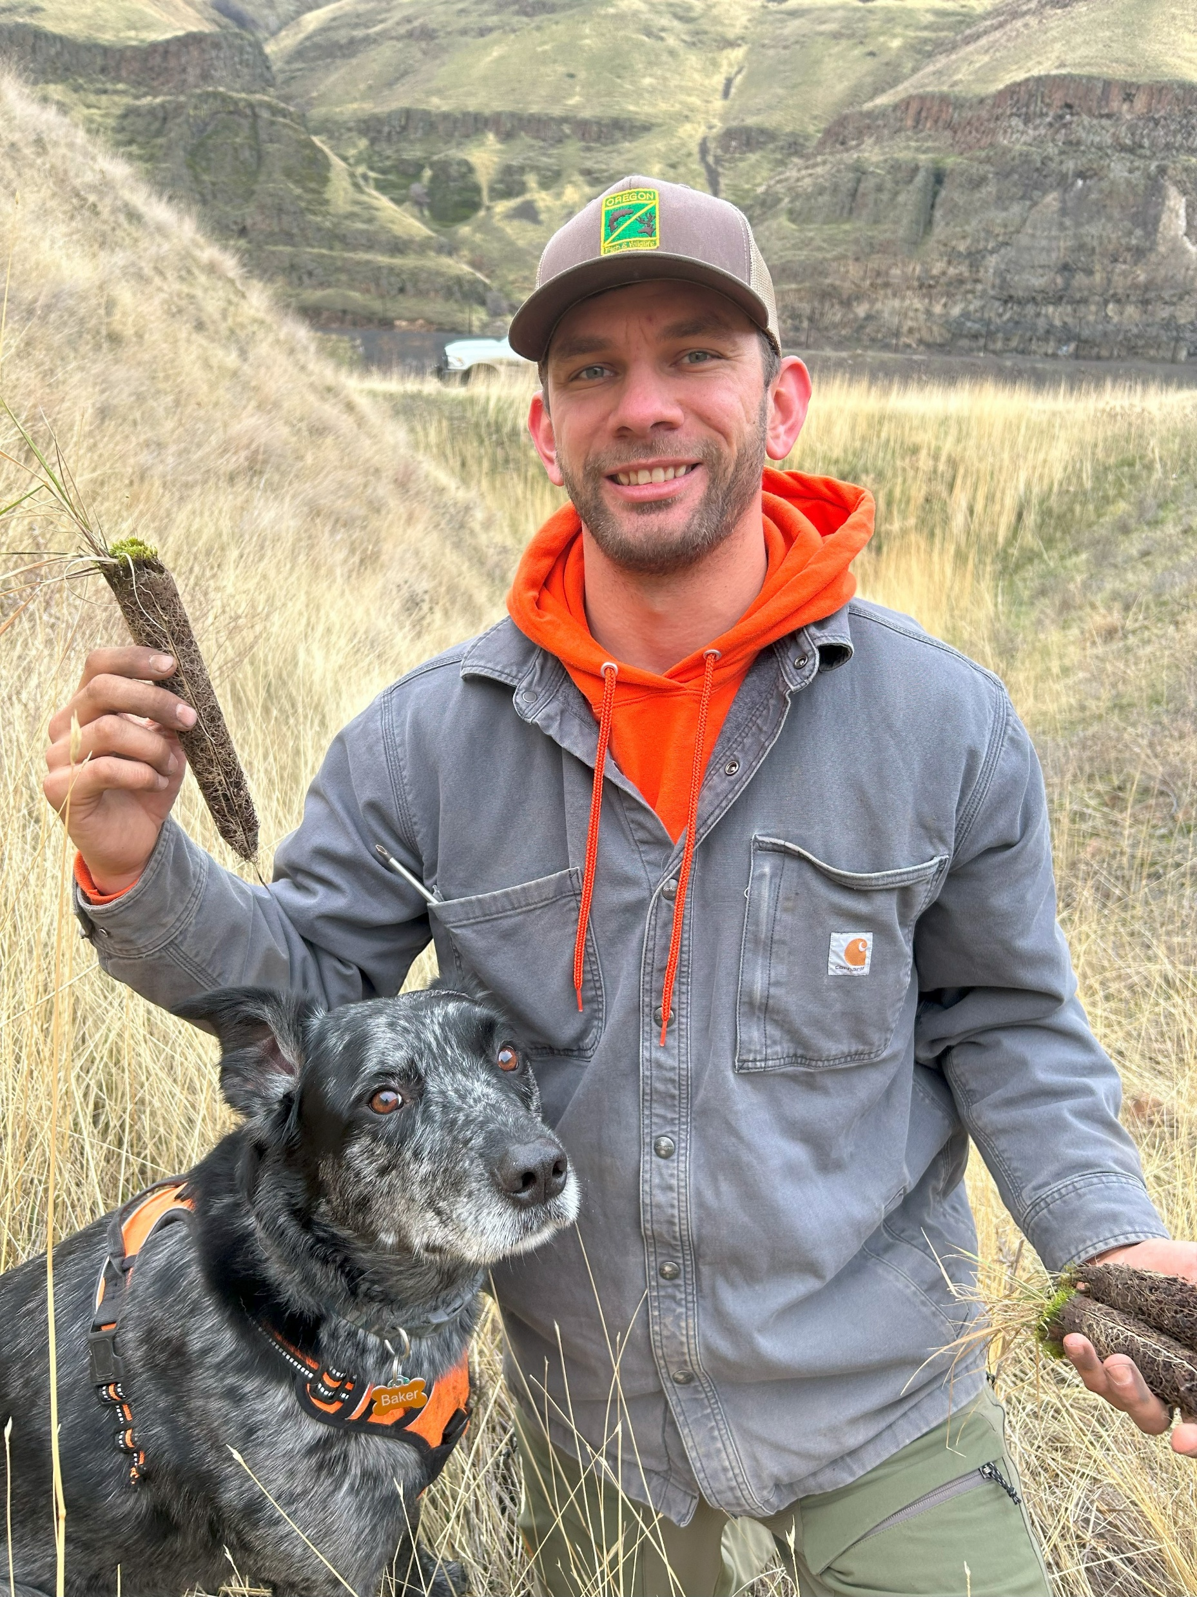
ODFW Implementation Potential
ODFW Wildlife Areas
Convert marginal agricultural lands to native habitats or native seed production
Develop pathways and agreements for annual designated funding for native seed collection, grow-outs, plantings, etc.
Relationships/agreements to operate greenhouse management for native plant production
Partner Collaboration
Native seed partnerships, grant collaboration, producer relationships

Slide 10
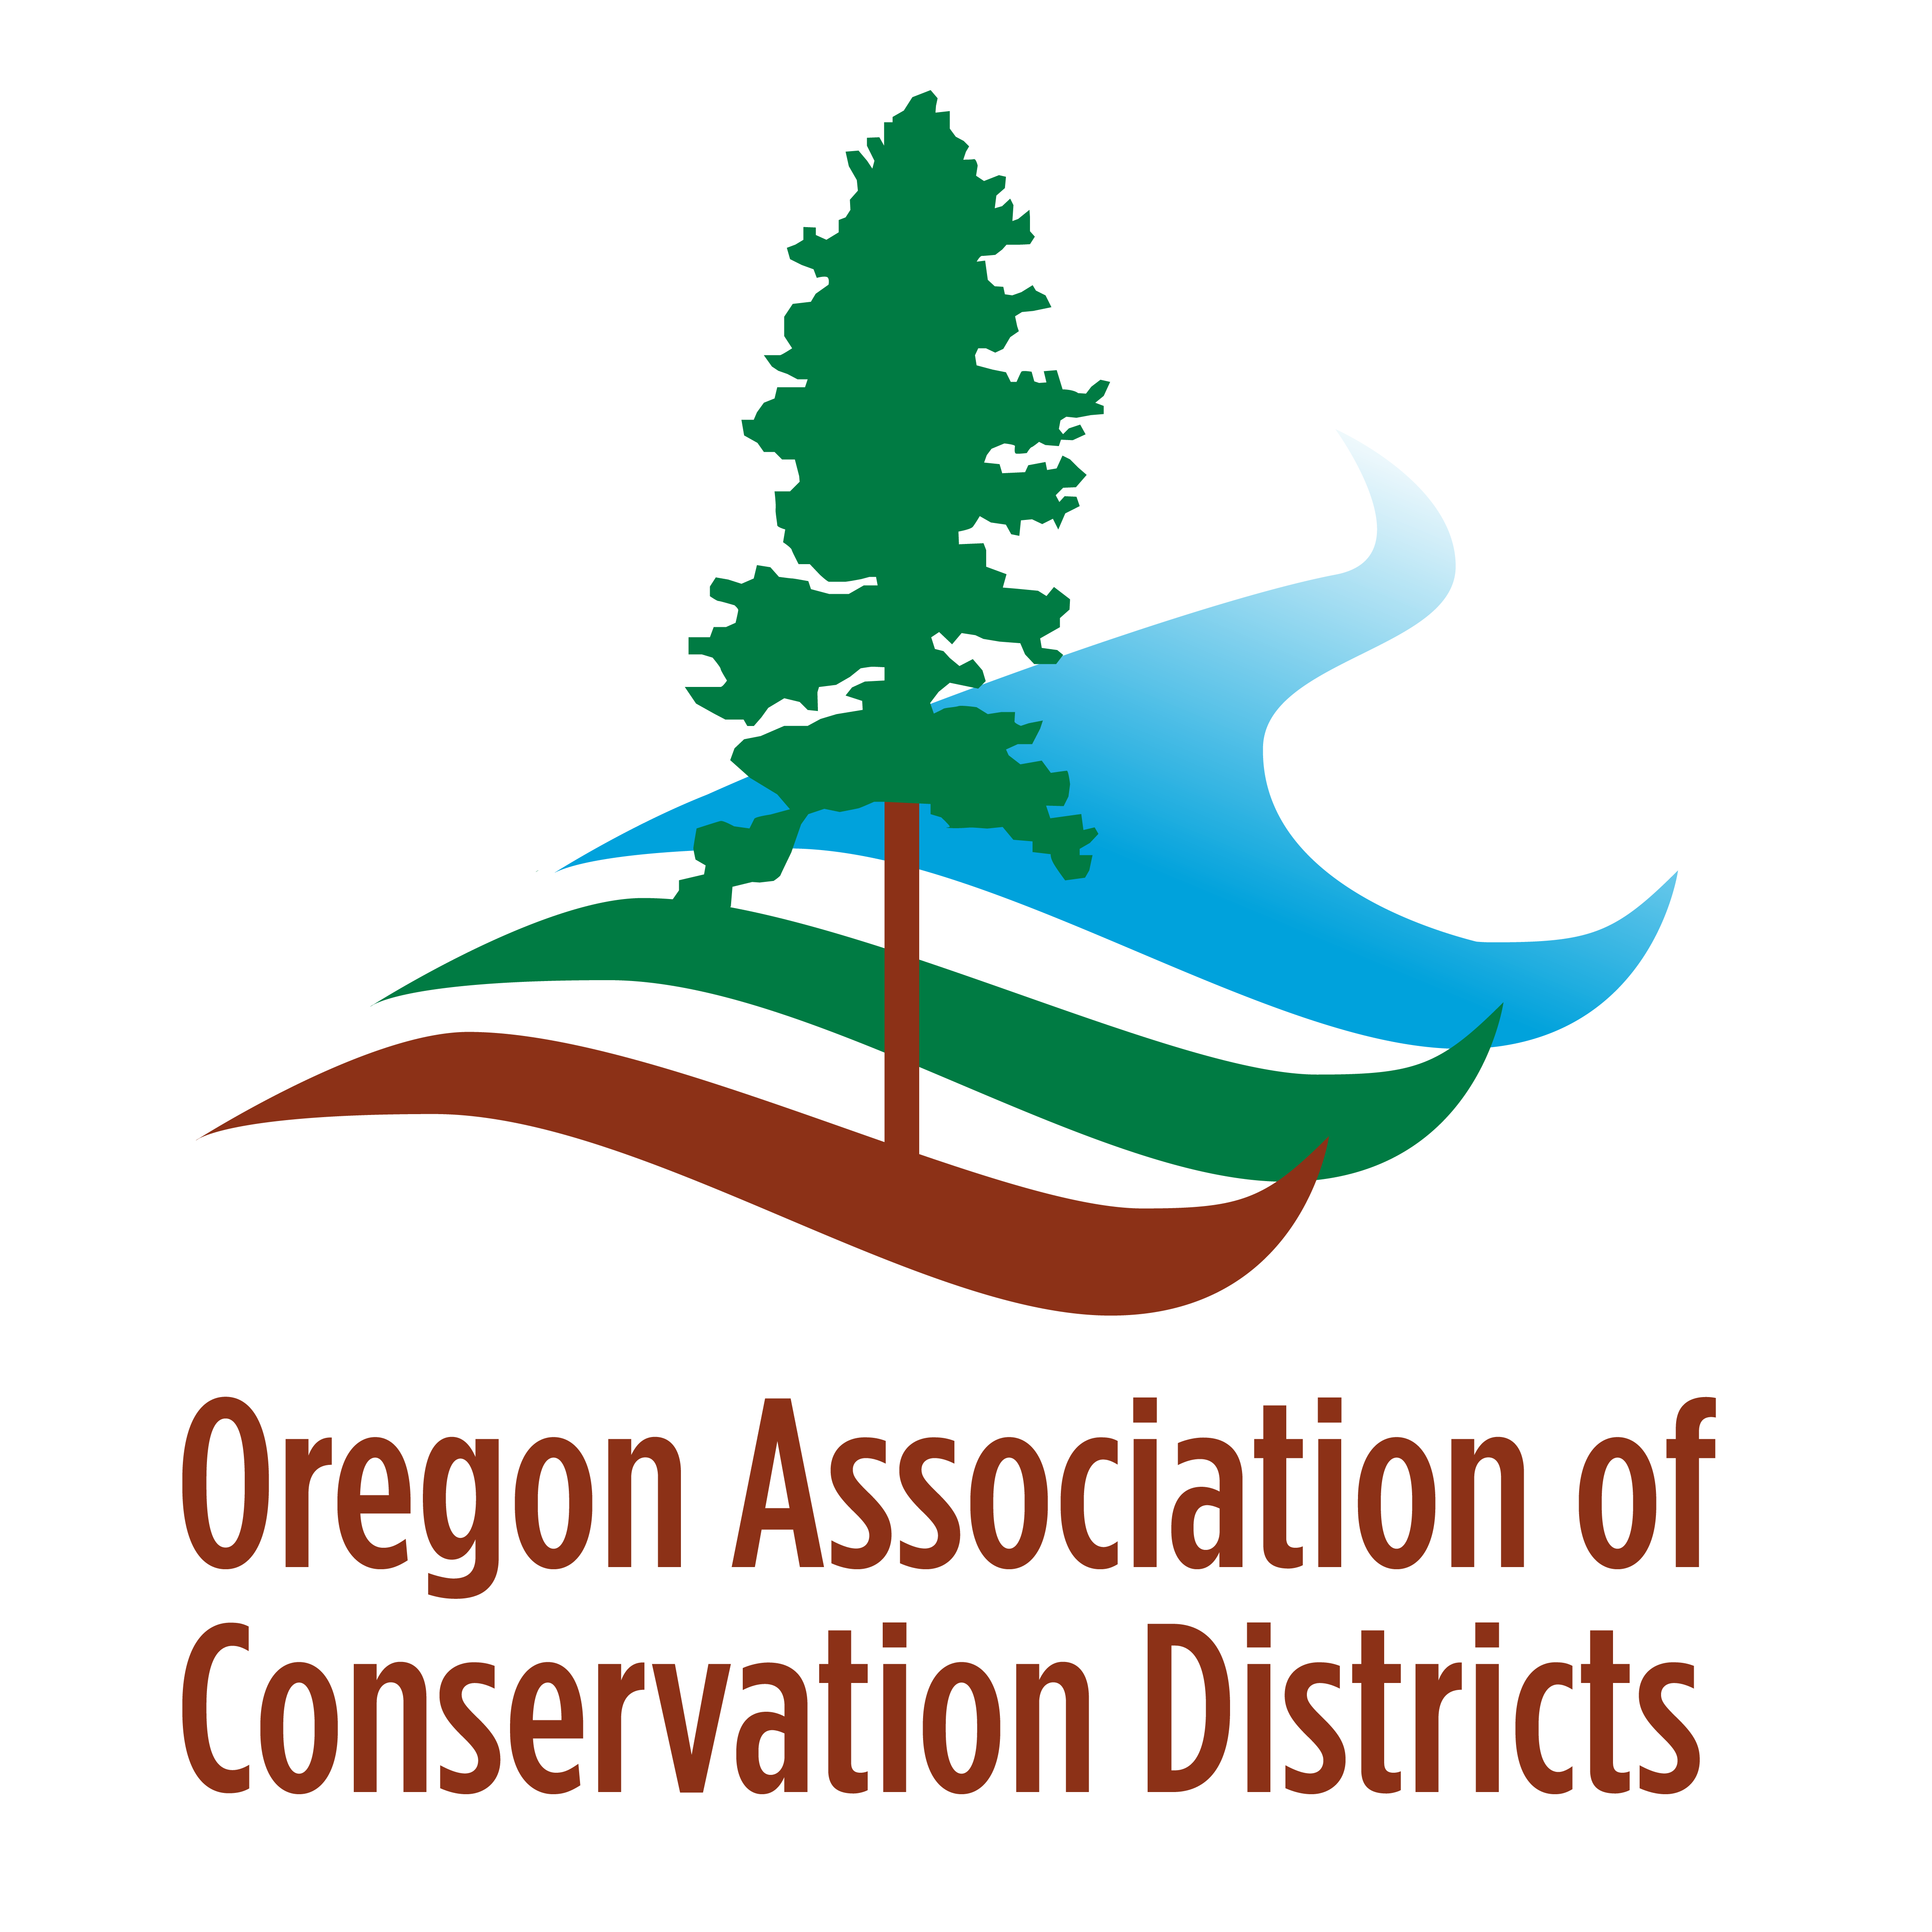
What can we do together?
Notes:
Get involved in the statewide effort- botanists share expertise; growers- partner to expand seed supply and diversity of species available; Regional grower hubs to support new growers- provide training, mentorship, technical guidance- shared infrastructure, create coordinated markets and demand, build a community of practice

