Slide 1


Slide 2


Slide 3

Special Districts Insurance
Services Benefits by Brad Eastman
History on SDAO
Claims History
Core Services Offered
Contacting SDAO
Notes:
We will do overview of the rules, then get into the top 10 things you can do to help your committee be effective.
How many have a safety committee?
Any one do safety meetings instead of a safety committee?
Any centralized Committees?

Slide 4
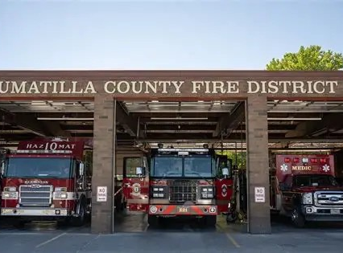
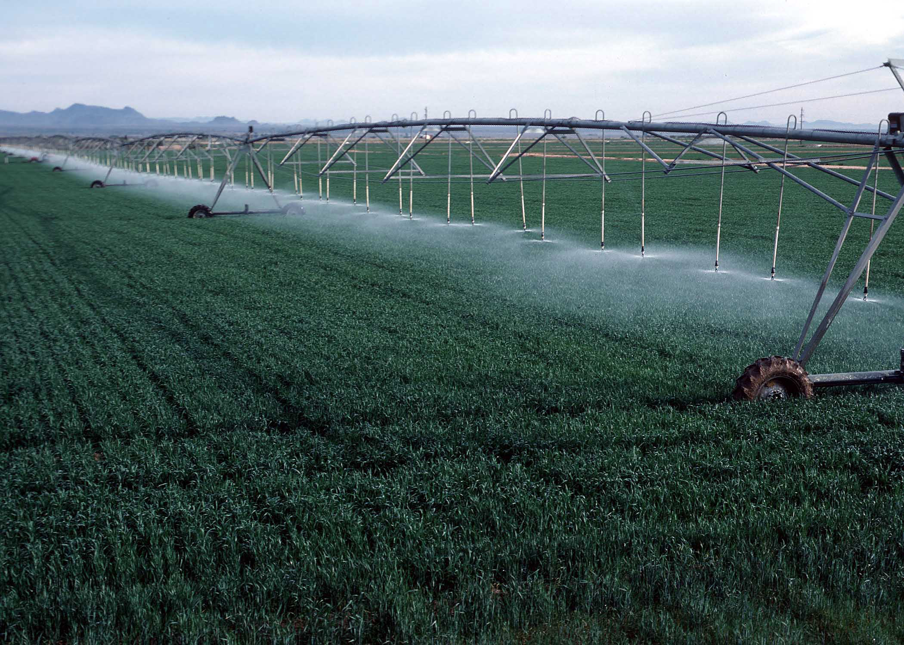
History of SDAO
Founded in 1979
Membership – Over 900 local government entities
Mission – Assist special district in delivering cost effective public services and advocate for their interests at the state and federal levels.
National Special Districts Association (NDSA)
Special District Insurance Services (SDIS) - 1985

Slide 5
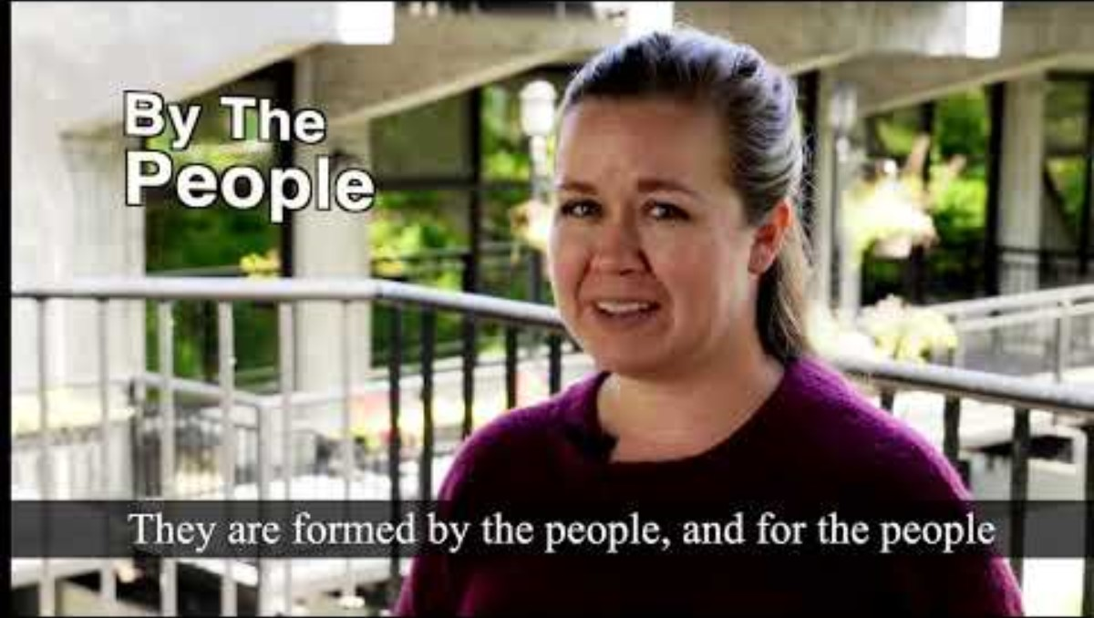
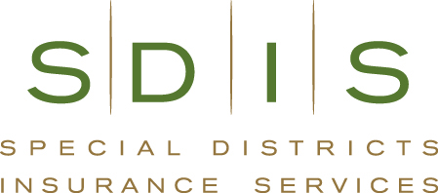
Notes:
To change the image on this slide, select the picture and delete it. Then click the Pictures icon in the placeholder to insert your own image.

Slide 6
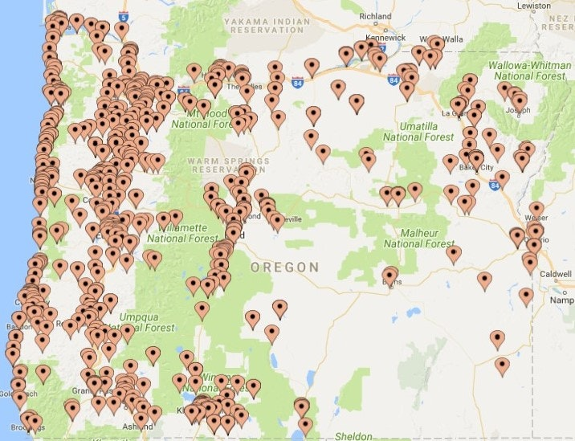
Types of Special Districts
Metropolitan Service
Park and Recreation
People's Utility
Ports
Predator Control
Radio and Data
9-1-1 Communications
Road Assessment
Sand Removal
Sanitary
Soil Water Conservation
Special Road
Transportation
Vector Control
Water Control
Water Improvement
Weather Modification
Weed Control
Airport
Cemetery Maintenance
County Service
Diking
Domestic Water Supply
Drainage
Emergency Communication
Fire Protection
Geothermal Heating
Health
Heritage
Highway Lighting
Irrigation
Library
Mass Transit

Slide 7

SDAO Loss Analysis (2015 – 2025)
Property and Casualty
Auto Physical (1866 claims ~ $ 13.6 million)
Auto Liability (1695 Claims ~ $11.01 million)
Property (1076 claims ~ $ 30.2 million)
General Liability (1914 claims ~ 28.6 million)
Workers Compensation (2015-2023)
3619 claims ~ $33.8 million

Slide 8

SDIS Member Benefits
Best Practices Program
Due: Friday November 7
Claims Administration
HR Advantage Plus Program
HR Answers, review policy manuals, samples of employee handbooks, job descriptions, and more.
Pre-Loss Legal Services
Advice and/or assistance on employment matters
Employee Assistance Programs (EAP)
Training and Education
Regional Training, Vector Solutions, Webinars, Annual Conference

Slide 9

SDIS Member Benefits (Continued)
Insurance Programs
Special Districts Insurance Services – property, liability, employee benefits
Consulting and Advisory Services
Employee Handbooks, HR support, compliance, policy development
Grants and Scholarships
EAP Scholarships, grant writing assistance
Risk Management Services
SDIS: Property walkthroughs, regional trainings, webinars
Service Group: Safety Program Reviews, OSHA reviews and assistance, ergonomic assessments, safety committee/meetings consults, job hazard analysis, and dosimeter testing, .

Slide 10
SDAO Service Group
Risk Management Services
Onsite risk assessments
Safety Training
Online Training
Additional risk management tools to help mitigate your worker's compensation exposures
Additional Benefits
4% Discount on Property/Liability contribution
$250,000 criminal defense coverage for unintended negligence as a result of an injured employee
$25,000 OSHA defense coverage
$10,000 HIPAA defense coverage
Continued support of the Public Safety Employee Assistance Program for all career firefighters in Oregon and districts with career first responders.
SDAO members in good standing that meet SAIF underwriting and eligibility standards may qualify for an additional discount on w/c policy.
Notes:
To change the image on this slide, select the picture and delete it. Then click the Pictures icon in the placeholder to insert your own image.

Slide 11
Administered By Special Districts Association of Oregon
1.800.285.5461
sdao@sdao.com
For more information about our services available to our member districts, visit:
www.sdao.com

